Slide 1
11

Slide 2
CHROMOSOME ORGANIZATION

Slide 3
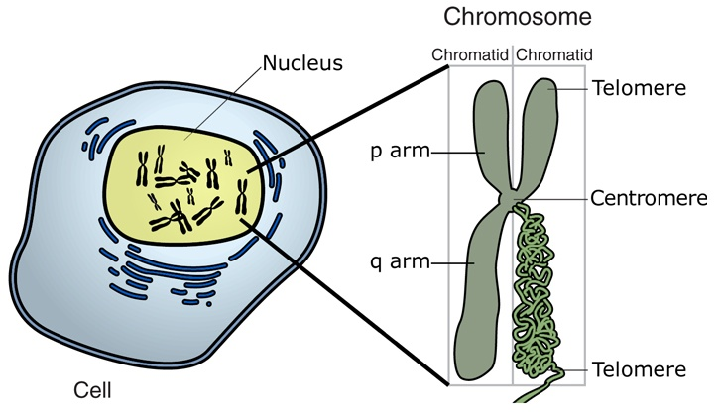
What is a chromosome
A chromosome is an organized structure of DNA and proteins that in eukaryotes is found in the nucleolus of the cell.
A chromosome is a single piece of coiled DNA containing many genes, regulatory elements, and other nucleotide sequences.
Chromosomes are the vector of heredity.
Notes:
A chromosome is a single large macromolecule of DNA, and constitutes a physically organized form of DNA in a cell. It is a very long, continuous piece of DNA (a single DNA molecule), which contains many genes, regulatory elements and other intervening nucleotide sequences.
DNA MOLECULES ARE EXTREMELY LONG FINS AND DELICATES. THEY ARE PACKAGE SO THAT THEY CAN FIT IN THE NUCLEOUS AND BE PROTECTED FROM DAMAGE.
GENES ARE INDIVIDUAL UNITS OF INFORMATION. AT A CHEMICAL LEVEL GENES ARE MADE OF DEOXYRIBONUCLEIC ACID (DNA). ALL OUR CELL CONTAIN THE SAME SET OF INFORMATION, IT IS ONLY HOW THE INFORMATION IS USED THAT MAKE THEM DIFFERENT.
Why do we need chromosomes? 1) Compact all the DNA into a small space,2) regulate cell division, 3) direct gene expression. They are the carrier of the genes. REMEMBER generally : -Eukaryotic cell (cell with nucleus) have large linear chromosomes and -Prokaryotic cells (cells without defined nuclei) have smaller circular chromosomes….there are many exception to this rule.
Chromosomes are used to pass the genetic information from cell to cell and from generation to generation

Slide 4
Chromosome are the best way to store all the building information
DNA
chromatin
chromosome
Notes:
Like a databese Chromosome store all the information. They are better than any databases that is use for storing data. All the instruction used in the development and functioning of all living organisms are organized in chromosomes.
he nucleus is only 6 micrometers in diameter. The total length of DNA in the human genome is 1.8 meters.

Slide 5
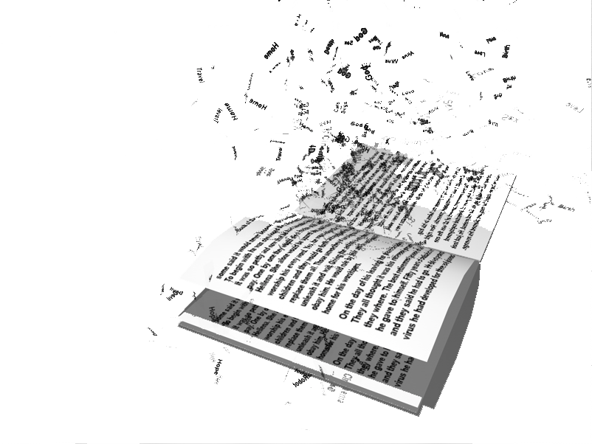
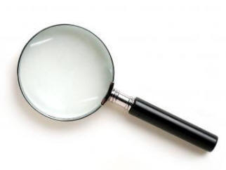
Information stored in a human genome
If the human genome could be represented as a book, would be:
one billion words long
5000 volume each one 300 pages long
All this information fits in a cell nucleus that is the size of a pinpoint
.
Notes:
It is better than any database because do not only store information but direct the use of thisinformation. In human the nucleus is around 6 micrometers

Slide 6
Chromosome rules
Three important rules regarding chromosomes of plants and animals:
1 The nucleus of each somatic cell in a given organism contains a fixed number of chromosomes.
2 The chromosome in the somatic cells are usually present in pairs.
- Cells containing two similar set of chromosomes are called diploid (2n).
- Example: Human has 23 pairs = 46 chromosomes.
3 The germ cell or gametes contain only one set of chromosomes.
- The gametes are haploid (n).
Notes:
THERE THREE IMPORTANT RULE THAT ARE SHARE AMONG ALL THE EUKARYOTES
somatic cells are any cells forming the body of an organism
Each pair comprises a chromosome inherited from one of the father's and the other mother
The nucleous of each somatic cell is the one forming the body.
2 ccould ne also polyploid

Slide 7
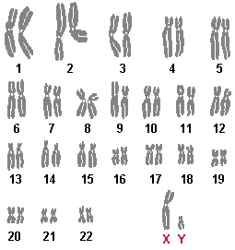
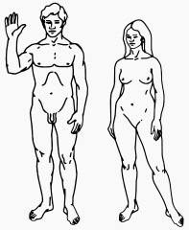
Not all chromosomes come in pairs
In sexually reproductive species not all chromosomes are present in pairs. In human for example there are 22 pairs of autosomes and two sex chromosomes.
♂
♀
22 + XY
22 + XX
Human karyotype
- In many cases, sex determination is genetic. In animals, this is often accompanied by chromosomal differences. - In other cases, sex is determined by environmental variables (such as temperature) or social variables (the size of an organism relative to other members of its population).
Notes:
A sex-determination system

Slide 8
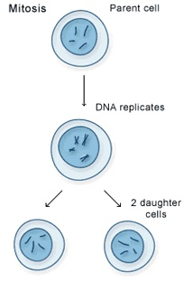
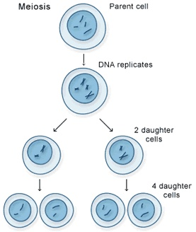
Somatic and germ cells have different chromosomes number
Diploid (somatic) vs. haploid (gamete) cells undergo two different processes of nuclear division.
MITOSIS
Maintains chromosomes number (2n)
MEIOSIS
Halves the number of chromosomes (n)
2n
2n
Transmission of chromosomes from cell to cell
Transmission of chromosomes from generation to generation
2n
2n
n
n
n
n
Notes:
If we take a moment to think about chromosome content in somatic and germ cell we understand that two different process of nuclear division are nedded to produce diploid and halpoid cell. Those two process of cell division are named: Mitosis and Meiosis.The first is used for the trasmission of chromosomes (and therefore all the genetic information for the function of a body) from cell to cell. Miosis instead is used to propagate genetic information between generation (only one copy of each chromosome is transmitted).
Fist of all I want to bring you r attention that each species has a characteristic set of chromosomes

Slide 9
Different species have different chromosome numbers…
SPECIES | Ch. Number (2n)
Fruit fly | 8
Domestic cat | 38
Rabbit | 44
Human | 46
Gorillas | 48
Elephants | 56
Horse | 64
Dog | 78
Notes:
Each specie has a cracteristic set of chromosomes.

Slide 10
…but the chromosomes number has little relationship with the complexity of the organism
8 chromosomes
78 chromosomes
46 chromosomes

Slide 11
Chromosome structure: Chromatin and nucleosomes

Slide 12
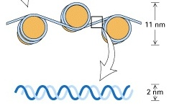
Chromatin is the fundamental structure of chromosomes
In eukaryotes the nuclear DNA is packed into a condensed structure called chromatin.
The major components of chromatin are DNA and histone proteins.
DNA and histone proteins form the nucleosome.
nucleosome
chromatin
Short region of DNA
The functions of chromatin are:
to package DNA into a smaller volume to fit in the cell
to regulate the division cycle (mitosis and meiosis) of the cell
as a mechanism to control gene expression
Notes:
DNA IS ATTRACTED BY CLUSTER OF HISTONE PROTEINS. A PORTION OF THE DNA WRAP AROUND THE CLUSTER ALMOST TWO TIMES.THIS OCCURS AT REGULAR INTERVAL ALONG THE MOLECULES. THEY SHORT THE DNA SO IT CAN FIT WITHIN THE NUCLEOUS.
In eukaryotes the nuclear DNA when not being transcribed or replicated is packed by proteins into a condensed structure called chromatin.
which is used to pack the large eukaryotic genomes into the nucleus while still ensuring appropriate access to it
Chromatin is the complex of DNA and protein that makes up chromosomes.
Chromatin contains genetic material-instructions to direct cell functions. Histones are small proteins (100/200 ammino acid), that differ from the rest of the proteins because 20/30% of the ammino acid are lysine and arginine, both of which have a positive charge. The positive charges enable the histone molecules to bind to DNA, primarily by electrostatic attraction to the negatively charged phosphate groups in the sugar-phosphate backbone of DNA.

Slide 13
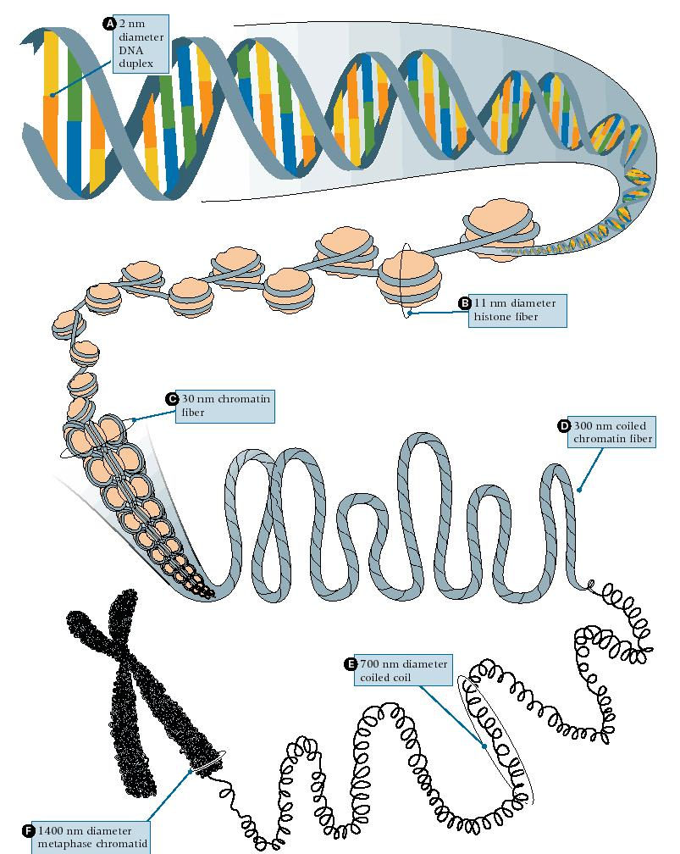
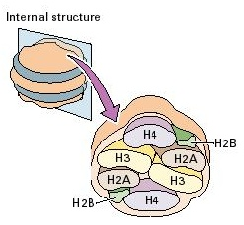
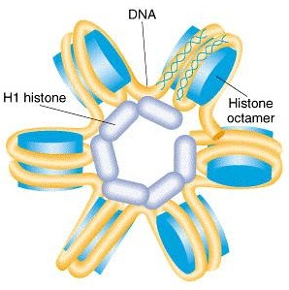
The nucleosome is the basic structural unit of chromatin
A nucleosome is composed of: four different type of histone proteins (H2A, H2B, H3, H4) and the DNA duplex wrapped around
H2A, H2B, H3, H4 histone proteins form a bead-like unit called core particle.
7 fold length reduction
A fifth histone (H1) together with the linker DNA play a role in bridging between beads to form a left-handed helix with 6 nucleosomes per turn, the nucleosome fiber.
50 fold length reduction
Notes:
WHEN THE SOLENOID IS FORMED THE CHROMOSOME STILL FAIRLY LONG BUT THEIR MOVEMENT DURING CELL DIVISION IS FACILITATED BY CONDENSATION. FOLLOWING REPLICATION THEY LOOP AND FOLD BACK ON THEMSELVES FORMING THIGHT PACKAGES OF DNA AND HISTONES. THEY SHORTEN AND THIKNESS THE CHROMOSOMES SO THAT THEY ARE VISIBLE UNDER THE MICROSCOPE DURING CELL DIVISION (PROPHASE)
The DNA molecules is wound one and 3/4 turns around the nucleosome, and is about 200bp long, the size varies with specie and tissue. The Nucleosome fiber compacts into a shorter, thicker fiber due the salt concentration present in the living cells.
The 30 nm chromatin structure is the organization of the DNA in a living cell, during interphase…before the cell start the meiosis

Slide 14
https://www.youtube.com/watch?v=N5zFOScowqo

Slide 15
11.3 Eukaryotic Chromosomes Are Organized into Chromatin
Eukaryotes have multiple chromosomes that undergo cyclic condensation for cell division
Eukaryotic genomes have tens to thousands of times more DNA than bacteria or archaea
The DNA and associated proteins of a eukaryotic chromosome are called chromatin
Proteins that organize chromosomes are essential and provide a mechanism for condensation, segregation, and organization of chromosomes
15

Slide 16
Histone Proteins and Nucleosomes
Each chromosome is approximately half DNA and half protein
About half of the proteins are histone proteins, small basic proteins that tightly bind DNA
The remaining proteins, the nonhistone proteins, are very diverse and perform a variety of tasks in the nucleus
16

Slide 17
Histones
There are five types of histone proteins in chromatin: H1, H2A, H2B, H3, and H4; they are highly conserved among eukaryotes
Nucleosome core particles—fundamental units of histone protein organization with two molecules of each histones H2A, H2B, H3, and H4 (octamer)
A span of DNA ∼146 bp long (core DNA) wraps around each octamer to form a nucleosome
17

Slide 18
Nucleosome Assembly
Histones H2A and H2B assemble into dimers; H3 and H4 also form dimers
Two H3-H4 dimers form a tetramer, after which two H2A-H2B dimers associate with it to form the octamer
The wrapping of DNA around the octamer is the first level of DNA condensation, and compacts the DNA about sevenfold
18

Slide 19
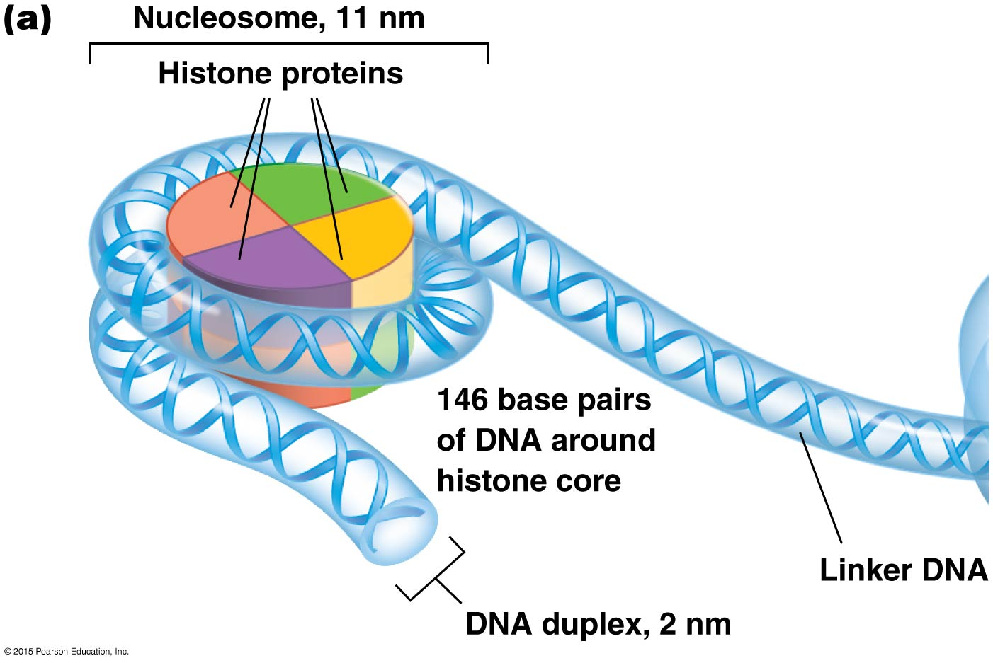

Slide 20
Solenoid Structure
The 10-nm fiber is not observed under normal cellular conditions
Instead, a 30-nm fiber (six times more condensed) is observed
The 30-nm fiber forms when the 10-nm fiber coils into a solenoid structure, with six to eight nucleosomes per turn and histone H1 stabilizing the solenoid
20

Slide 21
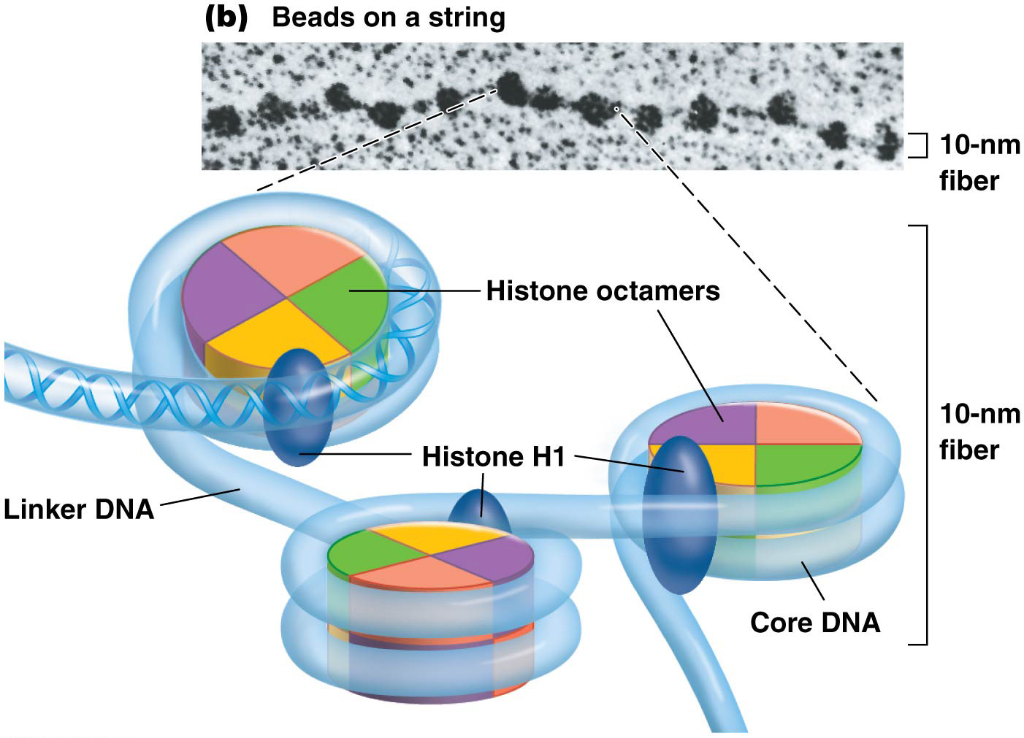
26

Slide 22
Higher-Order Chromatin Organization and Chromosome Structure
Chromatin exists in a 30-nm fiber or more condensed state during interphase and becomes maximally condensed during metaphase of mitosis
Interphase chromosomes have variably sized loops of 30-nm fibers attached to a nonhistone protein chromosome scaffold
The chromosome scaffold gives chromosomes their shape
The loops on the scaffold form the 300-nm fiber
22

Slide 23
Nucleosomes and Replication
As the replication fork passes, nucleosomes break down into H3-H4 tetramers and H2A-H2B diamers
H3-H4 tetramers immediately reassociate randomly with one of the sister chromatids
H2A-H2B dimers disassemble and are reassembled from both old and new histones
23

Slide 24
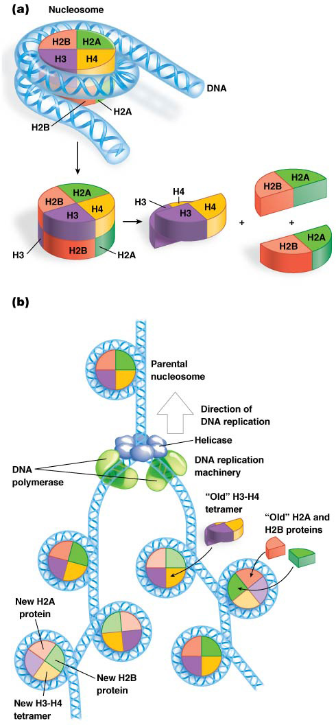

Slide 25
11.4 Chromatin Compaction Varies along the Chromosome
Chromosome condensation reaches a maximum at metaphase
Cytogeneticists can distinguish such chromosomes microscopically based on size, shape, and banding pattern
Chromosome bands appear light or dark when chromosomes are treated with specific dyes and stains
25

Slide 26
Chromosome Shape and Chromosome Karyotypes
Chromosomes are prepared for sister chromatid segregation during prophase when chromosomes condense, taking on a characteristic shape
Centromeres divide chromosomes into chromosome arms, segments of unequal length
The short arm is called the p arm and the long arm is the q arm
Chromosome shapes are named based on centromere position, which determines the relative lengths of the arms
26

Slide 27
Chromosome Shapes
Metacentric: The centromere is near the middle of the chromosome
Submetacentric: The centromere is between the center and the tip
Acrocentric: The centromere is close to one end
Telocentric: The centromere is at the tip of the chromosome and there is no p arm
27

Slide 28
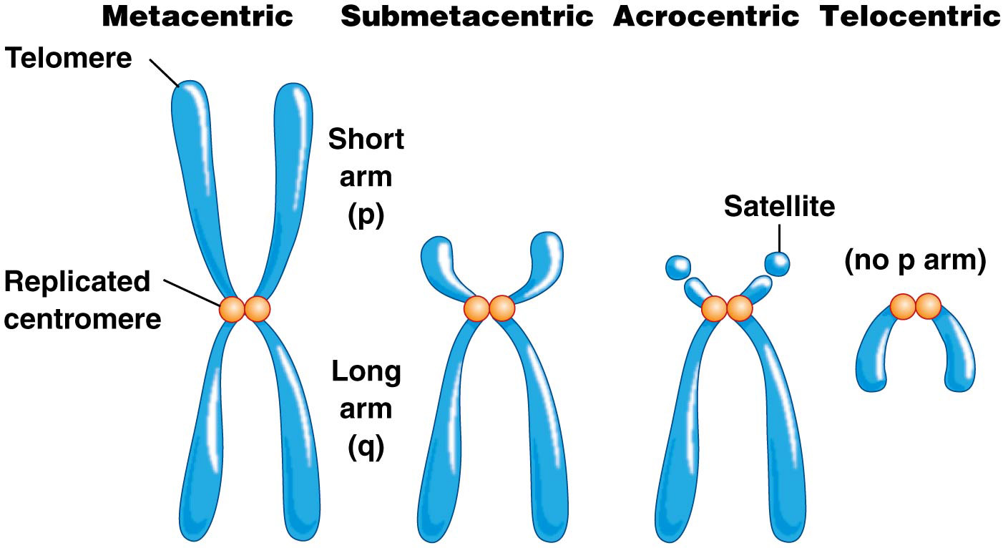
Chromosome shape.

Slide 29
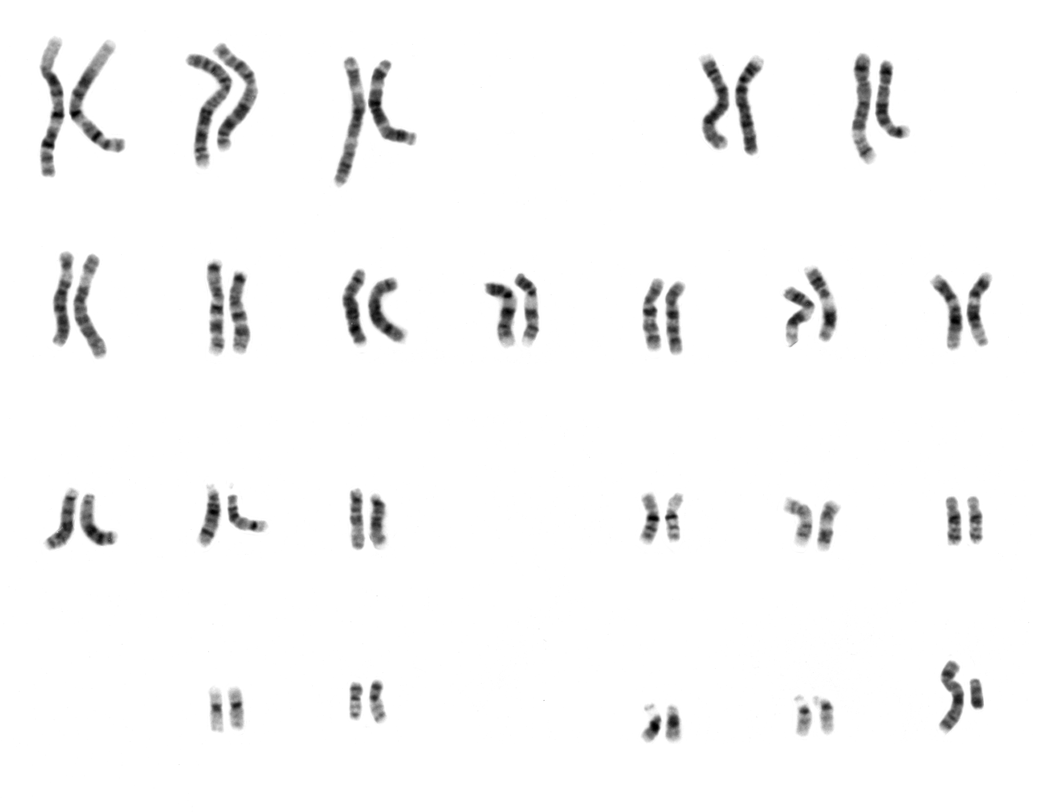
Karyotypes
A karyotype is a visual display of chromosomes as seen by microscopy; it may be used to identify abnormalities in chromosome number or structure
The chromosomes are grouped into homologous pairs in descending order of size
The sex chromosomes are identified separately
Chromosomes may be stained with dyes to show distinctive banding patterns for each chromosome
29

Slide 30
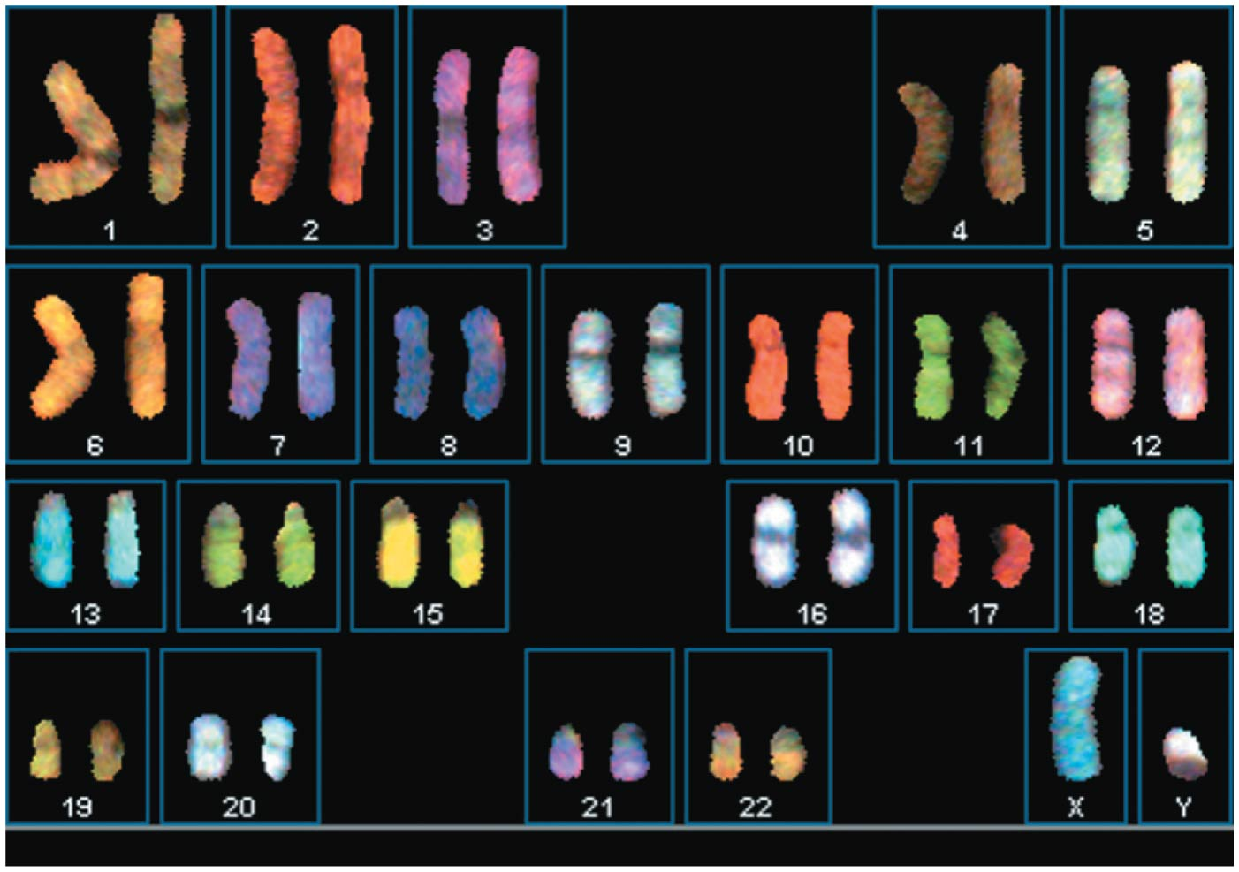
In Situ Hybridization
In situ hybridization uses molecular probes, labeled with fluorescence, to detect their target sequences. For human chromosomes, 24 different fluorophores are available that are unique to each chromosome
30

Slide 31
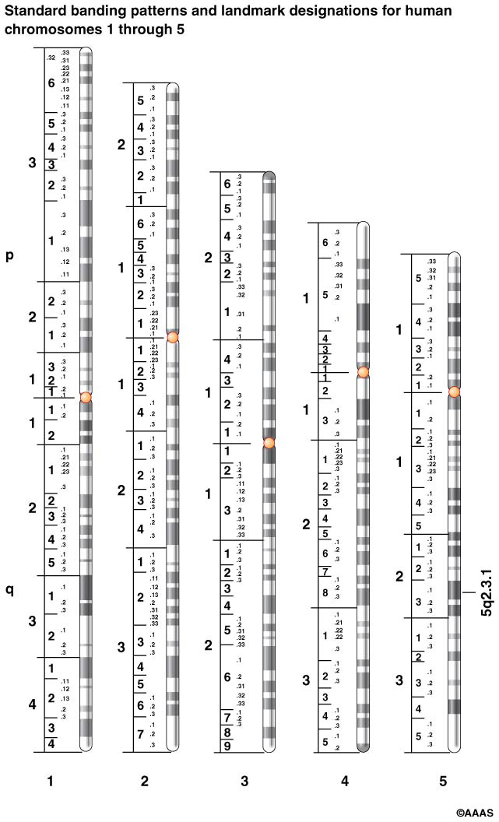
Chromosome Banding Techniques
Chromosome banding allows cytogeneticists to identify each chromosome in a karyotype
Different stains and dyes are used to produce banding patterns
The standard for human chromosome banding is G (Giemsa) banding; the patterns are distinct and reproducible
31

Slide 32
Dynamic Chromosomes
Chromosomes do not occupy the same territory in each nucleus, but once confined to a territory, a chromosome does not leave until the M phase is initiated
However, chromosomes are active within their territories and move, twist, and turn during transcription and DNA replication
Chromosomes appear to be anchored in their territories by their centromeres
Interchromosomal domains are regions between territories
These are channels for movement of proteins, enzymes, and RNA molecules
Early replicating parts of chromosomes are generally near the center of the nucleus and late replicating parts are near the periphery
32

Slide 33
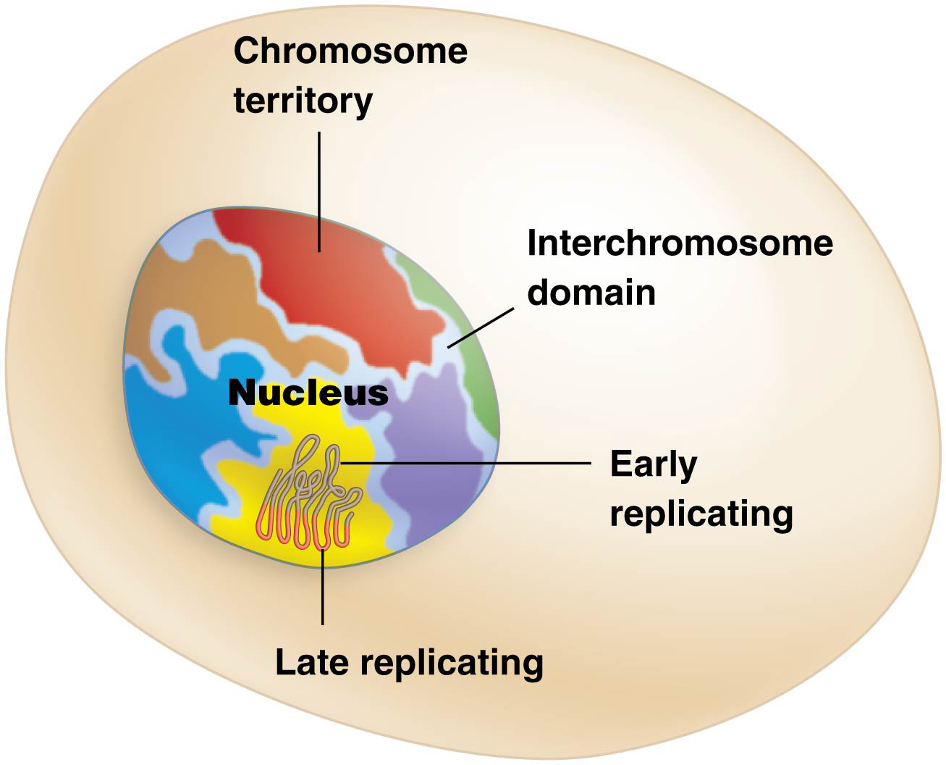
Chromosome territories in the eukaryotic nucleus.

Slide 34
Chromosome Position and Transcriptional Activity
Transcriptionally active portions of chromosomes are found nearer to interchromosomal domains, probably due to:
Greater access to needed proteins and enzymes
Faster dispersal of RNA transcripts, once they are completed
34

Slide 35
Heterochromatin and Euchromatin
Chromosome condensation varies from one part of a chromosome to another
Regions that contain actively expressed genes and are less condensed during interphase are called euchromatin
Regions that remain condensed in interphase and contain many fewer expressed genes are called heterochromatin
35

Slide 36
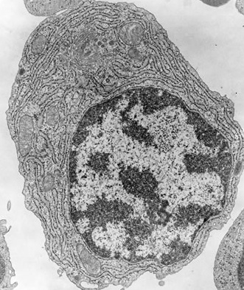
Chromatin is not homogeneous
Chromatin can be divided into two categories based on its state of condensation:
Euchromatin; a) largest part of the cellular chromatin, b) relatively dispersed appearance in the nucleus, c) condenses significantly only during mitosis, e) is rich in genes
E
H
Heterochromatin (constitutive, facultative); a) it is condensed during interphase, b) usually does not contain genes that are being expressed, c) is full of short repeated regions repeated in tandem (satellite DNA), d) is frequently localized at the periphery of the nucleus.
The number of genes located in heterochromatin is small relative to the number in euchromatin
Notes:
An electron micrograph is a micrograph prepared using an electron microscope.
HETEROCHROMATIN:
Constitutive heterochromatin, which is never expressed. It is located around the centromere and usually contains repetitive sequences
Facultative heterochromatin, which is sometimes expressed.

Slide 37
Types of Heterochromatin
Facultative heterochromatin exhibits variable levels of condensation, related to levels of transcription of resident genes
Constitutive heterochromatin is permanently condensed, found prominently in centromeres and telomeres, and composed primarily of repetitive DNA sequences. Constitutive heterochromatin in centromeres is present in all but S phase during replication
37

Slide 38
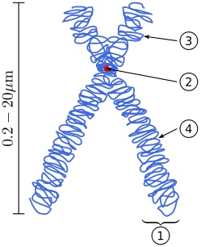
Chromatin condenses before cell division
Chromatin becomes more condensed before cell division. Individual chromosomes become visible and they form the classic four-arm structure.
short arm
10.000 fold length reduction
centromere
Long arm
Sister chromatid
The biological significance of this compaction of DNA before cell division is to: - facilitate the movement of the genetic material during nuclear division, - reduce abnormalities in the distribution of the genetic material.
Notes:
The centromere it is fundamentally important during cell division. A chromatid is one among the two identical copies of DNA making up a replicated chromosome, which are joined at their centromeres, During mitotic division, a transient structure called kinetochore is formed on top of the centromeres. The kinetochores are the sites where the spindle fibers attach.
A centromere is a region of DNA typically found near the middle of a chromosome where two identical sister chromatids come in contact. It is involved in cell division as the point of mitotic spindle. The centromere usually contains specific types of DNA sequences which are in higher eukaryotes typically tandem repetitive sequences, often called "satellite DNA".

Slide 39
Dynamic Chromatin Structure
Changes in level of compaction regulate access to DNA by proteins for replication, transcription, recombination, and repair
Position effect variegation (PEV) in Drosophila illustrates the effect of chromatin compaction on gene expression
Muller identified x-ray–induced mutations in fruit flies that resulted in variegated eye color
39

Slide 40
Analysis of Position Effect Variegation
Muller noticed that the X chromosomes of flies with variegated eye color had undergone inversion
The eye color gene had been moved from its normal position near the telomere to a region near the centromeric heterochromatin
The extent to which heterochromatin spreads from the centromere outward varies from one chromosome to the next
40

Slide 41
Heterochromatin and PEV
The stopping point of heterochromatic spread determines whether or not the relocated eye color gene will be expressed
If the eye color gene remains euchromatic, it is expressed; if the gene is compacted into heterochromatin, it is not expressed
In flies with the wild-type (red eye color) allele, some eye cells will have an active eye color gene; others an inactive one (resulting in no color), giving a speckled appearance
41

Slide 42
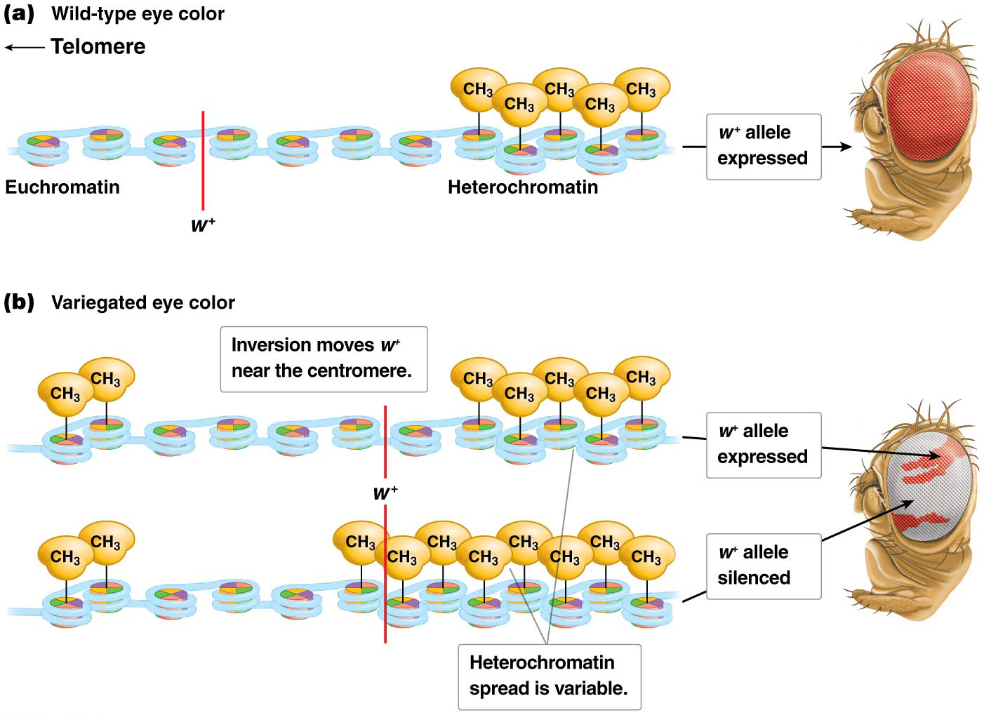
Position effect variegation of eye color in Drosophila.
65

