Slide 1
13

Slide 2
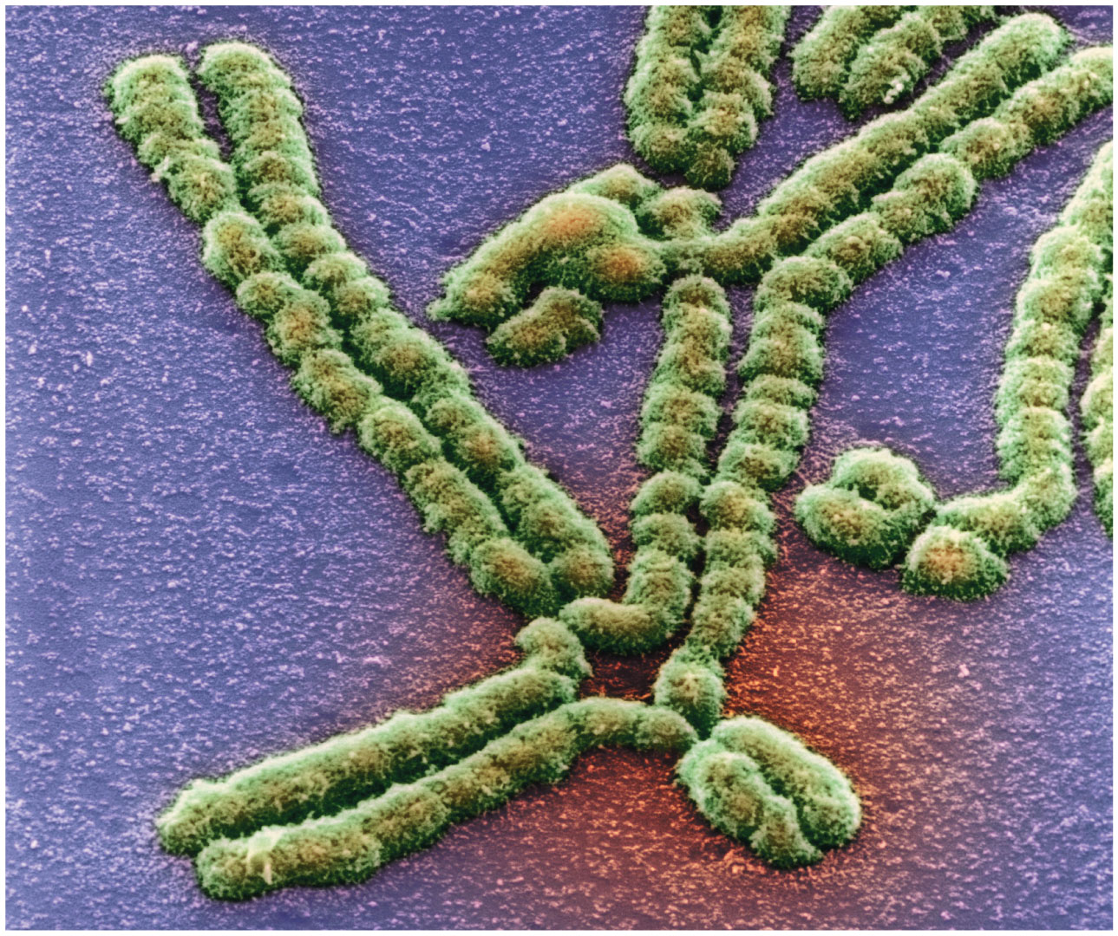
13.1 Nondisjunction Leads to Changes in Chromosome Number
Nondisjunction is the process of failed chromosome and sister chromatid segregation
It can result in abnormalities in chromosome number
2

Slide 3
Euploidy and Aneuploidy
The number of chromosomes in a nucleus and the relative size and shape of each chromosome are species-specific characteristics
The euploid number of chromosomes of an individual is the number of complete sets (e.g., n, 2n, 3n)
If cells contain a number of chromosomes that are not euploid, the chromosome number is aneuploid
3

Slide 4
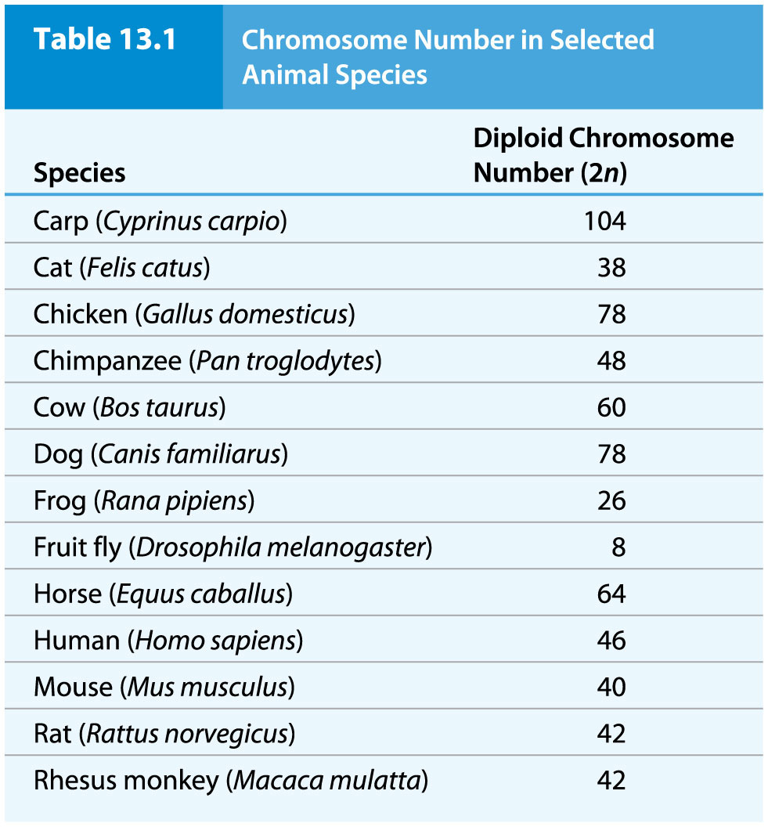
Table 13.1 Chromosome Number in Selected Animal Species

Slide 5
Chromosome Nondisjunction
Chromosome nondisjunction is the failure of homologous chromosomes or sister chromatids to separate as they normally do during cell division
In somatic cells, it can result in one daughter cell with an extra chromosome (2n + 1) and the other missing one chromosome (2n − 1)
The relatively poor survival of these cells normally limits their number in animals
5

Slide 6
Nondisjunction in Germ-Line Cells
The result of nondisjunction in germ-line cells is aneuploid gametes that can produce aneuploid zygotes
Nondisjunction in meiosis I results from failure of homologs to separate; the gametes produced are either n + 1 or n − 1
Fusion of these gametes with normal (n) gametes produces trisomic (2n + 1) or monosomic (2n − 1) offspring
6

Slide 7
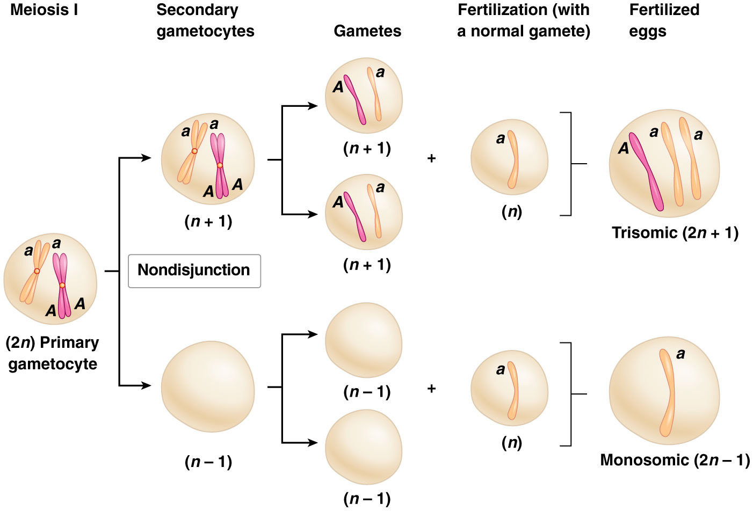
Figure 13.1 Meiosis I nondisjunction.

Slide 8
Nondisjunction in Meiosis II
The result of nondisjunction in meiosis II is the failure of sister chromatids to separate normally
Among the four gametes produced by meiosis, only two will be affected in this case
Two of the gametes will be normal (n); of the remaining two, one will be n + 1 and the other will be n − 1
8

Slide 9
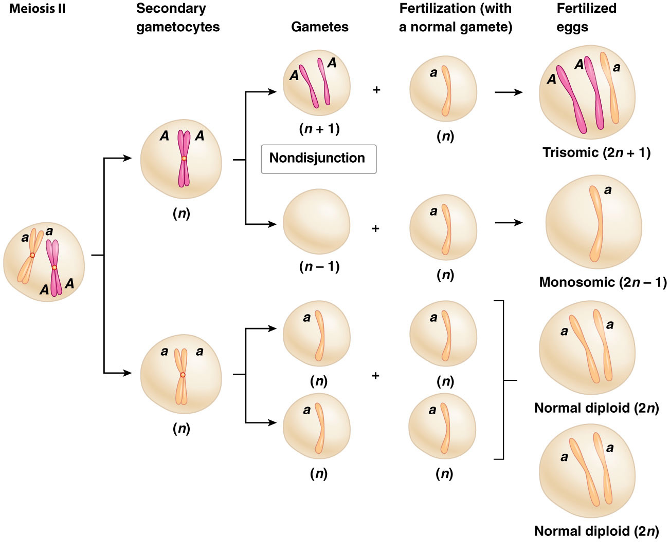
Figure 13.2 Meiosis II nondisjunction.

Slide 10
ANIMATION: Nondisjunction
10

Slide 11
Gene Dosage Alteration
Blakeslee and Belling (1913) studied aneuploidy in the jimson weed (Datura stramonium; 2n = 24)
They identified 12 phenotypically distinct lines of trisomic Datura, one for each chromosome
Phenotypic effects resulted from changes in gene dosage, the number of copies of a gene; aneuploidy alters dosage of all the genes on the affected chromosome
11

Slide 12
Gene dosage
Gene dosage is the number of copies of a particular gene present in a genome. Gene dosage is known to be related to the amount of gene product the cell is able to express, however, amount of gene product produced ina a cell is more commonly dependent on regulation of gene expression. Nonetheless, changes in gene dosage. Nonetheless, changes in gene dosage (copy number variations) due to gene insertions or deletions can have significant phenotypic consequences.

Slide 13
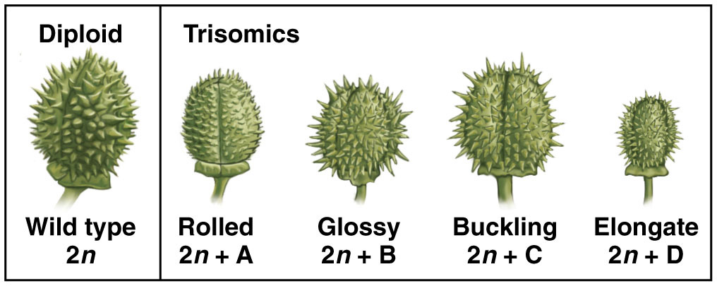
Figure 13.3 The appearance of the seed head in wild-type diploid and in four trisomic lines of jimson weed (Datura stramonium).

Slide 14
Gene Balance
Changes in gene dosage lead to an imbalance of gene products from the affected chromosome relative to the unaffected chromosomes
Most animals are highly sensitive to changes in gene dosage
In contrast, plants tolerate gene dosage changes more readily
14

Slide 15
Aneuploidy in Humans
Humans are enormously sensitive to gene dosage changes and aneuploids usually do not survive
AUTOSOMAL: Only autosomal trisomies (2n +1) of chromosomes 13, 18, and 21 are seen in newborn infants, and no autosomal monosomies (2n -1) are observed
SEX CHROMOSOMES: Multiple forms of sex-chromosome trisomies and one type of sex-chromosome monosomy occur
15

Slide 16
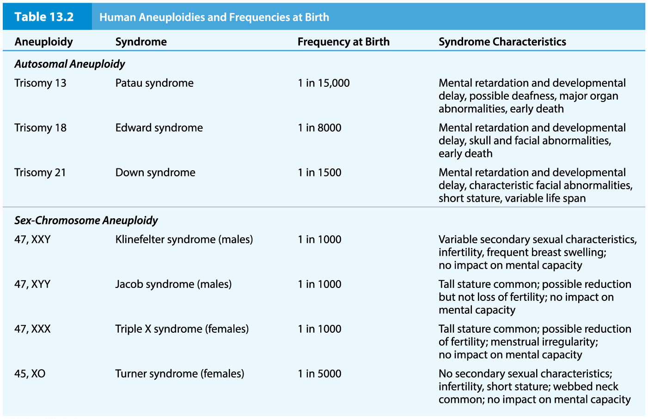
Table 13.2 Human Aneuploidies and Frequencies at Birth

Slide 17
Aneuploidy in Humans (continued)
Trisomies and monosomies other than those found in newborn infants are known to occur in humans
Studies that monitor human pregnancies indicate that about half of all conceptions spontaneously abort during the first trimester
More than half of the spontaneously aborted pregnancies carry abnormalities of chromosome number or structure
17

Slide 18
Trisomy 21 – Down syndrome
Trisomy 21, or Down syndrome, has been the focus of intense study
Research has identified a link between the risk of trisomy 21 and maternal age
A small number of genes on chromosome 21 are responsible for the cognitive disabilities and heart abnormalities that are principal symptoms
18

Slide 19
Critical Region on Chromosome 21
A portion of the chromosome called DSCR (Down syndrome critical region) can be correlated with the majority of the Down syndrome symptoms
A candidate gene called DYRK, known to produce dosage-sensitive learning defects in mice and flies, makes a major contribution to Down syndrome
The gene DSCAM is associated with formation of the heart and nervous system
19

Slide 20
Monosomy of X - Turner Syndrome
Turner syndrome is a monosomy of the X chromosome, with no second sex chromosome (XO)
In XO embryos, the single copy of the gene SHOX, is insufficient to direct normal development
The haploinsufficiency of this gene plays a central role in producing the symptoms of the syndrome
20

Slide 21
Trisomics and Meiosis
In trisomics, chromosome segregation during meiosis is disturbed because of failure to properly pair and segregate
Two patterns of synapsis are possible: 1) a trivalent synapsis or a 2) bivalent and univalent arrangement
Neither mechanism can segregate three chromosomes equally at anaphase I
21

Slide 22
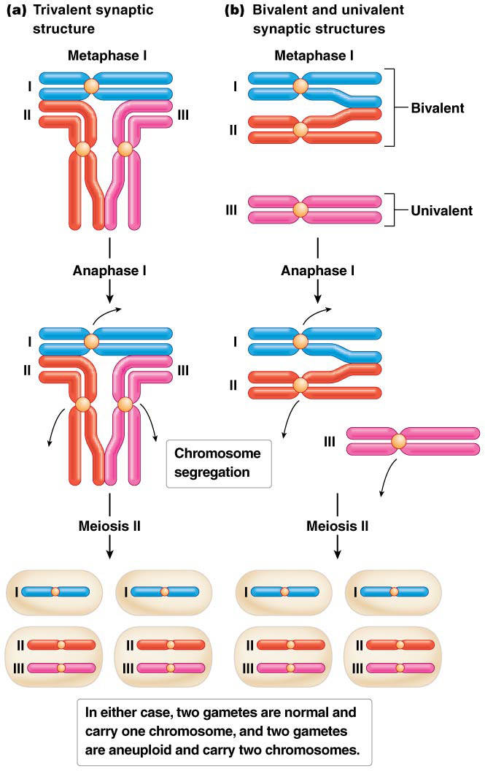
Figure 13.4 Two meiotic patterns of segregation in trisomics.

Slide 23
Reduced Fertility in Aneuploidy (continued)
In trisomics, meiosis results in two chromosomes moving to one pole and one chromosome moving to the other
Thus half the gametes contain two copies of the chromosome; these will produce trisomic offspring that are unlikely to survive
This results in a form of semisterility, in which only some of the offspring produced are viable
23

Slide 24
Gynandromorphs
Mosaicism can develop as a result of mitotic nondisjunction early in embryogenesis
In some insects such as butterflies and fruit flies, sex-chromosome mosaicism produces gynandromorphs
These are individuals with some female and some male cells
These occur due to sex-chromosome nondisjunction in early development
24

Slide 25
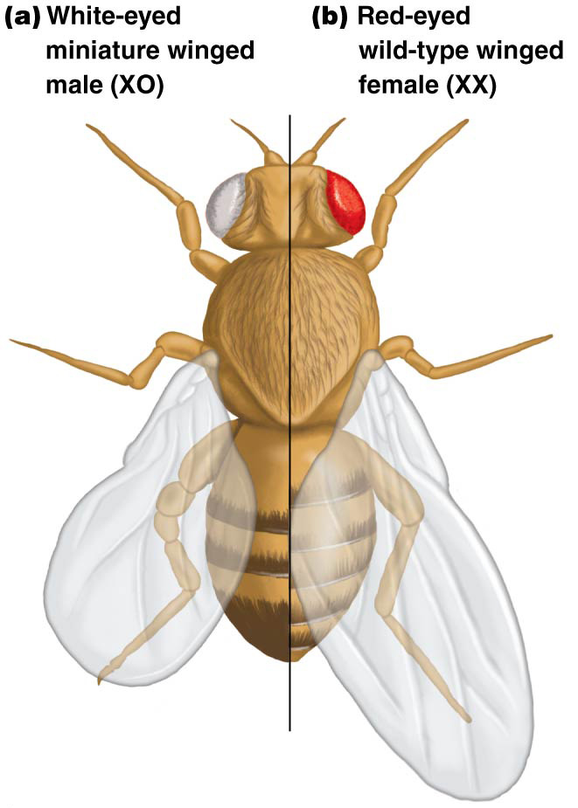
Figure 13.6 Gynandromorphy in Drosophila.

Slide 26
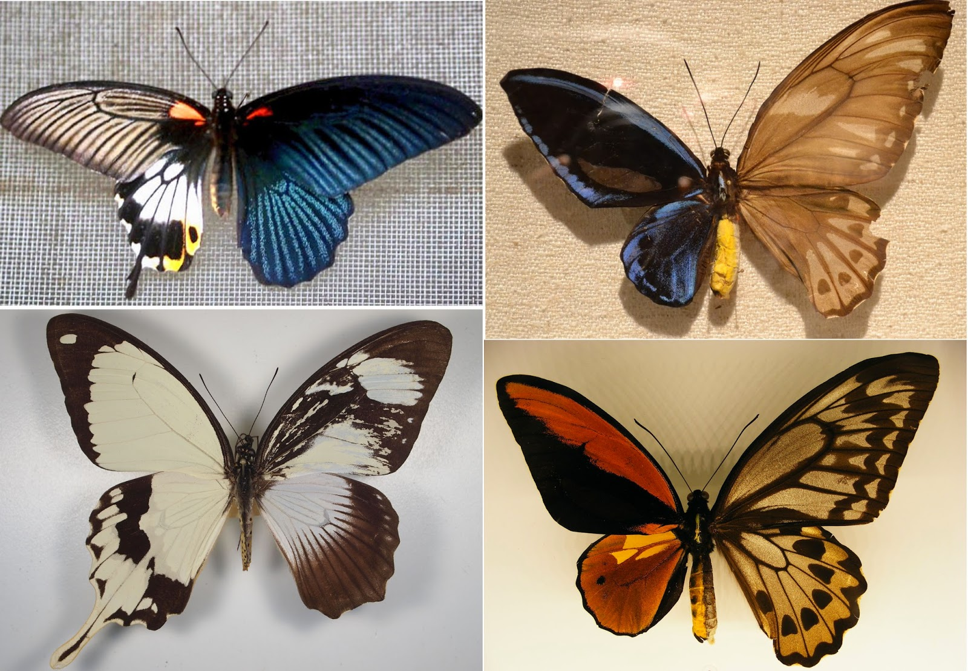

Slide 27
Trisomy Rescue and Uniparental Disomy
A rare abnormality, uniparental disomy, occurs in humans
This happens when both copies of a homologous chromosome pair arise from the same parent
It was first identified in connection with two conditions, Angelman syndrome and Prader-Willi syndrome, which are usually caused by deletion of a small region of chromosome 15
27

Slide 28
A More Common Mechanism for Uniparental Disomy
More often, nondisjunction occurs in one parent, resulting in a gamete with two copies of the chromosome (n + 1)
This unites with a normal gamete to produce a trisomic zygote
In a process called trisomy rescue, one copy of the trisomy chromosome is randomly ejected in one of the first mitotic divisions after fertilization
If the two copies retained by the zygote are from the same parent, uniparental disomy results
28

