Slide 1
3

Slide 2
3.3 The Chromosome Theory of Heredity Proposes That Genes Are Carried on Chromosomes
Sutton and Boveri proposed that chromosome behavior in meiosis mirrors hereditary transmission of genes = segregation of alleles
Morgan studied fruit flies, Drosophila melanogaster, to test Mendel’s rules on a natural, rather than domesticated, species
The term “wild type” signifies the phenotype most common in a population
2

Slide 3
Morgan’s Results
Over several years, Morgan’s lab members found numerous phenotypic variants and analyzed these in controlled crosses
He concluded from his results that genes were carried on chromosomes = chromosome theory of heredity
3

Slide 4
X and Y Chromosomes
After studying insects, Nettie Stevens concluded that sex-dependent hereditary differences are due to the presence of two X chromosomes in females and an X and a smaller Y chromosome in males
Stevens studied chromosome differences between male and female beetles (Tenebrio molitor)
She found that diploid cells of females contained 20 (XX) large chromosomes but those of males contained 19 large chromosomes and one small one (XY)
Half of the sperm of males contained 10 large chromosomes (X) and the other half had 9 large and one small chromosome (Y)
4

Slide 5
X-Linked Inheritance
Sex-linked inheritance refers to transmission of genes on sex chromosomes
In 1910, Morgan’s experiments with flies validated Stevens’s conclusions
5

Slide 6
The White-Eye Mutant
The first mutant identified in Morgan’s lab was a male with white eyes instead of the normal red color
The mutant white-eyed male was crossed to a normal red-eyed female, producing many F₁, all with red eyes
Thus the white-eyed mutant allele was recessive
6

Slide 7
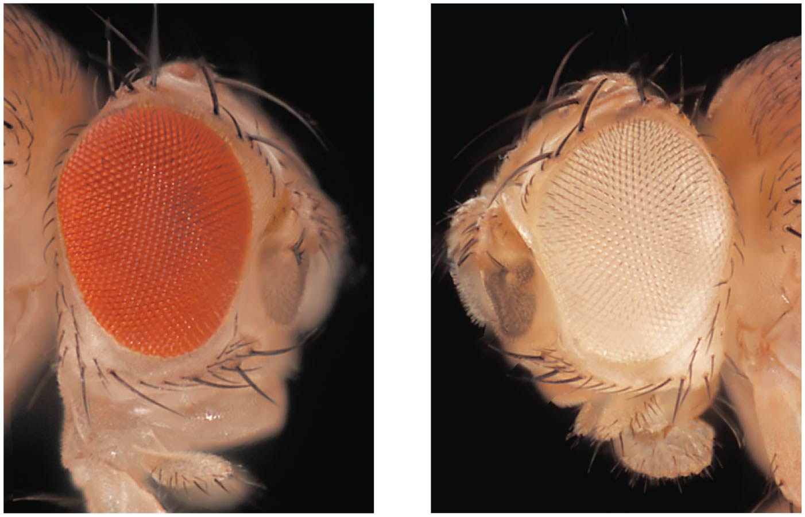
Figure 3.17 X-linked eye-color phenotypes in Drosophila melanogaster.
82

Slide 8
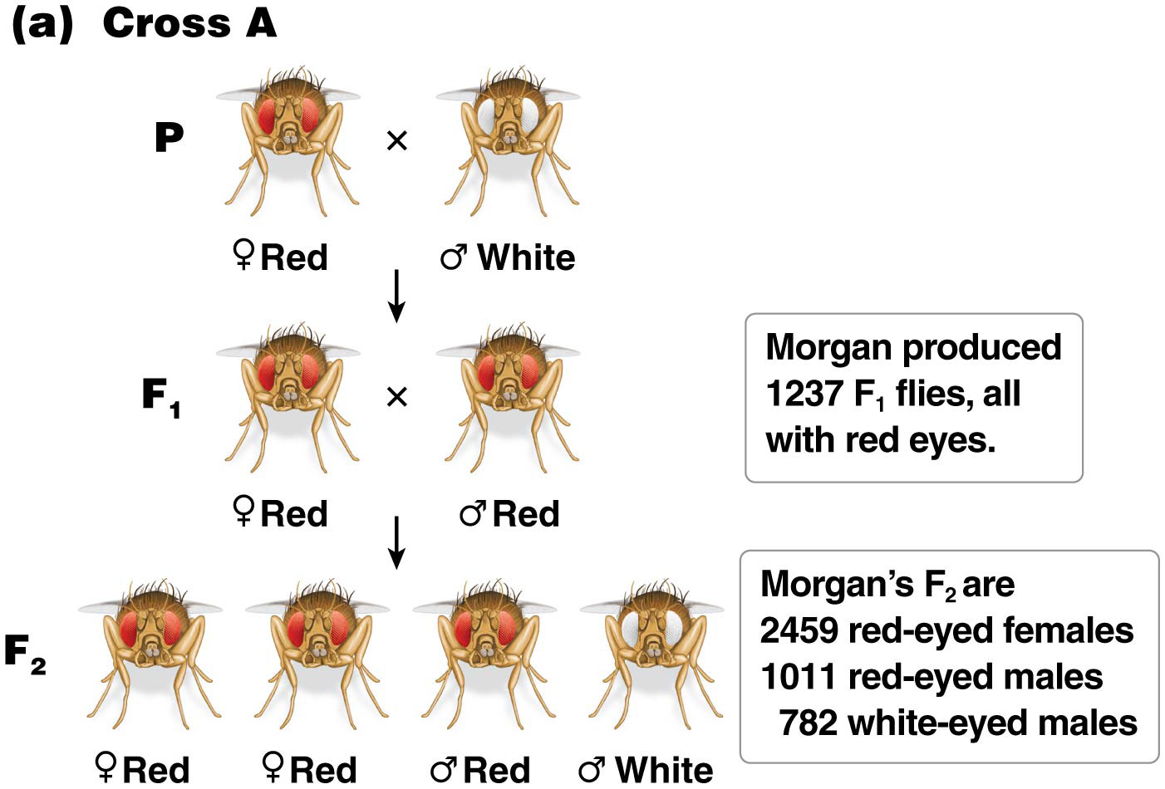
Figure 3.18a Two reciprocal Drosophila crosses performed by Morgan to determine X-linkage of the gene for eye color.
X^{A}X^{A}
XªY
XªX^{A}
X^{A}Y
83

Slide 9
F₁ Intercrossed
When the F₁ progeny were interbred, the F₂ offspring consisted of 1011 red-eyed males, 782 white-eyed males, and 2459 red-eyed females
This is not a normal 3:1 ratio, because there are phenotypic differences between male and female progeny
Only males had white eyes
9

Slide 10
Additional Crosses
A cross between a white-eyed female and red-eyed male produced red-eyed female and white-eyed male F₁
A cross between these F₁s produced F₂ with red and white eyes in equal frequencies among both male and female progeny
10

Slide 11
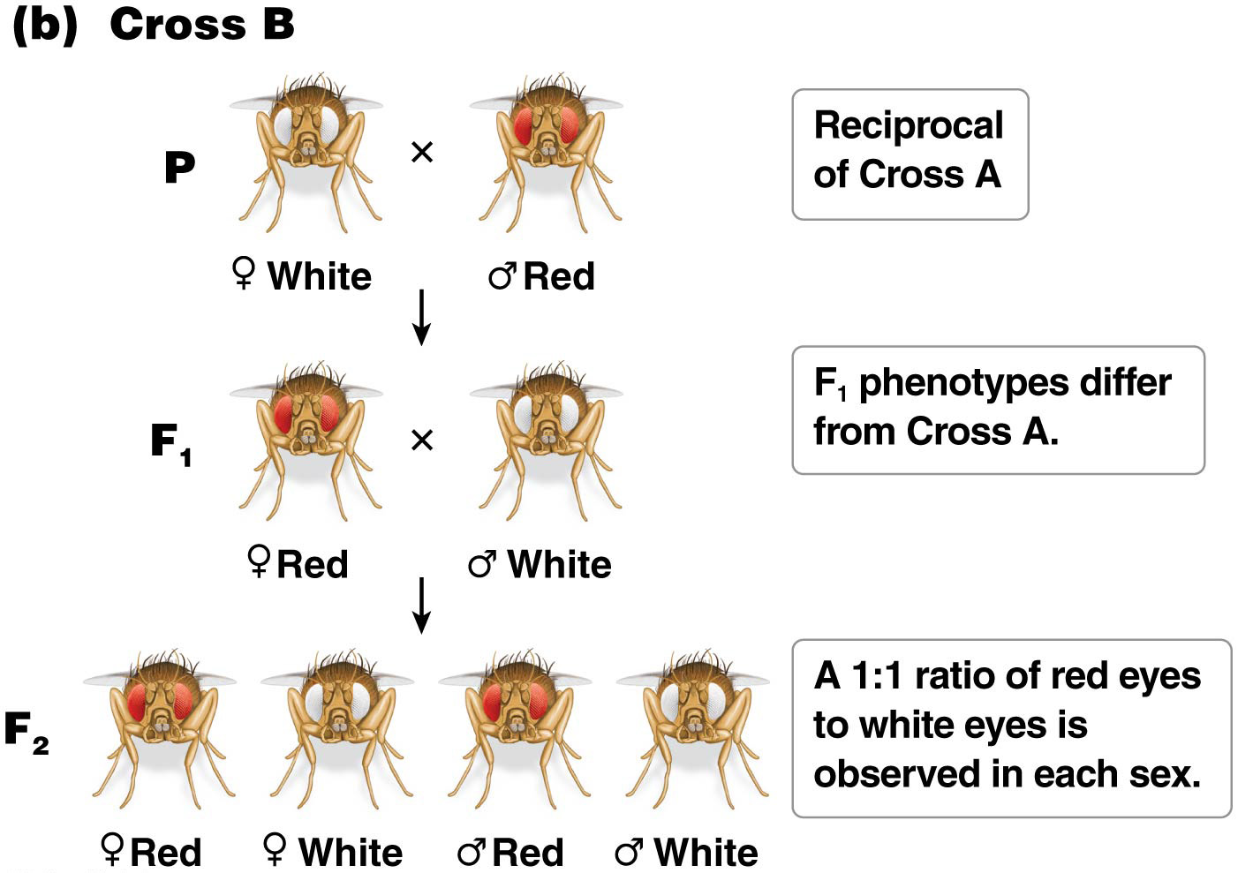
Figure 3.18b Two reciprocal Drosophila crosses performed by Morgan to determine X-linkage of the gene for eye color.
XªXª
X^{A}Y
86

Slide 12
The Gene for Eye Color Is on the X Chromosome
The differences in phenotype according to gender are not anticipated according to Mendel’s laws
The transmission of the X chromosome carrying a gene for eye color can account for the results obtained by Morgan’s lab
X-linked inheritance is the term for transmission of genes carried on the X chromosome; males have only one X, so are called hemizygous for X-linked traits
12

Slide 13
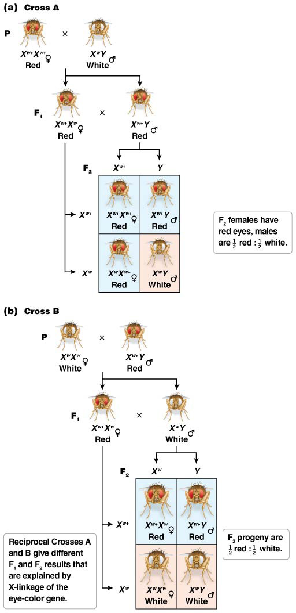
Figure 3.19 The X-linked genetic model of Morgan’s eye-color inheritance experiments in Drosophila.
88

Slide 14
ANIMATION: X-linked Inheritance
14

Slide 15
3.4 Sex Determination Is Chromosomal and Genetic
Sex determination involves the genetic and biological processes that produce the male and female characteristics of a species
Chromosomal sex is the presence of chromosomes characteristic of each sex and is determined at the moment of fertilization
Phenotypic sex is the internal and external morphology of each sex, and results from differences in gene expression
15

Slide 16
Sex Determination in Drosophila and X/Autosome ratio
Females have two X chromosomes and males have one X chromosome
Thus in flies, males have XO, XYY, or XY (normal), whereas females are XXY or XX (normal)
The X/A ratio or X/autosome ratio determines gender based on the number of X chromosomes to sets of autosomes
Males have an X/A ratio of 0.5 and females have a ratio of 1.0
16

Slide 17
Mammalian Sex Determination
Placental mammals have X and Y chromosomes too
In mammals sex determination depends on the presence or absence of a single gene, SRY, found on the Y chromosome
In mammals, males can be XY (normal), XXY, or XYY; females are XX (normal), XO, or XXX
SRY produces a transcription factor needed for male-specific gene expression
17

Slide 18
SRY
Early mammalian embryos have clusters of tissue called undifferentiated gonads, which can develop as ovaries or testes
Expression of SRY initiates testicular development of the undifferentiated gonads
The absence of SRY expression allows the default state, female, to develop
18

Slide 19
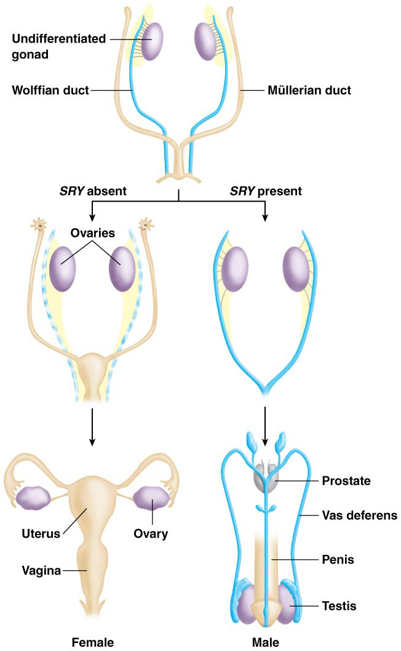
Figure 3.21 Mammalian sex determination is initiated by the Y-linked SRY gene.
98

Slide 20
Diversity of Sex Determination
A different system, the Z/W system, is used by birds, some reptiles, some fish, butterflies, and moths
In this system females have two different sex chromosomes (ZW), and males have two sex chromosomes that are the same (ZZ)
20

Slide 21
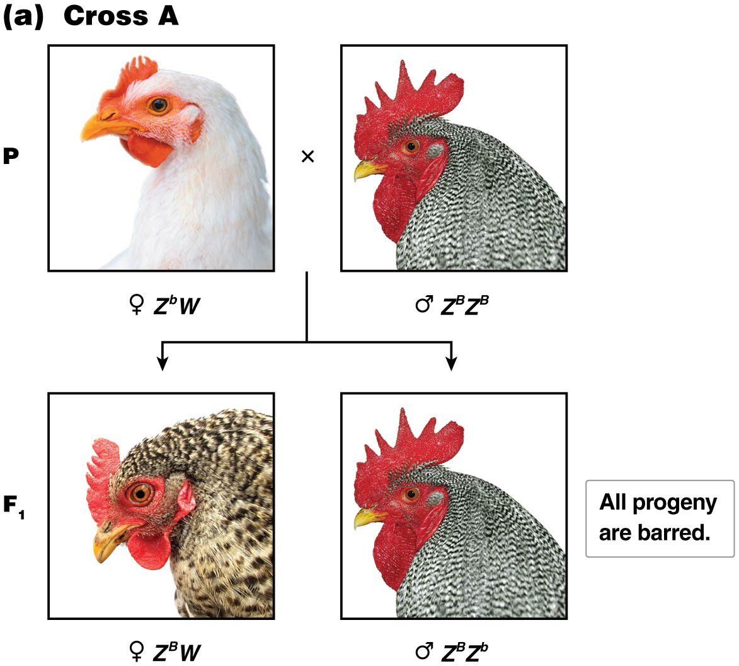
Figure 3.22a ZW inheritance of feather form in poultry is revealed by analysis of reciprocal crosses.
Recessive is white
100

Slide 22
Expression of X-Linked Recessive Traits
A hallmark of recessive X-linked inheritance in human is the expression of the trait much more often in males than in females.
CAN YOU TELL MY WHY?
Humans have numerous X-linked recessive traits
22

Slide 23
3.5 Human Sex-Linked Transmission Follows Distinct Patterns
In X-linked recessive inheritance, females homozygous for the recessive allele (XªXª) or males hemizygous for it (XªY) display the recessive phenotype
In X-linked dominant traits, females heterozygous (XªX^{A}) and males hemizygous (X^{A}Y) for the dominant allele express the dominant phenotype
Hemizygous males display any allele on their single X whether the allele is recessive or dominant in females
23

Slide 24
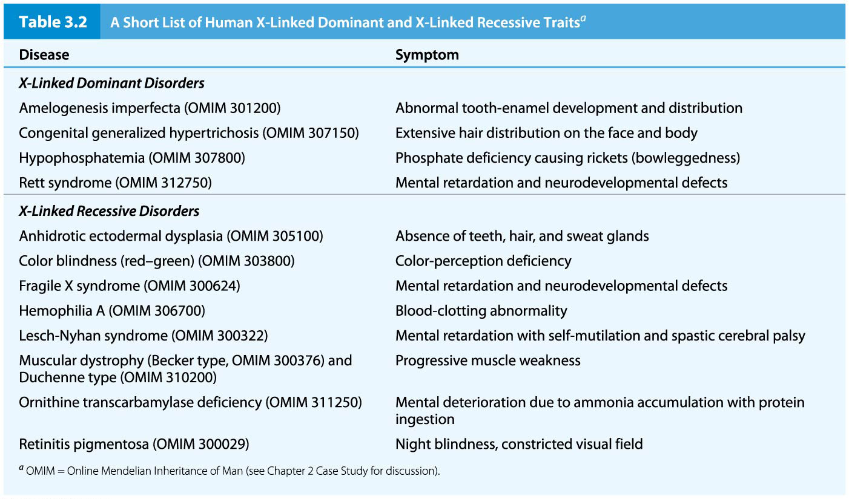
Table 3.2 A Short List of Human X-Linked Dominant and X-Linked Recessive Traits
104

Slide 25
Features of X-Linked Recessive Inheritance
Many more males than females express X-linked traits due to hemizygosity (XY)
A recessive male mated to a homozygous dominant female (XªY / X^{A}X^{A}) produces all offspring with the dominant phenotype (X^{A}Y, X^{A}Xª), and all female offspring are carriers
Matings of recessive males with carrier females (heterozygous) (XªY / X^{A}Xª) give half dominant and half recessive offspring of both sexes (XªY, X^{A}Y, X^{A}Xª, XªXª )
Matings of homozygous recessive females with dominant males (X^{A}Y / XªXª) produce all dominant (carrier) female offspring (X^{A}Xª) and all recessive male offspring (XªY)
25

Slide 26
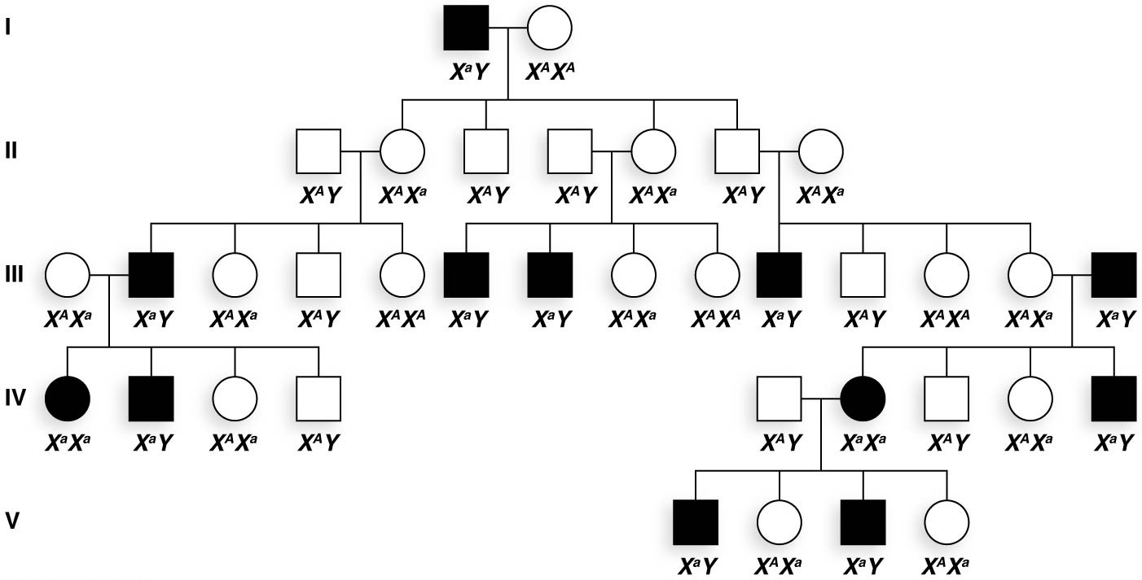
Figure 3.23 An idealized example of X-linked recessive inheritance.
107

Slide 27
Hemophilia A Is an X-Linked Recessive Trait
Hemophilia A is caused by a mutation in the factor VIII gene on the X chromosome
The mutant allele produces a nonfunctional blood-clotting protein
A de novo (newly occurring) mutation is thought to have been passed from Queen Victoria of England to some of her offspring
27

Slide 28
X-Linked Dominant Trait Transmission
The distinctive characteristics of X-linked dominant traits are
Heterozygous females mated to wild-type males (XªY / X^{A}Xª) transmit the dominant allele to half their progeny of each sex (X^{A}Y, XªY, X^{A}Xª, XªXª)
Dominant males mated to homozygous recessive females (X^{A}Y / XªXª) pass the trait to all their daughters and none of their sons (XªY / X^{A}Xª)
The trait appears equally frequently in males and females
28

Slide 29
Congenital Hypertrichosis
Congenital hypertrichosis (CGH) is a rare X-linked dominant disorder in humans
It leads to a large increase in the number of hair follicles on the body, and males and females have more body hair than normal
29

Slide 30
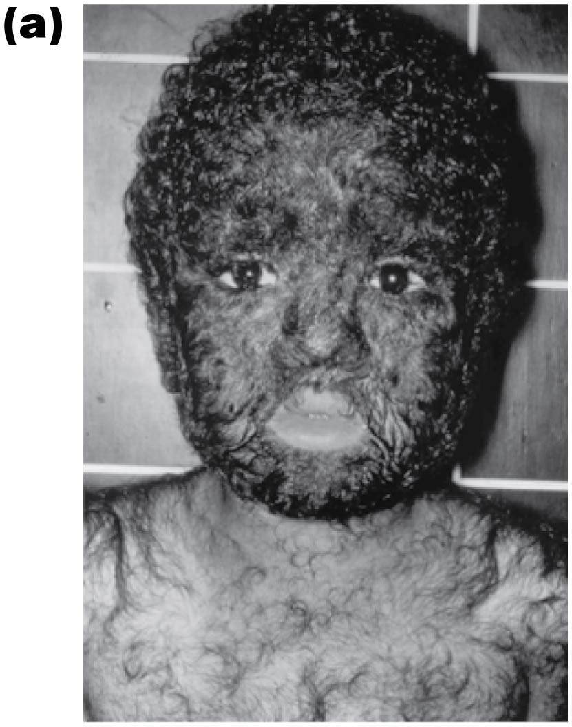
Figure 3.25a Congenital generalized hypertrichosis (CGH), an X-linked dominant trait in humans.
112

Slide 31
Y-Linked Inheritance
Y-linked traits are transmitted in an exclusively male-to-male pattern
Mammals have fewer than 50 genes on the Y chromosome; those genes likely play roles in male sex determination or development
Many genes on the Y chromosome also have a copy on the X chromosome
31

Slide 32
3.6 Dosage Compensation Equalizes the Expression of Sex-Linked Genes
In organisms with sex chromosomes, there is a gender imbalance between the copy number of genes on the sex chromosomes
Any mechanism that compensates for the difference in number of copies of genes between males and females is called dosage compensation
There are several mechanisms of dosage compensation
32

Slide 33
Random X-Chromosome Inactivation in Placental Mammals
Early in mammalian development, one of two X chromosomes in each female somatic cell is randomly inactivated
The random X inactivation hypothesis is also called the Lyon hypothesis, after Mary Lyon, who first proposed it (1961)
The inactive X chromosome is visible near the nuclear wall, as a condensed Barr body, first visualized by Murray Barr (1949)
33

Slide 34
Female Mammals Are Mosaics
Once X inactivation has occurred in a cell, it is permanent in all the descendants of that cell
Female mammals are mosaics of two populations of cells; one expresses the maternal X and the other the paternal X
Alleles of both chromosomes are expressed approximately equally over the whole organism
34

Slide 35
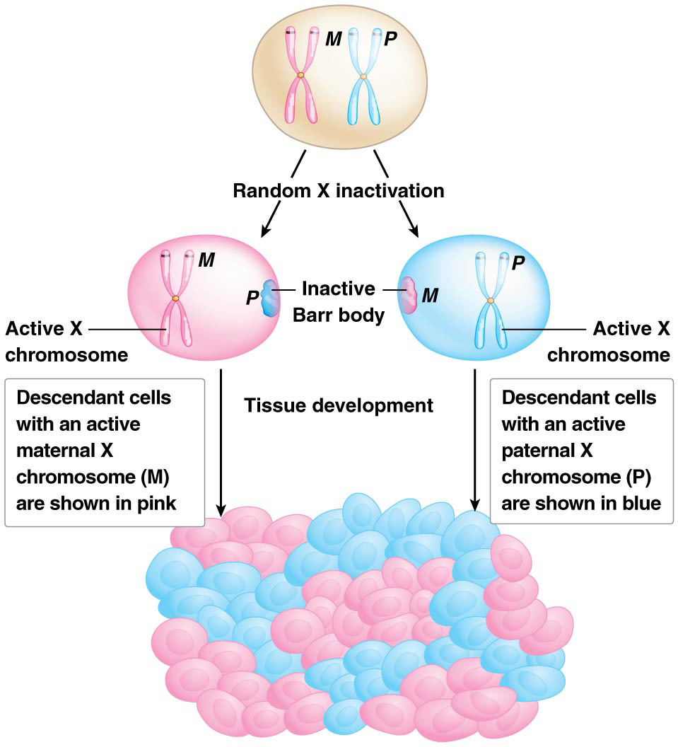
Figure 3.26 Random X inactivation in female placental mammals.
119

Slide 36
Calico and Tortoiseshell Cats Are Visibly Mosaic
In cats, the X chromosome carries a gene responsible for coat color
One allele specifies a black color; the other a yellow color
X inactivation in heterozygous females leads to a pattern of orange and black patches that is unique to each individual
36

Slide 37
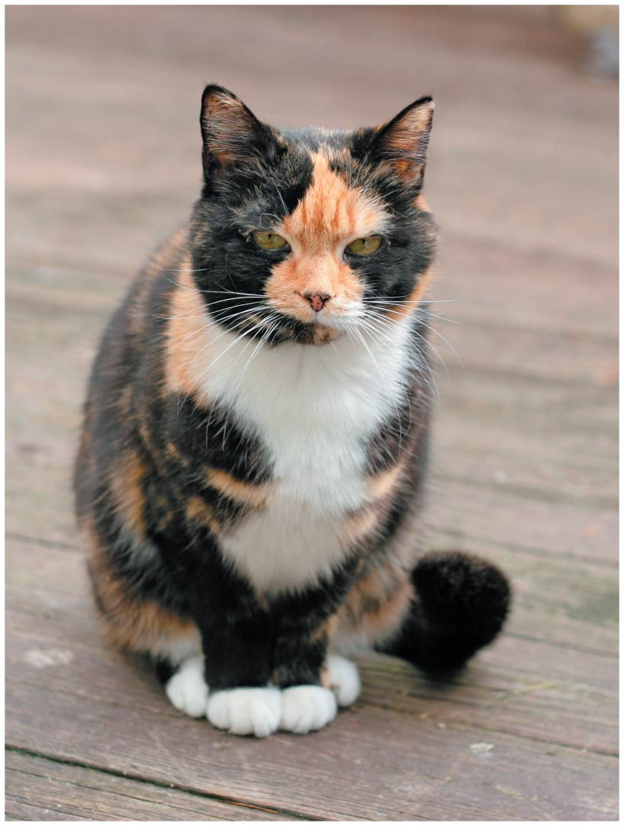
Figure 3.27 Calico coat, produced by X inactivation in female cats.
121

Slide 38
Mechanism of X Inactivation
Random X inactivation requires an X-linked gene called Xist (X-inactivation-specific-transcript)
The gene produces large RNA molecules that spread out and cover (or paint) the chromosome to be inactivated
Xist can only act on the chromosome from which it is being transcribed and not the homolog (i.e., it acts in cis)
38

Slide 39
ANIMATION: Sex Determination and Dosage Compensation in Drosophila
39
Notes:
39

