Slide 1
REPASO

Slide 2
2

Slide 3
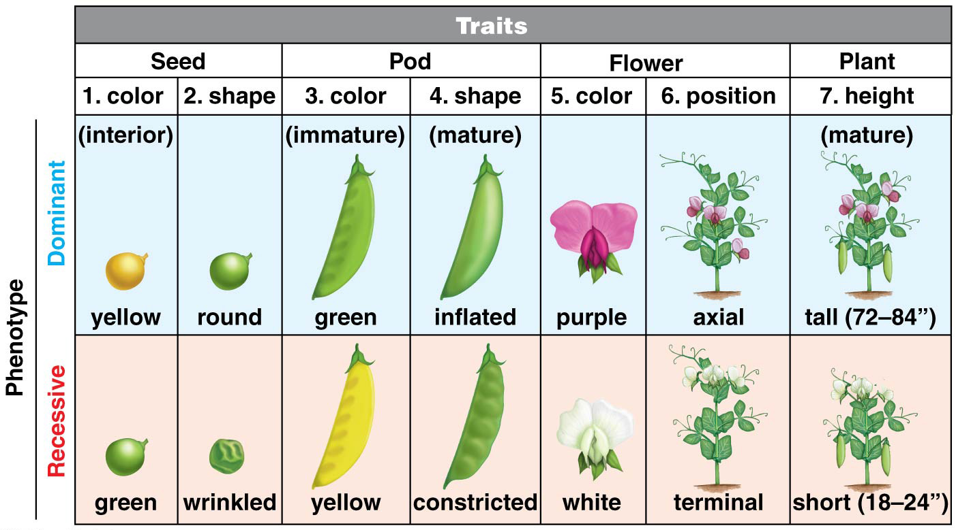
Monohybrid or dihybrid
A monohybrid cross represents the inheritance pattern of a single trait, whereas a dihybrid cross represents the inheritance patterns of two traits that are linked

Slide 4
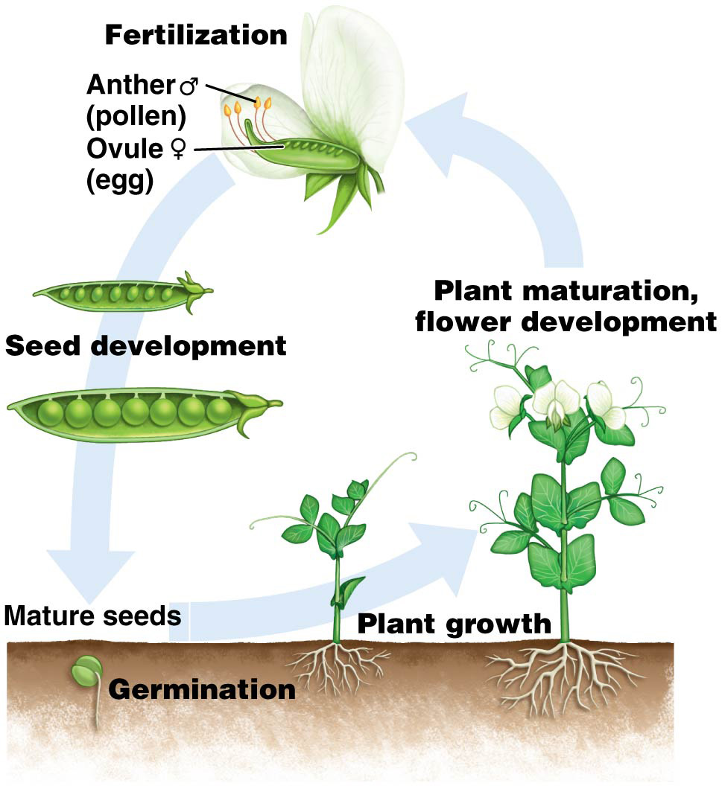
Figure 2.2 Life cycle of Pisum sativum. Self fertilization.
12

Slide 5
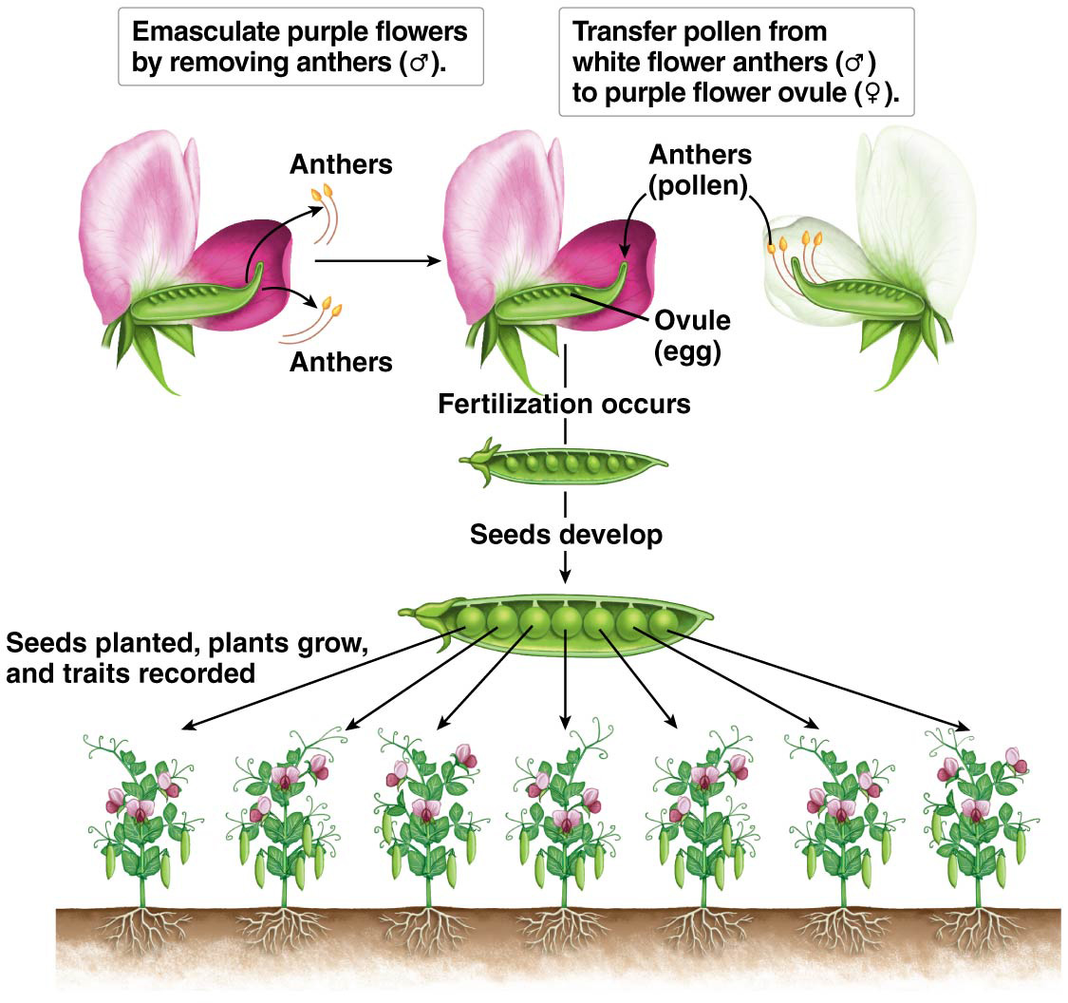
Figure 2.3 Artificial cross-fertilization of pea plants.
5

Slide 6
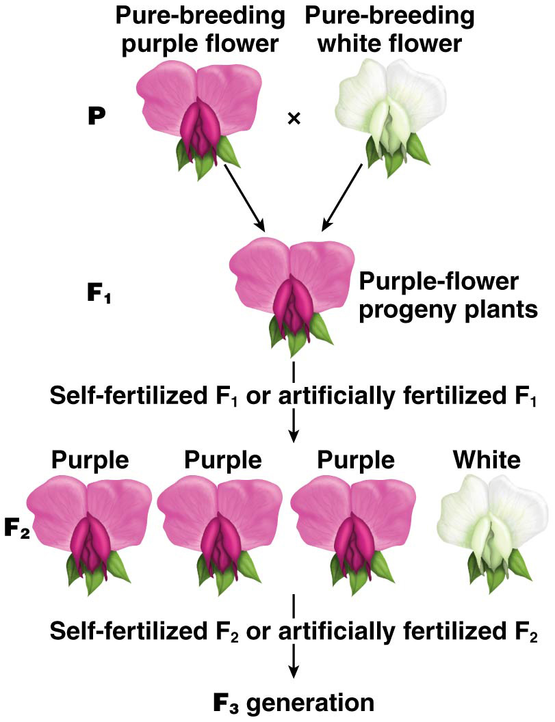

Slide 7
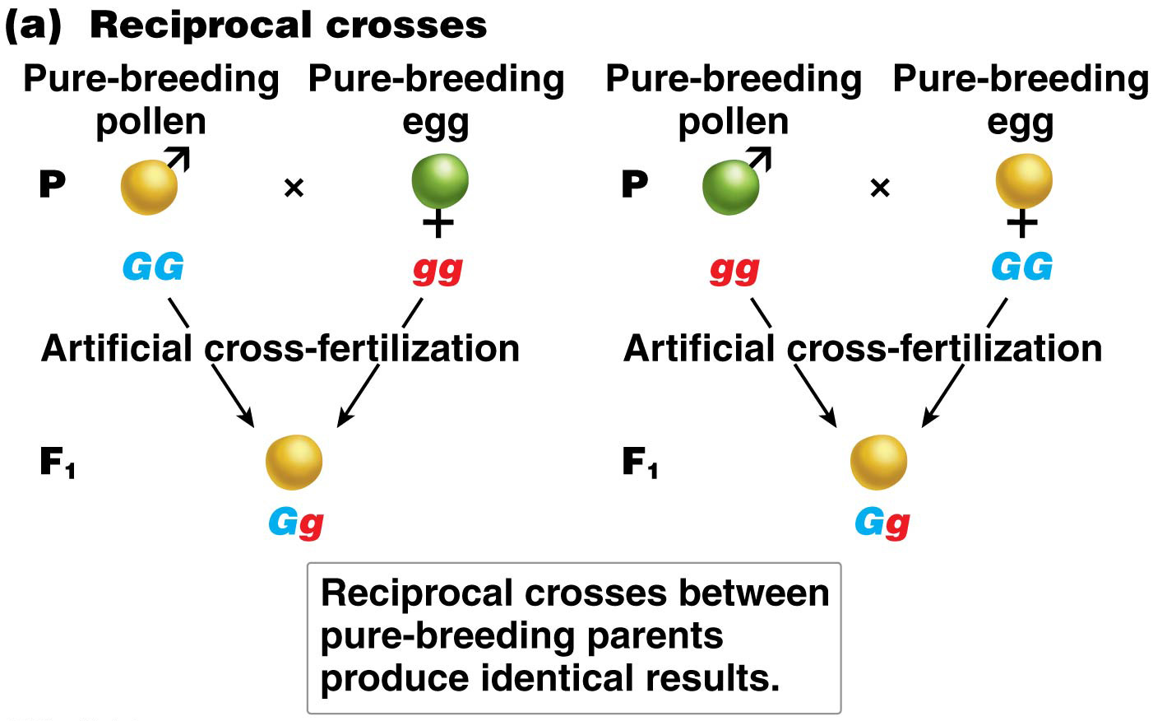

Slide 8
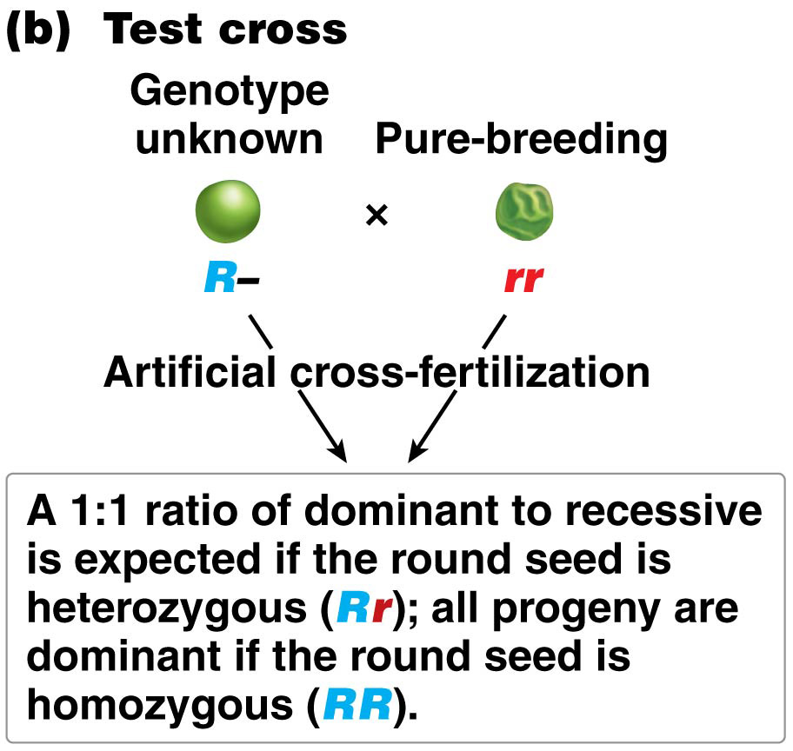
Figure 2.5b Reciprocal crosses and test cross.
21

Slide 9
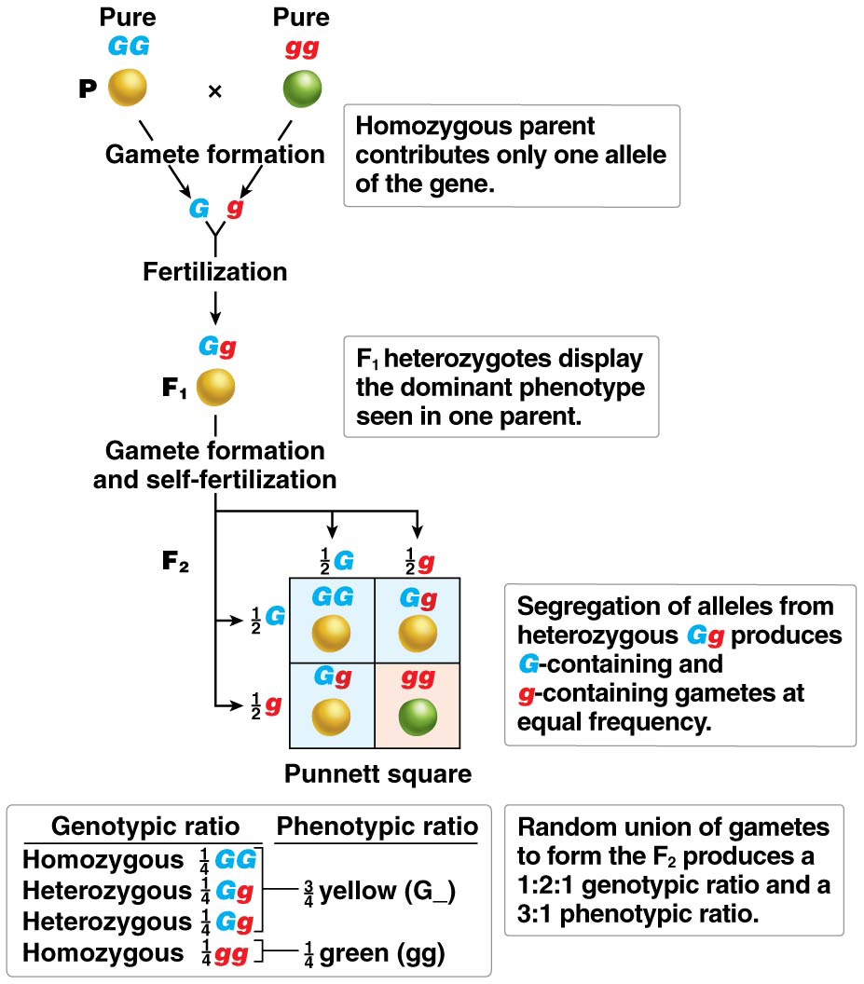
Figure 2.6 Segregation of alleles for seed color.
25

Slide 10
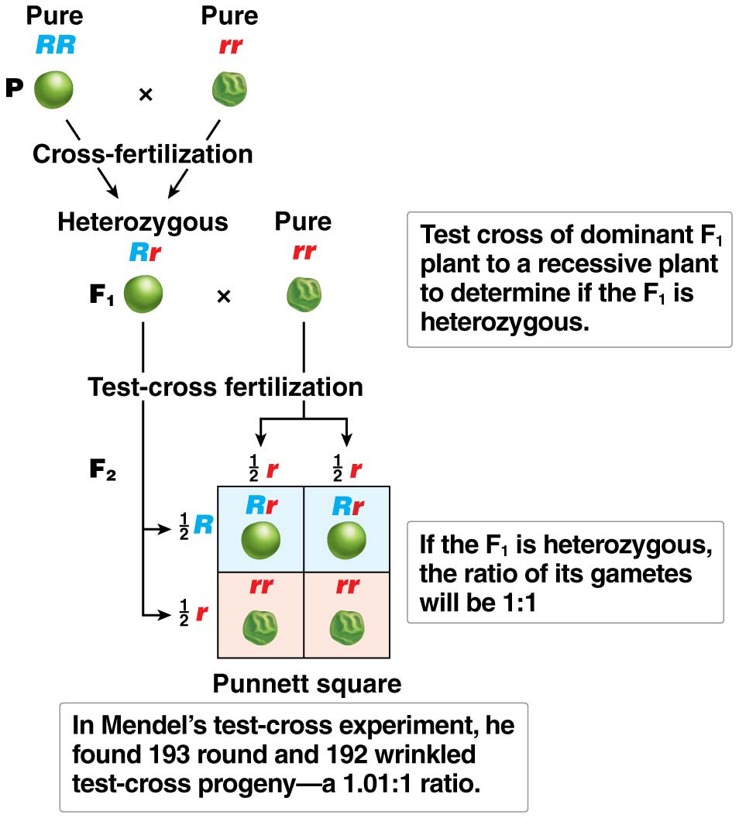
Figure 2.7 Test-cross analysis of F₁ plants.
33

Slide 11
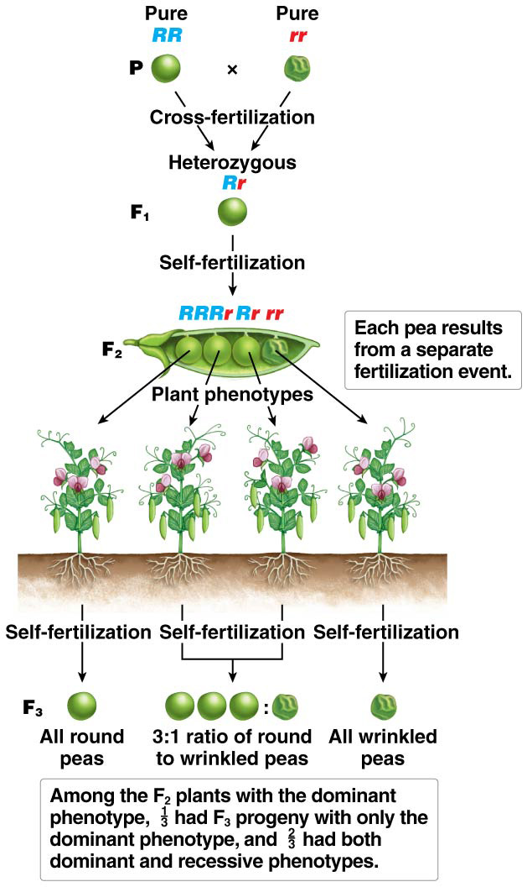
Figure 2.8 Determination of the genotype of F₂ plants by the production of F₃ progeny.
39

Slide 12
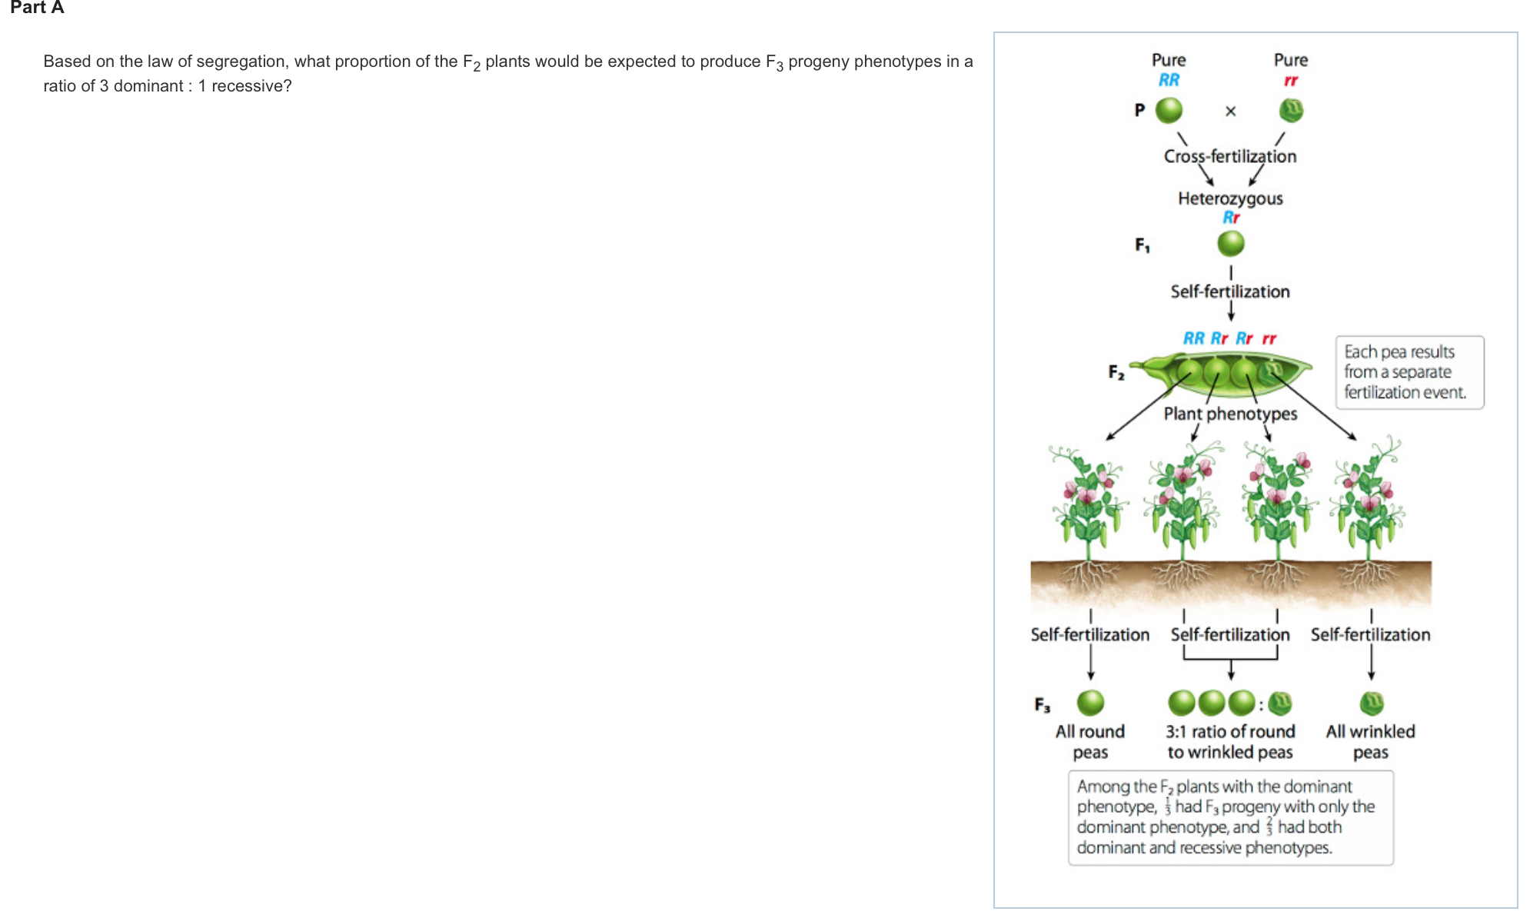
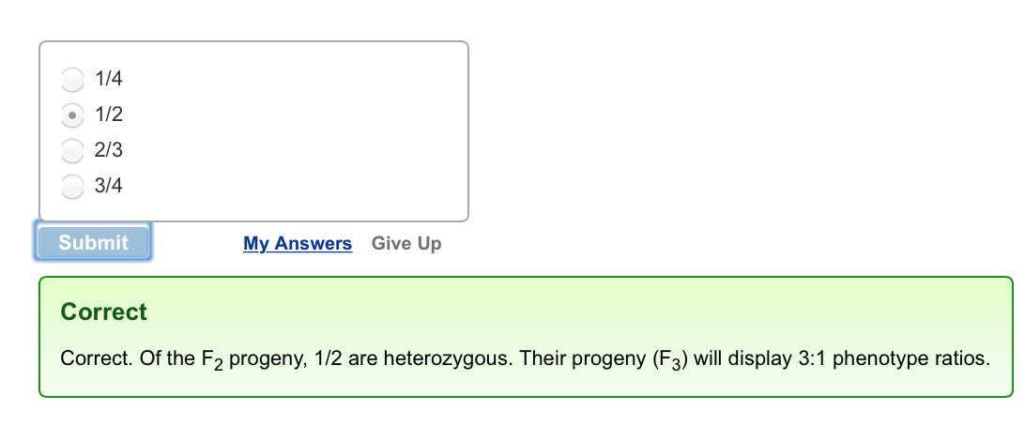

Slide 13
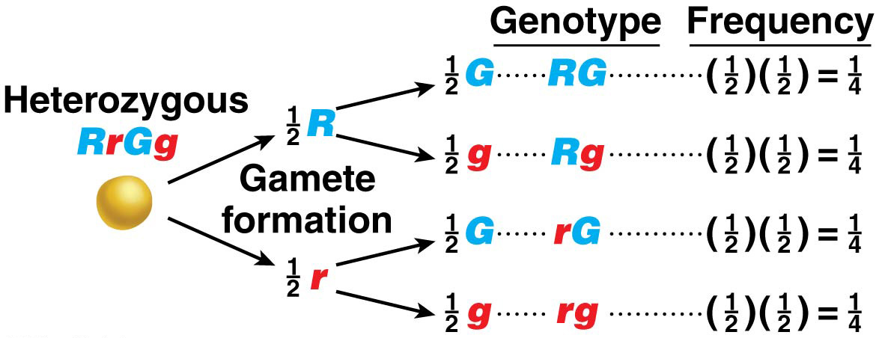
An Aid to Prediction of Gamete Frequency
The forked-line diagram is used to determine gamete genotypes and frequencies
13

Slide 14
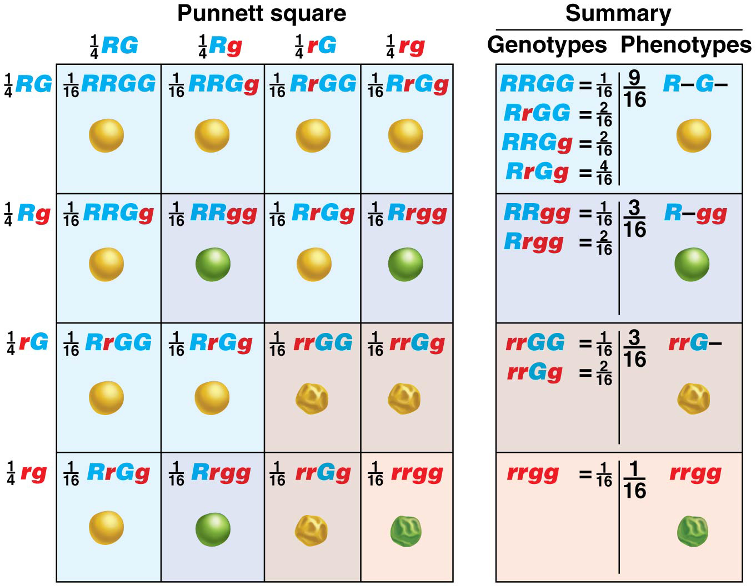
Figure 2.11 Independent assortment of alleles at two loci.
RrGg x RrGg

Slide 15
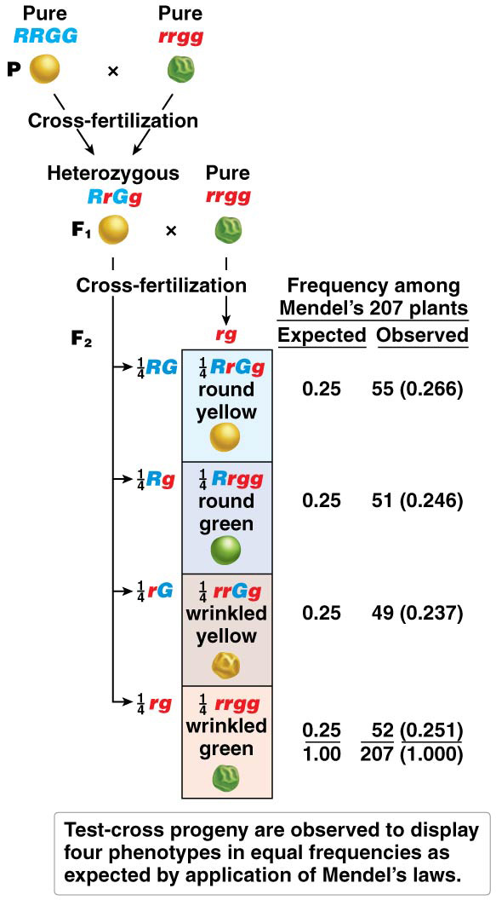
Figure 2.13 Mendel’s test cross to verify independent assortment.
52

Slide 16
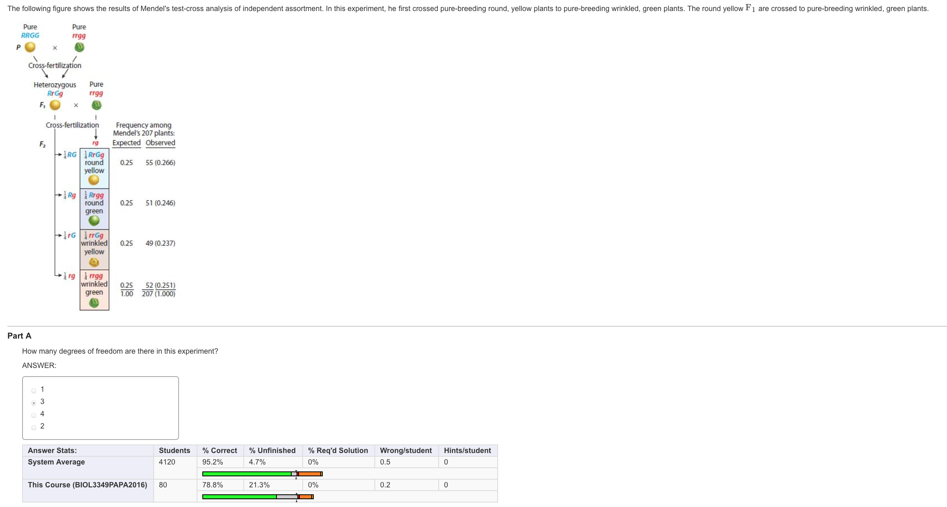

Slide 17
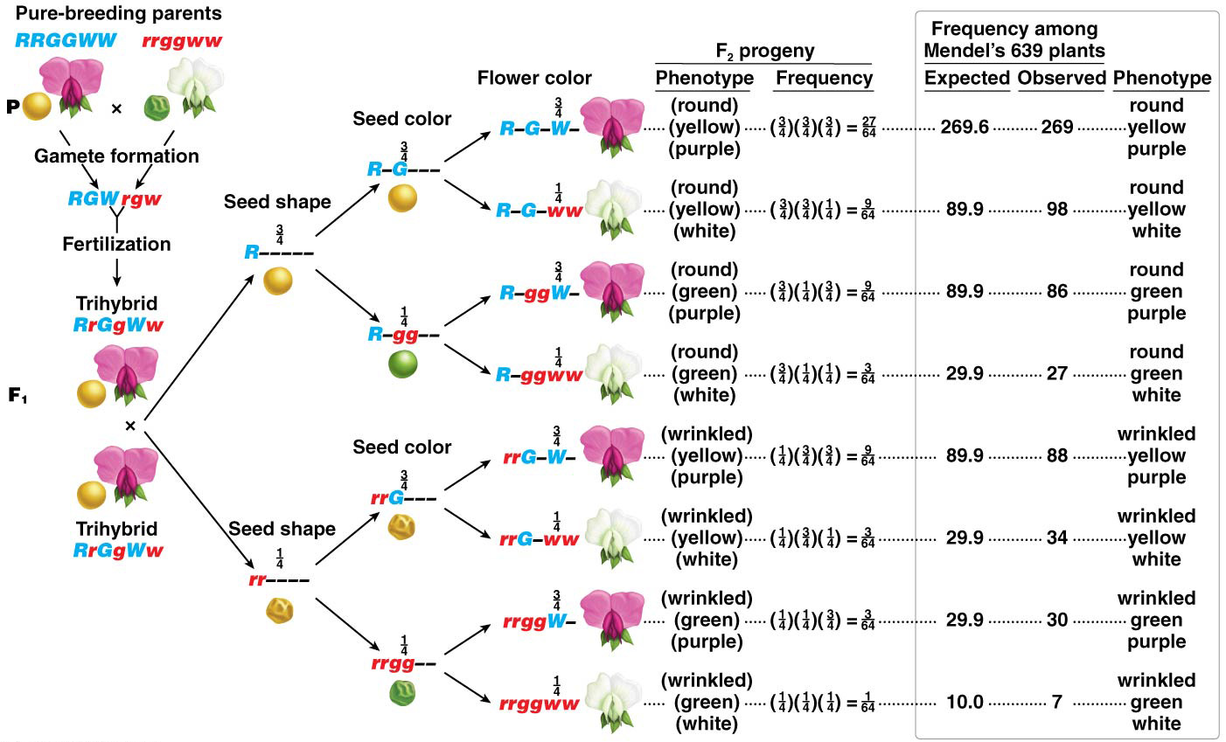
Figure 2.14 Trihybrid cross to verify independent assortment.
55

Slide 18
Rr x Rr
R
r
R
RR
Rr
Rr
rr
r

Slide 20
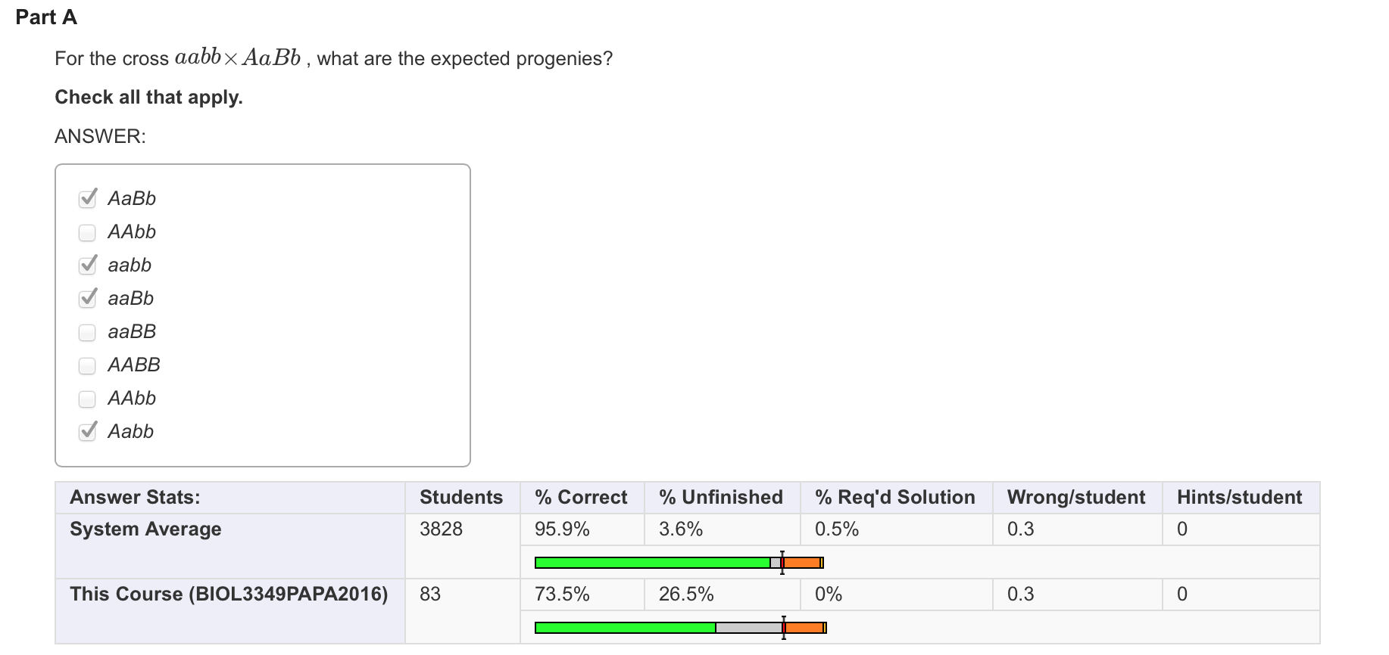

Slide 21
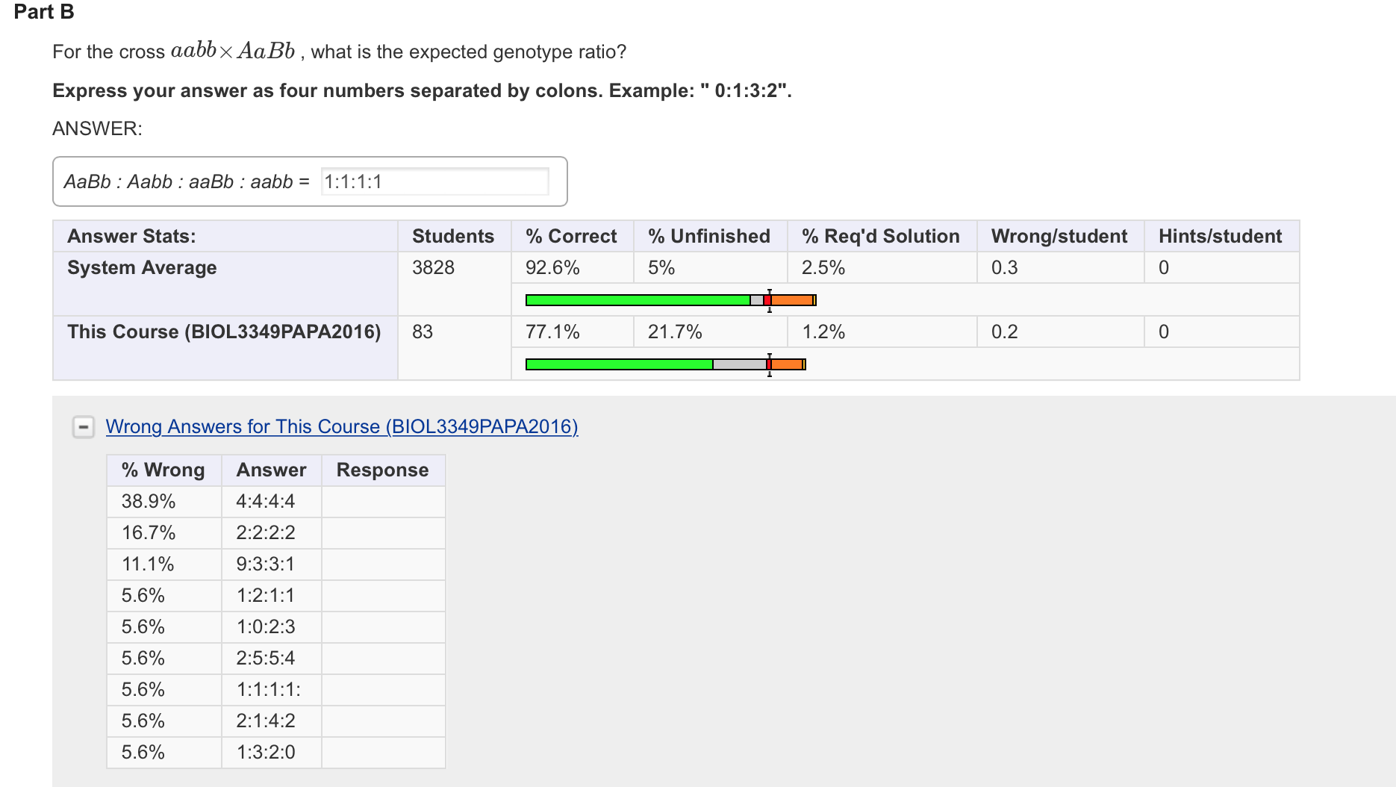

Slide 22
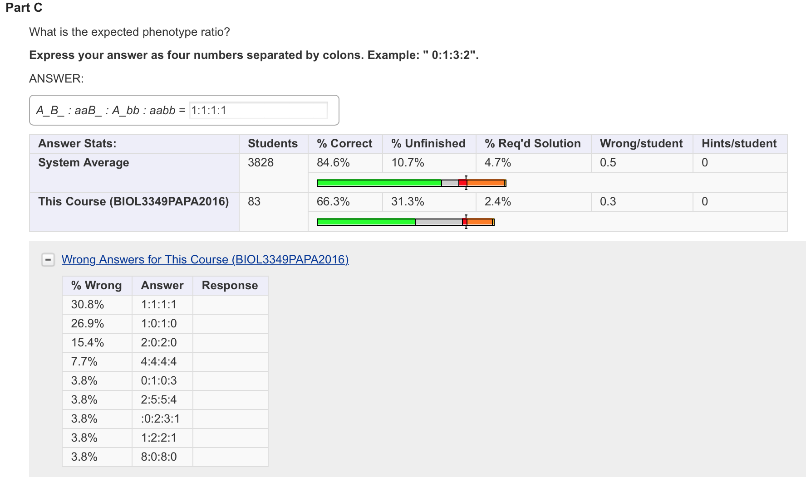

Slide 23
examples

Slide 24
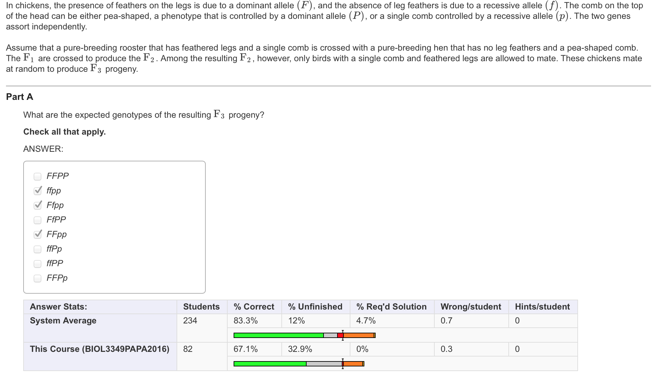
FP, Fp, fP, fp
FFpp x ffPP = F1: FfPp

Slide 25
F2: FfPp x FfPp = F2: FFPP, FFPp, FfPP, FfPp, FfPp, Ffpp, ffPp
 | FP | Fp | fP | fp
FP | FFPP | FFPp | FfPP | FfPp
Fp | FFPp | FFpp | FfPp | Ffpp
fP | FfPP | FfPp | ffPP | ffPp
fp | FfPp | Ffpp | ffPp | ffpp
F_pp = FFpp, Ffpp, Ffpp = gametes: Fp, fp = Ffpp, FFpp, ffpp

Slide 26
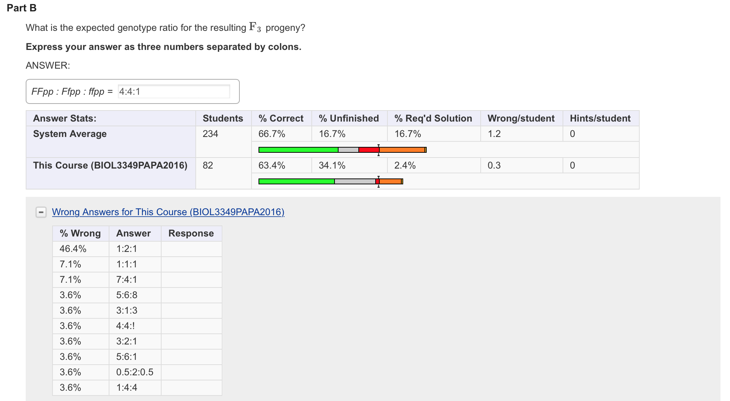

Slide 27
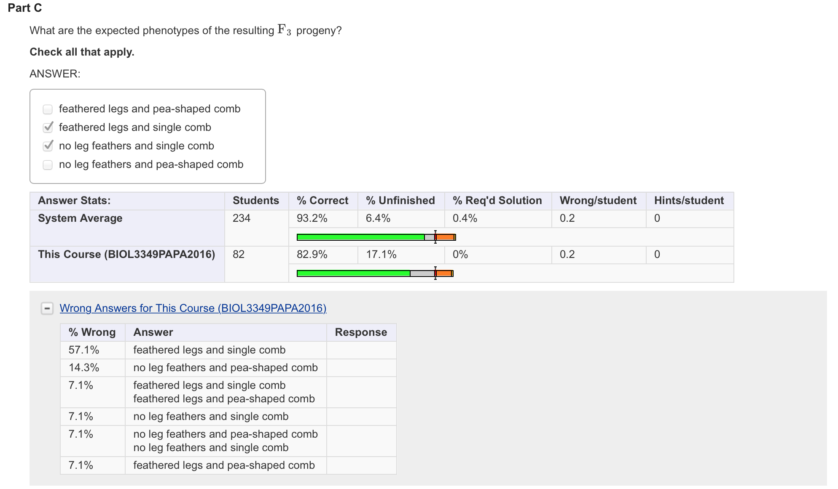
Ffpp, FFpp, ffpp

Slide 28
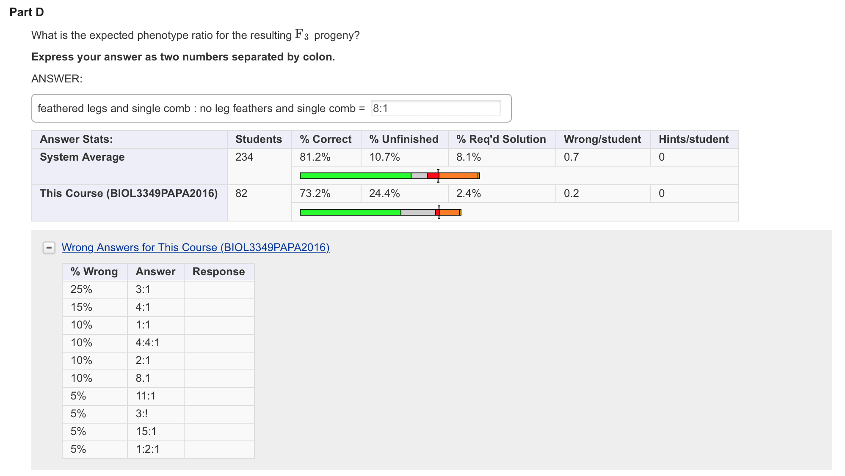

Slide 29
Interpreting segregation of traits

Slide 30
Short hair in the leaf of tomato plant is a dominant trait control by the allele H. The recessive allele generate a soft leaf (genotype hh). The below table represent 3 indipendednt crosses. La tabla demuestra la progenie de tres cruces independientes de plantas parentales con genotipos y fenotipos desconocidos.
Determine the parental genotype based on the distribution.
Cruce | Numero de progenie
 | Pelos cortos (H-) | Hojas suaves (hh)
1 | 32 | 11
2 | 42 | 45
3 | 0 | 24

Slide 31
Cruce | Numero de progenie
 | Pelos cortos (H-) | Hojas suaves (hh) | Total de progenie
1 | 32 | 11 | 43
2 | 42 | 45 | 97
3 | 0 | 24 | 24
Progeny in the three crosses:
Cross 1: 32/11 = 2.91 :1 around 3:1
Cross 1: ¾ of the progeny with the dominant phenotype (32/43) = 75% while ¼ of the progeny has a recessive phenotype (11/43) = 25%.
Cruce 2: 42/45 = 0.93 :1 around 1:1
Cruce 2: Dominant phenotype is around 50% (42/97)thus the recessive is also around 50%.
Cruce 3: 0/24 = 0:1 since all the progeny has a recessive phenotype

Slide 32
Determinar genotipo:
Cross 1: (3:1) : Hh x Hh.
 | H | h
H | HH | Hh
h | Hh | hh

Slide 33
Cruce 2: (1:1) : Hh x hh
 | H | h
h | Hh | hh
h | Hh | hh

Slide 34
Cruce 3: (0:1) hh x hh:
 | h | h
h | hh | hh
h | hh | hh

Slide 35
The chi-square (χ²) test is commonly used for quantifying how closely an experimental observation matches the expected outcome. It can be used to test Mendeian inheritance.
Here we test the probability that seeds are segregating in a 9:3:3:1 proportion for color and shape. The allele are green and yellow and round or wrinkle.
Notes:
Jjjj chi cuadrado

Slide 36
Are the data following a 9:3:3:1 segregation?.
Null hypothesis: Both variable are indipendents. Thus you can have a 9:3:3:1 segregation. The difference between obsrved and expected values is minimal.
Alternative hypothesis: The variables are related and do not follow a 9:3:3:1 distribution.

Slide 37
Calculate the observed value.
Valores Observados | Valores Esperados
315 semillas redondas y amarillas | (9/16)(556) = 312.75 redondas y amarillas
108 semillas redondas y verdes | (3/16)(556) = 104.25 redondas y verdes
101 semillas arrugadas y amarillas | (3/16)(556) = 104.25 arrugadas y amarillas
32 semillas arrugadas y verdes | (1/16)(556) = 34.75 arrugadas y verdes
556 Total de semillas | 556.00 Total de semillas

Slide 38
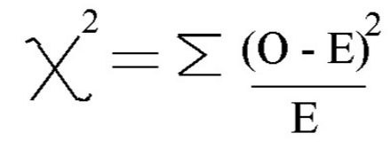
Segundo utilizamos la fórmula de Chi-cuadrado:
O = Resulltados observados
E = Resultados esperados

Slide 39
Valores Observados | Valores Esperados
315 semillas redondas y amarillas | (9/16)(556) = 312.75 redondas y amarillas
Formula con valores observados y esperados:
0.028 + 0.1538 + .086 + .11 =0 .37
Number of classes: 4
Grade of freedom: n-1, 4 – 1 = 3.

Slide 40
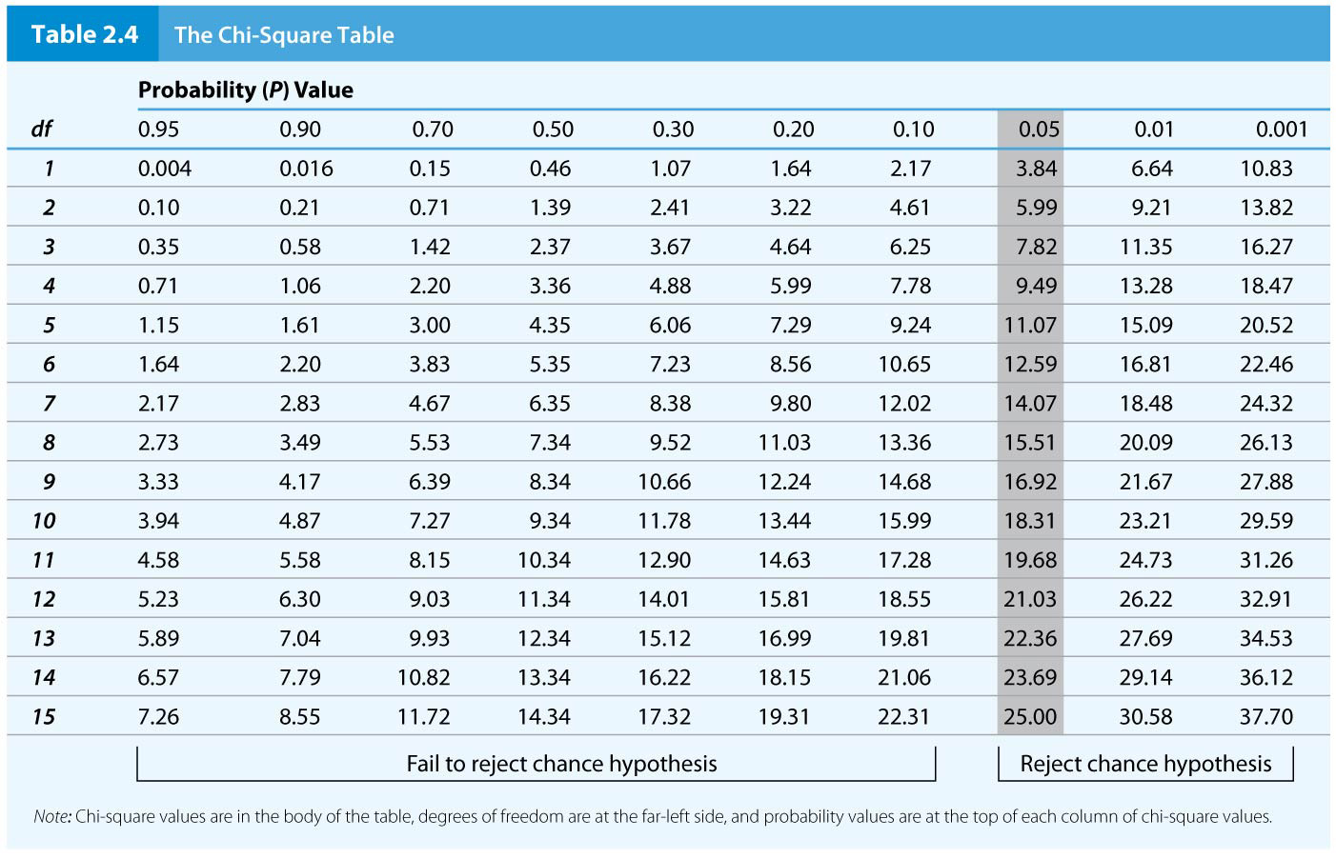
Table 2.4 The Chi-Square Table
77

Slide 41
The probability is in the 95%.
Less is the difference between observed and expected, less is the value of p.
We can not reject the null hypothesis. Thus the data follow a 9:3:3:1.

Slide 42
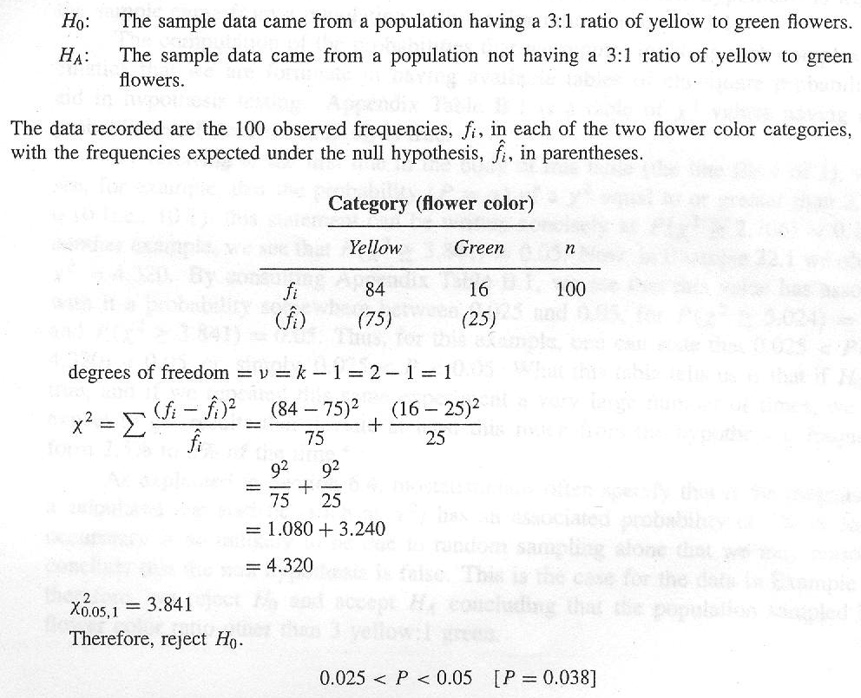
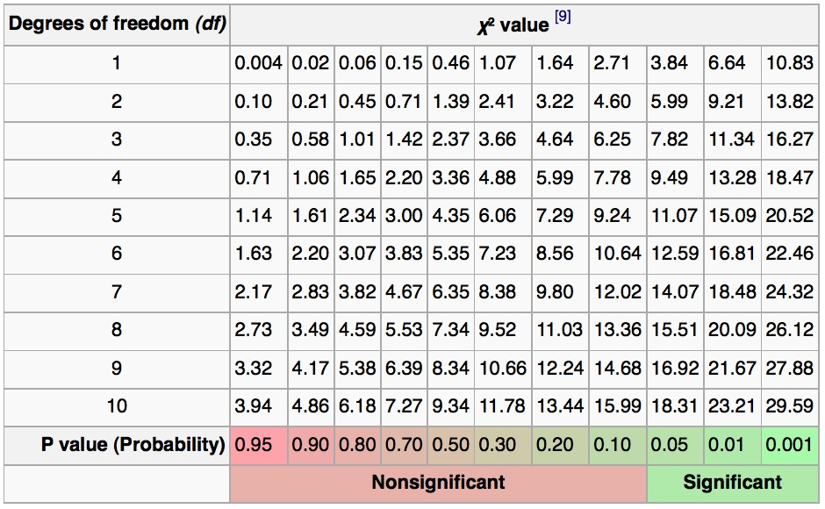
Example of Chi square goodness of fit
Calculation of chi square goodness of fit, of data consisting of the Colors of 100 flowers, to a hypothesized color ratio of 3:1 (Yy x Yy)
χ² = Σ (O – E )²
E

Slide 43
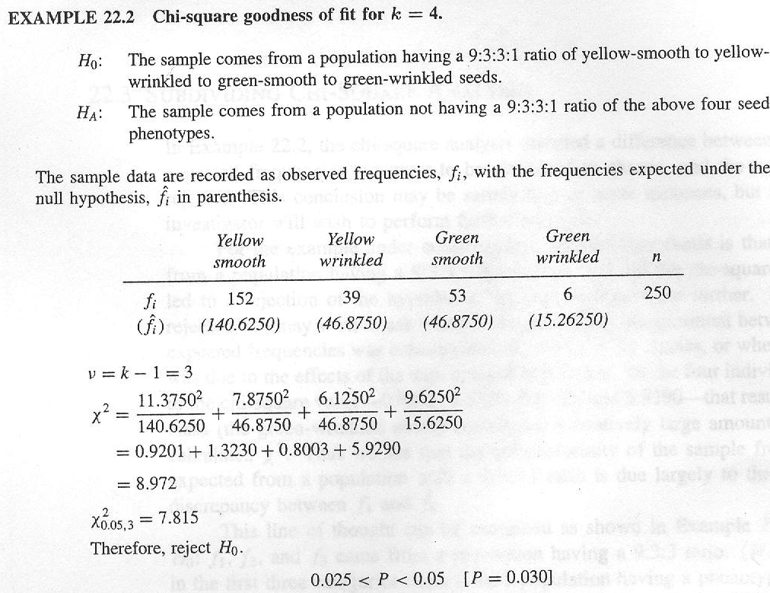
(YyRr x YyRr)

Slide 44
(250/16)9

Slide 45
(250/16)9
(250/16)3

Slide 46
(250/16)9
(250/16)3
(250/16)3
(250/16)1

Slide 48
Binomial Expansion Formula — Example
For families with three children, predict the proportions with each possible combination of boys and girls
p = probability of a boy = ½; q = probability of a girl = ½
Binomial expansion: (p + q)³ = p³ + 3p2q + 3pq² + q³
p³ = 1/8 (3 boys); 3p²q = 3/8 (2 boys, 1 girl); 3pq² = 3/8 (1 boy, 2 girls); q³ = 1/8 (3 girls)
48

Slide 49
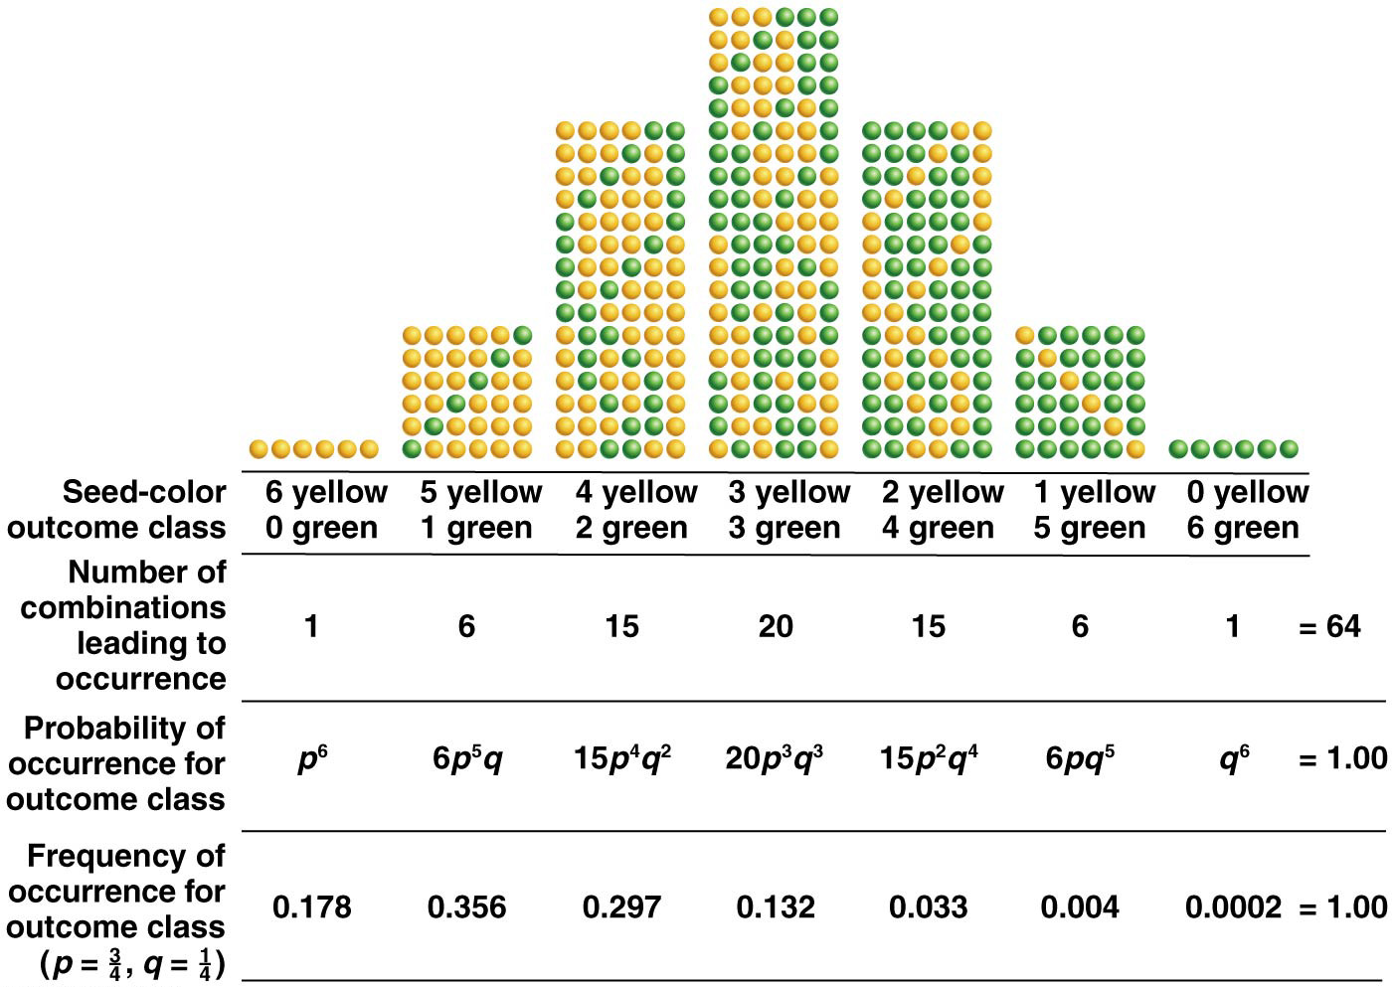
Figure 2.16 Binomial-probability calculation of seed-color phenotype in six-seeded pods.
69

Slide 50
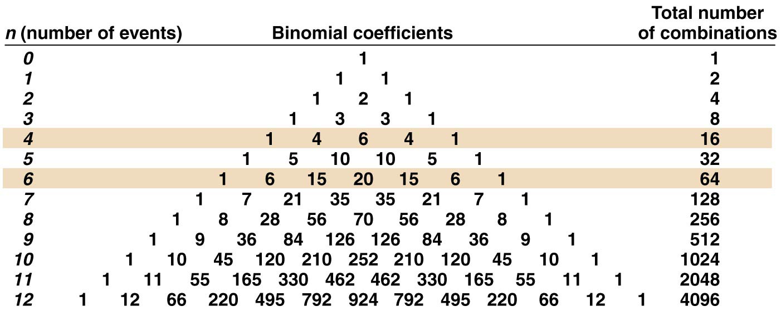
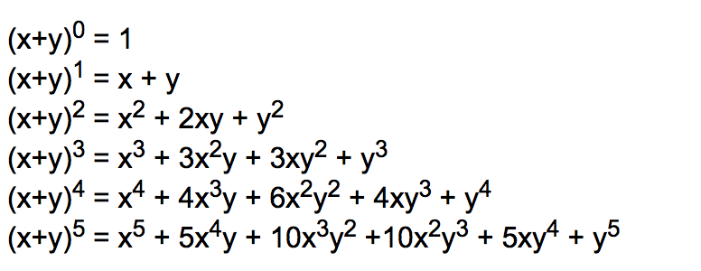
Figure 2.15 Pascal’s triangle of binomial coefficients (p + q) raised to the nth power.
68

Slide 51
Family tree

Slide 52
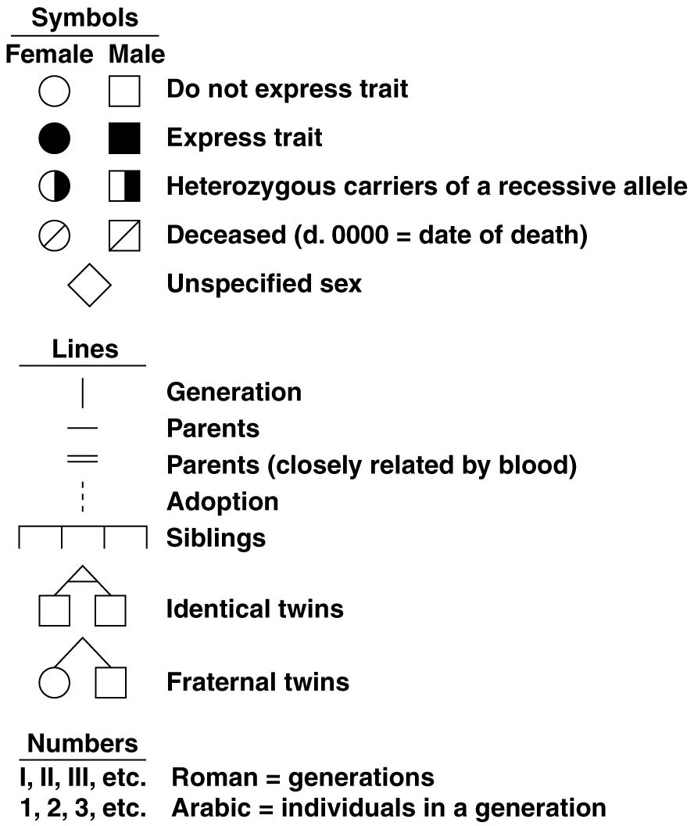
Figure 2.18 Common pedigree symbols.
86

Slide 54
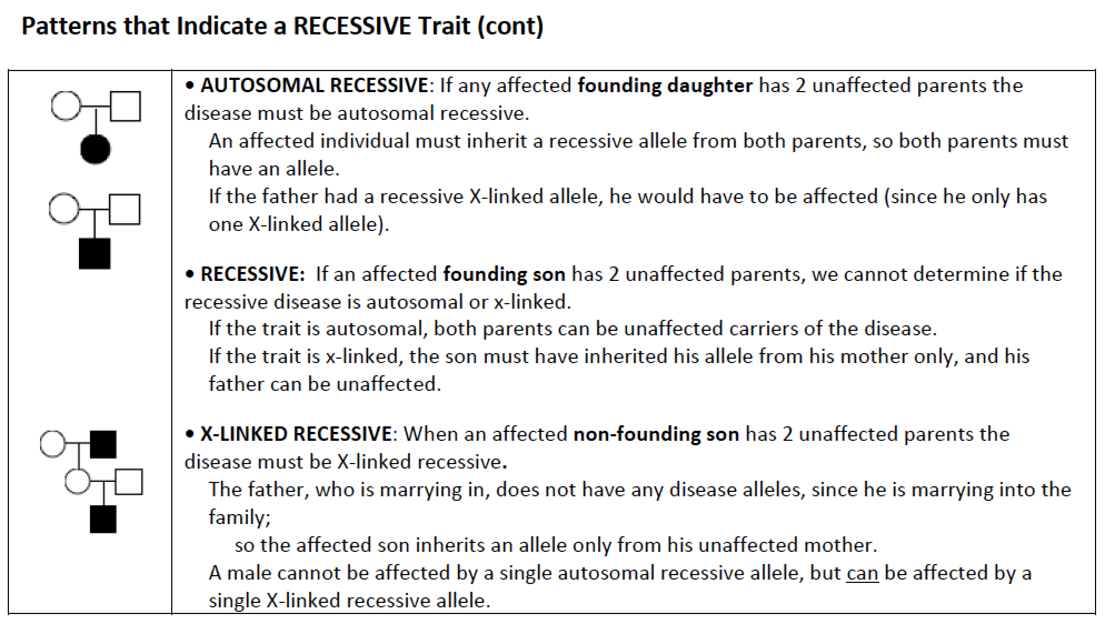

Slide 56
Figure 2.19 Autosomal dominant inheritance.
89

Slide 57
Autosomal Dominant Inheritance
Autosomal dominant inheritance has six characteristics:
Each individual who has the disease has at least one affected parent
Males and females are affected in equal numbers
Either gender can transmit the disease allele
In crosses where one parent is affected and the other is not, approximately half the offspring express the disease
Two unaffected parents will not have any children with the disease
Two affected parents may produce unaffected children
57

Slide 58
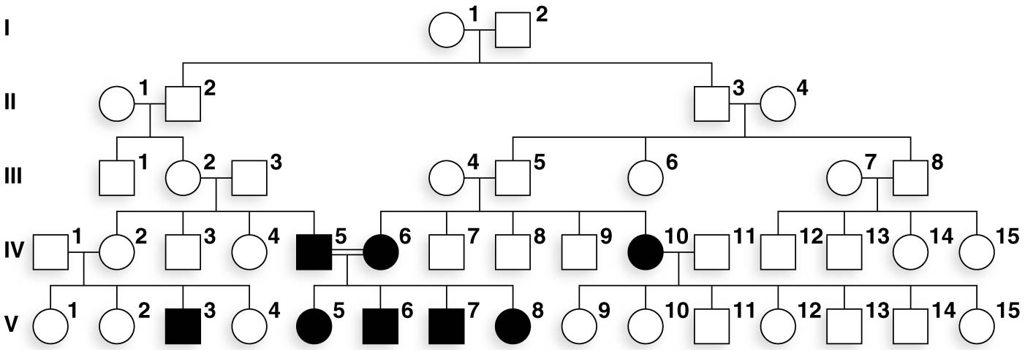
Figure 2.20 Autosomal recessive inheritance.
92

Slide 59
Autosomal Recessive Inheritance
Autosomal recessive inheritance has six key features:
Individuals who have the disease are often born to parents who do not
If only one parent has the disorder, the risk that a child will have it depends on the genotype of the other parent
If both parents have the disorder, all children will have it
The sex ratio of affected offspring is expected to be equal
The disease is not usually seen in each generation, but if an affected child is produced by unaffected parents, the risk to subsequent children is ¼
If the disease is rare in the population, unaffected parents of affected children are more likely to be related to one another
59

Slide 60
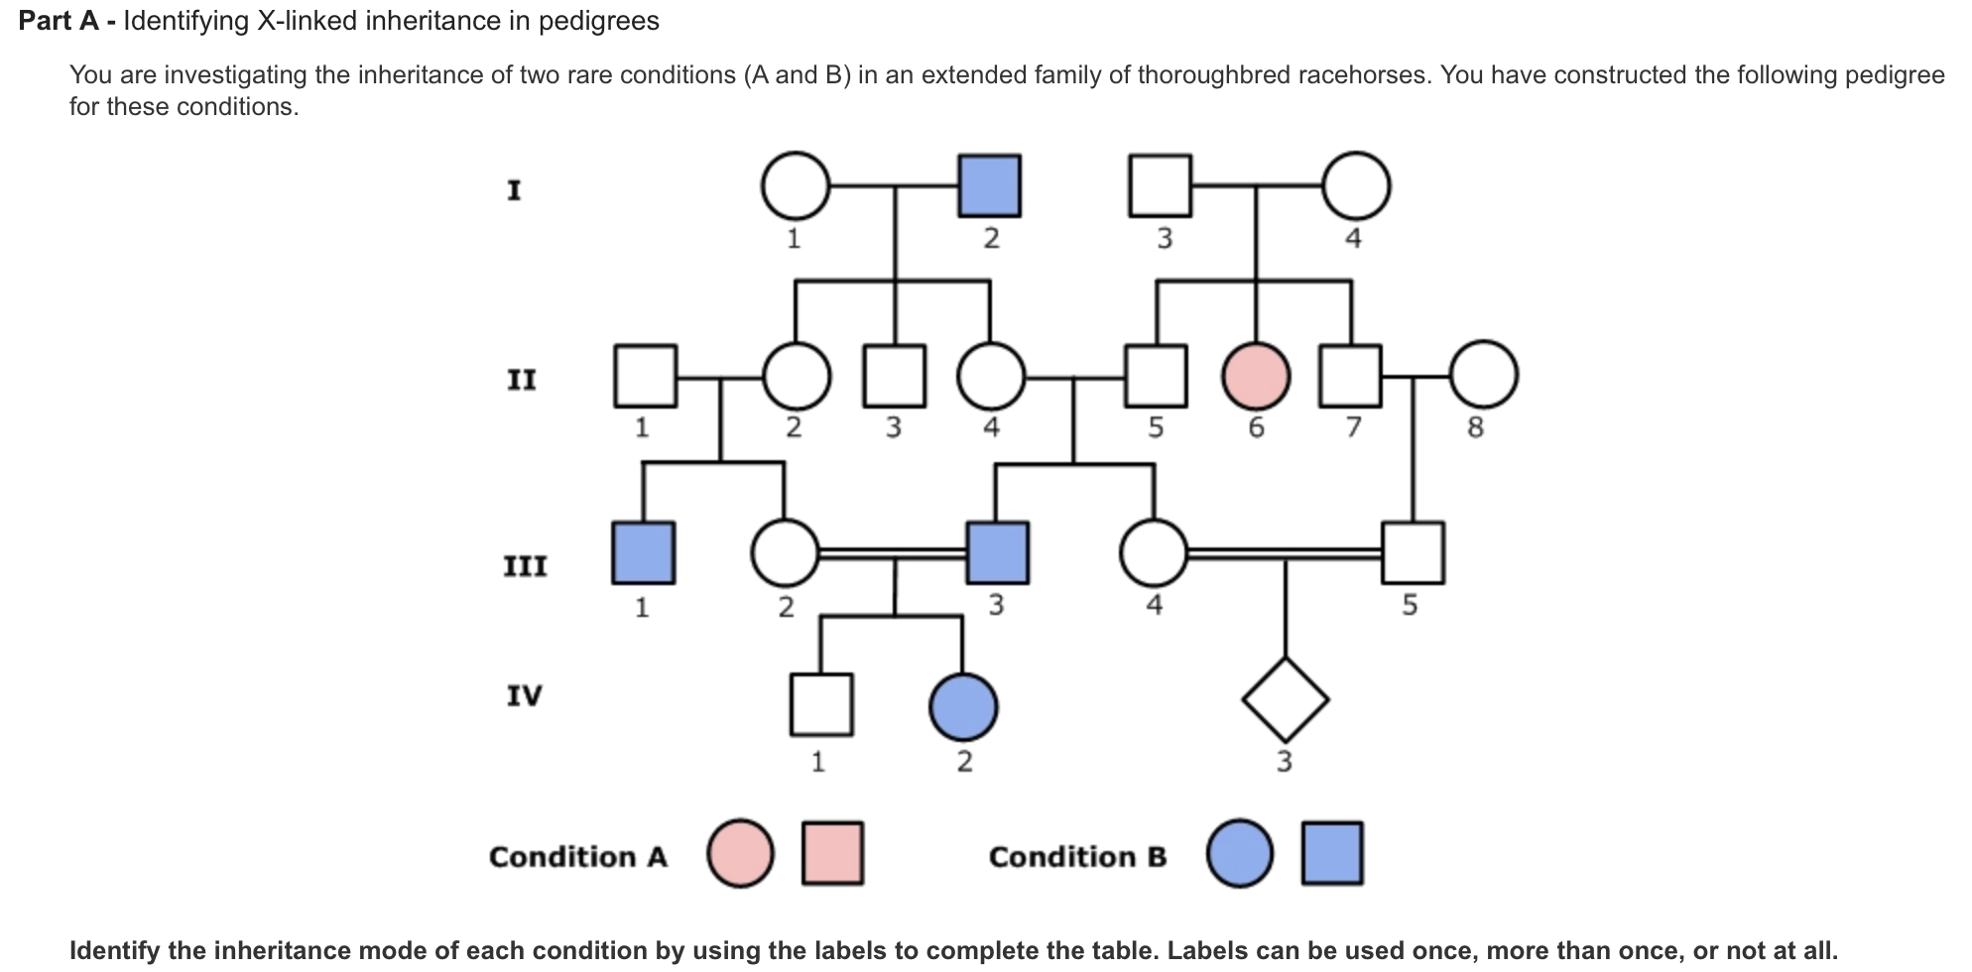
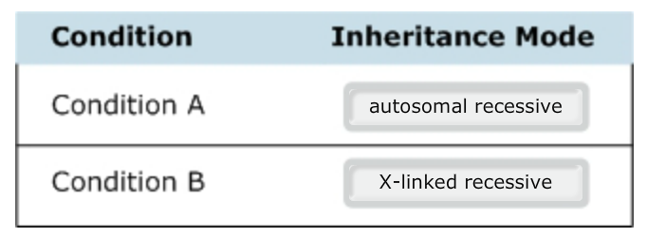

Slide 61
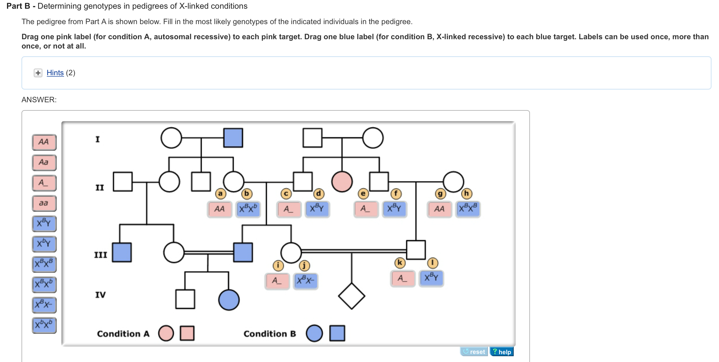

Slide 62
3

Slide 64
G2, Meiosis I
S
Citokinesis I
G1
Meiosis II
Fecundacion
-Diploide-
Citokinesis II
--- 1 sola cromatida-----
----Haploide---
2n

Slide 65
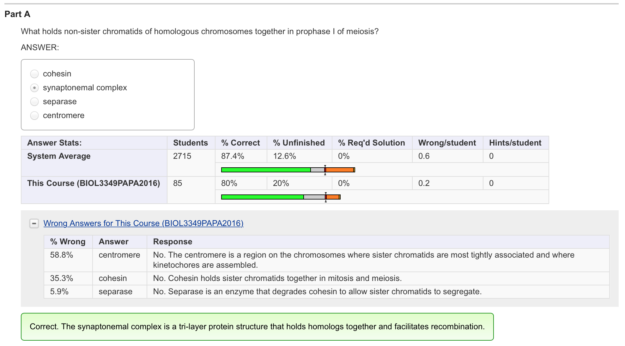

Slide 66
