Slide 1
4

Slide 2
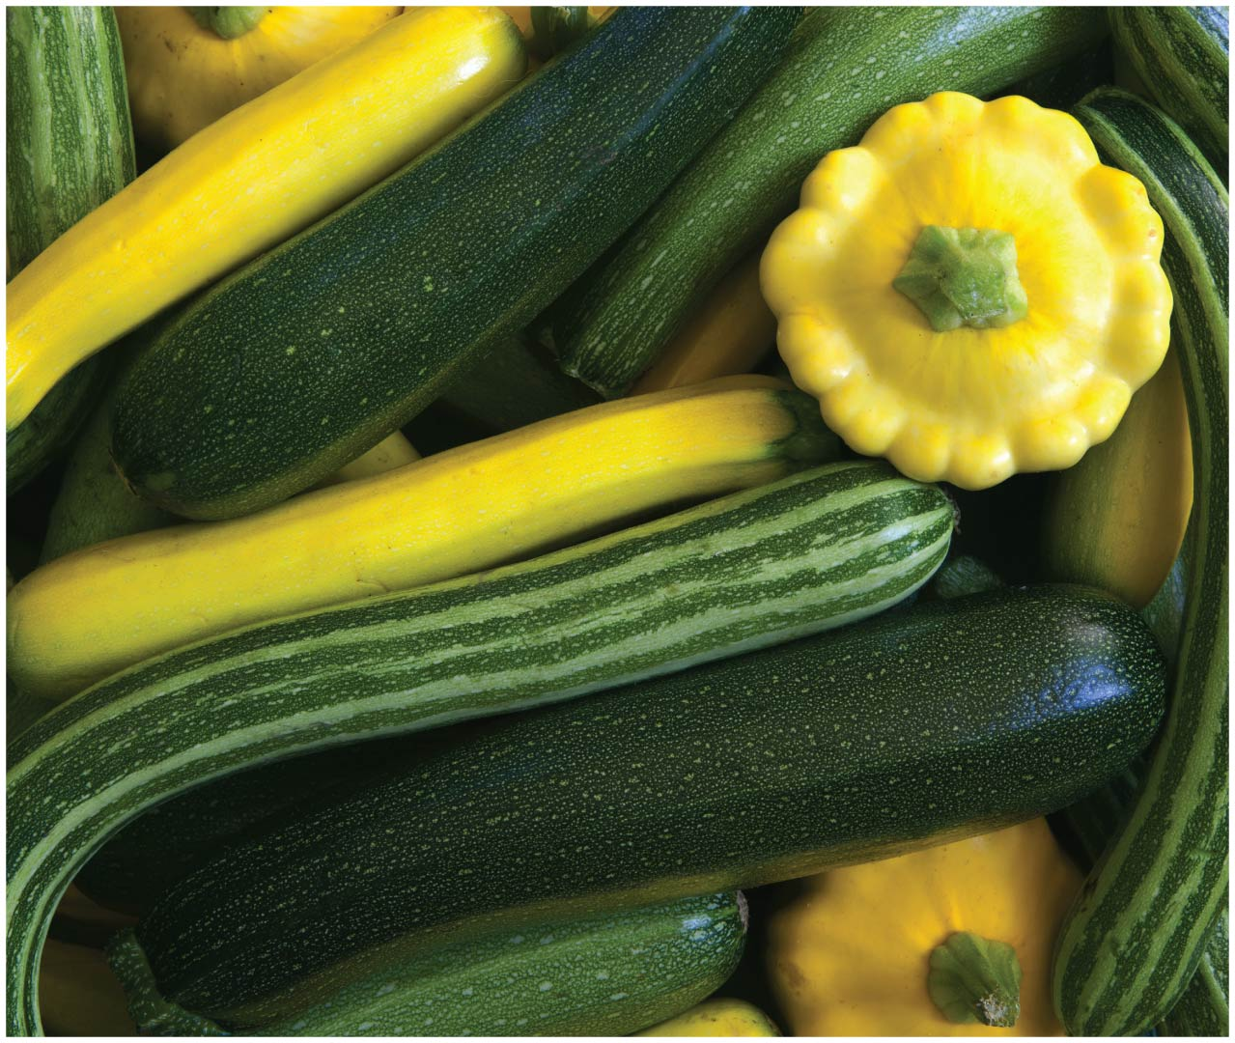
Chapter 4 Opener

Slide 3
Gene interaction
Alleles, mutations and gene product
Dominance, codominance, incomplete penetrance
Lethal alleles
Sex determined traits

Slide 4
Gene Interaction
The phrase gene interactions refers to the ways genes collaborate or interact to influence a phenotype
There are several important types of interactions:
Between alleles: There may be more than two alleles for a given locus within a population. However, dominance of one allele over another may not be complete
Between genes: Two or more genes may affect a single trait. The expression of a trait may depend on the interaction of more than one gene and/or the interaction of genes with nongenic factors

Slide 5
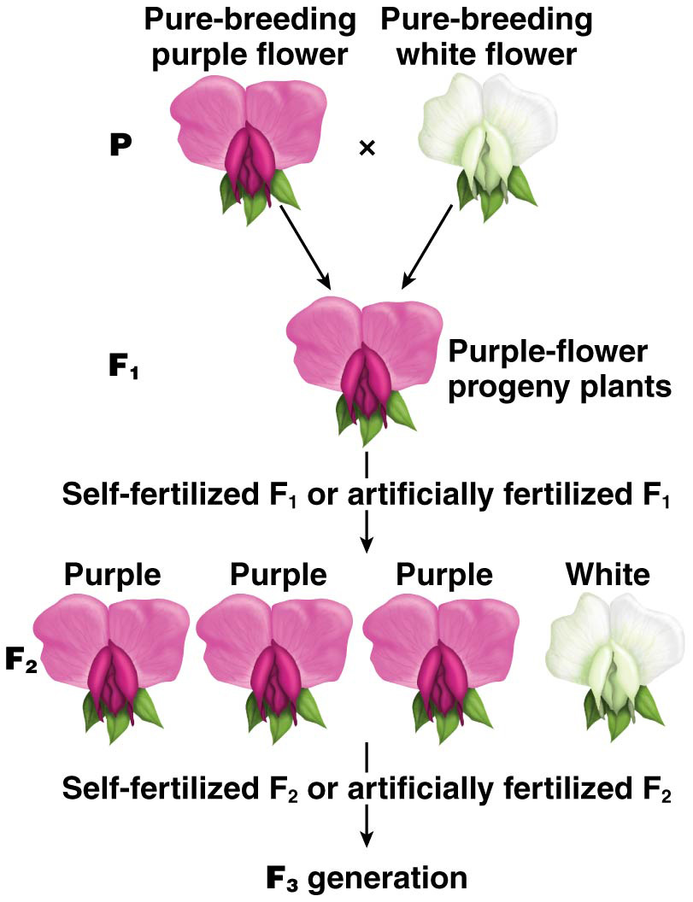
The Molecular Basis of Dominance
The terms dominant and recessive have a phenotypic basis
In Mendel experiments each case one form was completely dominant over the other, such that individuals heterozygous for the two alleles showed the dominant phenotype
However, the dominance of one allele over another is determined by the protein product of that allele
The overall phenotype is the consequence of the activities of the protein products of the alleles of the gene

Slide 6
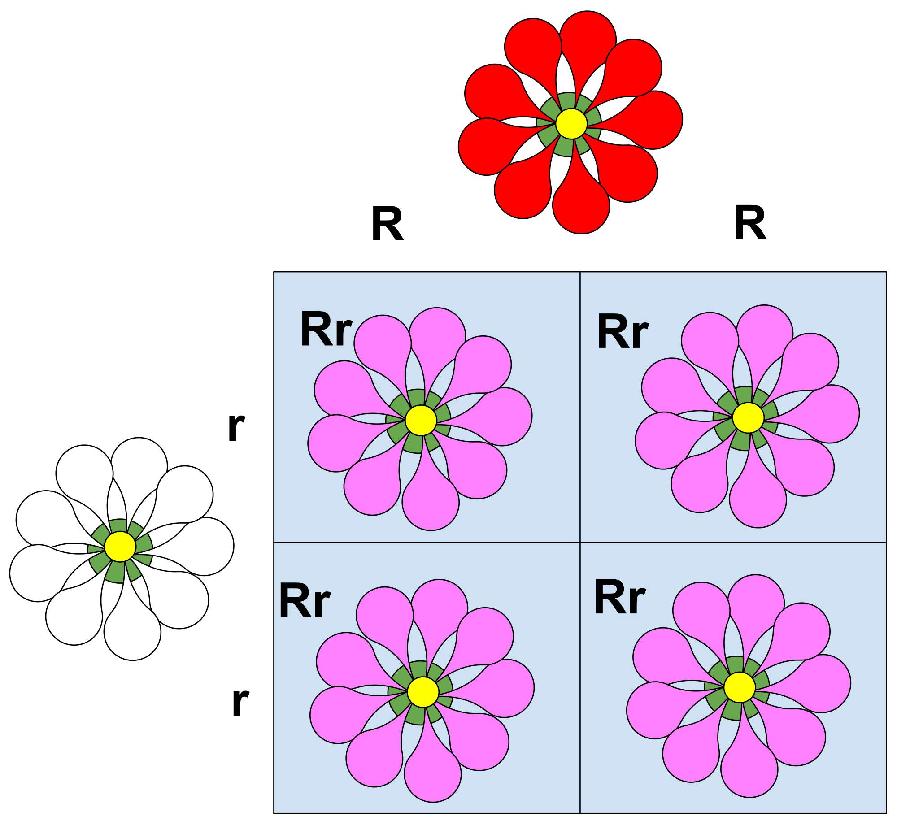
Incomplete Dominance
Often the dominance of one allele over the other is not complete; in this case, allele designations such as A¹, A² or B¹, B² are used instead of A, a or B, b
Incomplete dominance, or partial dominance, is when heterozygous individuals display intermediate phenotypes between either homozygous type
Typically the heterozygote is more similar to one of the homozygous types than the other

Slide 7
Codominance
Codominance leads to heterozygotes with a different phenotype than that of either homozygote
More than one pattern of dominance may exist between different alleles of a gene, for example, ABO blood type

Slide 8
Dominance Relationships of ABO Alleles
The ABO blood type has four different types, resulting from different combinations of three alleles
The alleles are I^{A}, I^{B}, and i; the I^{A} and I^{B} alleles are completely dominant over the i allele but codominant with each other
Blood type A involves the presence of one antigen on the blood cell surfaces; type B the presence of a different antigen
Type AB people have both antigens and type O people have neither

Slide 9
Blood Types and Genotypes
Type A: I^{A}I^{A} or I^{A}i (Complete dominant)
Type B: I^{B}I^{B} or I^{B}i (Complete dominant)
Type AB: I^{B}I^{A} (Codominant)
Type O: ii

Slide 10
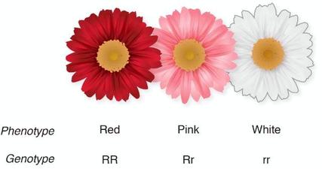
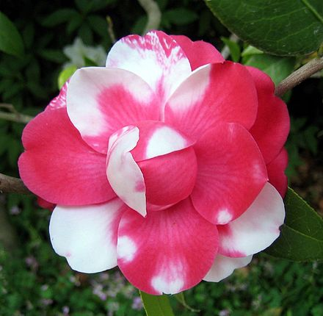
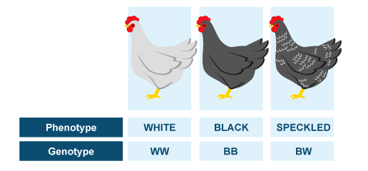
Incomplete Dominance: Mendel observed that there was no blending of alleles in inheritance (e.g., lavender flowers resulting from a cross between purple and white flowers). However, some traits do blend together. Another way of saying this is that heterozygous organisms express phenotypes with characteristics of both the dominant and the recessive allele. Some flowers exhibit incomplete dominance.
Co-dominance: occurs when the contributions of both alleles are visible in the phenotype. In some cases, neither allele is dominant over the other, but they also do not blend together. In offspring expressing co-dominant traits, both traits are expressed equally. Another way of saying this is to say that in co-dominance, there are three phenotypes: two separate phenotypes and a third in which the other two phenotypes appear together.

Slide 11
The Effects Of Mutations

Slide 12
Example 1: Mutant Allele Recessive to Wild Type
A wild-type allele (R⁺) produces an active enzyme (50 units), and a mutant allele (r) produces little or no active enzyme (0 units)
40 or more units of enzyme activity will produce a wild-type phenotype, thus R⁺R⁺ (100 units) or
R⁺r (50 units) individuals are wild type
r/r individuals (0 units) have the mutant phenotype; thus the mutant allele is recessive

Slide 13
Example 2: Mutant Allele Dominant to Wild Type
An allele (T₁) produces an active enzyme (10 units), and a mutant allele (T₂) produces less active enzyme (5 units)
18 or more units of enzyme activity will produce a wild-type phenotype, thus only T₁T₁ (20 units) individuals will be wild type
T₁T₂ (15 units) and T₂T₂ (10 units) individuals have a mutant phenotype because neither produces enough enzyme

Slide 14
Effects of Mutation
Mutant alleles can be:
Loss-of-function, in which there is a significant decrease or complete loss of functional gene product
Gain-of-function, in which the gene product acquires a new function or expresses increased wild-type activity

Slide 15
Loss-of-Function Mutations
Loss-of-function mutations:
1) Can produce no functional gene product ( also called null mutations, or amorphic mutations), are often lethal when homozygous
2) Can produce a partial loss of function (leaky mutations or hypomorphic mutations), the change in the phenotype depends on the level of activity of the leaky mutation

Slide 16
The functional consequences of mutation.

Slide 17
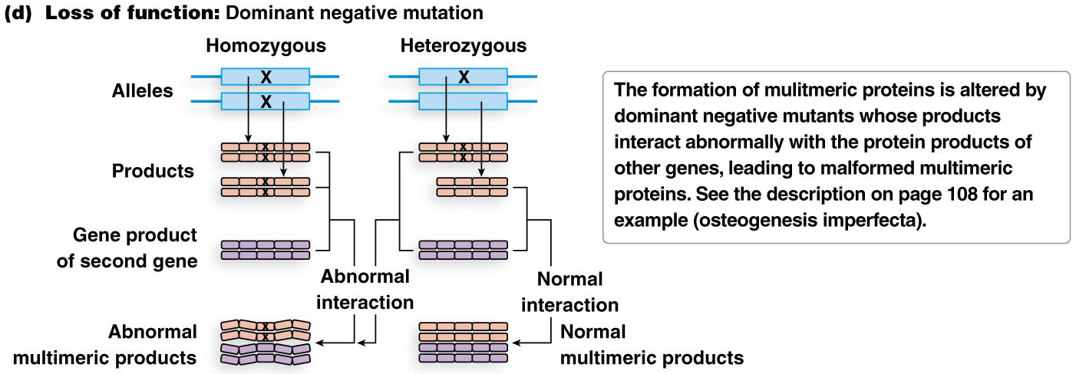
Dominant Negative Mutations
Multimeric proteins, composed of two or more polypeptides that join together to form a functional protein, are particularly subject to dominant negative mutations. These mutations are dominant due to loss of function of the multimeric protein, which results from an amino acid change in one subunit. They effect on the protein as a whole

Slide 18
Gain-of-Function Mutations
Gain-of-function mutations are:
Hypermorphic mutations produce more gene activity than normal
Neomorphic mutations acquire novel gene activities not found in the wild type

Slide 19
The Importance of Alleles

Slide 20
Allelic Series
In populations the number of alleles is theoretically unlimited and some genes have many. A locus with more than two alleles is said to have multiple alleles
One of the best example is the color coat in mammals

Slide 21
The C-Gene System for Mammalian Coat Color
Many genes are required to produce and distribute pigment to the hair follicles or skin cells, where they give rise to skin or coat color
The C gene is responsible for coat color in mammals like cats, rabbits, and mice
It produces an enzyme active in the production of melanin
The gene has dozens of alleles, but four that form an allelic series are discussed

Slide 22
The Allelic Series of the C Gene (in rabbits)
C, c^{ch}, c^{h}, c
The wild-type allele, C, produces a functional enzyme and full coat color
c^{ch} produces a “dilute” phenotype called chinchilla
c^{h} produces a phenotype called Himalayan with little pigment on the body but full color on the extremities
c is a fully recessive null allele and produces an albino phenotype

Slide 23
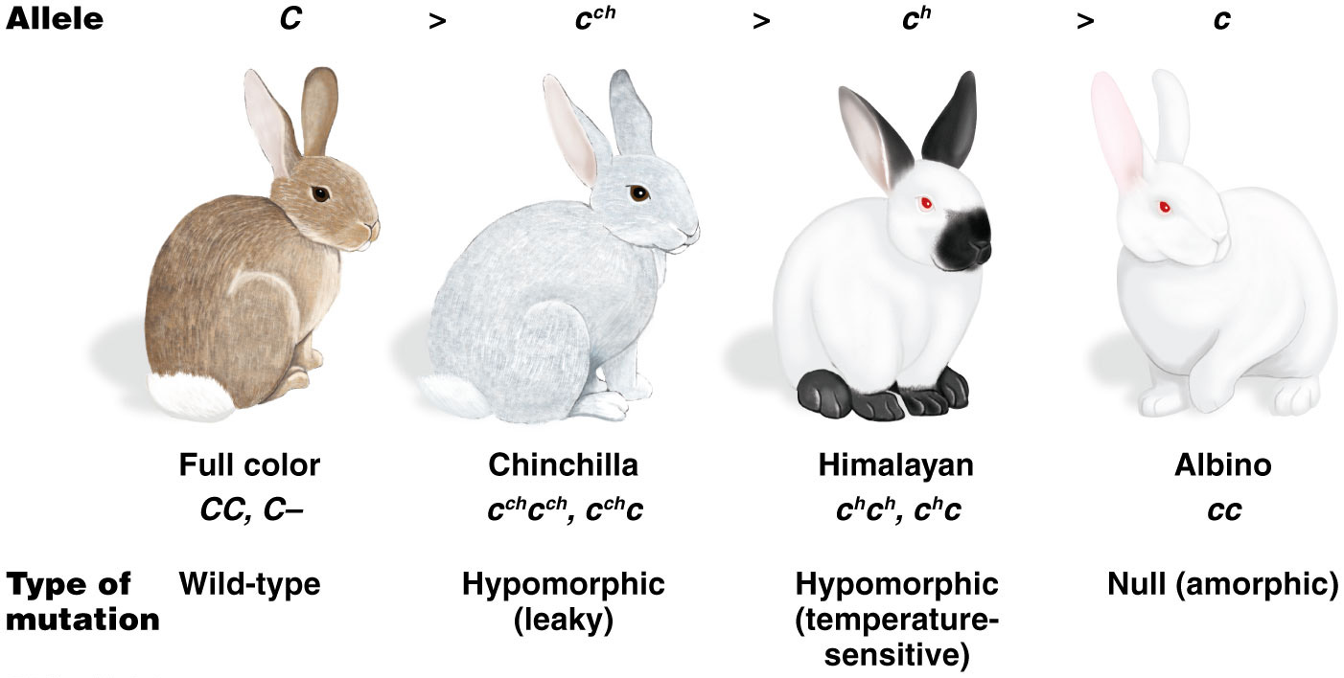
Figure 4.5 Allelic series for coat-color determination in mammals.

Slide 24
Dominance Relationships in the Allelic Series
Crosses among different genotypes has revealed the dominance relationship of the alleles
The C allele is dominant over all the others
The c^{ch} allele is partially dominant (incomplete dominance) over c^{h}
All the alleles are dominant over the c allele

Slide 25
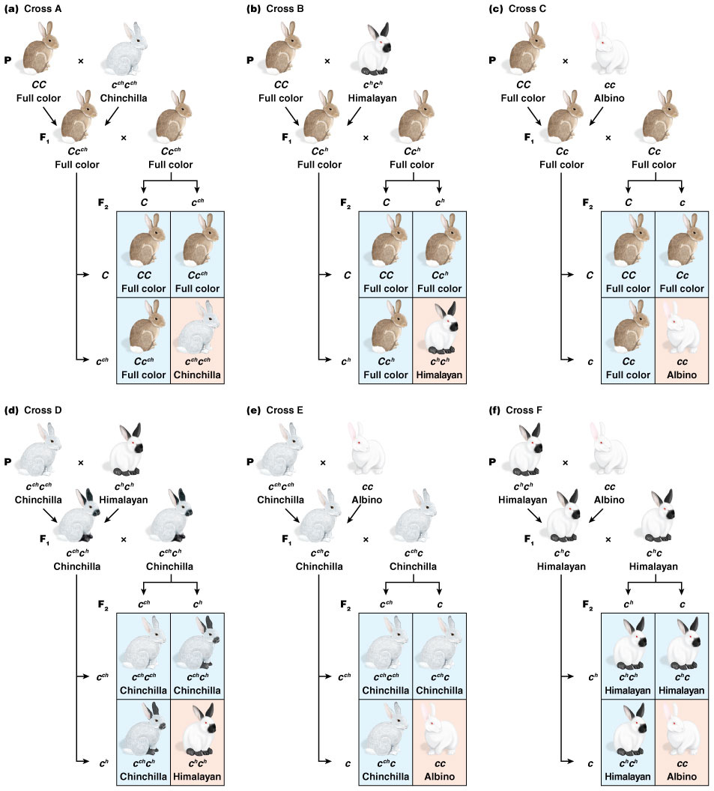
Figure 4.6 The genetics of C-gene dominance.
C_Dominant
C_Dominant
C_Dominant

Slide 26
Figure 4.6 The genetics of C-gene dominance.
C^{ch}C^{h}
Co-dominance
C^{ch}c
dominance
C^{h}c
dominance

Slide 27
Lethal Alleles
Some single-gene mutations are so detrimental that they cause death in the organism
These are caused by lethal mutations, which are inherited as recessive alleles (only the homozygotes die)
Lethal alleles can be detected as distortions in segregation ratios caused by one or more missing classes of progeny

Slide 28
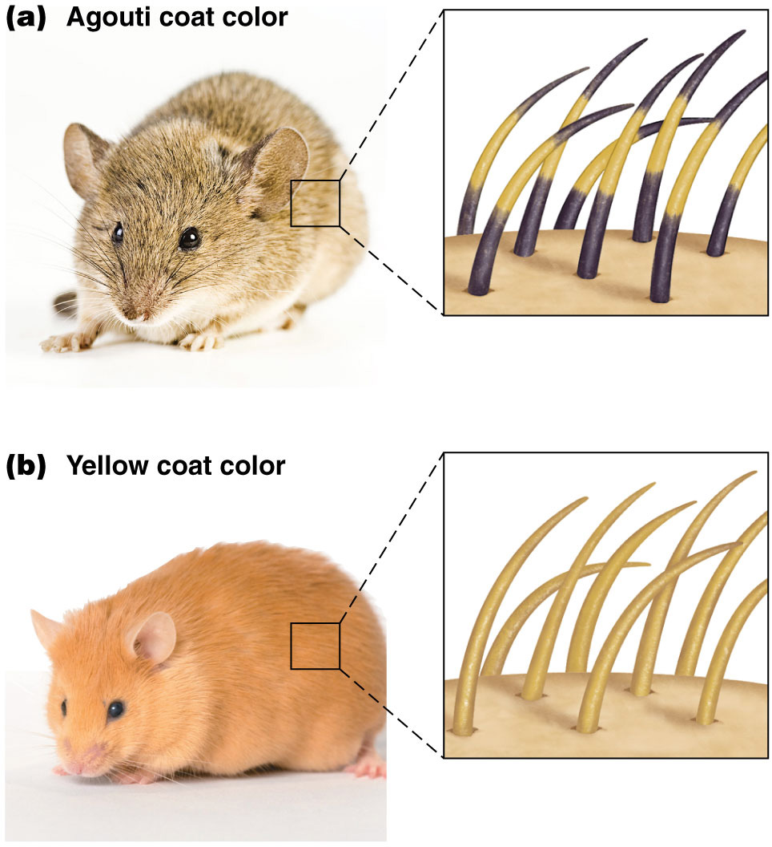
Lethal Alleles: The Agouti Locus
In mice, wild-type coat color is agouti A, produced by a combination of yellow and black pigments along each hair
The mutant allele of agouti, A^{Y}, is dominant and causes yellow pigment to be deposited along the entire hair, resulting in a yellow coat
The A^{Y} allele is a recessive embryonic lethal, so all yellow mice are heterozygous…..Can you tell me why?

Slide 29
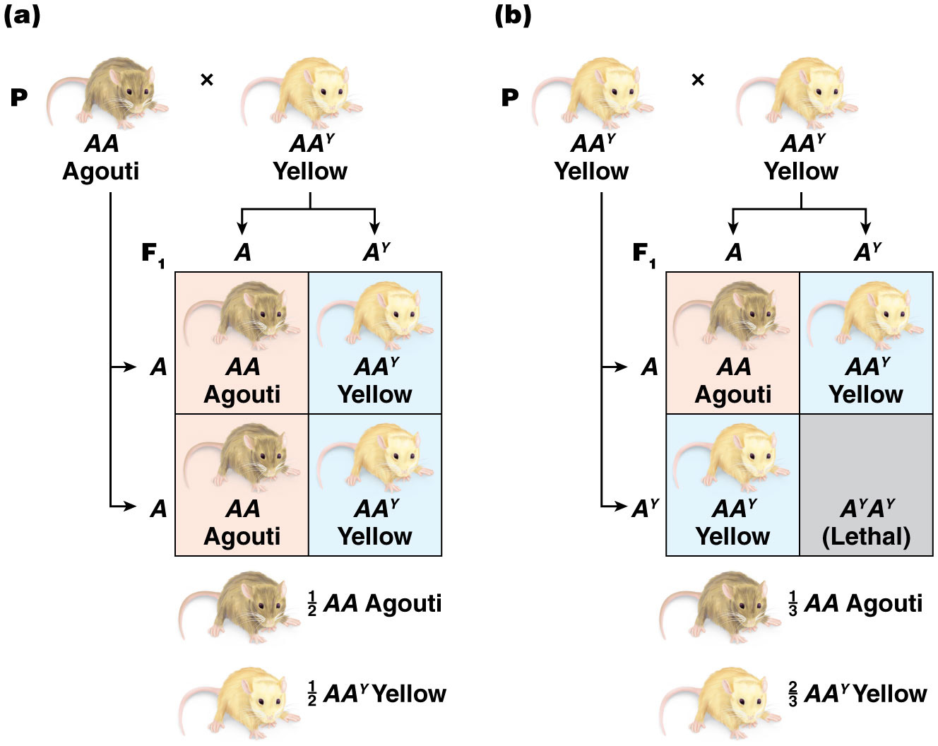
Figure 4.9 Dominance and lethality of A^{Y}.

Slide 30
Molecular Basis of the A^{Y} Lethality
The A^{Y} mutation is caused by a deletion that affects two genes, Agouti and Raly
Raly produces a protein essential for mouse development; the deletion connects the Raly promoter to the Agouti gene
homozygotes die due to lack of the Raly protein

Slide 31
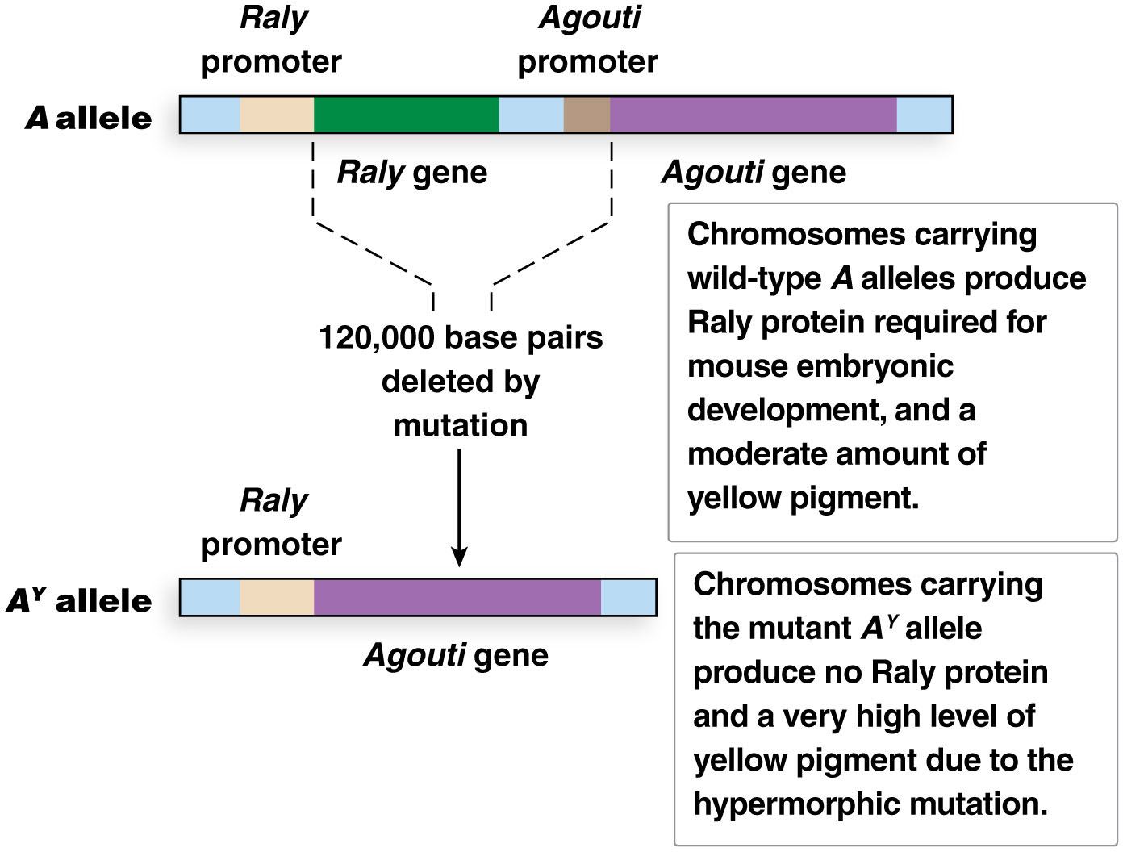
Figure 4.10 Mutation of Raly and Agouti producing yellow coat.
DELETION

Slide 32
Delayed Age of Onset
Dominant lethal alleles can sidestep natural selection if they have a delayed age of onset
The abnormalities they produce are not expressed until after the affected individual has reproduced
A prominent example is Huntington disease (HD), a fatal neurodegenerative disorder that does not usually show symptoms until the late thirties or early forties. They do not effect distortions in segregation ratios

Slide 33
Sex Limited Traits

Slide 34
Sex-Limited Traits
The sex of an organism can influence gene expression
Sex-limited gene expression is a pattern of expression limited to one sex or the other
The traits involved are called sex-limited traits; both sexes carry the genes for such traits, but they are expressed in just one sex

Slide 35
Sex-Limited Traits: Examples
Mammalian breasts and ability to produce milk are female-specific traits
Horn development is limited to males in some sheep, cows, and other hoofed animals
Behavioral traits, especially related to mating behaviour, are strongly influenced by sex
Sex hormones differentially influence expression of genes related to these and other sex-limited traits

Slide 36
Sex-Influenced Traits
Sex-influenced traits are those in which the phenotype corresponding to a particular genotype differs depending on the sex of the organism
A chin beard in certain goat breeds is an example:
In both sexes, B₁B₁ individuals are beardless and B₂B₂ individuals are bearded
Androgenic hormones influence phenotype of B₁B₂ individuals
B₁B₂ males are bearded, whereas B₁B₂ females are beardless

Slide 37
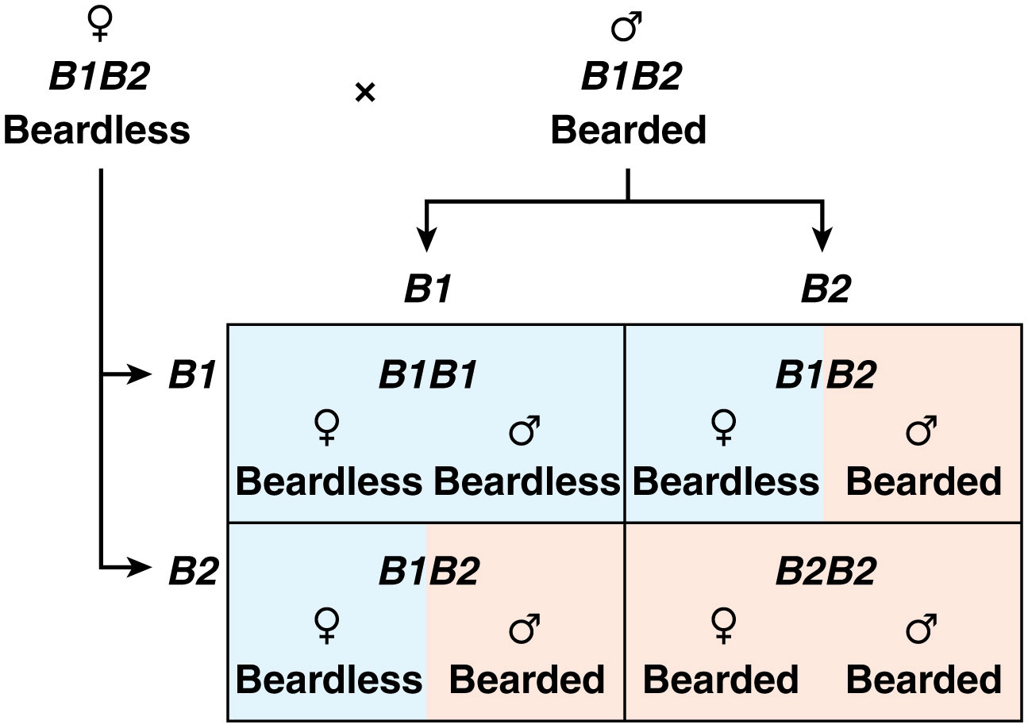
Figure 4.11 Sex-influenced inheritance of beard appearance in goats.

Slide 38
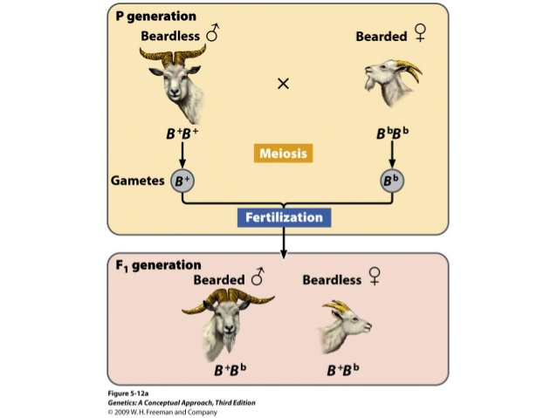
B⁺B⁺ = B²B²
B^{b}B^{b} = B¹B¹

Slide 39
Variable Phenotype but Identical Genotype! MORE COMPLEX GENETIC CONTROL

Slide 40
Same genotype control different phenotype:
incomplete penetrance
variable expressivity
gene environment interaction
pleiotropy

Slide 41
4.2 Some Genes Produce Variable Phenotypes
Interpretation of genotypic and phenotypic ratios is based on the assumption that there is a strict correlation between phenotype and genotype
In some cases, however, different phenotypes can result from the same genotype
Incomplete penetrance and variable expressivity can complicate interpretation of genotypic and phenotypic ratios

Slide 42
Incomplete Penetrance
An organism is penetrant for a trait when the phenotype is consistent with the genotype
An organism that does not produce the phenotype generally associated with the genotype is nonpenetrant
Traits in which nonpenetrant individuals occasionally or routinely occur are said to display incomplete penetrance

Slide 43
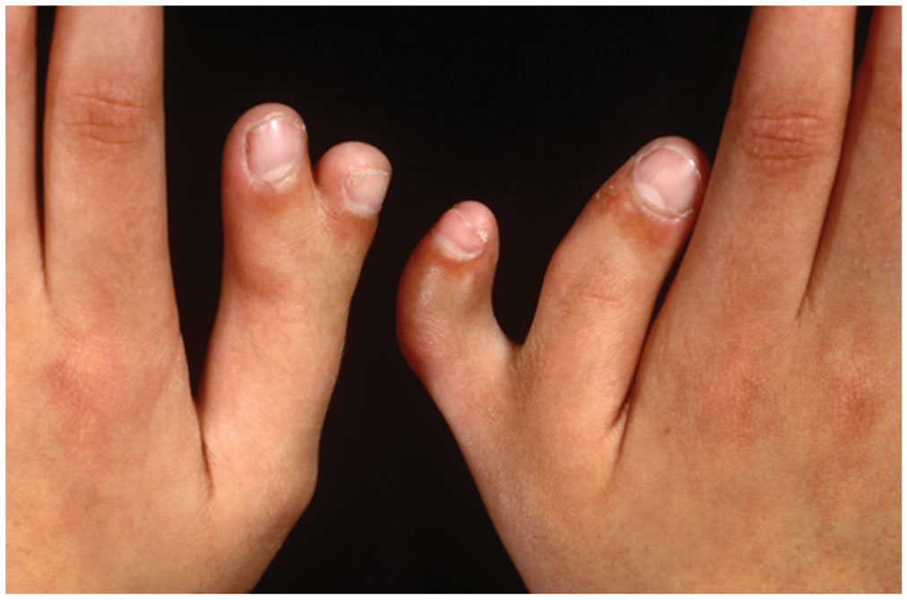
Incomplete Penetrance: Polydactyly
Polydactyly is an autosomal dominant condition in which affected individuals have more than five fingers and toes
The most common alternative number of digits is six
The dominant allele is nonpenetrant (do not express the phentype) in about 25–30% of individuals carrying it

Slide 44
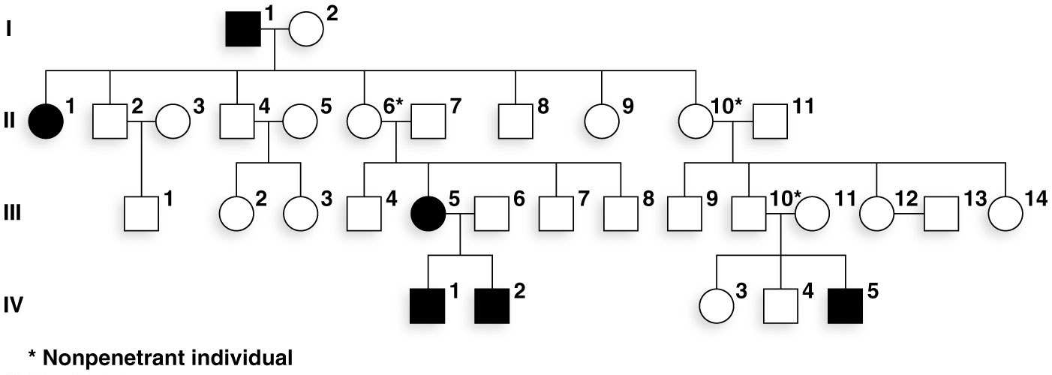
Figure 4.14 Incomplete penetrance for polydactyly. Three nonpenetrant individuals (II-6, II-10, and III-10) are seen in this family.

Slide 45
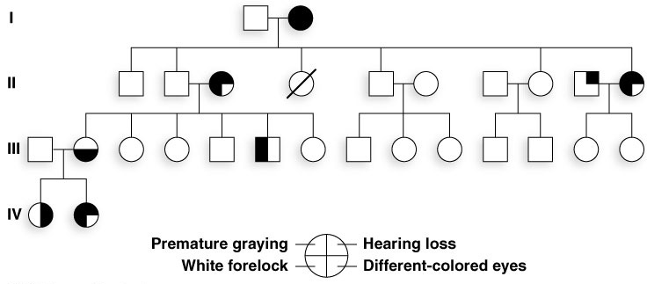
Variable Expressivity
In variable expressivity individuals who carry the alleles for a trait show a phenotype but to a varying degree of severity or form of expression
Waardenburg syndrome has four principal features
Each family member with Waardenburg syndrome has the same genotype but may show a different combination of symptoms

Slide 46
Gene–Environment Interactions
Genes alone are not responsible for all the variation seen among organisms
Gene–environment interactions are the result of the influence of the environment on the expression of genes and on the phenotype of the organism

Slide 47
Environmental Modification to Prevent Hereditary Disease
The human autosomal recessive condition PKU (phenylketonuria) is caused by the absence of an enzyme involved in phenylalanine breakdown
Infants with PKU are normal at birth, but over time, the inability to break down phenylalanine is toxic to developing neurons
PKU is one of the hereditary disorders infants are routinely screened for

Slide 48
Preventing Symptoms of PKU
The key to preventing PKU is restricting phenylalanine in the diet of infants found to have PKU
Thousands of people with PKU are living normal lives due to the simple dietary modification that prevents the expression of the PKU phenotype

Slide 49
Pleiotropic Genes
Pleiotropy through action of a mutant protein product is often seen in studies of development
For example, in Drosophila the hormone called juvenile hormone influences numerous attributes of development and reproduction such as body size, development time, sexual maturity, and others
Pleiotropy: single gene controlling multiple (two or more) traits. Is the alteration of multiple distinct traits by a mutation in a single gene

Slide 50
Pleiotropy in Sickle Cell Disease
Sickle cell disease is an autosomal recessive condition caused by a mutation in the β-globin gene
Many red blood cells of people with sickle cell disease take on a sickle shape and cause numerous physical problems and complications

Slide 51
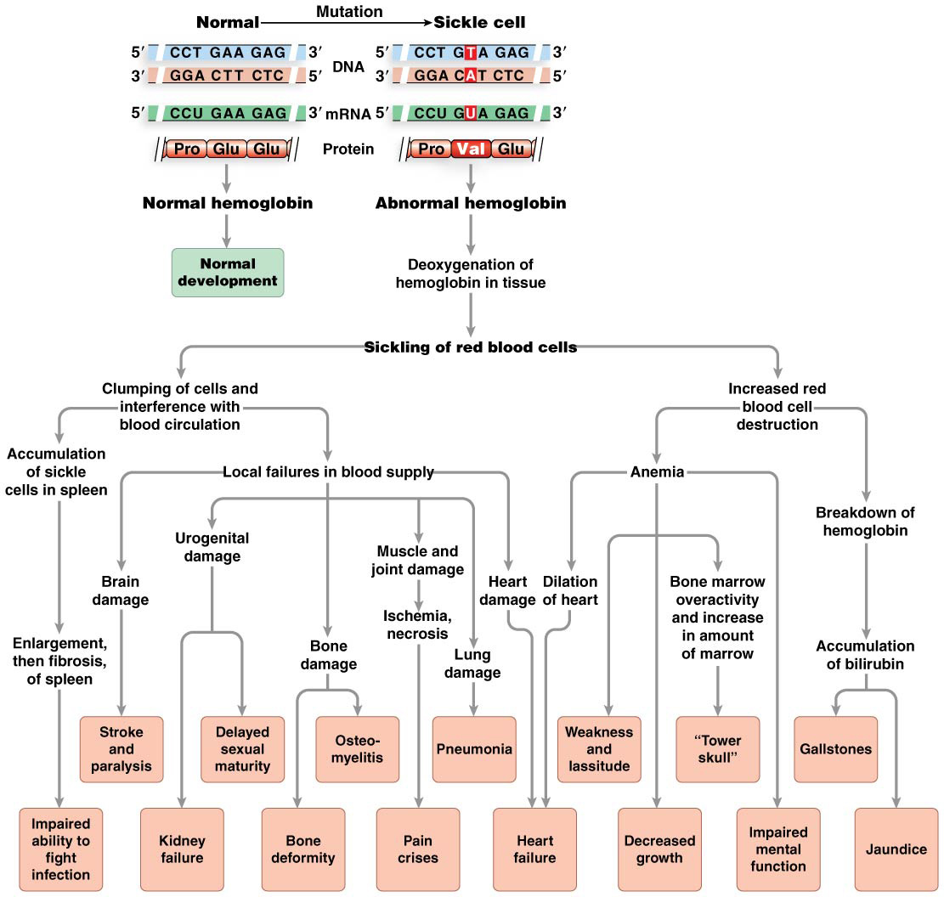
Figure 4.16 Pleiotropy in sickle cell disease.

Slide 52
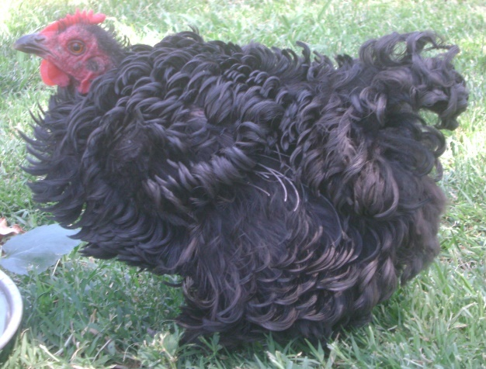
Chickens and the Frizzle Trait
In 1936, researchers Walter Landauer and Elizabeth Upham observed that chickens that expressed the dominant frizzle gene produced feathers that curled outward rather than lying flat against their bodies (Figure 2). However, this was not the only phenotypic effect of this gene — along with producing defective feathers, the frizzle gene caused the fowl to have abnormal body temperatures, higher metabolic and blood flow rates, and greater digestive capacity. Furthermore, chickens who had this allele also laid fewer eggs than their wild-type counterparts, further highlighting the pleiotropic nature of the frizzle gene.

Slide 53
Genes interact among each other to produce a phenotype

Slide 54
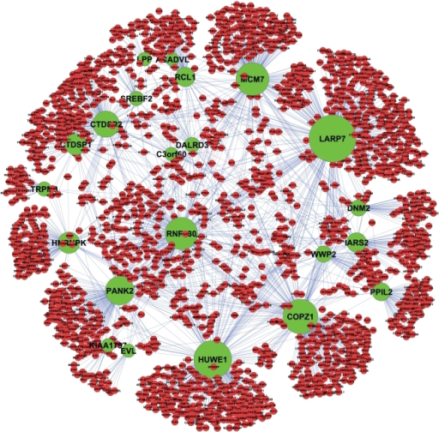
4.3 Gene Interaction Modifies Mendelian Ratios
Genes work together to build the complex structures and organ systems of plants and animals
The collaboration of multiple genes in the production of a single phenotypic characteristic or group of related characteristics is termed gene interaction

Slide 55
Gene Interaction in Pathways
Single-gene trait describes an inherited variation of a gene that can produce a mutant phenotype
However, this is not a complete depiction of genetic reality
For example, numerous genes contribute to the normal red eye color of Drosophila, including those responsible for production of eye pigments or transport proteins

Slide 56
Three Genes Involved in Drosophila Eye Color
The brown gene produces an enzyme in a pathway that synthesizes a bright red pigment; mutant flies, bb, have brown eyes
The vermillion genes produces an enzyme in a pathway that synthesizes a brown pigment; mutant flies, vv, have bright red eyes
The white gene encodes a transporter that carries pigment to the eye; flies that do not produce this protein have white eyes

Slide 57
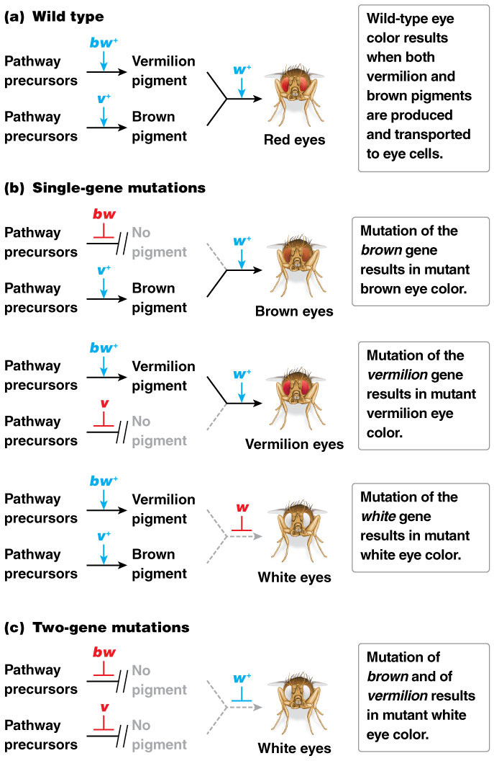
Figure 4.18 Interacting genes control eye color in Drosophila.

Slide 58
Four Distinct Types of Genetic Pathways
Biosynthetic pathways involve networks of interacting genes building complex compounds as the end product
Degradation pathways involve networks of interacting genes that break down compounds into intermediate compounds
Signal transduction pathways receive chemical signals from outside a cell and initiate a response inside the cell
Developmental pathways direct growth, development, and differentiation of body parts and structures

Slide 59
The One Gene–One Enzyme Hypothesis
George Beadle and Edward Tatum were among the first to investigate biosynthetic pathways, and laid the groundwork for later examination of genetic pathways
Their proposal, the one gene–one enzyme hypothesis, came out of their experiments
Each gene produces an enzyme, and each enzyme has a specific role in a biosynthetic pathway that produces the phenotype

Slide 60
More Recent Adjustments to the Hypothesis
Some genes produce transport molecules, structural, or regulatory proteins, rather than enzymes
Some genes produce RNAs rather than proteins
Some proteins (e.g., β-globin) must join with other proteins to acquire a function

Slide 61
Epistasis: Gene Interaction and Phenotype Effects

Slide 62
Epistasis and Its Results
Did you know that genes can mask each other's presence or combine to produce an entirely new trait?
Epistasis describes how gene interactions can affect phenotypes. Genes work together to produce the end product
Mutation of one gene in a pathway may prevent the production of the end product
Gene interaction can lead to altered phentoypic ratios of wild-type and mutant progeny

Slide 63
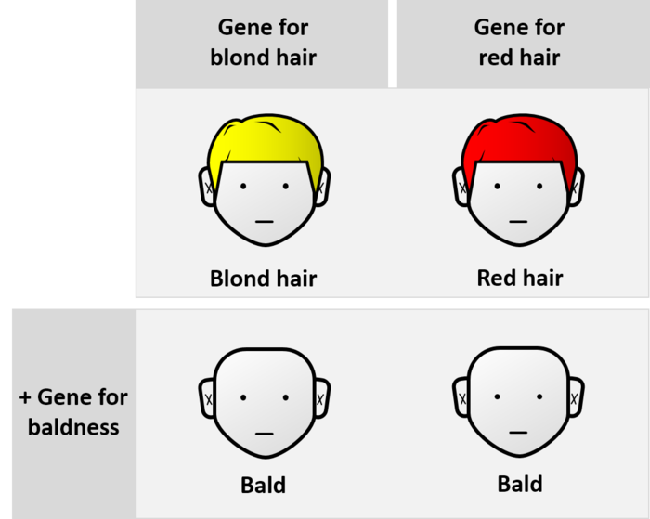
Epistasis
Epistasis: an allele of one gene modifies or prevents expression of alleles at another gene

Slide 64
Epistatic Interactions
A minimum of two genes are required for epistatic interactions; these usually participate in the same pathway
Epistasis is readily detected among progeny of dihybrid crosses involving genes with both dominant and recessive alleles
There are six ways epistasis could affect the predicted 9:3:3:1 dihybrid ratio

Slide 65
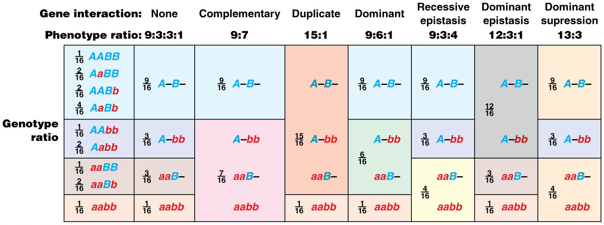
Figure 4.20 Patterns resulting from epistatic gene interaction.

Slide 66
No Interaction (9:3:3:1 Ratio)
The expected 9:3:3:1 ratio is seen in the absence of epistasis: when the genes do not interact to change the expression of one another
For example, crosses involving the genes contributing for the Mendel peas color and shape or for feather color in budgerigar parakeets (“budgies”)
When pure-breeding blue budgies (BByy) are crossed to pure-breeding yellow budgies (bbYY), the F₁ all have wild-type green feathers (BbYy)

Slide 67
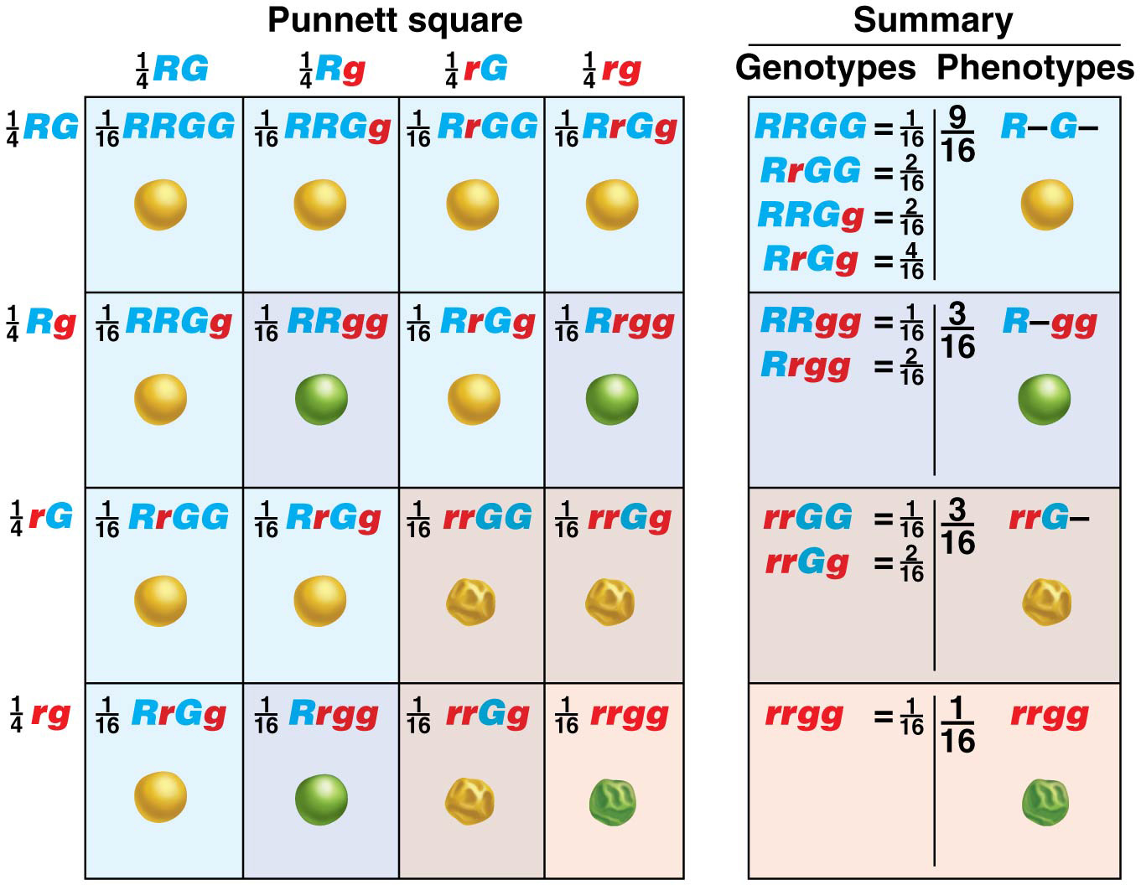

Slide 68
Results of F₁ × F₁
When the F₁ are interbred, the F₂ are:
9/16 wild type, green feathers
3/16 blue feathers
3/16 yellow feathers
1/16 white feathers
The results show that the genes are not undergoing epistatic interaction with one another

Slide 69
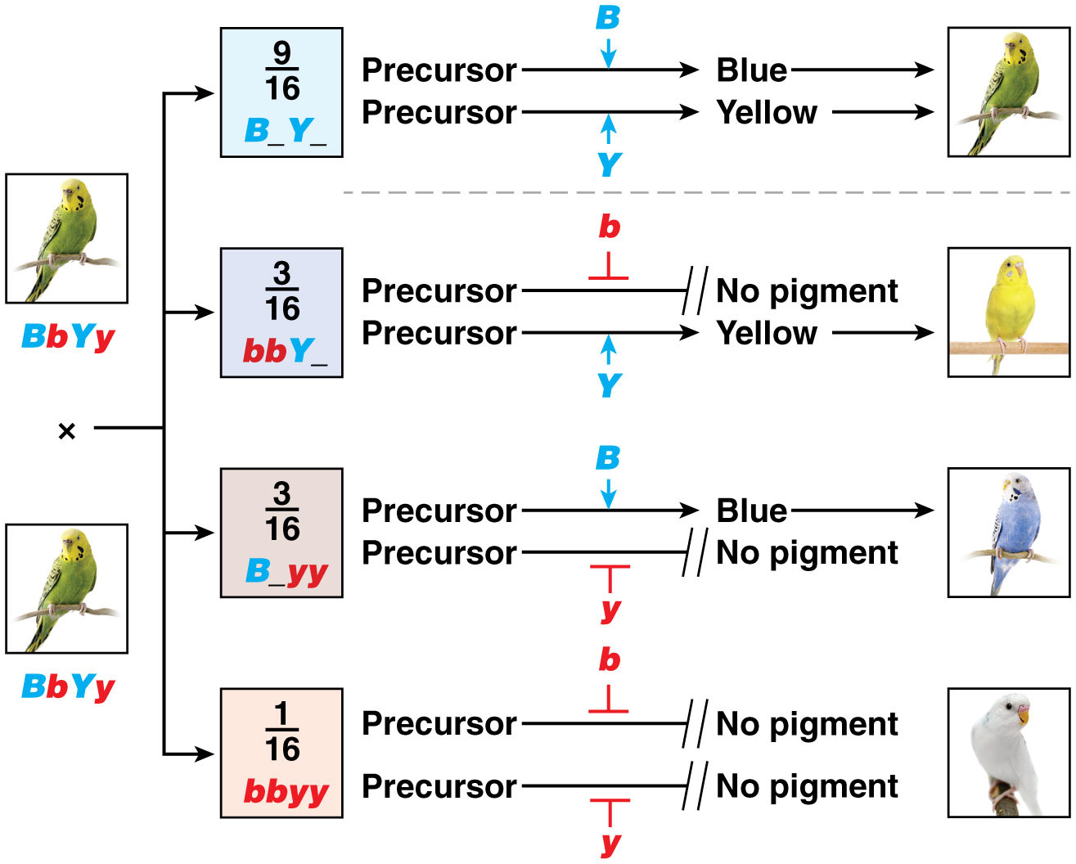
Figure 4.21 No gene interaction in the production of feather color in budgerigar parakeets.

Slide 70
Complementary Gene Interaction (9:7 Ratio)
Two genes interact to produce the overall flower color; when genes work in tandem to produce a single gene product, the process is called complementary gene interaction
Only when you have both “dominant” alleles at the two genes you have the phenotype

Slide 71
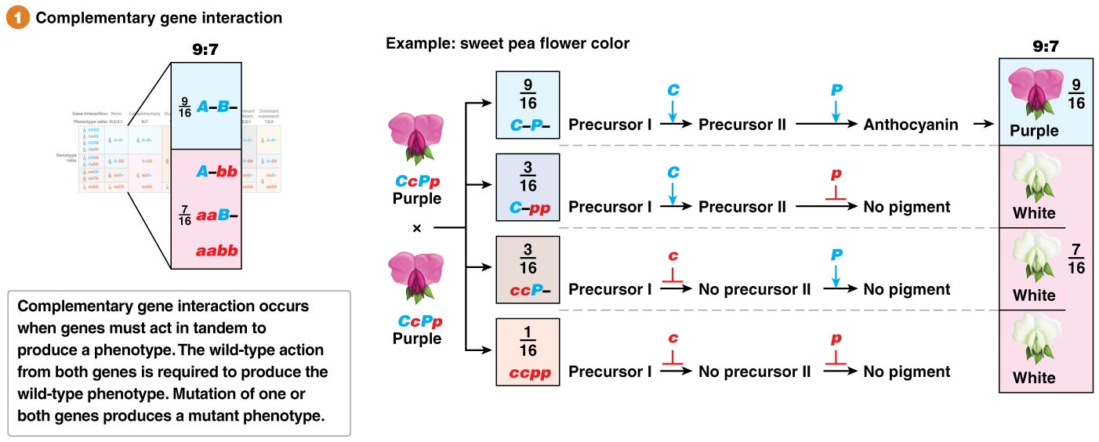
Complementary Gene Interaction (9:7 Ratio)

Slide 72
Duplicate Gene Action (15:1 Ratio)
Two genes that duplicate each other’s activity constitute a redundant system in which a dominant allele at either locus gives rise to a wild-type phenotype. The genes in a redundant system have duplicate gene action; they encode the same product, or they encode products that have the same effect in a pathway or compensatory pathways
One“dominant” alleles at one of the two genes is sufficient to express the phenotype

Slide 73
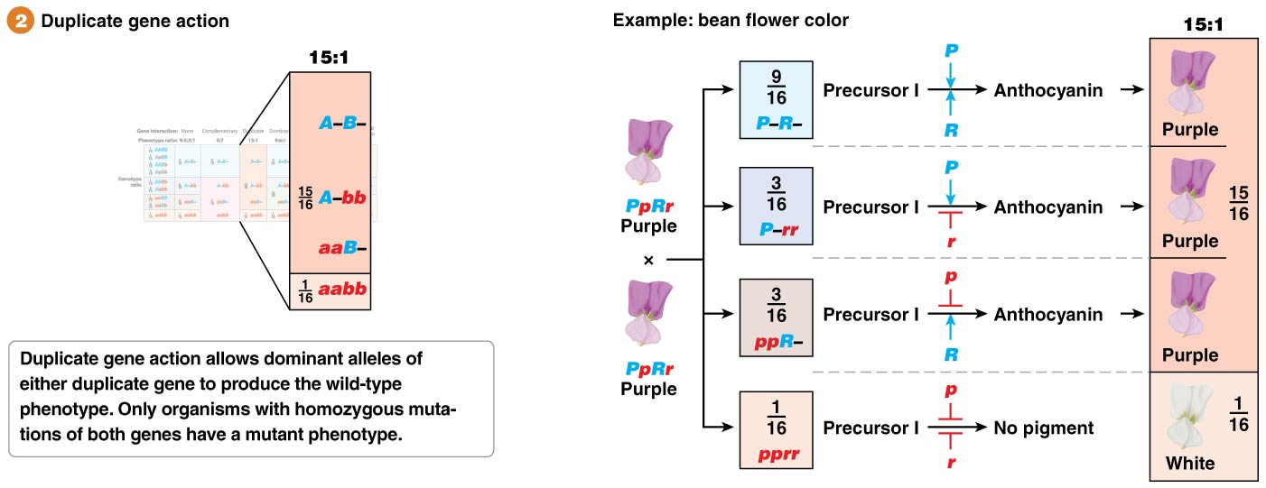
Duplicate Gene Action (15:1 Ratio)

Slide 74
Dominant Gene Interaction (9:6:1 Ratio)
Plants that have one or two dominant alleles for just one of either of the genes will have round fruit and those with only recessive alleles of both genes will have long fruit
Different allelic combination at the two genes determine different phenotypes

Slide 75
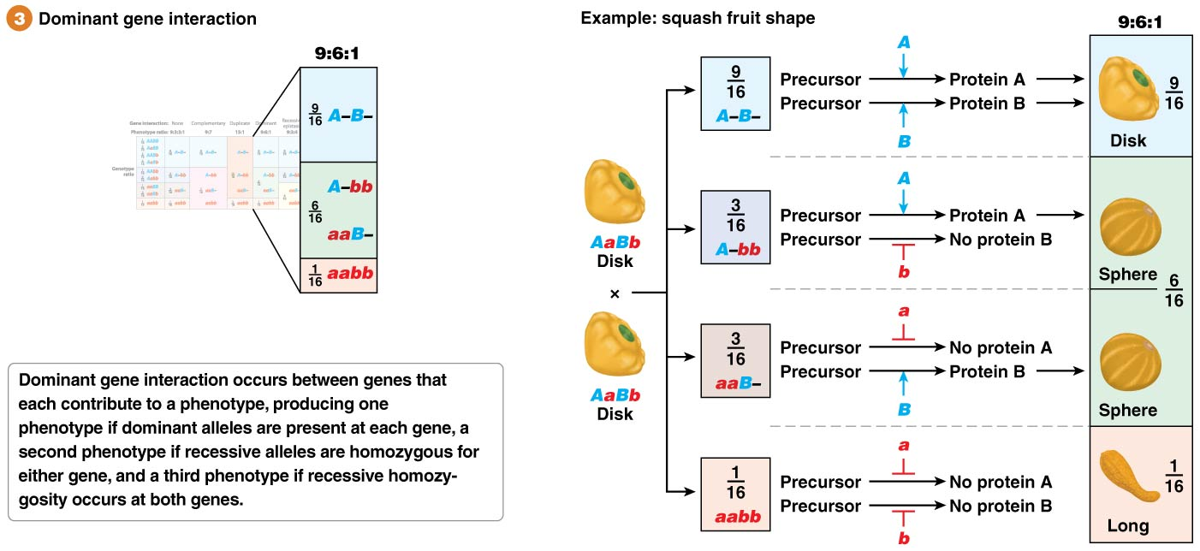
Dominant Gene Interaction (9:6:1 Ratio)

Slide 76
Recessive Epistasis (9:3:4 Ratio)
In recessive epistasis, homozygosity for the recessive alleles at one locus will mask the phenotypic expression of the alleles at a second locus, giving a 9:3:4 ratio

Slide 77
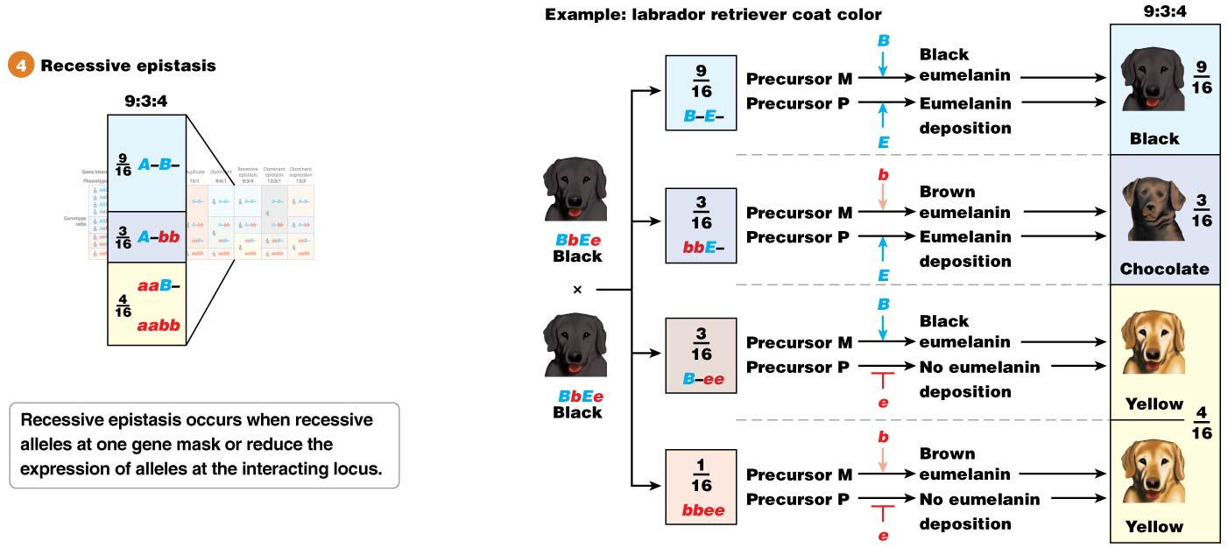
Recessive Epistasis (9:3:4 Ratio)
For example, in Labrador retrievers one gene is responsible for eumelanin production, while a second is responsible for the deposition of the pigment in the hairs
Dogs that cannot deposit the eumelanin pigment have a yellow coat color regardless of the genotype at the “eumelanin production” locus

Slide 78
Dominant Epistasis (12:3:1 Ratio)
In dominant epistasis, a dominant allele at one locus will mask the phenotypic expression of the alleles at a second locus, giving a 12:3:1 ratio

Slide 79
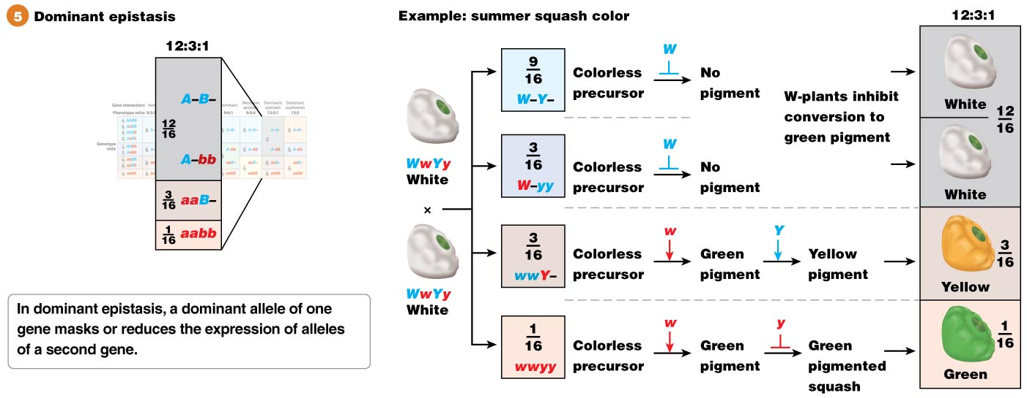
Dominant Epistasis (12:3:1 Ratio)
For example, in summer squash a dominant allele at one locus prevents conversion of a colorless precursor to a green intermediate
This allele masks the effect of the dominant allele at a second locus that is responsible for converting the green intermediate to yellow

Slide 80
Dominant Suppression (13:3 Ratio)
In dominant suppression, a dominant allele at one locus completely suppresses the phenotypic expression of the alleles at a second locus, giving a 13:3 ratio

Slide 81
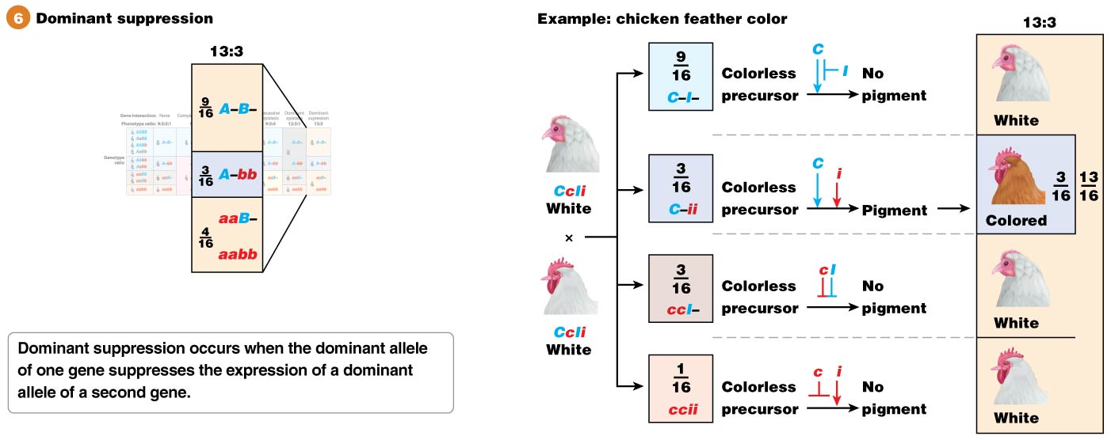
Dominant Suppression (13:3 Ratio)
For example, in chickens, the C allele is responsible for pigmented feathers and the c allele for white feathers
The dominant allele of a second gene, I, can suppress the color-producing effect of the C allele, leading to white feathers in both C/− and c/c individuals

Slide 82
4.4 Complementation Analysis Distinguishes Mutations in the Same Gene from Mutations in Different Genes
When geneticists encounter organisms with the same mutant phenotype, they ask two questions:
Do these organisms have mutations in the same or in different genes?
How many genes are responsible for the mutations observed?

Slide 83
Genetic Complementation
Genetic heterogeneity is when mutations in different genes can produce the same or very similar mutant phenotypes
Mating of two organisms with similar mutant phenotypes can lead to wild-type offspring, a phenomenon called genetic complementation
Complementation occurs when the mutations in the parents affect different genes

Slide 84
Complementation Testing
Complementation testing is when two pure breeding organisms with similar mutant phenotypes are mated
If complementation occurs, wild-type offspring are obtained and the mutations are known to affect two different genes
When the mutations fail to complement, the offspring have the mutant phenotype and the mutations are known to affect the same gene

