Slide 1
8

Slide 2
RNA Nucleotides and Structure
RNA ribonucleotides are composed by: a) a sugar, nucleotide base, b) one or more phosphate groups
But with two critical differences compared to DNA nucleotides:
The bases adenine, guanine, and cytosine are the same, but thymine is replaced by uracil
The sugar ribose is used rather than deoxyribose
2

Slide 3
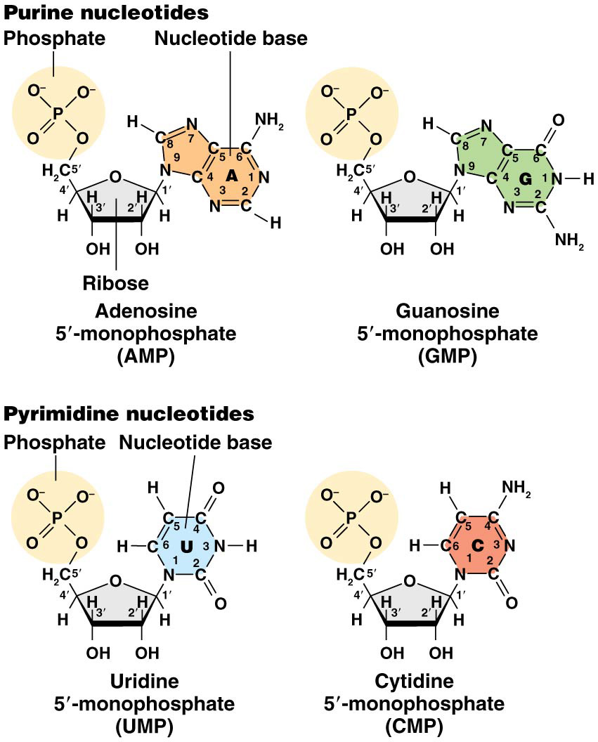
Figure 8.1 The four RNA ribonucleotides.

Slide 4
RNA Assembly and Structure
The similar sugars in RNA and DNA lead to formation of nearly identical sugar-phosphate backbones in the molecules
RNA strands are assembled by formation of phosphodiester bonds between the 5′ phosphate of one nucleotide and the 3′ hydroxyl of the adjacent one
RNA is synthesized from a DNA template using complementary base pairing (A with U and C with G)
4

Slide 5
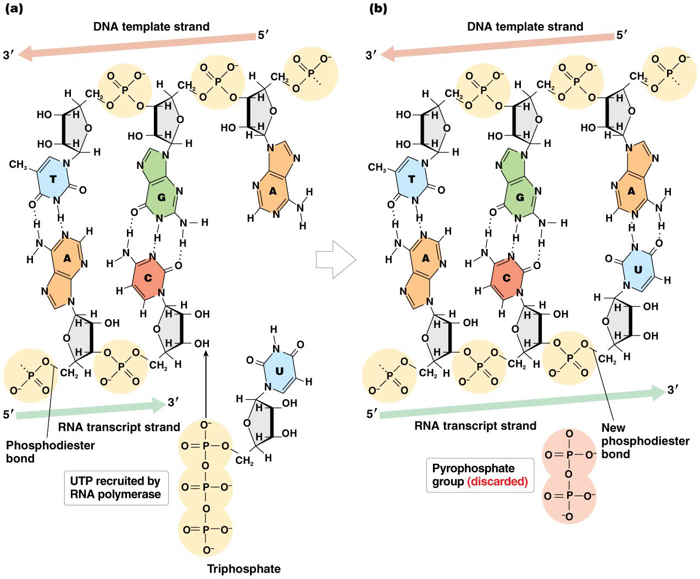
Figure 8.2 RNA synthesis.

Slide 6
RNA Synthesis
RNA polymerase catalyzes the addition of each ribonucleotide to the 3′ end of the nascent strand, and forms phosphodiester bonds between nucleotides
6

Slide 7
RNA Classification
Messenger RNA (mRNA) is produced by protein-producing genes and is a short-lived intermediary between DNA and protein
It is the only type of RNA that undergoes translation
Transcription of mRNA is often followed by post-transcriptional processing
7

Slide 8
Functional RNAs
Functional RNAs do not encode proteins, but instead perform functional roles in the cell
Transfer RNAs (tRNAs) are encoded in dozens of forms and are responsible for binding an amino acid and depositing it for inclusion into a growing protein chain
Ribosomal RNA (rRNA) combines with numerous proteins to form ribosomes
8

Slide 9
Additional Functional RNAs
Small nuclear RNA (snRNA) of various types is found in the nucleus of eukaryotes and plays a role in mRNA processing
Micro RNA (miRNA) and small interfering RNA (siRNA) are active in plant and animal cells and are involved in posttranscriptional regulation of mRNA
Certain RNAs in eukaryotic cells have catalytic activity; these are called ribozymes
9

Slide 10
The basis of transcription
Transcription is the synthesis of a single-stranded RNA molecule by RNA polymerase
The polymerase uses the template strand of the DNA to assemble a complementary, antiparallel strand of ribonucleotides
The coding strand of DNA, also called the nontemplate strand, is complementary to the template strand
10

Slide 11
Gene Structure
The gene contains several segments with distinct functions
The promoter is immediately upstream (5′) to the start of transcription
The promoter controls the access of RNA polymerase to the gene
11

Slide 12
Gene Structure (continued)
The coding region of the gene is the portion that contains the information needed to synthesize the protein product
The termination region of the gene regulates cessation of transcription
The termination region is immediately downstream (3′) to the coding segment of the gene
12

Slide 13
Figure 8.3 A general diagram of gene structure and associated nomenclature.

Slide 14
Essential Steps of Transcription in Bacteria (E. coli) – 4 steps
Promoter recognition
Transcription initiation
Chain elongation
Chain termination
14

Slide 15
Bacterial RNA Polymerase
A single type of RNA polymerase catalyzes transcription of all RNAs in E. coli
Rifampicin inhibits RNA synthesis by inhibiting formation of the first phosphodiester bond. Rifampicin, also known as rifampin, is an antibiotic used to treat a several types of bacterial infections.
When exposed to rifampicin, sensitive bacterial strains are unable to synthesize mRNA, tRNA, or rRNA
15

Slide 16
RNA Polymerase Composition
The bacterial RNA polymerase is composed of a pentameric core enzyme that binds a sixth subunit, called the sigma (σ) subunit
The large core enzyme is composed of two α subunits, two β subunits, and an ω subunit
The core enzyme can transcribe RNA from a DNA template but cannot bind the promoter or initiate RNA synthesis without the σ subunit
16

Slide 17
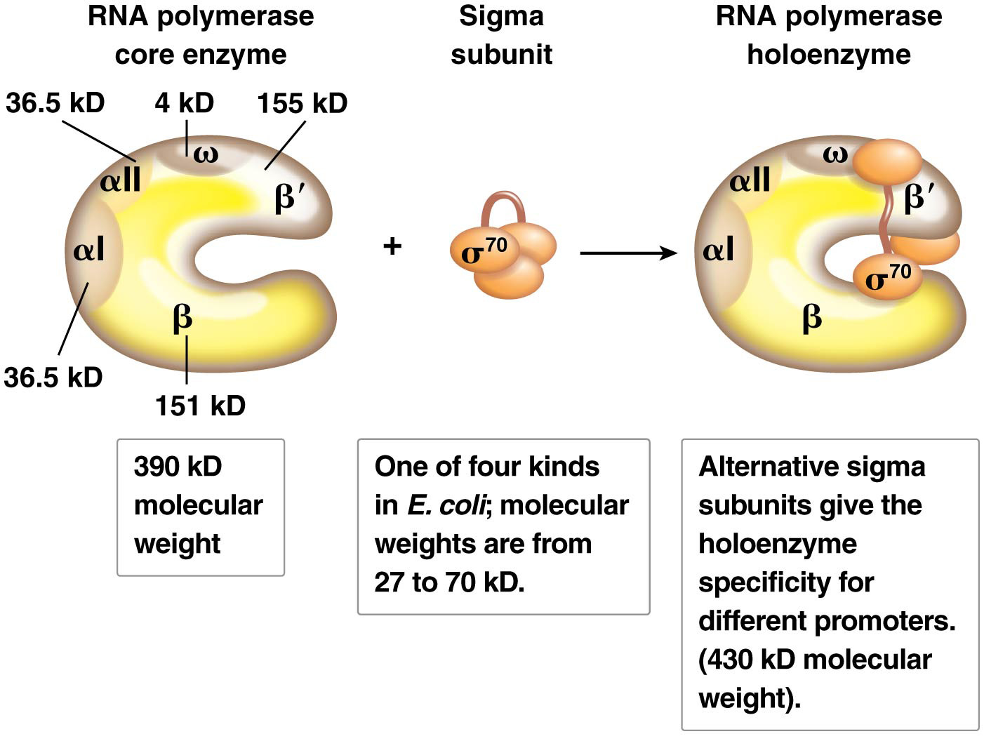
Figure 8.4 Bacterial RNA polymerase core plus a sigma (σ) subunit forms the fully active holoenzyme.

Slide 18
Bacterial Promoters
A promoter is a double-stranded DNA sequence that is the RNA polymerase binding site; promoters also bind other transcription proteins
The promoter is located a short distance upstream of the coding sequence, within a few nucleotides of +1
RNA polymerase is attracted to promoters by the presence of consensus sequences
18

Slide 19
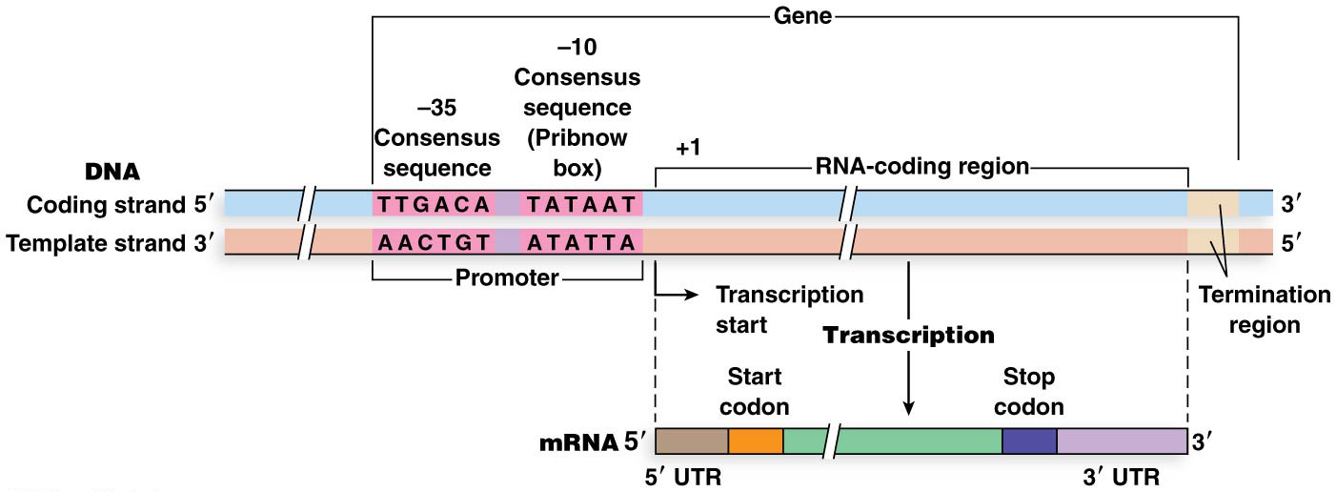
Bacteria Promoter Consensus Sequences
Consensus sequences are written in single-stranded shorthand form, 5′ to 3′ on the coding strand:
At the −10 position is the Pribnow box, or −10 consensus sequence, 5′-TATAAT-3′
At −35 is a 6-bp region, the −35 consensus sequence, 5′-TTGACA-3′
RNA polymerase binds to −10 and −35 sequences and occupies the space between and around them
19

Slide 20
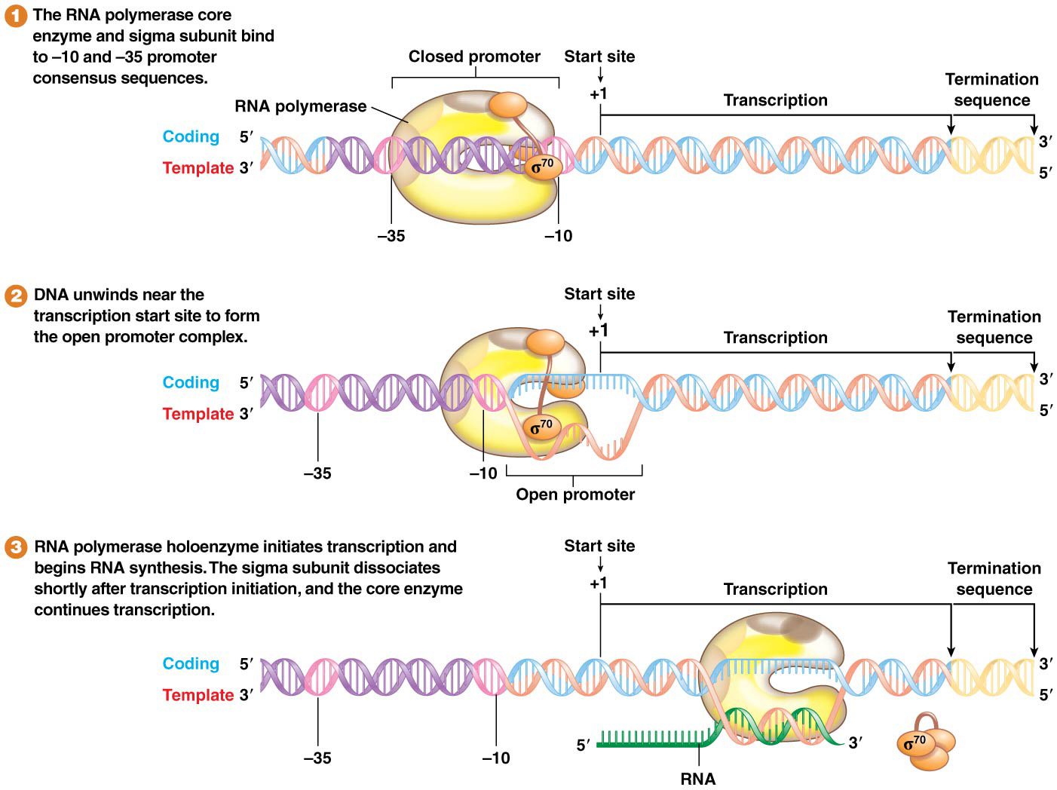
Transcription Initiation
RNA polymerase initiates through a two-step process:
1) First, the holoenzyme makes a loose attachment to the promoter sequence, then binds tightly to form the closed promoter complex
2) The holoenzyme next unwinds about 18 bp of DNA around the −10 position to form the open promoter complex
20

Slide 21
Transcription Initiation (continued)
Next, the holoenzyme progresses downstream to initiate RNA synthesis at the +1 site
Considerable sequence variation exists among promoters; alternative sigma sites allow for holoenzyme binding to variant promoters
21

Slide 22
Transcription Elongation and Termination
The holoenzyme initiated RNA synthesis at the +1 site and it remains intact until the first 8 to 10 RNA nucleotides have been joined, at which point the sigma subunit dissociates from the core enzyme
DNA is unwound ahead of the enzyme to maintain about 18 base pairs of unwound DNA; the double helix re-forms behind the RNA polymerase
22

Slide 23
Termination of Transcription
When transcription of the gene is completed, the 5′ end of the RNA trails off the core enzyme
The core enzyme dissociates from the DNA
Shortly after one round of transcription is initiated, a second round begins
23

Slide 24
Transcription Termination Mechanisms
Termination of transcription in bacteria is signaled by a DNA termination sequence that usually contains a repeating sequence
In intrinsic termination, a mechanism dependent only on the presence of the repeat induces a secondary structure needed for termination
Rho-dependent termination requires a different termination sequence and the rho protein
24

Slide 25
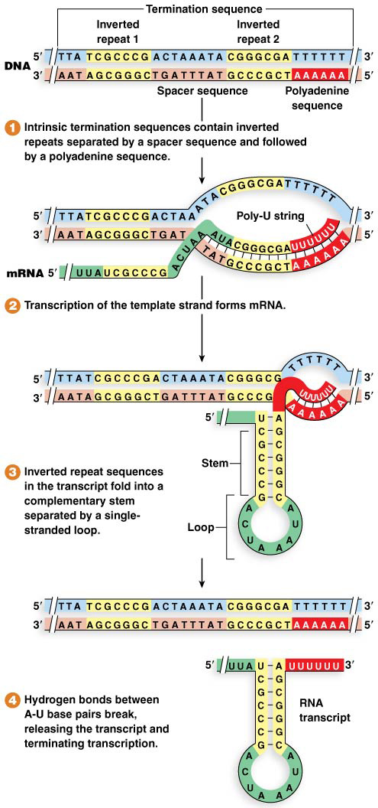
Intrinsic Termination
Most bacterial termination occurs via intrinsic termination
Termination sequences include an inverted repeat followed by a string of adenines
mRNA containing the inverted repeats form into a short stem-loop structure, called a hairpin
The hairpin followed by a series of U’s in the mRNA causes the RNA polymerase to slow down and destabilize
The instability caused by the slowing polymerase and the U-A base pairs induces the polymerase to release the transcript and separate from the DNA
25

Slide 26
Rho-Dependent Termination
Certain bacterial genes require the action of rho protein to bind to the nascent mRNA and catalyze the separation of the mRNA from the RNA polymerase
Rho-dependent termination sequences do not have a string of uracils; instead they have a rho utilization (or rut) site, a stretch of about 50 nucleotides rich in cytosines
After being activated the Rho protein moves along the transcript to RNA polymerase and catalyzes the breakage of hydrogen bonds between the mRNA and the DNA template, which triggers the release of the polymerase
26

Slide 27
8.3 Archaeal and Eukaryotic Transcription Displays Homology, Common Ancestry and differences
Complexity in transcription increase from Bacteria, Archaea to Eukaryotes.
Bacteria and archaea each have a single RNA polymerase, but bacteria also have multiple different sigma subunits
Eukaryotes have multiple RNA polymerases that transcribe different genes
The eukaryotic RNA polymerase used for most protein-coding genes and the archaeal RNA polymerase share a common structure that is divergent from bacterial RNA polymerase
Transcription in archaea and eukaryotes is more complex than in bacteria
27

Slide 28
Comparison of Transcription Complexity
Promoter consensus sequences in archaea are less complicated that those in eukaryotes but more diverse than those of bacteria
Eukaryotes have three different RNA polymerases that recognize different promoters and produce different types of RNAs
The complex that assembles to initiate and elongate transcription is more elaborated in eukaryotes and archaea than in bacteria
28

Slide 29
Eukaryotic Transcription
Eukaryotic genes carry introns and exons, and require processing to remove introns (splicing)
Eukaryote DNA is associated with proteins to form chromatin; the chromatin composition of a gene affects its transcription
Chromatin thus plays an important role in gene regulation of eukaryotes
29

Slide 30
Eukaryotic Polymerases
RNA polymerase I (RNA pol I) transcribes three ribosomal RNA genes
RNA polymerase II (RNA pol II) transcribes protein coding genes and most small nuclear RNA genes
RNA polymerase III (RNA pol III) transcribes tRNA, one small nuclear RNA, and one ribosomal RNA
RNA pol II and RNA pol III transcribe miRNA (micro RNA) and siRNA (small interfering RNA)
30

Slide 31
Eukaryotic Polymerases
RNA polimerasa | transcribe
I | rRNAS (3 differents)
II | mRNA, snRNA (majority), miRNA
III | tRNA, un snRNA, one rRNA and siRNA
31

Slide 32
Eukaryotic Promoter Elements
The most common eukaryotic promoter consensus sequence is the TATA box, or the Goldberg-Hogness box, located at about position −25
The consensus sequence is 5′-TATAAA-3′
A CAAT box is often found near the −80 position
A GC-rich box (consensus 5′-GGGCGG-3′) is located at −90, or further upstream
32

Slide 33
Eukaryotic Promoter Elements (continued)
Eukaryotic promoters display a high degree of variability in type, number, and location of consensus sequence elements
The TATA box is most common, whereas the CAAT box and GC-rich box are more variable
33

Slide 34
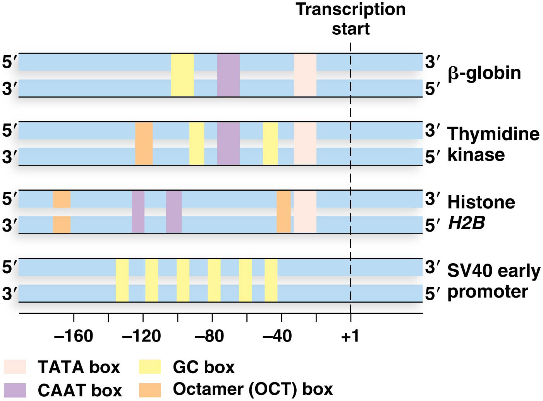
Figure 8.9 Examples of eukaryotic promoter variability.

Slide 35
Promoter Recognition
RNA pol II recognizes and binds to promoter sequences in eukaryotes with the aid of proteins called transcription factors (TFs)
TFs bind to regulatory sequences and interact directly, or indirectly, with RNA polymerase; those interacting with pol II are called TFII factors
The TATA box is the principal binding site during promoter recognition
35

Slide 36
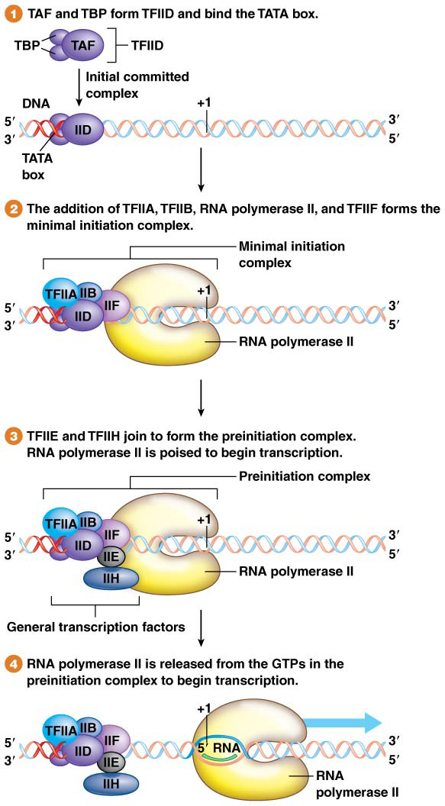
Promoter Recognition
At the TATA box, TFIID, a multisubunit protein containing the TATA-binding protein (TBP) and subunits of a protein called TBP-associated factor (TAF), binds the TATA box sequence
The assembled TFIID bound to the TATA box forms the initial committed complex
Next, TFIIA, TFIIB, TFIIF, and RNA pol II join the complex to form the minimal initiation complex
36

Slide 37
Promoter Recognition
The minimal initiation complex is joined by TFIIE and TFIIH to form the preinitiation complex (PIC)
The complete initiation complex contains multiple proteins commonly referred to as “general transcription factors”
The complete complex directs RNA pol II to the +1 position, where it begins to assemble mRNA
37

Slide 38
Detecting Promoter Consensus Elements
Research methodology to verify that a segment of DNA is a functionally important component of a promoter has two components:
Discovering the presence and location of DNA sequences to which transcription factors will bind
Mutational analysis to confirm the functionality of each sequence
38

Slide 39
Mutational Analysis of β-Globin Promoter
Myers and colleagues produced many different point mutations and compared the level of transcription generated by the mutant sequence relative to wild type
Most mutations inside the consensus regions significantly reduced levels of transcription
Mutations outside the consensus region had nonsignificant effects on transcription
39

Slide 40
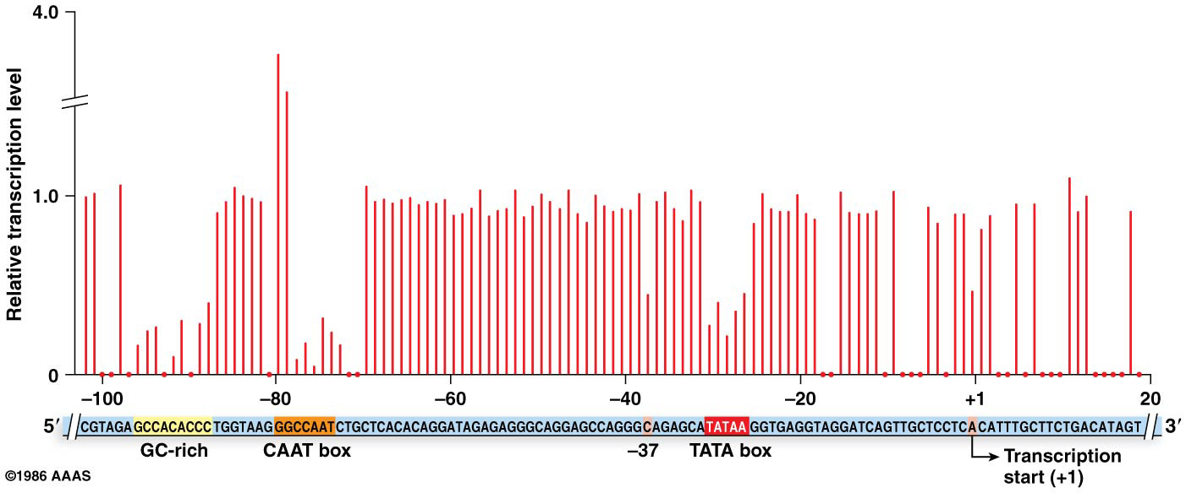
Figure 8.11 Mutation analysis of the β-globin gene promoter.

Slide 41
Enhancers and Silencers
Promoters alone may not be sufficient to initiate eukaryotic transcription
Two categories of DNA regulatory sequences lead to differential expression of genes
These are enhancer sequences and silencer sequences
41

Slide 42
Enhancer Sequences
Enhancer sequences increase the level of transcription of specific genes
They bind proteins that interact with the proteins that are bound to gene promoters. Together the promoters and enhancers drive gene expression
Enhancers may be variable distances from the genes they affect and may be upstream or downstream of the gene
42

Slide 43
Enhancer Sequences and DNA Bending
Enhancer sequences bind activator proteins and associated coactivators to form a “protein bridge” that links the complete initiation complex at the promoter to the activator–coactivator complex at the enhancer
This bridge bends the DNA so that the proteins at both locations are brought close enough together for them to interact
43

Slide 44
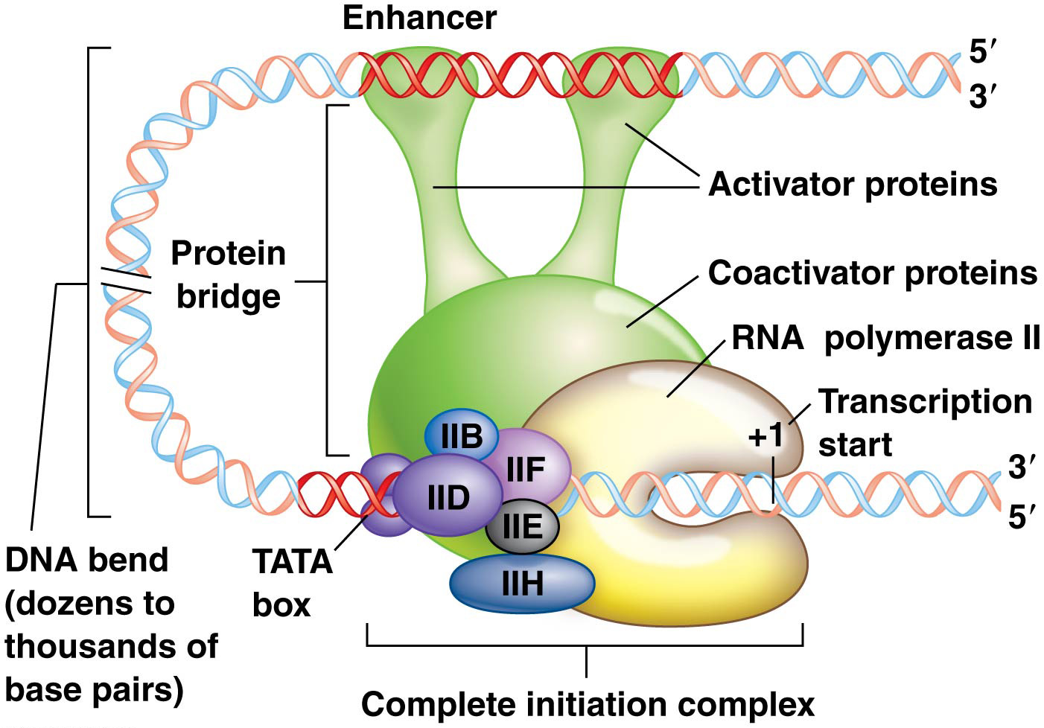
Figure 8.12 Enhancers activate transcription in cooperation with promoters.

Slide 45
Silencer Sequences
Silencer sequences are DNA elements that act at a distance to repress transcription of their target genes
Silencers bind transcription factors called repressor proteins that induce bends in DNA
These bends reduce transcription of the target gene
Silencers may be located variable distances from their target genes, either upstream or downstream
45

Slide 46
RNA POLYMERASES

Slide 47
RNA Polymerase I Promoters
RNA polymerase I transcribes genes for rRNA using a mechanism similar to that of RNA pol II
RNA pol I is recruited to upsteam promoter elements following binding of transcription factors, and transcribes ribosomal genes found in the nucleolus
The nucleolus is a nuclear organelle containing rRNA and multiple copies of genes encoding rRNA
47

Slide 48
RNA Polymerase I Promoters (continued)
Promoters recognized by RNA pol I have two functional sequences near the start of transcription:
The core element stretches from −45 to +20, and is needed for initiation of transcription; it is bound by sigma-like factor 1 (SL1) protein
The upstream control element spans from −100 to −150, and increases the level of transcription; it is bound by upstream binding factor 1 (UBF1)
48

Slide 49
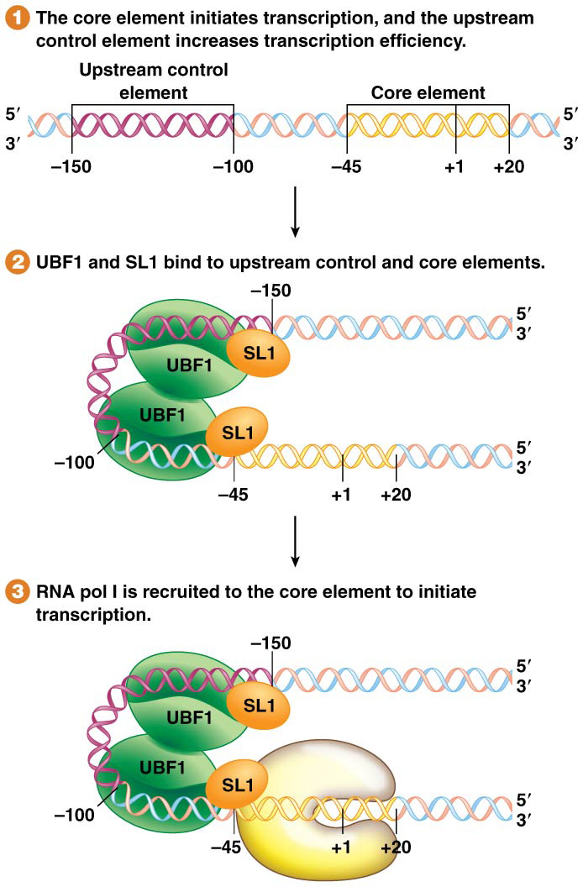
Figure 8.13 Promoter consensus sequences for transcription initiation by RNA polymerase I.

Slide 50
RNA Polymerase III Promoters
RNA polymerase III is primarily responsible for transcription of tRNA genes, but also transcribes one rRNA and other RNA-encoding genes
50

Slide 51
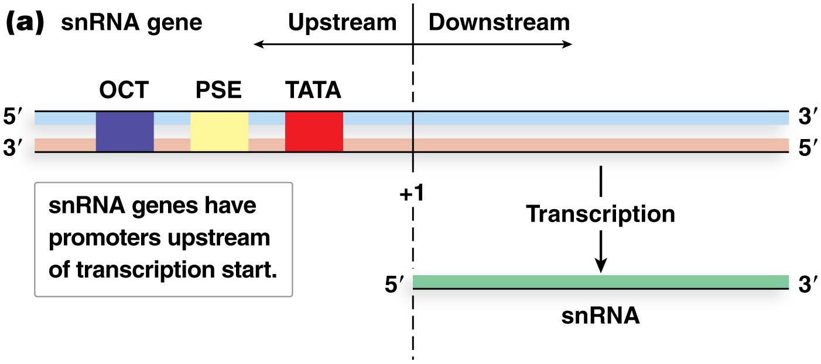
RNA Polymerase III Promoters—The Upstream Elements
Small nuclear RNA genes have three upstream elements. The upstream elements of the snRNA genes are a TATA box, a promoter-specific element (PSE), and an octamer (OCT). A small number of transcription factors bind these elements and recruit RNA pol III. RNA pol III initiates transcription in a manner similar to other polymerases
51

Slide 52
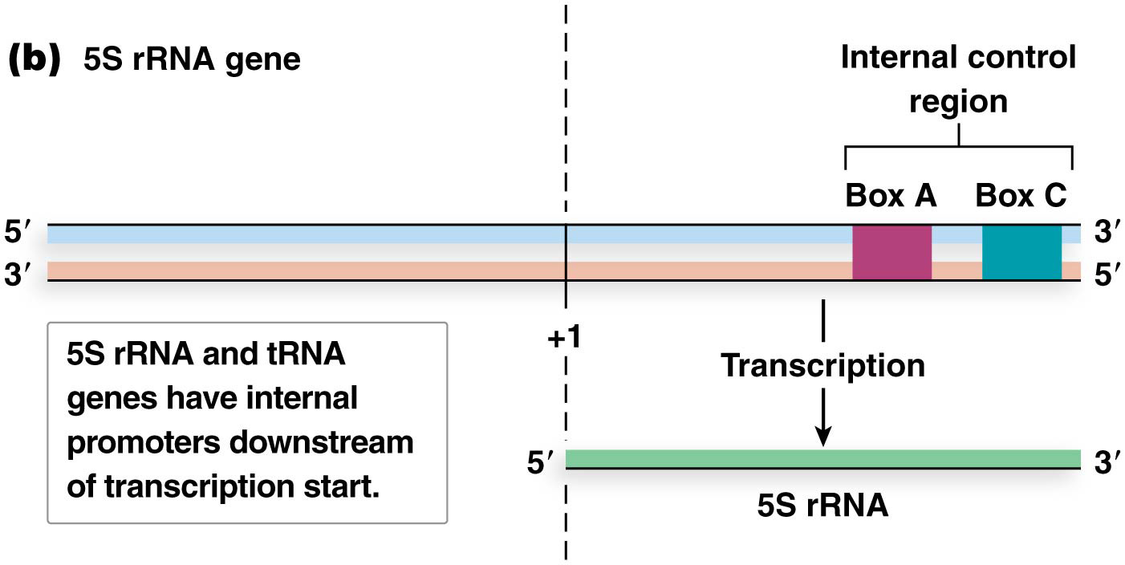
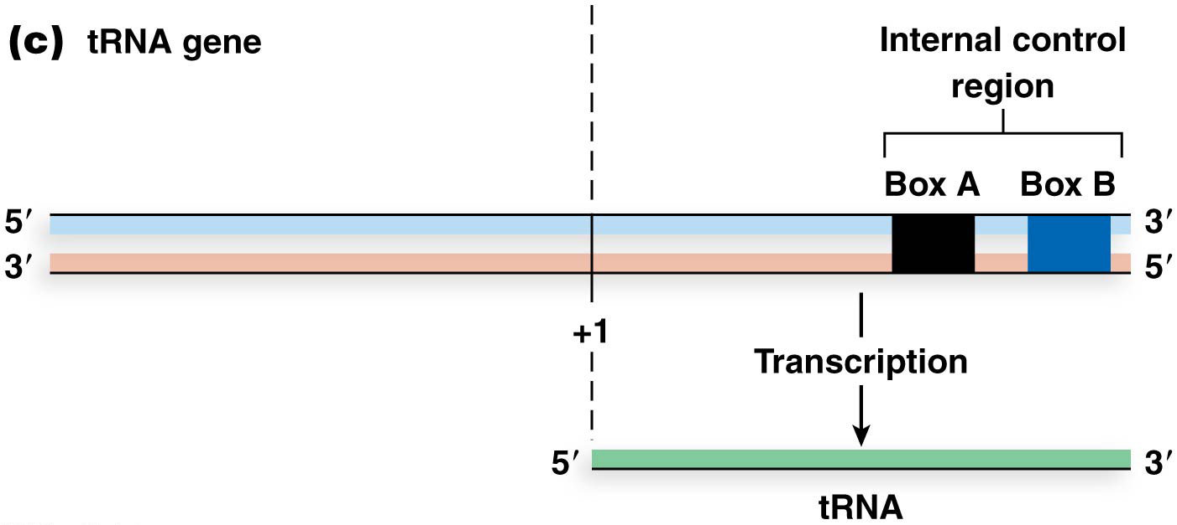
RNA Polymerase III Promoters—The Internal Promoter Elements
The 5S rRNA and tRNA genes each have two internal promoter elements called internal control regions (ICRs). These are two short DNA sequences, called either box A and box B for some genes, or box A and box C for other genes. These are located between positions +55 and +80
52

Slide 53
Function of the Internal Promoter Elements
TFIIIA binds box B or box C, which facilitates binding of TFIIIC to box A
TFIIIB then binds to the other transcription factors
Finally, RNA polymerase III binds to the complex and overlaps the +1 nucleotide, where it initiates transcription
53

Slide 54
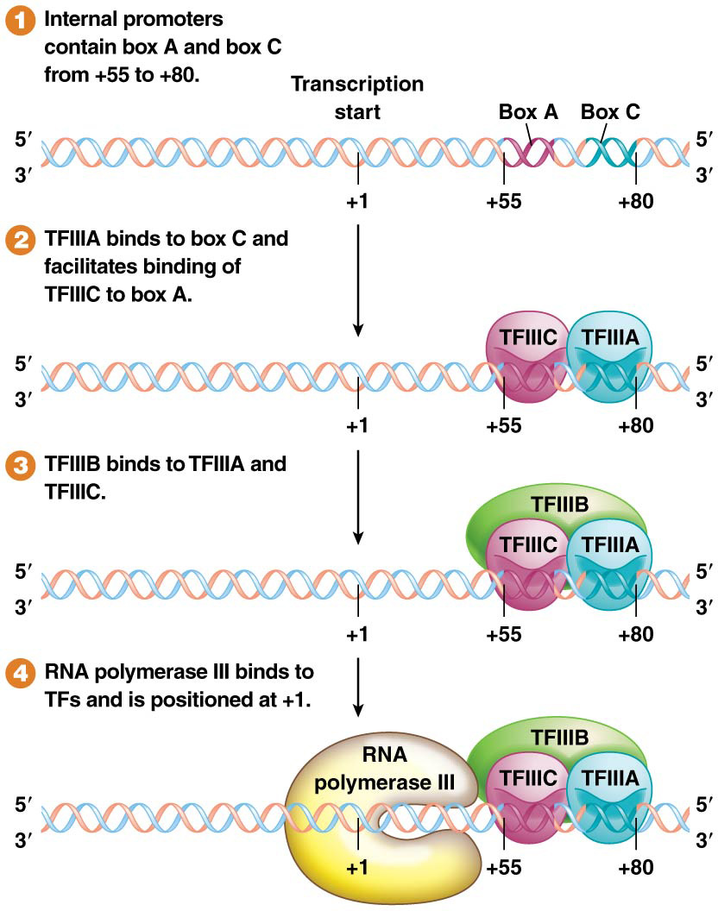
Figure 8.15 Promoter internal control regions for transcription by RNA polymerase III.

Slide 55
Termination in RNA Polymerase I or III Transcription
Each eukaryotic RNA polymerase has a different termination mechanism
RNA polymerase III transcription is terminated similarly to E. coli termination. It transcribes a terminator sequence that creates a string of uracils in the transcript, though no stem-loop structure forms near it.
Transcription by RNA pol I is terminated at a 17-bp consensus sequence that binds transcription-terminating factor 1 (TTF1)
55

