Slide 1
8

Slide 2
8.4 Posttranscriptional Processing Modifies RNA Molecules
Eukaryotic transcripts are more stable than bacterial and archaeal transcripts
In eukaryotes, transcription and translation are separated in time and location
Eukaryotic genes have introns, which are not found in most bacterial and archaeal genes
These features are all related to post-transcriptional modification of eukaryotic transcripts
2

Slide 3
Posttranscriptional Processing
The initial eukaryotic gene mRNA is called the pre-mRNA, whereas the fully processed mRNA is called the mature mRNA; modifications include:
5′ capping
3′ polyadenylation
Intron splicing
3

Slide 4
Capping 5′ mRNA
After the first 20 to 30 nucleotides of mRNA have been synthesized, a special enzyme, guanylyl transferase, adds a guanine to the 5′ end of the pre-mRNA. The addition of the guanine to the mRNA is called 5′ capping
4

Slide 5
Capping 5′ mRNA in Three Steps
Guanylyl transferase removes the gamma phosphate at the 5′ end of the mRNA, leaving two phosphates on the mRNA
The guanine to be added loses two phosphates to become guanine monophosphate
Guanylyl transferase joins the guanine monophosphate to the 5′ mRNA by a 5′-to-5′ triphosphate linkage; methylation also occurs via methyl transferase
5

Slide 6
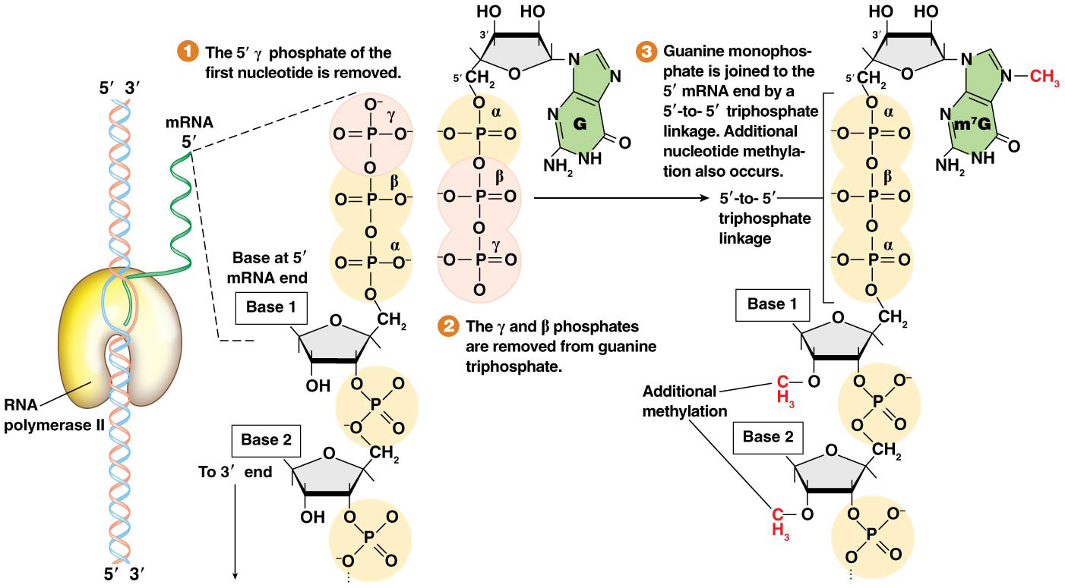
Figure 8.17 Capping the 5′ end of eukaryotic pre-mRNA.

Slide 7
Functions of the 5′ Cap
Protection of mRNA from rapid degradation
Facilitating transport of mRNA out of the nucleus
Facilitating subsequent intron splicing
Enhancing translation efficiency by orienting the ribosome on the mRNA
7

Slide 8
Polyadenylation of 3′ Pre-mRNA
The 3′ end of the pre-mRNA is created by enzyme action that removes a section of the 3′ message and replaces it with a string of adenines
This is thought to be associated with the subsequent termination of transcription
8

Slide 9
Steps of Polyadenylation
Cleavage and polyadenylation specificity factor (CPSF) binds near the polyadenylation signal sequence—5′-AAUAAA-3′—which is downstream of the stop codon
The pre-mRNA is cleaved 15 to 30 nucleotides downstream of the polyadenylation signal sequence
The cleavage releases a fragment of the mRNA, which is bound by CFI, CFII and CStF; this fragment is later degraded
The 3′ end of the cut pre-mRNA undergoes enzymatic addition of 20 to 200 adenines through the action of CPSF and PAP
After addition of the first 10 adenines, molecules of poly-A-binding protein (PABII) join the adenine tail and increase the rate of addition of adenines
9

Slide 10
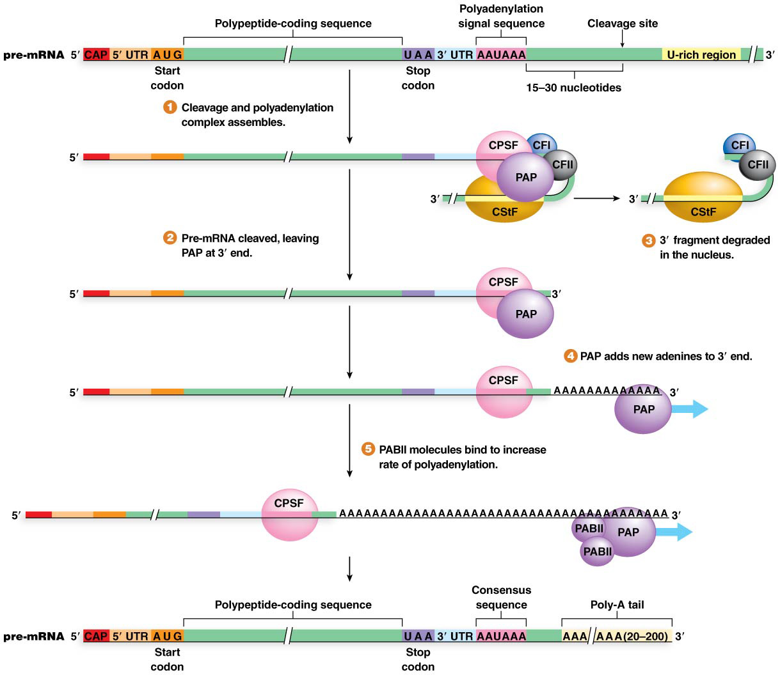
Figure 8.18 Polyadenylation of the 3′ end of eukaryotic pre-mRNA.

Slide 11
Functions of Polyadenylation
Facilitating transport of mature mRNA across the nuclear membrane to the cytoplasm
Protecting the mRNA from degradation
Enhancing translation by enabling the ribosomal recognition of mRNA
Some eukaryotic transcripts (e.g., the histone genes) do not undergo polyadenylation
11

Slide 12
Pre-mRNA Intron Splicing
Intron splicing requires great precision to remove intron nucleotides accurately
Errors in intron removal would lead to incorrect protein sequences
Roberts and Sharp shared the 1993 Nobel Prize for their codiscovery of “split genes” (i.e., the presence of intron and exon sequences)
12

Slide 13
R-Looping
The presence of intron sequences can be demonstrated by a technique called R-looping
DNA encoding a gene is isolated and hybridized to mature mRNA from the same gene
Regions of the DNA where introns are present have no complementary region within the mRNA, and thus loop out visibly
13

Slide 14
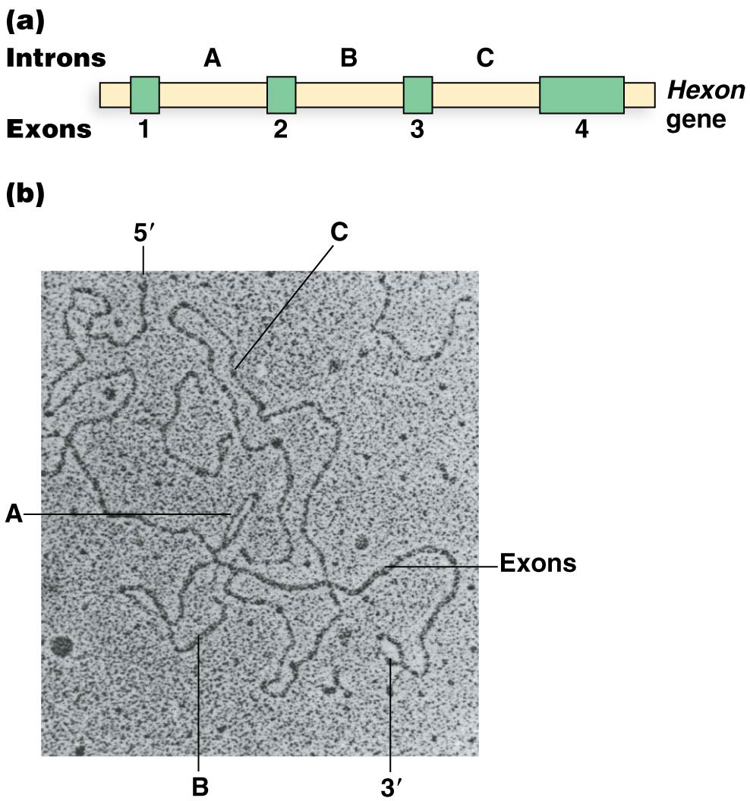
Figure 8.20 R-loop experimental analysis.

Slide 15
Splicing Signal Sequences
Specific short sequences define the junctions between introns and exons
The 5′ splice site is at the 5′ intron end and contains a consensus sequence with a nearly invariant GU dinucleotide at the 5′-most end of the intron
The 3′ splice site at the opposite end of the intron has an 11-nucleotide consensus with a pyrimidine-rich region and a nearly invariant AG at the 3′-most end
A third consensus region, called the branch site, is 20 to 40 nucleotides upstream of the 3′ splice site. It is pyrimidine-rich and contains an invariant adenine called the branch point adenine near the 3′ end
Mutation analysis shows that all three consensus sequences are required for accurate splicing
15

Slide 16
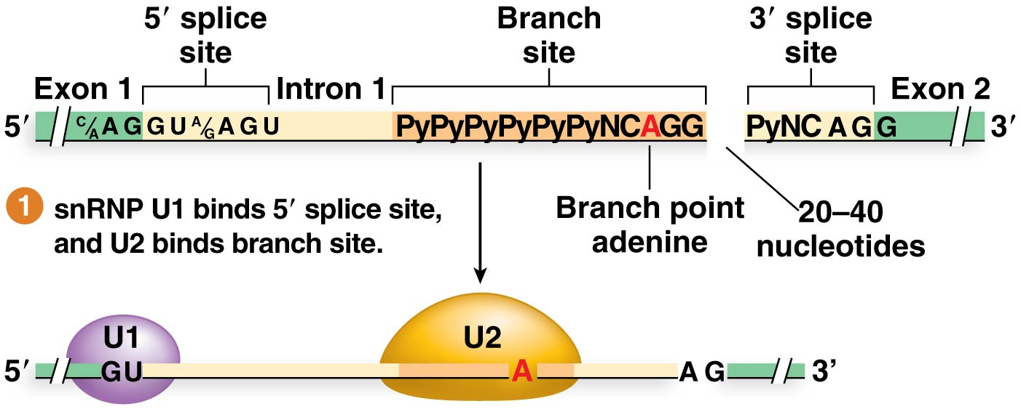
Figure 8.21 Intron splicing in eukaryotic pre-mRNA.
16

Slide 17
Splicing
Introns are removed from the pre-mRNA by an (small nuclear RNA) snRNA-protein complex called the spliceosome
The 5′ splice site is cleaved first and a lariat intron structure is formed when the 5′ intron end binds to the branch point adenine
Then the 3′ splice site is cleaved and the exon ends are ligated together
Introns appear to be removed one by one, but not necessarily in order
17

Slide 18
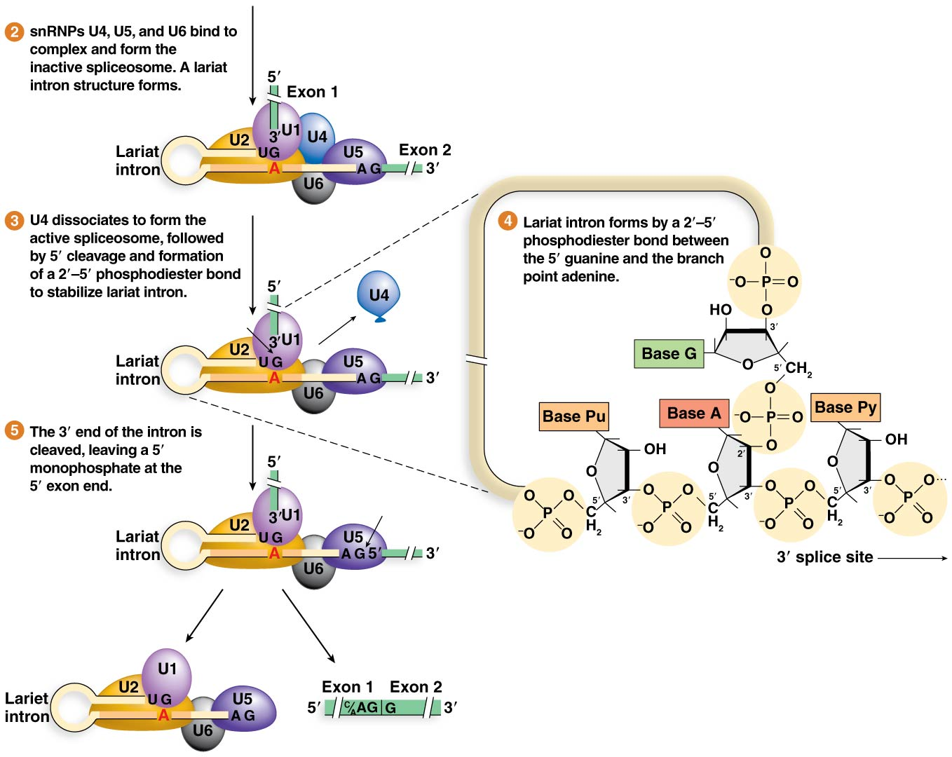
Figure 8.21 Intron splicing in eukaryotic pre-mRNA.
18

Slide 19
Spliceosome Composition
The spliceosome is a large complex made of multiple snRNPs (snRNPs U1 through U6)
The composition is dynamic, changing through the steps of splicing
Spliceosome snRNPs come and go as particular splicing reaction steps are carried out
19

Slide 20
Alternative Transcripts of Single Genes
It is common for large eukaryotic genomes to express more proteins than there are genes in the genome
For example, human cells produce over 100,000 distinct polypeptides but contain ∼22,000 genes
Three transcription-associated mechanisms can explain this
20

Slide 21
Mechanisms for Producing Alternative Transcript
Pre-mRNA can be spliced in alternative patterns in different cell types
Alternative promoters can initiate transcription at distinct +1 start points in different cell types
Alternative localizations of polyadenylation can produce different mature mRNAs
Together these comprise alternative pre-mRNA processing
21

Slide 22
Alternative Intron Splicing
Alternative intron splicing: processing of identical transcripts in different cells can lead to mature mRNAs with different combinations of exons and thus different polypeptides
Approximately 70% of human genes are thought to undergo alternative splicing
It is less common in other animals and rare in plants
22

Slide 23
Alternative Processing
Use of alternative promoters can occur when more than one sequence upstream of a gene can initiate transcription
Alternative polyadenylation requires more than one polyadenylation signal in a gene
Alternative promoters and alternative polyadenylation are controlled by variable expression of regulatory proteins in specific cell types
23

Slide 24
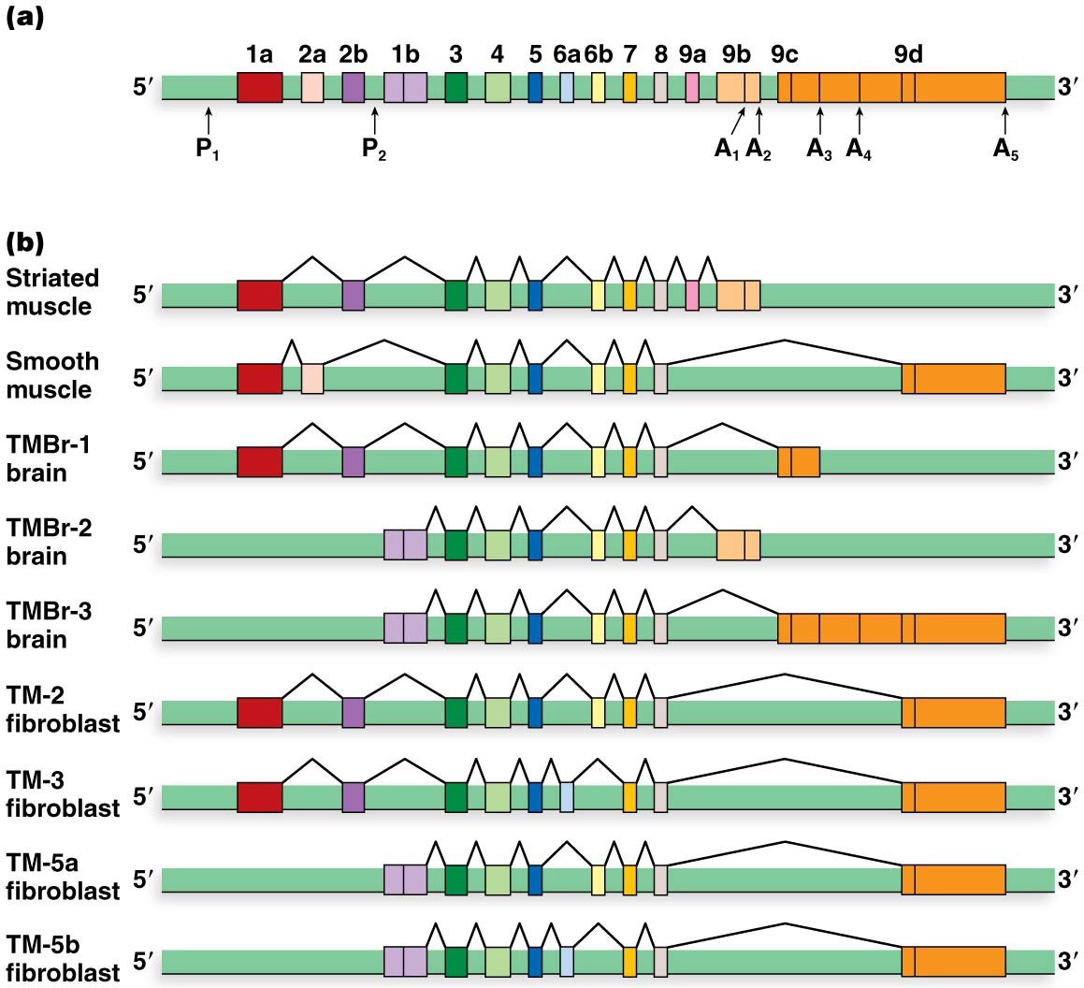
Figure 8.24 Alternative pre-mRNA processing of the rat α-tropomyosin gene.

Slide 25
Control of Alternative Splicing
Alternative splicing is carefully controlled in cells
Exonic or intronic splicing enhancers (ESE or ISE) attract proteins rich in serine and arginine, called SR proteins, that direct spliceosome activity
Exonic or intronic splicing silencers (ESS or ISS) attract splice repressor proteins that prevent splicing by blocking spliceosome activity
25

Slide 26
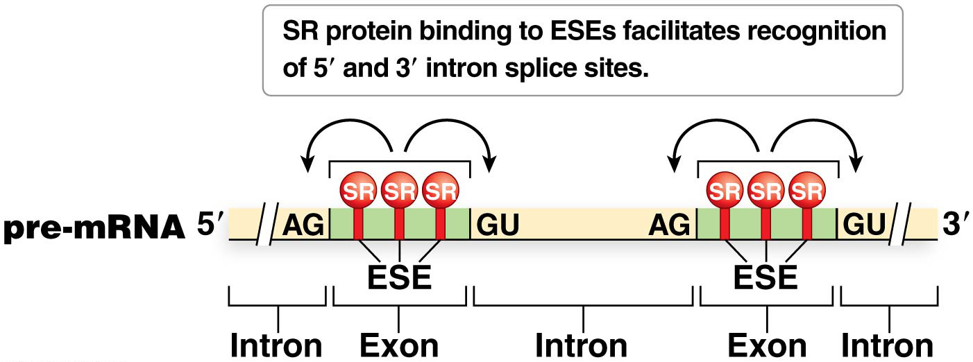
Figure 8.25 SR-protein recruitment to ESEs, directing spliceosome components to nearby splice sites.

Slide 27
Ribosomal RNA Processing
In bacteria, archaea, and eukaryotes, rRNAs are transcribed as large precursor molecules that are cleaved into smaller molecules by removal of spacer sequences between the rRNA genes
After processing, the rRNAs fold into complex secondary structures and join ribosomal proteins to form the ribosome subunits
Some chemical modifications of rRNA occur after transcription is complete (e.g., methylation)
27

Slide 28
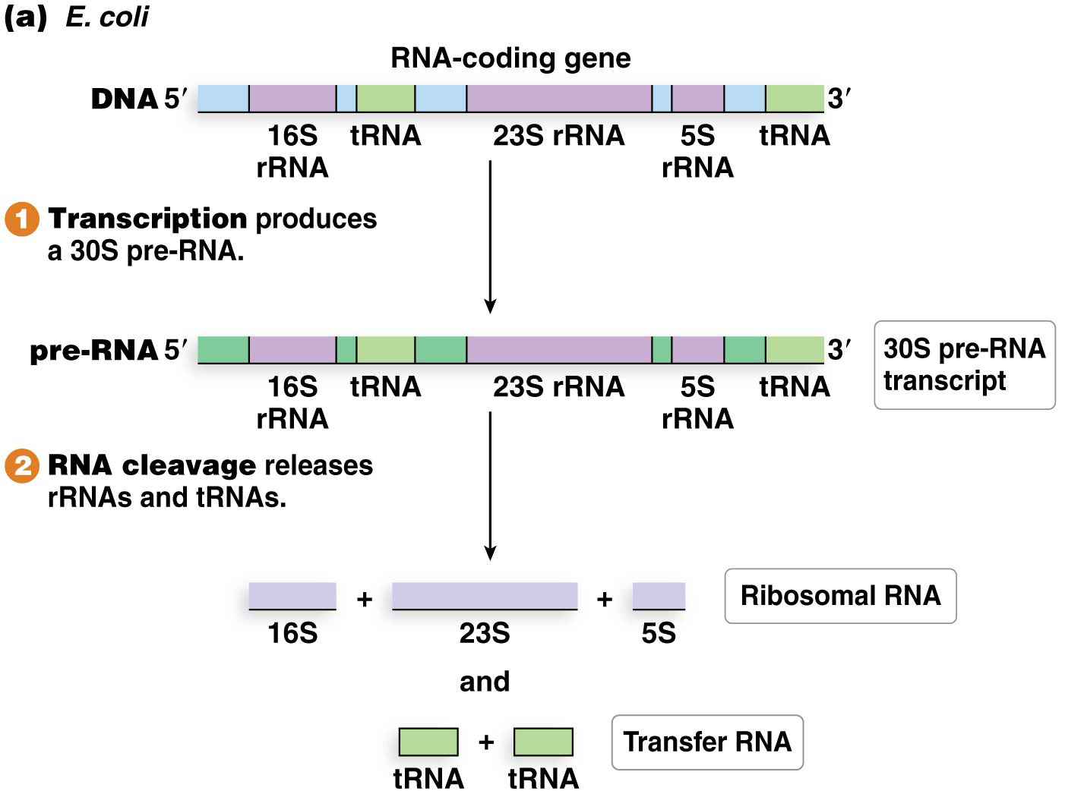
Figure 8.27a The processing of ribosomal and transfer RNA.

Slide 29
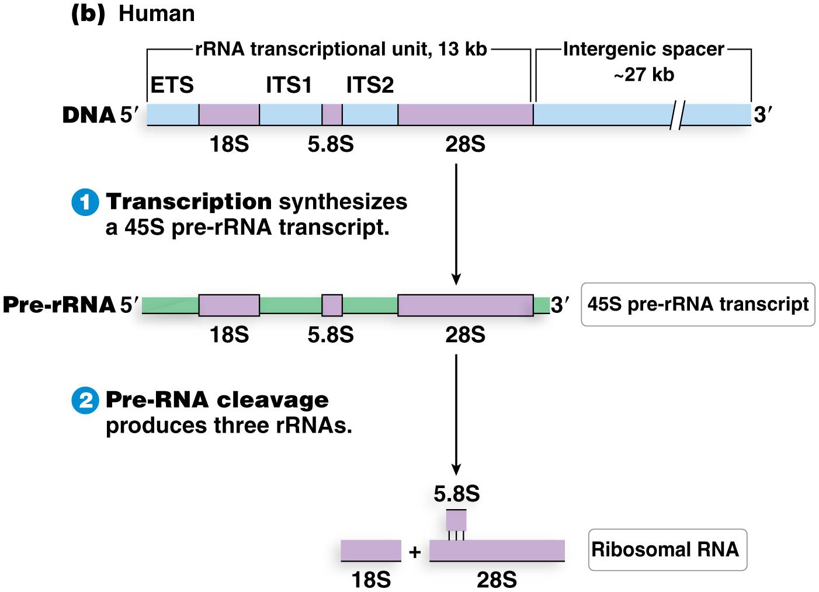
Figure 8.27b The processing of ribosomal and transfer RNA.

Slide 30
Transfer RNA Processing
Processing of tRNA is different in bacteria and eukaryotes
All tRNAs have similar structure and function, albeit different nucleotide sequences
Some bacterial tRNAs are produced simultaneously with rRNAs; others are transcribed as part of a large pre-tRNA transcript and then cleaved into individual tRNA molecules
Each eukaryotic tRNA gene is individually transcribed
30

Slide 31
tRNAs
The number of different tRNAs produced differs among organisms
Most produce about 30 to 40 tRNAs, fewer than 61,
Some eukaryote genomes do contain all 61 possible tRNA genes, one for each codon
31

Slide 32
Bacterial tRNA Processing
Bacterial tRNAs require processing before they can assume their functional role:
Many tRNAs are cleaved from the large precursor transcripts to produce several individual tRNA molecules
Nucleotides are trimmed from the 3′ and 5′ ends of the molecule
Certain individual nucleotides are chemically modified
tRNAs fold into a precise three-dimensional structure including four double-stranded stems, three of which are capped by single-stranded loops
tRNAs undergo posttranscriptional addition of bases, most commonly CCA at the 3′ end
Eukaryotic and archaeal tRNAs undergo similar processing modifications, but eukaryotic tRNAs may also include small introns that are removed

Slide 33
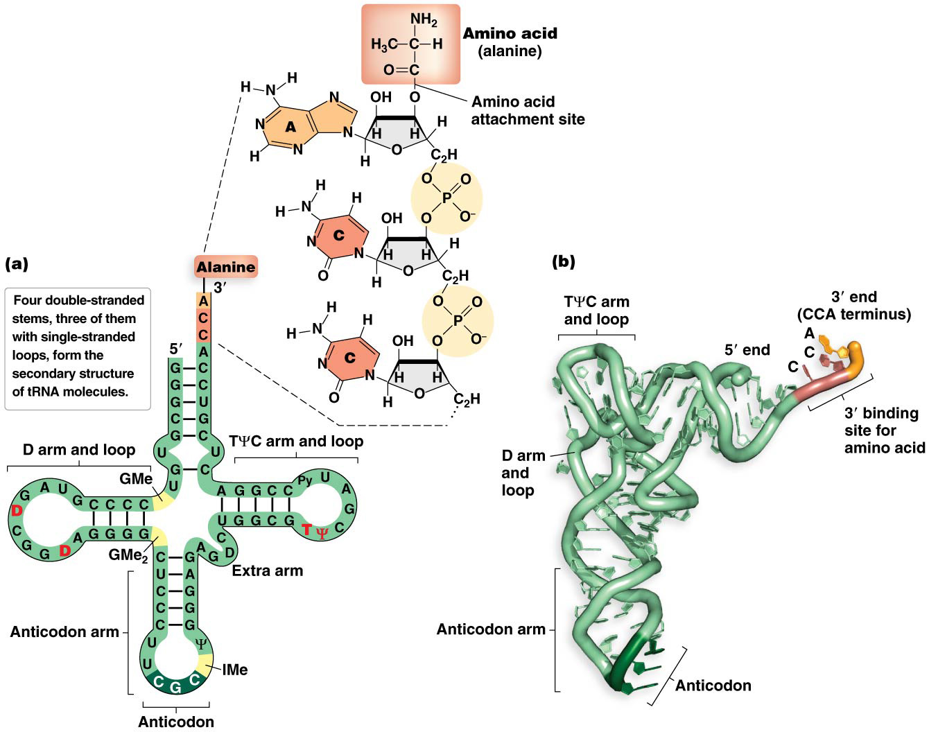
Figure 8.28 Transfer RNA structure.

Slide 34
Posttranscriptional RNA Editing
In the mid-1980s, RNA editing was uncovered that is responsible for posttranscriptional modifications to the nucleotide sequence (and the protein produced) of some mRNAs
In one kind of RNA editing, uracils are added with the assistance of a guide RNA (gRNA), which contains a sequence complementary to the mRNA that it edits
Editing may sometimes involve deletion of uracils, too
34

Slide 35
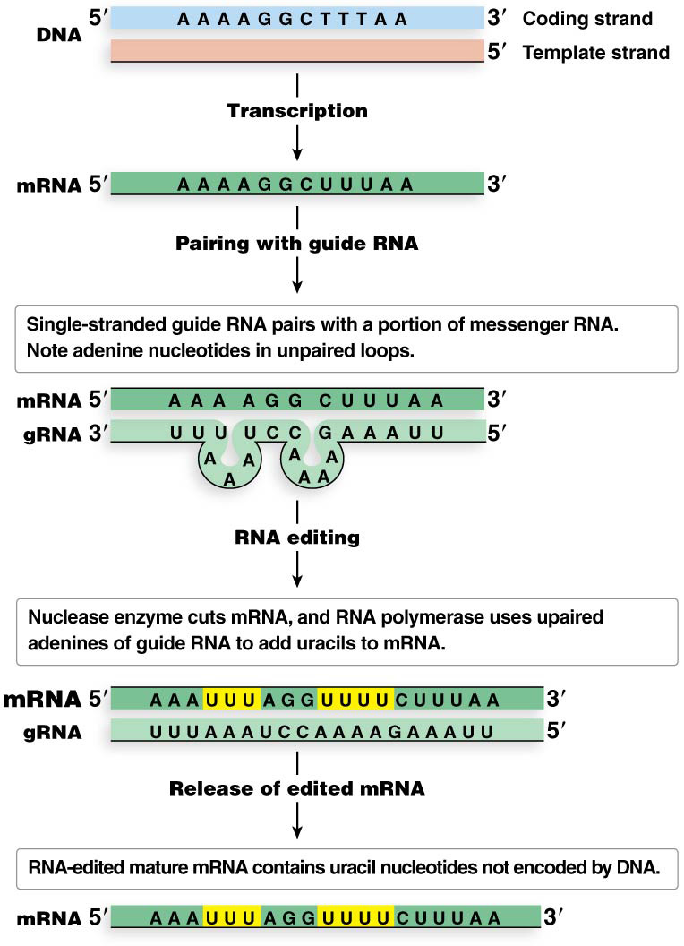
Figure 8.29 Guide RNA (gRNA) directs RNA editing.

Slide 36
Base Substitution
A second type of RNA editing is base substitution, which frequently involves replacement of cytosine with uracil
This has been identified in mammals, most land plants, and some single-celled eukaryotes
36

Slide 37
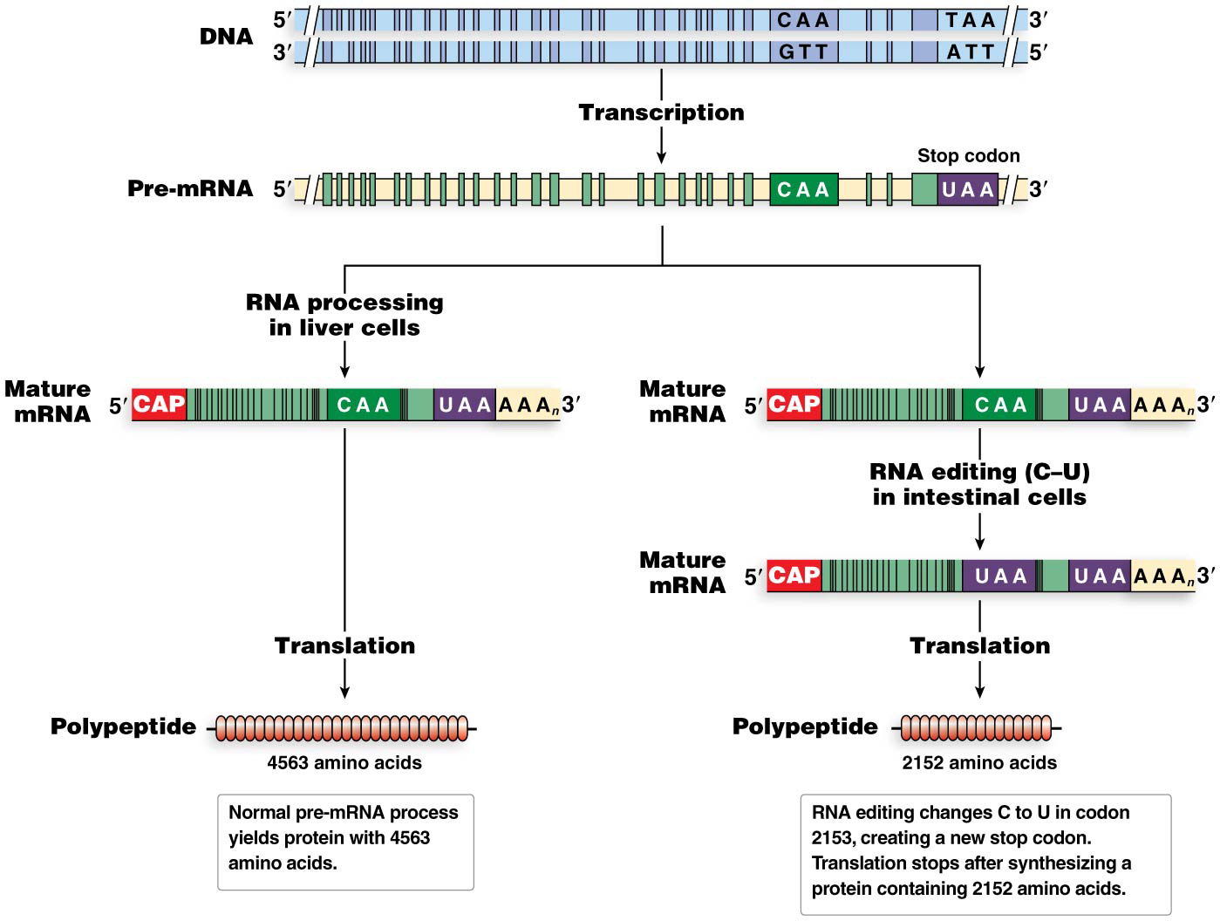
Figure 8.30 RNA editing of the mRNA transcript of the human apolipoprotein B gene.

