Slide 1
9

Slide 2
9.1 Polypeptides Are Composed of Amino Acid Chains That Are Assembled at Ribosomes
Twenty different amino acids serve as building blocks of polypeptides
Covalent bonds form between amino acids to form a polypeptide chain
Distinctive features of amino acids allow them to participate in certain chemical reactions or behave in a hydrophobic or hydrophilic manner
2

Slide 3
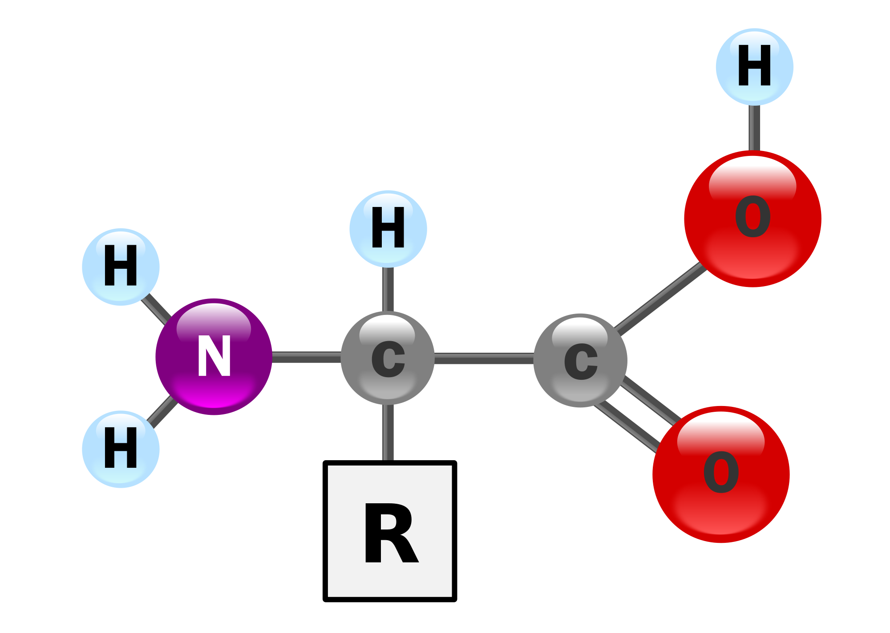
Amino Acid Structure
All amino acids have a central carbon, an amino group, and a carboxyl group
An enzyme of the ribosome catalyzes formation of a peptide bond between the carboxyl group of one amino acid and the amino group of the next
The R-group of each amino acid is distinct; some are not charged, some are polar, and some are electrically charged
3

Slide 4
Polypeptide and Transcript Structure
Polypeptides are strings of amino acids that are assembled by ribosomes
Ribosomes are “machines” that contain multiple ribosomal RNAs (rRNAs) and proteins
Ribosomes translate mRNA in the 5′-to-3′ direction, reading each triplet codon and assembling the amino acids in the order specified by the codons
4

Slide 5
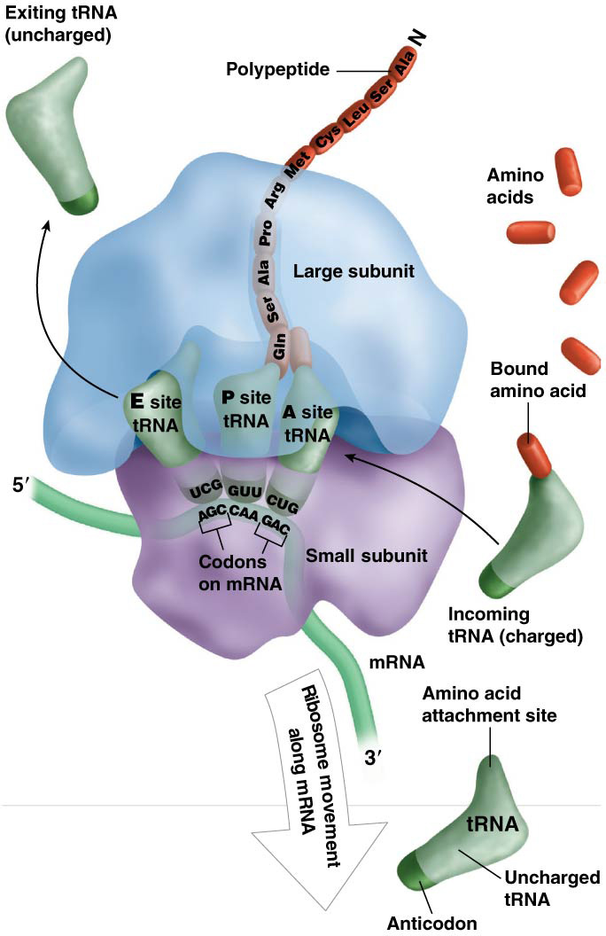
Figure 9.2 Translation overview.

Slide 6
Messenger RNA
The mRNA sequence dictates the resulting amino acid sequence
Boundaries of translation are defined by a start codon that corresponds to the N-terminus of the protein and a stop codon that corresponds to the C-terminus
The 5′ untranslated region (5′ UTR) and 3′ UTR are segments of the mRNA outside of the translated regions
6

Slide 7
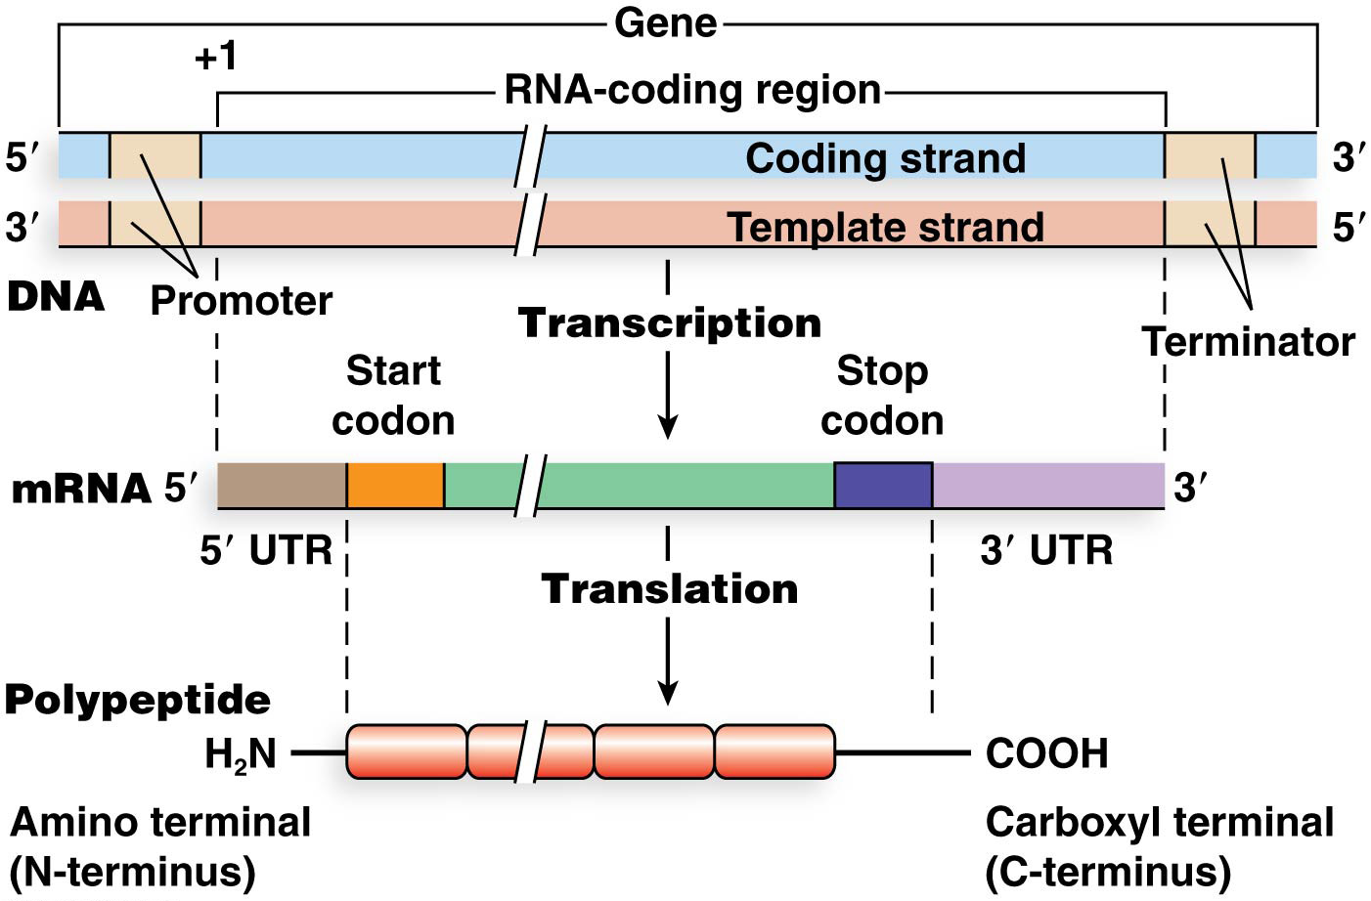
Figure 9.3 Alignment of DNA, mRNA, and polypeptide.

Slide 8
Polypeptide Structure
Polypeptides have four levels of organization
The sequence of amino acids in the polypeptide chain is the primary structure
Secondary structures form due to hydrogen bonding between different amino acids in the chain. Secondary structures include the alpha helix and the beta-pleated sheet
Tertiary structure results from a variety of interactions involving the R-groups of different amino acids in the polypeptide chain. Tertiary structure is dependent on primary and secondary structure
Quaternary structure contains two or more polypeptides
8

Slide 9
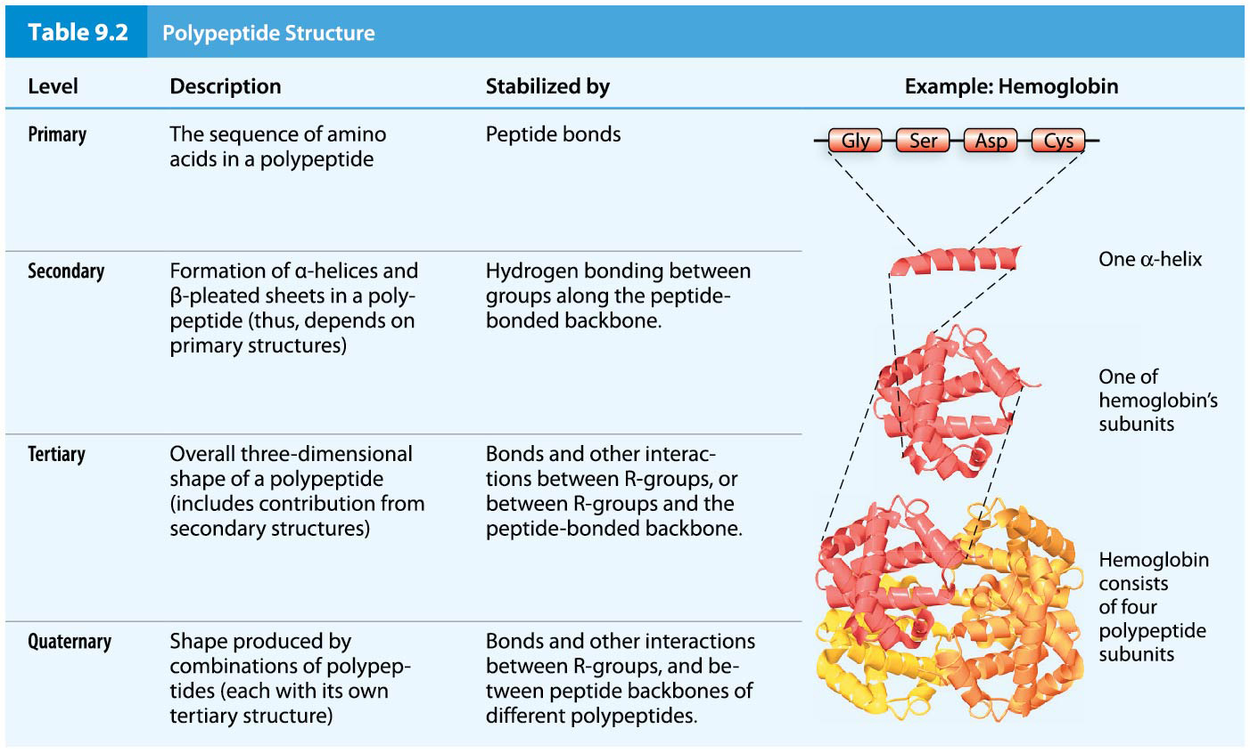
Table 9.2 Polypeptide Structure

Slide 10
Ribosome Structures
Ribosomes in bacteria, archaea, and eukaryotes perform three tasks:
Bind mRNA and identify the start codon, where translation begins
Facilitate complementary base pairing of mRNA codons and the corresponding tRNA anticodons
Catalyze formation of peptide bonds between amino acids on the growing polypeptide chain
10

Slide 11
Ribosome Composition
Ribosome composition—number and sequence of rRNA molecules and number and type of proteins—differs between bacteria, archaea, and eukaryotes
Ribosomes are composed of two subunits, the large ribosomal subunit and the small ribosomal subunit
Ribosomal subunit size is measured in Svedberg units (S), a property based on size, shape, and hydration state
11

Slide 12
Ribosomes of E. coli
Ribosomes of E. coli are the most thoroughly studied bacterial ribosomes
The large subunit is 50S and contains 32 proteins, a small 5S rRNA, and a large 23S rRNA
The small subunit is 30S and contains 21 proteins and one 16S rRNA molecule
The fully assembled ribosome is 70S
Figure 9.4 Ribosomes of bacteria,
12

Slide 13
Eukaryotic Ribosomes
Mammalian ribosomes are the most fully characterized of the eukaryotic ribosomes
The large subunit (60S) contains 45 to 50 proteins and three rRNA molecules, of 5S, 5.8S, and 28S
The small (40S) subunit contains about 35 proteins and one 18S rRNA
These ribosomes (80S) contain the P and E sites and the polypeptide channel
13

Slide 14
Important Regions of Ribosomes
The peptidyl site (P site) holds the tRNA to which the polypeptide is attached
The aminoacyl site (A site) binds a new tRNA molecule containing an amino acid to be added to the growing polypeptide chain
The exit site (E site) provides an avenue for exit of the tRNA after its amino acid has been added to the chain
Ribosomes also form a channel from which the polypeptide chain emerges
14

Slide 15
9.2 Translation Occurs in Three Phases
Translation can be divided into three phases: initiation, elongation, and termination
The phases are similar in bacteria and eukaryotes, though there are several differences
The differences lie largely in how the start codon is identified when translation is initiated
15

Slide 16
INITIATION

Slide 17
Translational Initiation
1) Initiation begins when the small ribosomal subunit binds near the 5′ end of the mRNA and identifies the start codon
2) The initiator tRNA, carrying the first amino acid of the polypeptide, binds to the start codon
3) Finally, the large subunit joins the small subunit to form the intact ribosome and translation begins
17

Slide 18
Initiation
Initiation factor proteins help control ribosome formation and binding of the initiator tRNA
GTP provides the energy for initiation
tRNAs used during translation that carry an amino acid are called charged tRNAs, whereas tRNAs without amino acids attached are uncharged
24

Slide 19
Bacterial Translational Initiation
In E. coli, six molecular components come together to initiate translation:
1) mRNA
2) the small ribosomal subunit,
3) the large subunit,
4) the initiator tRNA,
5) three initiation factor proteins,
and 6) GTP
For most of initiation, the 30S subunit is affiliated with an initiation factor (IF3) which prevents the 30S subunit from binding the 50S subunit. The small subunit–IF3 complex binds near the 5′ end of the mRNA, searching for the start codon

Slide 20
The Shine–Dalgarno Sequence
The preinitiation complex forms when the 16S rRNA bind the Shine–Dalgarno sequence on the mRNA base-pair. The Shine–Dalgarno sequence is a purine-rich sequence located between three to nine nucleotides upstream of the start codon
20

Slide 21
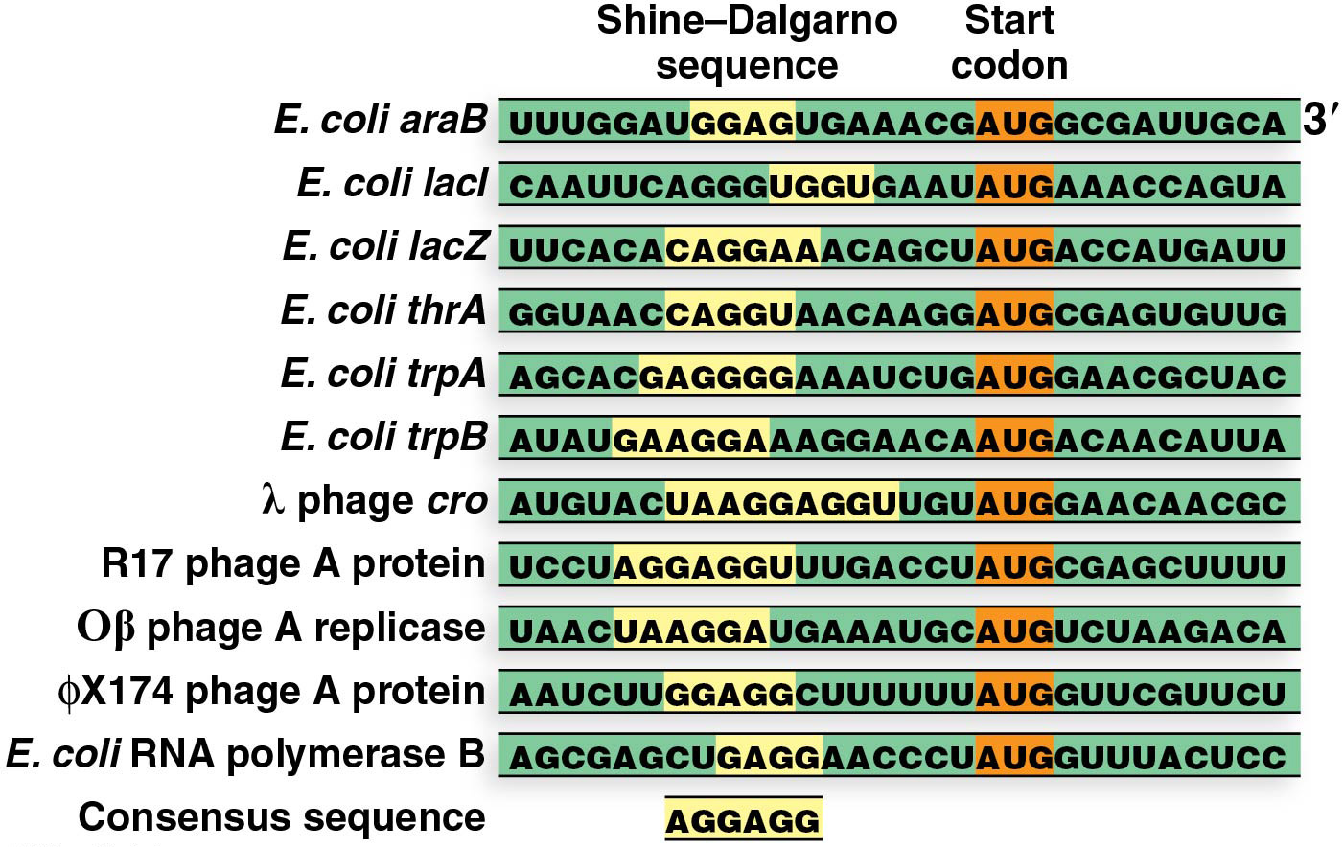
Figure 9.7 The Shine–Dalgarno consensus binding sequence.

Slide 22
The Second Step of Initiation
The initiator tRNA binds to the start codon where the P site will be once the ribosome is fully assembled
The amino acid on the initiator tRNA is a modified amino acid, N-formylmethionine (fMet); the charged initiator tRNA is called tRNA^{fMet}
Initiation factor, IF2, and a GTP molecule are bound at the P site to facilitate binding of tRNA^{fMet} and IF1 joins the complex; together these form the 30S initiation complex
22

Slide 23
Figure 9.6 Initiation of bacterial translation.

Slide 24
The Final Step of Initiation
In the last stage of initiation, the 50S subunit joins the 30S subunit to form the intact ribosome
The union of the two subunits is driven by hydrolysis of GTP to GDP
The dissociation of IF1, IF2, and IF3 accompanies the joining of the subunits to create the 70S initiation complex
24

Slide 25
Figure 9.6 Initiation of bacterial translation.

Slide 26
Eukaryotic Translational Initiation
The eukaryotic 40S ribosomal subunit complexes with eukaryotic initiation factor (eIF) proteins
eIF1, eIF1A, and eIF3 bind the small subunit to form the preinitiation complex
The preinitiation complex then joins with the initiator tRNA and eIF5
26

Slide 27
Later Steps of Eukaryotic Initiation
The mRNA joins the preinitiation complex to form the initiation complex
Once the initiation complex is formed, it uses scanning to move the small subunit along the 5′ UTR in search of the start codon
Approximately 90% of eukaryotic mRNAs use the first AUG as the start codon
27

Slide 28
The Final Steps of Eukaryotic Initiation
The correct start codon (AUG) can be located because it is embedded in a consensus sequence: 5′-ACCAUGG-3′ (the Kozak sequence)
Location of the start codon leads to recruitment of the 60S subunit to the complex, using energy from GTP hydrolysis, and the dissociation of the eIF proteins
28

Slide 29
ELONGATION

Slide 30
Polypeptide Elongation
Elongation begins with recruitment of elongation factor (EF) proteins that use energy of GTP hydrolysis to:
Recruit charged tRNAs to the A site
Form peptide bonds between sequential amino acids
Translocate the ribosome in the 3′ direction along the mRNA
30

Slide 31
Polypeptide Elongation in Bacteria
Several different EFs and other ribosomal proteins carry out elongation in a series of steps
Charged tRNAs affiliated with EF-Tu and GTP inspect the open A site; the tRNA with the correct anticodon sequence enters the A site
tRNA pairs with the mRNA codon and hydrolysis of GTP releases EF-Tu-GDP from tRNA
Peptidyl transferase catalyzes peptide bond formation between amino acids at the P and A sites, elongating the polypeptide and transferring it to the tRNA at the A site
31

Slide 32
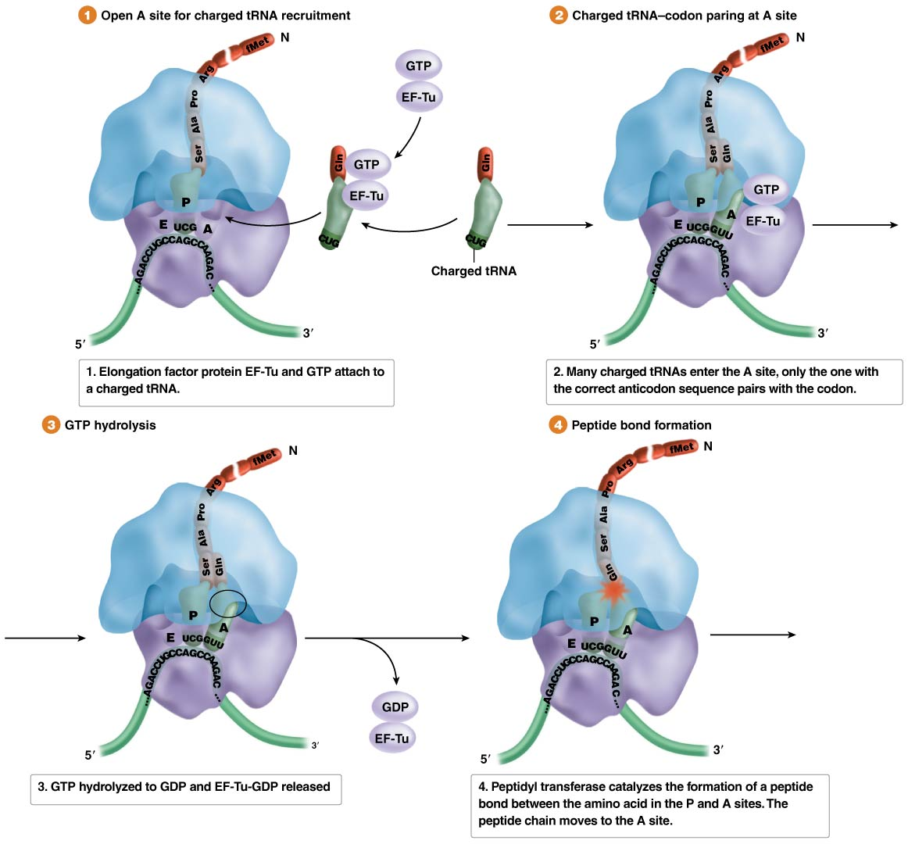
Figure 9.9 Bacterial Translation Elongation

Slide 33
Additional Steps of Elongation
The tRNA from the P site then exits through the E site
Using GTP hydrolysis, EF-G translocates the ribosome, moving it three nucleotides toward the 3′ end of the mRNA
This moves the tRNA at the A site to the P site and opens the A site for the next charged tRNA carrying the correct anticodon
33

Slide 34
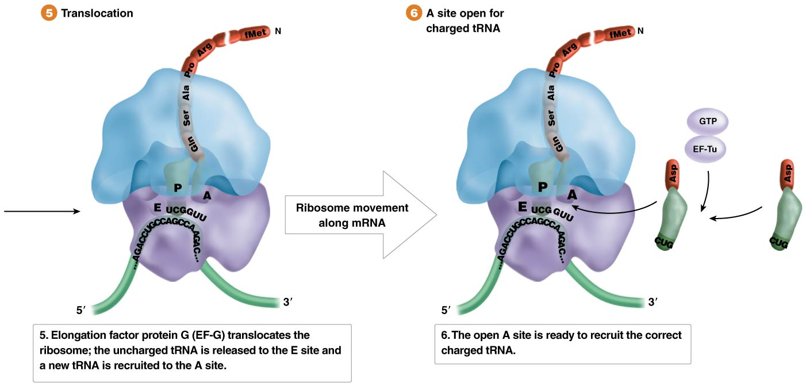
Figure 9.9 Bacterial Translation Elongation

Slide 35
Elongation of Eukaryotic and Archaeal Polypeptides
Distinct elongation factors carry out elongation in eukaryotes and archaea and the steps are similar to those of bacteria
Based on sequence, archaeal and eukaryotic EF homologs are more alike than archaeal and bacterial EFs
This sequence comparison reinforces the conclusion that eukaryotes and archaea are more closely related to one another than either is to bacteria
35

Slide 36
TERMINATION

Slide 37
Translation Termination
The elongation cycle continues until one of the three stop codons (UAA, UAG, UGA) enters the A site of the ribosome
All organisms use release factors (RF) to bind a stop codon in the A site
The polypeptide bound to the tRNA at the P site is then released while the RF is ejected and the ribosomal subunits separate
37

Slide 38
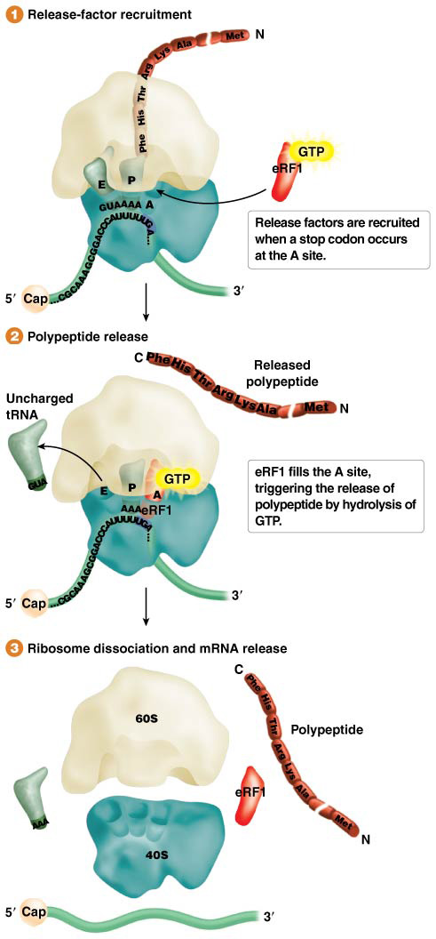
Figure 9.10 Termination of translation by release factor (eRF) proteins.

Slide 39
Figure 9.10 Termination of translation by release factor (eRF) proteins.

Slide 40
Release Factors
In bacteria there are several release factors. The release factor RF1 recognizes UAG and UAA and RF2 recognizes UAA and UGA, while RF3 recycles RF1
Eukaryotic and archaeal termination is accomplished by a single release factor eRF1 in eukaryotes and aRF1 in archaea, each of which recognizes all three stop codons
Eukaryotes have a second release factor that recycles eRF1
40

Slide 41
Translation and Transcription
Translation is an active and ongoing process that works highly efficiently
In bacteria, the coupling of transcription and translation allows ribosomes to begin translating mRNAs that have not yet been completed
In eukaryotes, mRNAs are produced in the nucleus
Eukaryotic mRNAs must be processed to form mature mRNAs and then exported to the cytoplasm for translation
41

Slide 42
Translation of Bacterial Polycistronic mRNA
Each polypeptide-producing gene in eukaryotes produces monocistronic mRNA, an RNA that directs synthesis of a single kind of polypeptide
Groups of bacterial and archaeal genes, called operons, often share a single promoter and produce polycistronic mRNAs that lead to synthesis of several different proteins
The genes of operons function in the same metabolic pathway and are regulated as a unit
42

Slide 43
Polycistronic mRNA
Polycistronic mRNAs contain multiple polypeptide-producing segments, each with a translation-initiating region
In all but leaderless archaeal mRNAs, the translation-initiating region contains a Shine–Dalgarno site and start and stop codons
An intercistronic spacer sequence that is not translated separates the segments
When the spacer sequences are short (a few nucleotides long), intact ribosomes may proceed to the next start codon after finishing translation of the previous segment
43

Slide 44
Figure 9.12 Polycistronic mRNA.

Slide 45
9.4 The Genetic Code Translates Messenger RNA into Polypeptide
The term “genetic code” describes the correspondence between mRNA codon sequences and the amino acid sequences of the resulting polypeptides
Transfer RNAs (tRNAs) are adaptor molecules that interpret and then act on information carried in mRNA. They have anticodon sequences complementary to mRNA codons
45

Slide 46
The Triplet Code
Groups of three consecutive nucleotides (codons) in an mRNA each correspond to one amino acid
The genetic code contains 64 different codons; with only 20 common amino acids, this leads to redundancy—some amino acids are specified by more than one codon
46

Slide 47
47

Slide 48
The Genetic Code Displays Third-Base Wobble
The triplet genetic code, with 64 combinations, provides enough variety to code 20 amino acids
61 codons specify amino acids, and 3 are stop codons
All amino acids except methionine (Met) and tryptophan (Trp) are specified by at least two codons, called synonymous codons
48

Slide 49
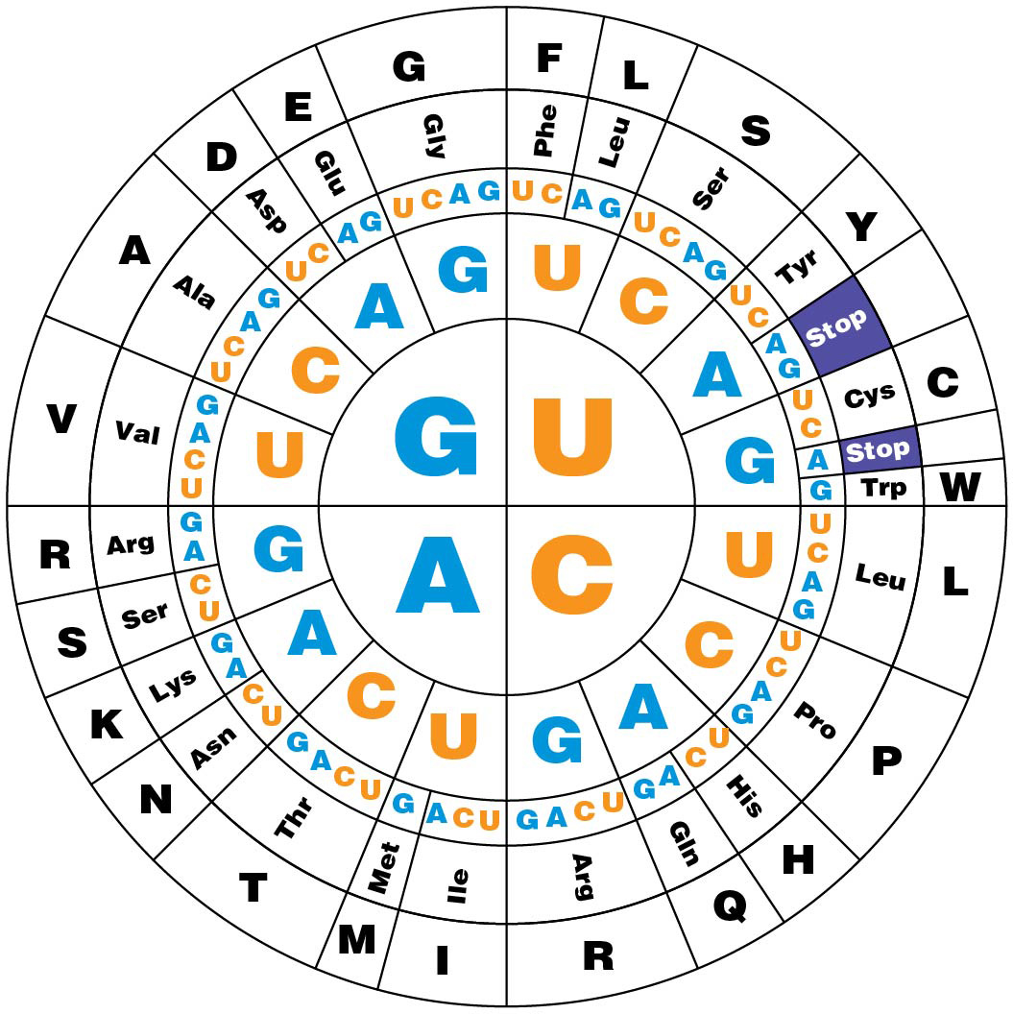
Figure 9.13 The genetic code.

Slide 50
Third-Base Wobble
tRNA molecules with different anticodons for the same amino acids are called isoaccepting tRNAs
Though there are 61 different codons that specify amino acids, most genomes have 30 to 50 different tRNA genes
A relaxation of the strict complementary base-pairing rules at the third base of the codon is called third-base wobble
50

Slide 51
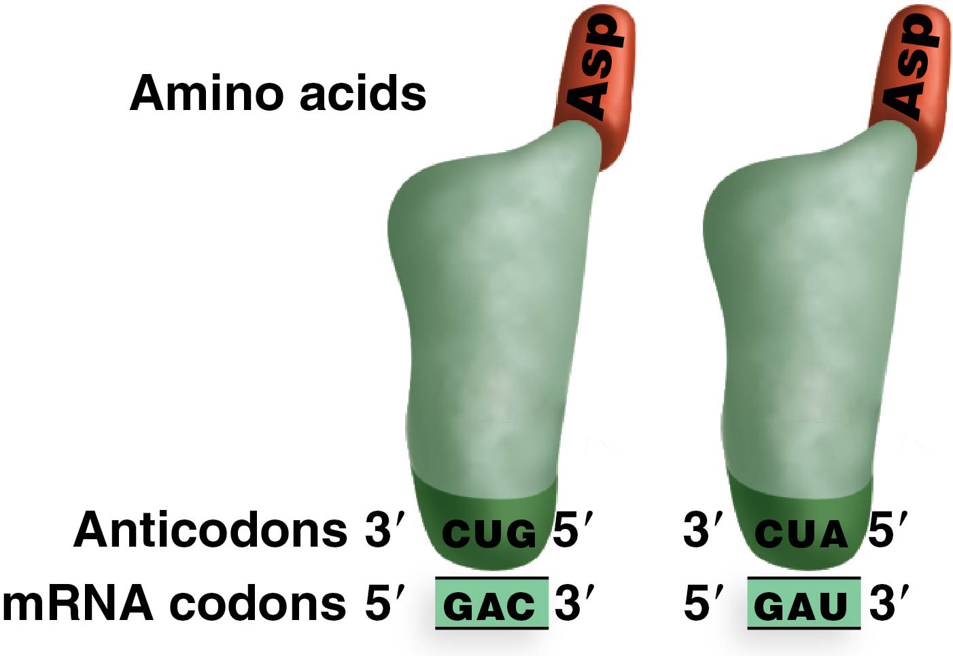
Figure 9.14 Codon–anticodon pairing.

Slide 52
How Third-Base Wobble Works
Most synonymous codons can be grouped into pairs that differ only in the third base; the pairs either both carry a purine (A or G) or both carry a pyrimidine (C or U)
Third-base wobble occurs through flexible pairing at the 3′-most nucleotide of the codon and the 5′-most nucleotide of the anticodon
However, a pyrimidine must still base-pair with a purine
52

Slide 53
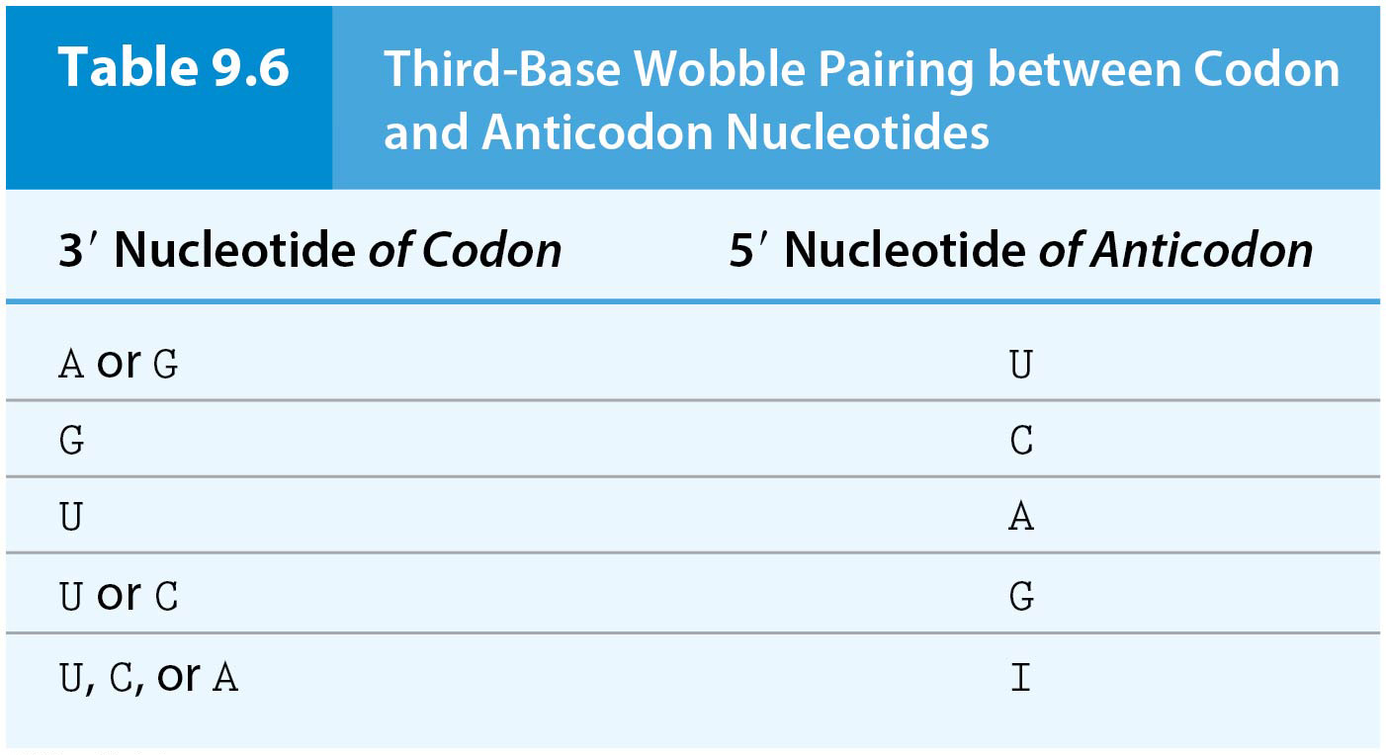
Table 9.6 Third-Base Wobble Pairing between Codon and Anticodon Nucleotides
A modified nucleotide inosine (I)

Slide 54
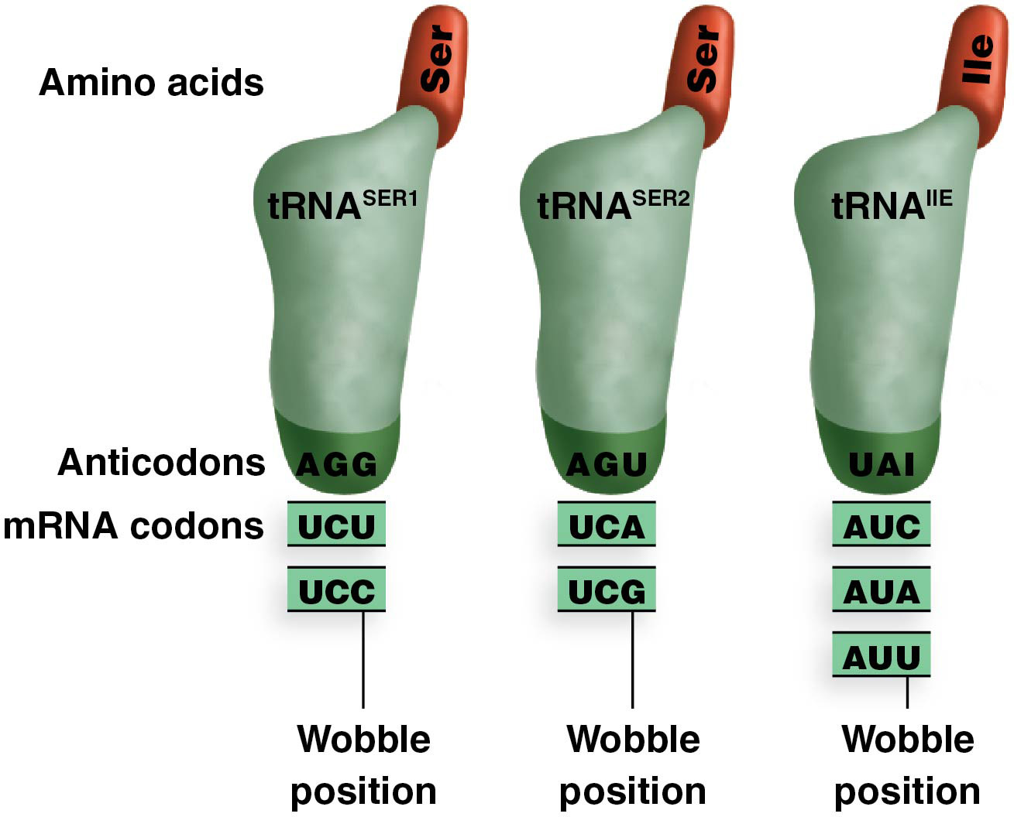
Figure 9.15 Effect of wobble

Slide 55
Charging tRNA Molecules
tRNA molecules are transcribed from tRNA genes
Correct charging of each tRNA molecule is crucial for the integrity of the genetic code
Enzymes called aminoacyl-tRNA synthetases or tRNA synthetases catalyze the addition of the correct amino acid to tRNAs
Recognition of the isoaccepting tRNAs by the enzyme is complex with no single set of rules
55

Slide 56
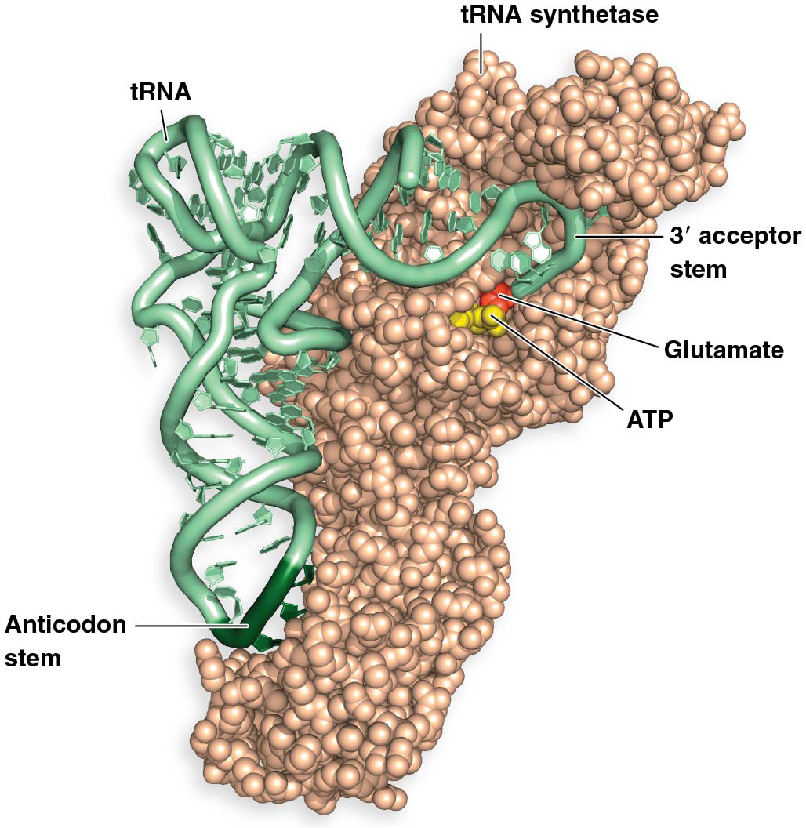
tRNA Synthetase
tRNA synthetase is a large molecule that contacts several points on the tRNA in the recognition process
The acceptor stem of the correct tRNA fits into the active site of the enzyme
The active site contains the amino acid to be added to the tRNA; ATP provides the energy for amino acid attachment
56

Slide 57
No Overlap in the Genetic Code
If the genetic code were nonoverlapping, each mRNA nucleotide would be part of a single codon
If the code were overlapping, each nucleotide could be part of multiple codons
In 1957, Sidney Brenner determined that an overlapping code was not possible because it restricted evolutionary flexibility and was unsupported by biochemical observations
57

Slide 58
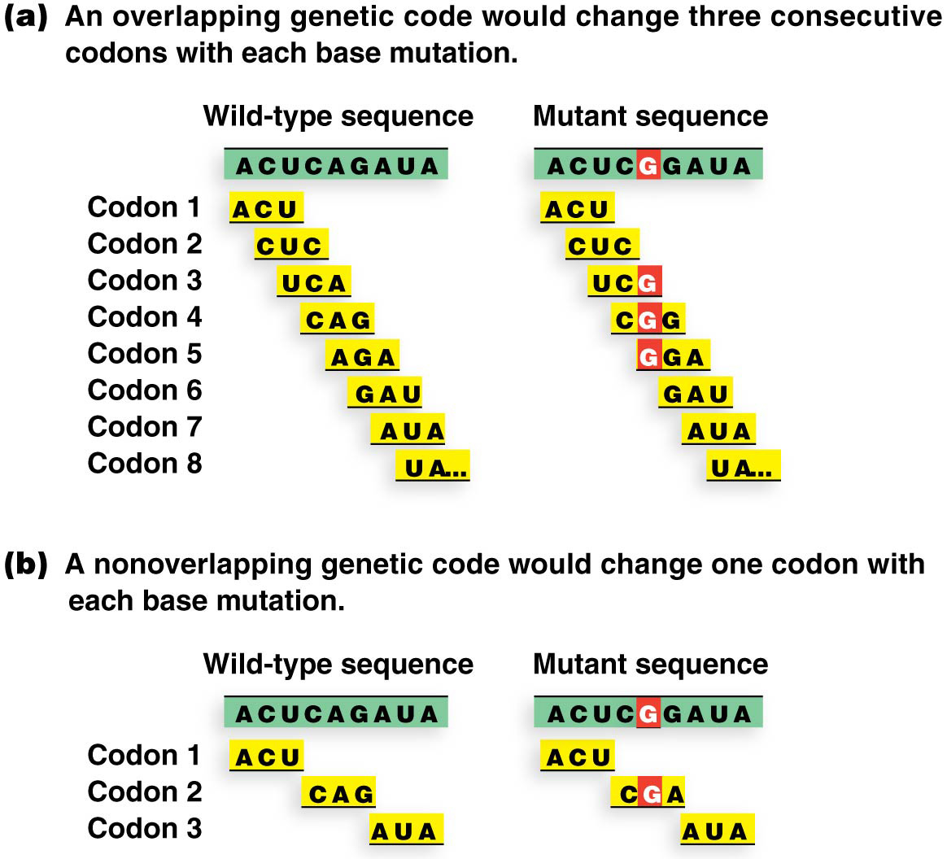
Figure 9.17 Proof that the genetic code is nonoverlapping.

Slide 59
A Triplet Genetic Code
Proof of a triplet genetic code came in 1961 when researchers (Crick, Barnett, Brenner, and Watts-Tobin) created mutations by insertion or deletion of single base pairs in the rII gene in T4 bacteriophage
This leads to a change in the reading frame of the mRNA
Reading frame refers to the specific codon sequence as determined by the start codon
59

Slide 60
Frameshift Mutations
Mutations that alter the reading frame are called frameshift mutations and garble the sense of the translated message:
Wild type: YOU/MAY/NOW/SIP/THE/TEA
Mutant addition: YOU/MAC/YNO/WSI/PTH/ETE/A
Mutant deletion: YOU/MAY/NOS/IPT/HET/EA
All the codons after the addition or deletion will specify the wrong amino acids
60

Slide 61
Reversion of Frameshift Mutations
Frameshift mutations may be restored if a second mutation in a different location in the gene restores part of the reading frame (reversion mutation)
Mutant addition: YOU/MAC/YNO/WSI/PTH/ETE/A
Reversion mutant deletion: YOU/MAC/YNO/SIP/THE/TEA
The frameshift is now confined to just a small area between the original mutation and the reversion mutation—the rest of the protein (sentence) is normal
61

Slide 62
Deciphering the Genetic Code
The genetic code was deciphered between 1961 and 1965
It was a milestone in establishing the central dogma of biology: DNA → RNA → protein
62

Slide 63
First Steps in Deciphering the Genetic Code
Nirenberg and Matthaei performed an experiment in 1961 that laid the groundwork for later work
Strings of repeating nucleotides were translated in vitro and the resulting polypeptide identified
For example, an artificial mRNA containing only uracils, poly(U), resulted in polypeptides containing only phenylalanine, so the codon UUU corresponds to the amino acid Phe
63

Slide 64
The (Almost) Universal Genetic Code
In all organisms from bacteria to humans, the processes of transcription and translation are similar
Because the genetic code is universal, bacteria can be used to produce important proteins from plants and animals
However, there are a few exceptions to the universality of the genetic code, found principally in mitochondria, though there are two exceptions in living organisms
64

Slide 65
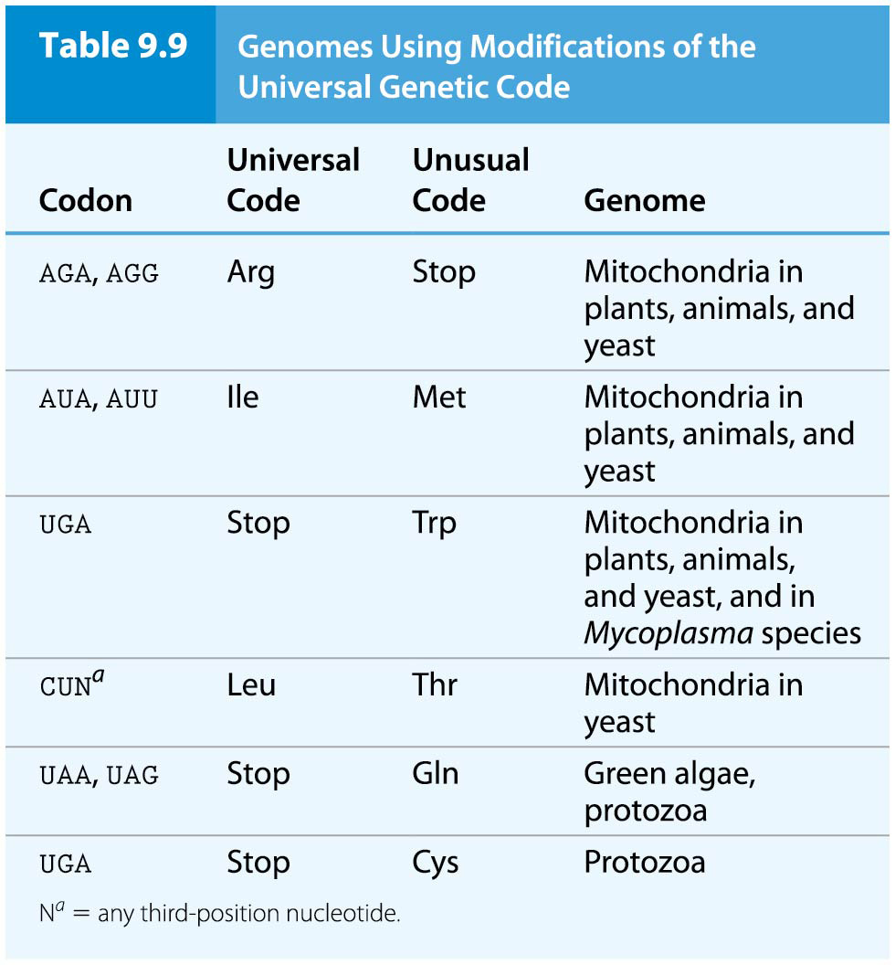
Table 9.9 Genomes Using Modifications of the Universal Genetic Code

Slide 66
9.6 Translation Is Followed by Polypeptide Folding, Processing, and Protein Sorting
The production of functional proteins from polypeptides is not complete until polypeptides are chemically modified and transported to their final destinations, inside or outside the cell
66

Slide 67
Two Categories of Events
Two categories of posttranslational events modify and transport polypeptides
Posttranslational polypeptide processing modifies polypeptides into functional proteins by removal or chemical alteration of amino acids
Signal sequences direct proteins to their cellular destinations
67

Slide 68
Posttranslational Processing
The removal of one or more amino acids from a polypeptide is a common form of posttranslational polypeptide processing
For example, fMet is not found in functional bacterial proteins, nor is methionine always the first amino acid in eukaryotic proteins
The absence of these from the N-terminus of proteins is due to their removal after translation
68

Slide 69
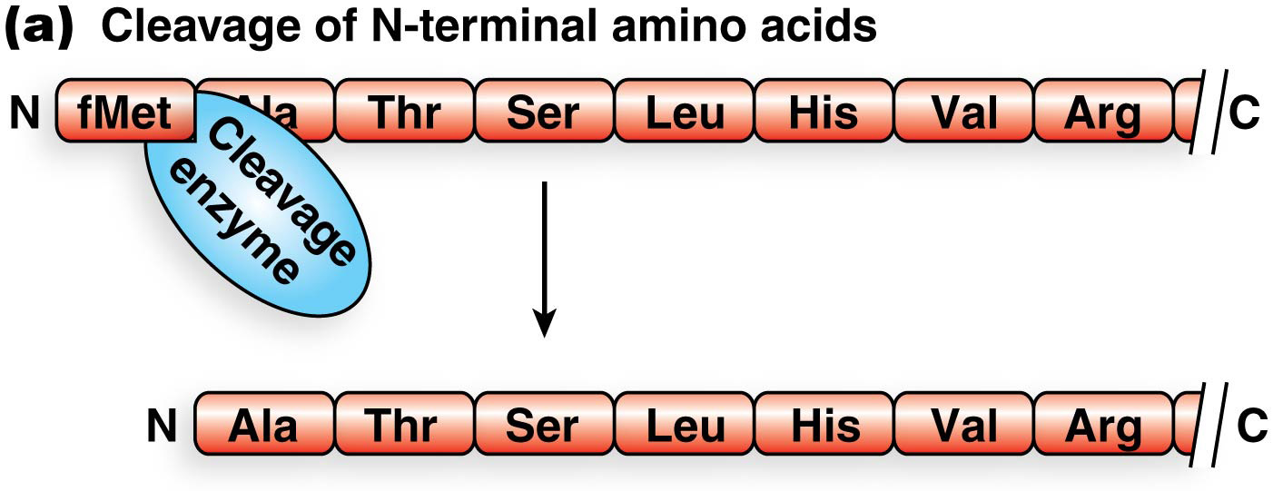
Figure 9.20a Examples of posttranslational processing.

Slide 70
Modification of Amino Acids
One of the most common amino acid modifications is phosphorylation, carried out by kinases
This modification can activate or inactivate a protein
Other enzymes may add methyl, hydroxyl, or acetyl groups to amino acids
70

Slide 71
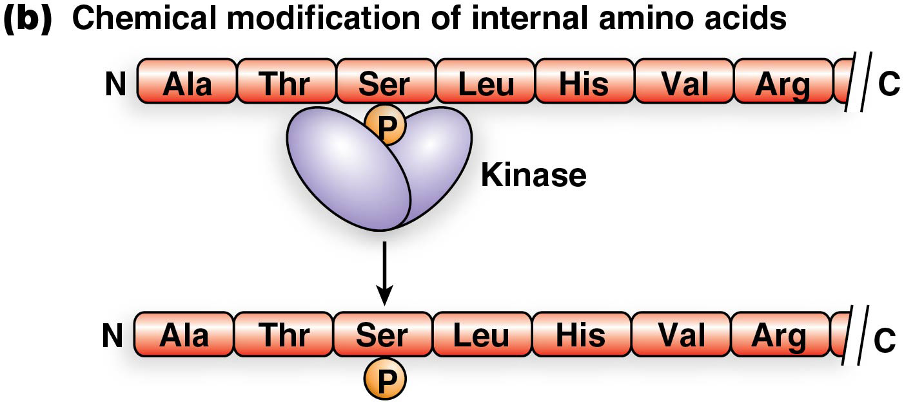
Figure 9.20b Examples of posttranslational processing.

Slide 72
Cleavage of Polypeptides
Polypeptides may be cleaved into multiple segments that have separate functions or that aggregate to form a functional protein
The hormone insulin is first produced as preproinsulin, from which the pre–amino acid segment at the N-terminus is cleaved to produce proinsulin
Proinsulin forms disulfide bonds and is cleaved again to produce insulin, a functional protein consisting of the A-chain and B-chain segments
72

Slide 73
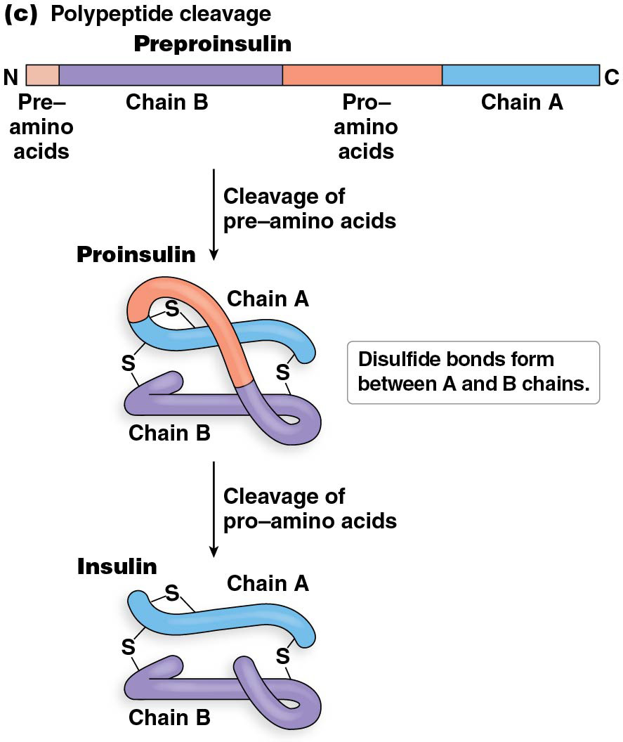
Figure 9.20c Examples of posttranslational processing.

Slide 74
Protein Sorting
The signal hypothesis suggests a mechanism by which proteins are transported to their correct locations
It proposes that the first 15 to 20 amino acids of many polypeptides contain an “address label” that directs proteins to their correct locations
Blobel suggested that the signal sequence directs proteins to the endoplasmic reticulum (ER), where they are sorted for their specific destinations
74

Slide 75
Role of ER in Protein Sorting
Polypeptides destined for secretion are produced at the rough ER (endoplasmic reticulum )
These polypeptides are translated into the cisternal space of the rough ER
Once inside, polypeptides are processed and packaged for transport to the Golgi apparatus
In the Golgi apparatus, proteins are further processed and then packed into vesicles for transport to their intercellular destination
75

Slide 76
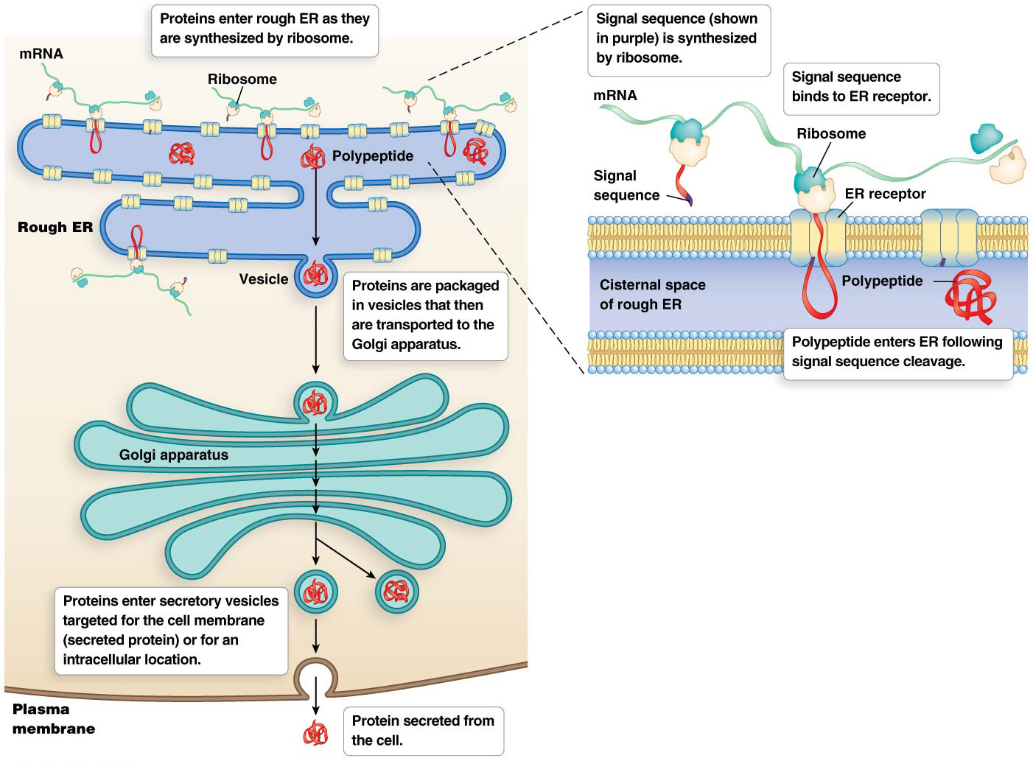
Figure 9.21 Proteins enter the endoplasmic reticulum (ER).

