Slide 1
12

Slide 2
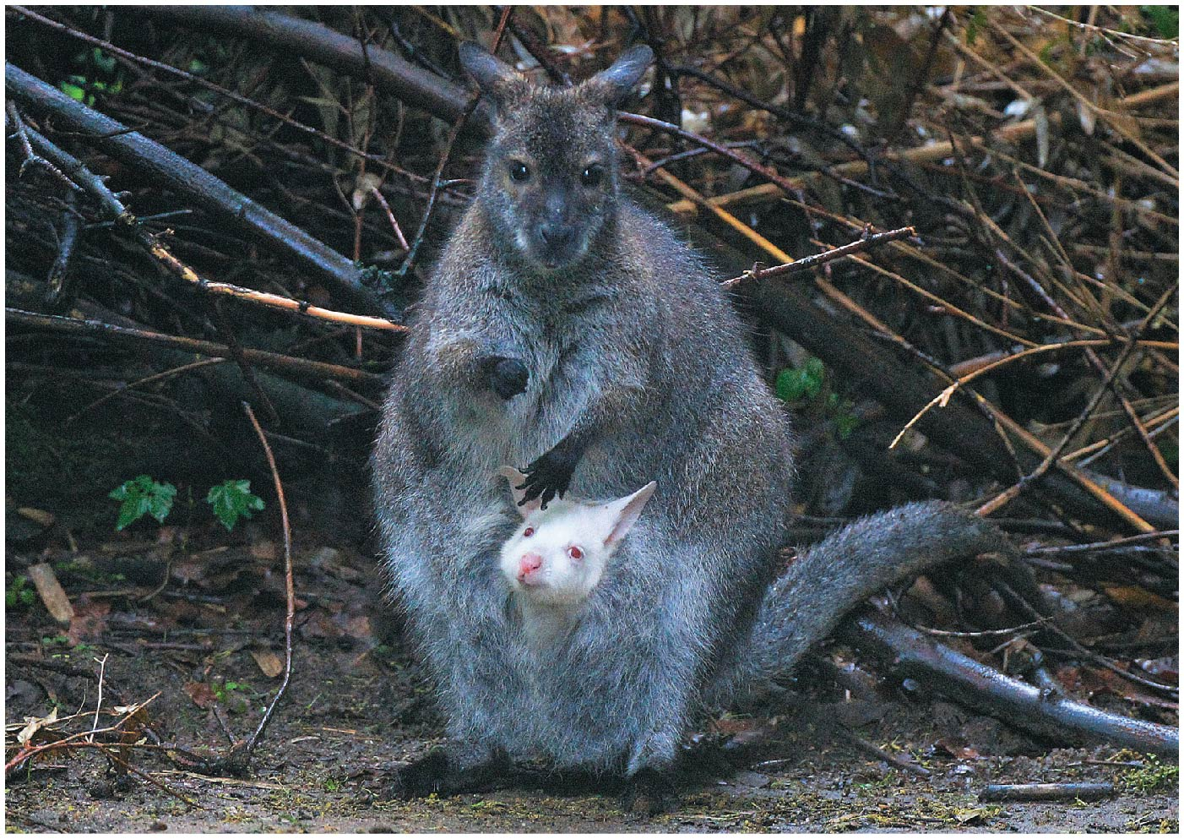
Chapter 12 Opener

Slide 3
12.1 Mutations Are Rare and Occur at Random
Mutation rates are low in all genomes, contributing slowly to inherited diversity
Mutations are random and usually deleterious, impairing function of the gene or gene product
Mutations generate inherited genetic diversity that fuels evolutionary change
Mutation rates vary among organisms and among different genes of a single species
3

Slide 4
Mutation Rates
In bacteria and other haploid organisms, mutation rate is measured as the number of times mutation alters a particular gene per replication cycle or generation
Mutation rate is defined and studied differently in sexually reproducing diploids
It is defined as the number of mutational events in a given gene per generation
4

Slide 5
Study of Mutation Rate
Dominant mutations are easier to detect than recessive mutations since a single copy will manifest in the phenotype
Average mutation rates may be as low as 1 × 10⁻⁹ and as high as 1 × 10⁻⁴ depending on organism
Factors such as genome size and life cycle of the organism affect mutation rates
5

Slide 6
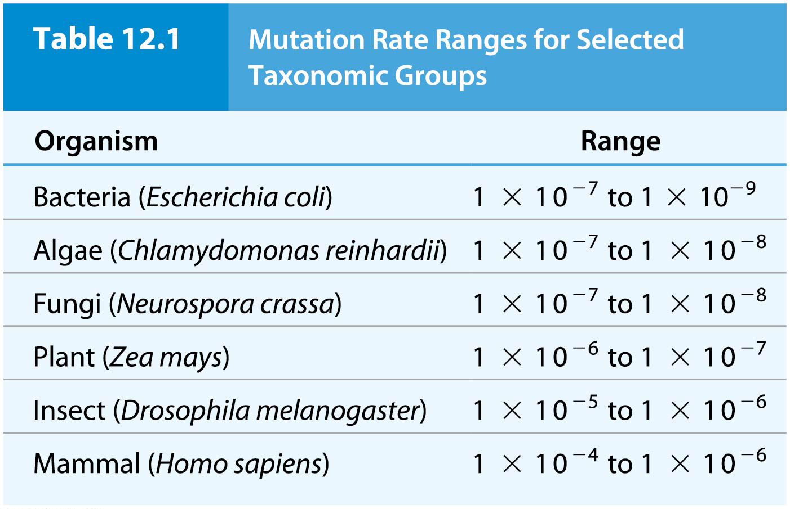
Table 12.1 Mutation Rate Ranges for Selected Taxonomic Groups

Slide 7
Variation in Mutation Rate
Each species has an average mutation rate; those with larger genomes have, on average, higher mutation rates
Mutation rates for some genes are considerably higher than others in a given genome; genes that have elevated mutation rates are called hotspots of mutation
One reason for mutational hotspots is large gene size
7

Slide 8
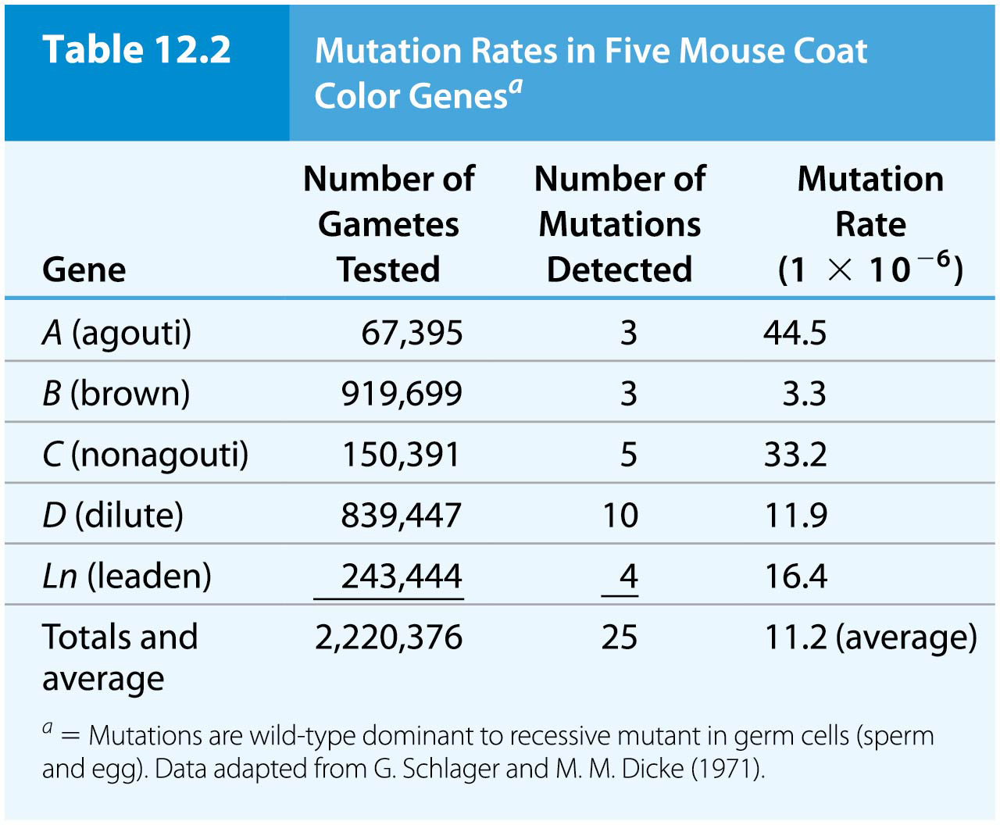
Table 12.2 Mutation Rates in Five Mouse Coat Color Genes

Slide 9
Determination of Mutation Rate from Genome Sequence Analysis
When analyzing expressed genes for mutation detection, only a small part of the genome can be sampled
Whole genome sequencing allows assessment of mutation rates throughout the genome
9

Slide 10
12.2 Gene Mutations Modify DNA Sequence
Gene mutations substitute, add, or delete one or more DNA base pairs
Localized mutations, or point mutations, occur at a specific, identifiable position in a gene
Such mutations have varied consequences depending on the type of sequence change and the location of the affected part of the gene
10

Slide 11
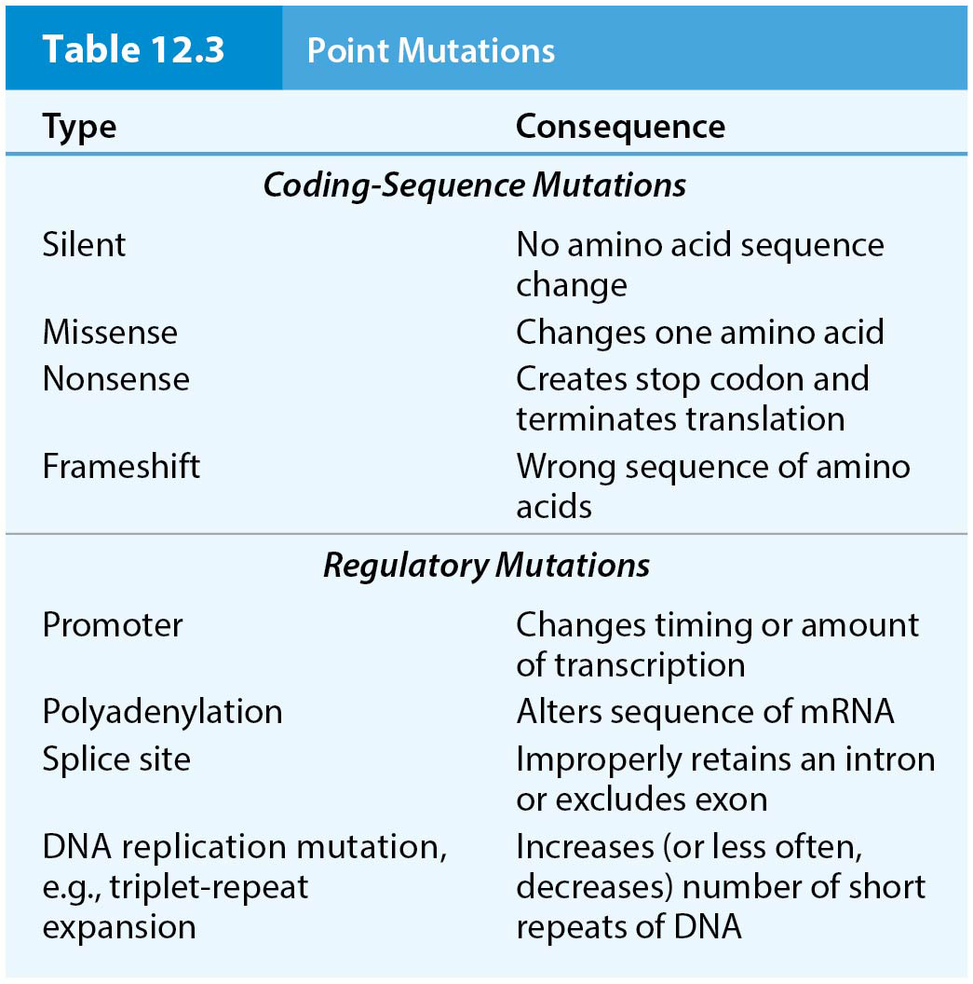
Table 12.3 Point Mutations

Slide 12
Base-Pair Substitution Mutations
Base-pair substitution mutations: the replacement of one nucleotide base pair by another
Transition mutations: one purine (A,G) replaces another, or one pyrimidine (T,C) replaces another
Transversion mutations: a pyrimidine is replaced by a purine or vice versa
12

Slide 13
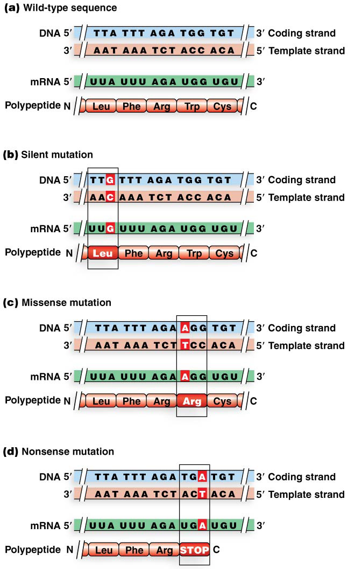
Three Types of Base-Pair Substitution Mutations
Silent mutation: a base-pair change that does not alter the resulting amino acid due to the redundancy of the genetic code
Missense mutation: a base-pair change that results in an amino acid change in the protein
Nonsense mutation: a base-pair change that creates a stop codon in place of a codon specifying an amino acid
13

Slide 14
Frameshift Mutations
Insertion or deletion of one or more base pairs leads to addition or deletion of mRNA nucleotides, altering the reading frame of the message
These are called frameshift mutations
The wrong amino acid sequence is produced starting at the point of mutation; premature stop codons may also be produced
14

Slide 15
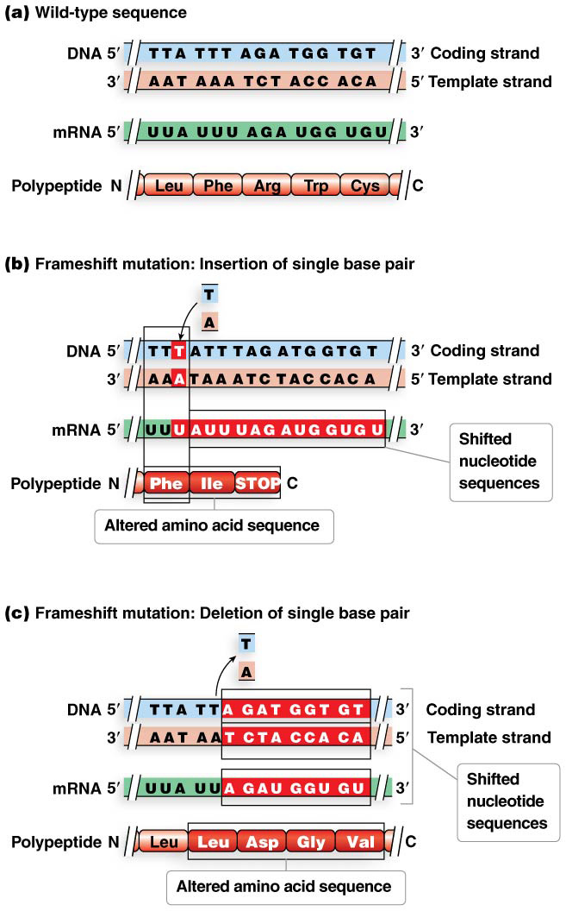
Figure 12.2 Frameshift mutation.

Slide 16
Regulatory Mutations
Some point mutations alter the amount (but not the amino acid sequence) of protein product produced by a gene
These regulatory mutations affect regions such as promoters, introns, and the regions coding for 5′-UTR and 3′-UTR segments
Three types of regulatory mutations are recognized; promoter mutations, spicing mutations, and cryptic slice sites
16

Slide 17
Promoter Mutation
Mutations that alter consensus sequence nucleotides of promoters are called promoter mutations
These interfere with efficient transcription initiation
Some promoter mutations cause mild to moderate reductions in transcription levels, whereas others may abolish transcription
17

Slide 18
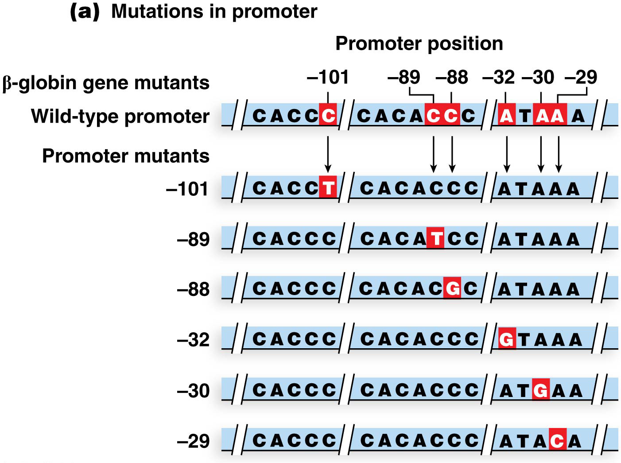
Figure 12.3a Regulatory mutations of the human β-globin gene.

Slide 19
Splicing Mutation
Efficient splicing of introns from mRNA requires specific sequences at either end of the intron
Mutations that alter these nucleotides are called splicing mutations
These can result in splicing errors and the production of mutant proteins due to the retention of intron sequences in the mRNA
19

Slide 20
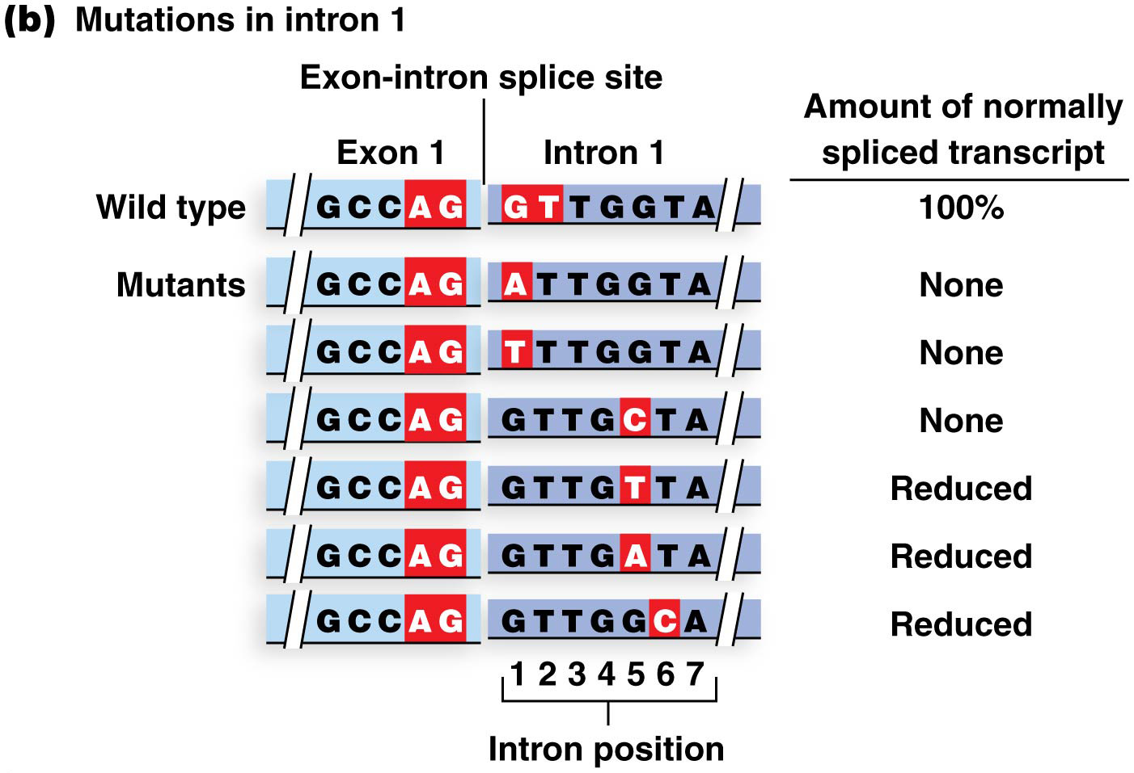
Figure 12.3b Regulatory mutations of the human β-globin gene.

Slide 21
Cryptic Splice Sites
Some base-pair substitution mutations produce new splice sites that replace or compete with authentic splice sites during mRNA processing
These are called cryptic splice sites
A base-pair substitution changing G to A at position 110 of human β-globin intron 1 creates an AG cryptic splice site
This leaves 19 additional nucleotides in the mature mRNA
21

Slide 22
Figure 12.4 Cryptic splicing.

Slide 23
Forward Mutation and Reversion
Forward mutation: converts a wild-type allele to a mutant allele
Reverse mutation or reversion: converts mutant alleles to wild-type or near wild-type allele
True reversion: wild-type DNA sequence is restored by a second mutation within the same codon
23

Slide 24
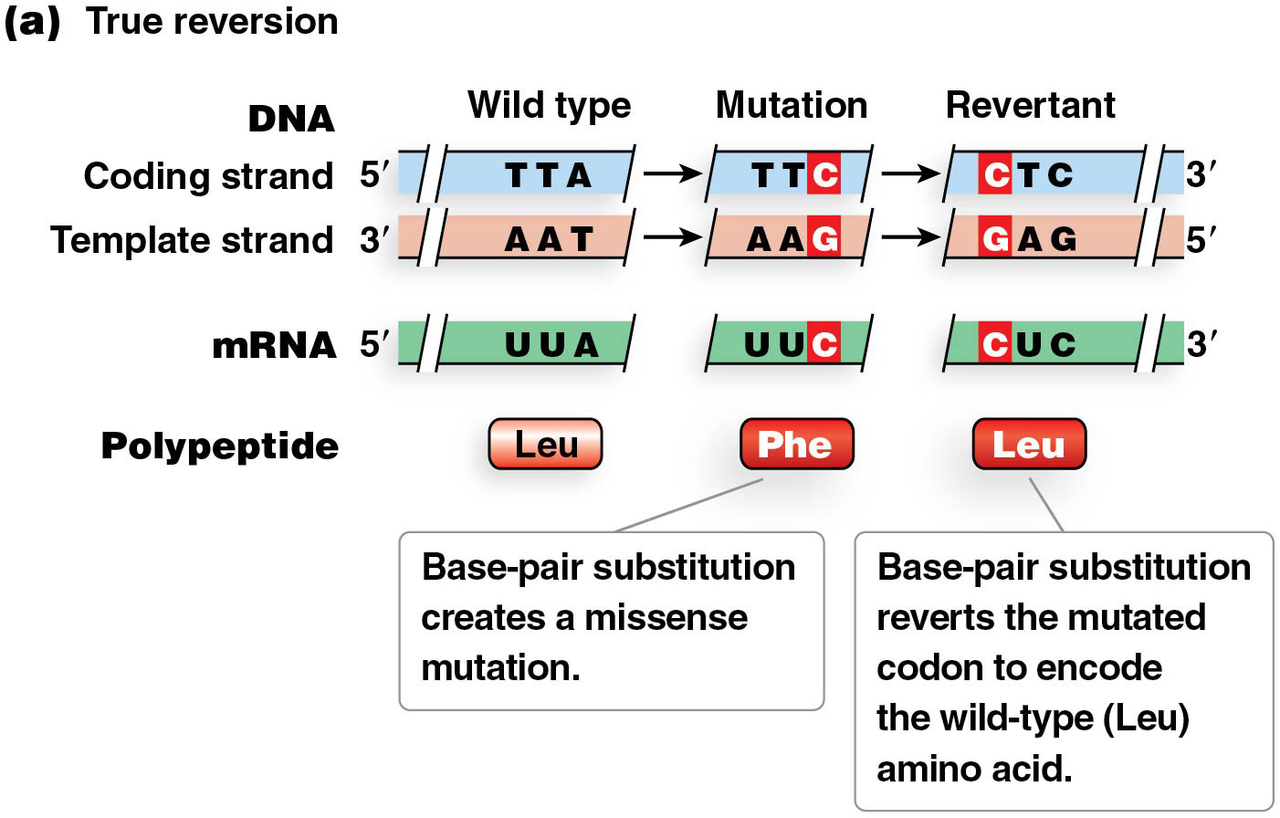
Figure 12.5a Reversion mutations.

Slide 25
Types of Reversion
Intragenic reversion: occurs through mutation elsewhere in the same gene
Second-site reversion: occurs by mutation in a different gene that compensates for the original mutation, restoring the organism to wild-type
Second-site reversions are also known as suppressor mutations because the second mutation “suppresses” the mutant phenotype caused by the first mutation
25

Slide 26
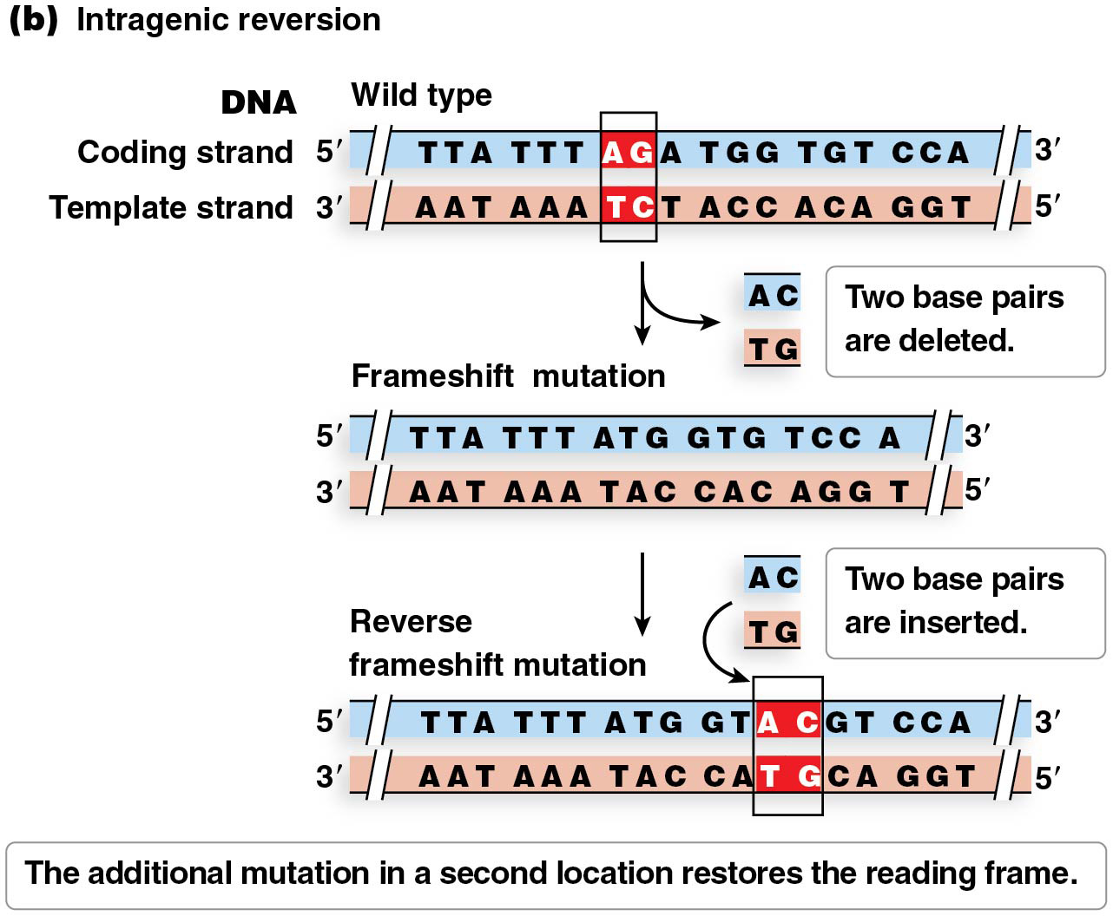
Figure 12.5b Reversion mutations.

Slide 27
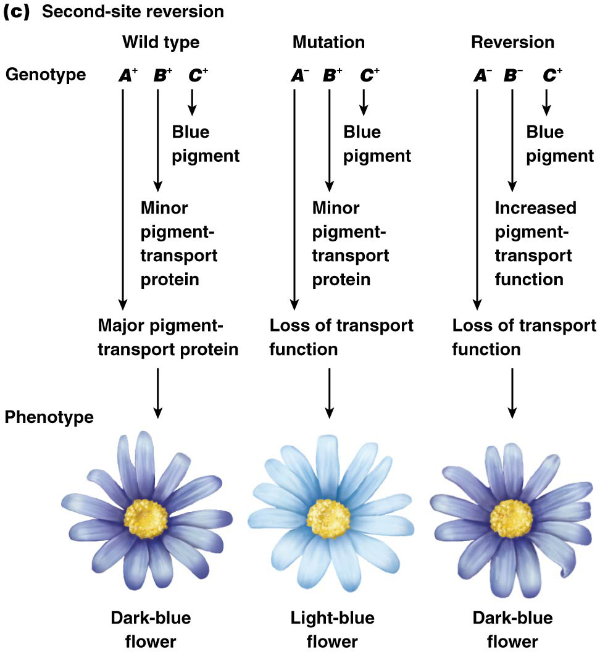
Figure 12.5c Reversion mutations.

Slide 28
12.3 Gene Mutations May Arise from Spontaneous Events
Spontaneous mutations arise in cells without exposure to agents capable of inducing mutation
These arise primarily through errors in DNA replication or spontaneous changes in the chemical structure of a nucleotide base
28

Slide 29
DNA Replication Errors
DNA replication has very high fidelity due to the proofreading ability of DNA polymerases and mismatch repair
Genomic regions containing repeat sequences experience higher degrees of errors during replication
These result in changes in number of base pairs in repeating sequences; they are another source of hotspots of mutation
29

Slide 30
Trinucleotide Repeat Disorders
Trinucleotide repeat disorders are a special class of mutations causing some hereditary diseases in humans and other organisms
Wild-type alleles of the genes in question normally have a variable number of DNA trinucleotide repeats
Increases in the number of repeats beyond a certain threshold cause the disorders
30

Slide 31
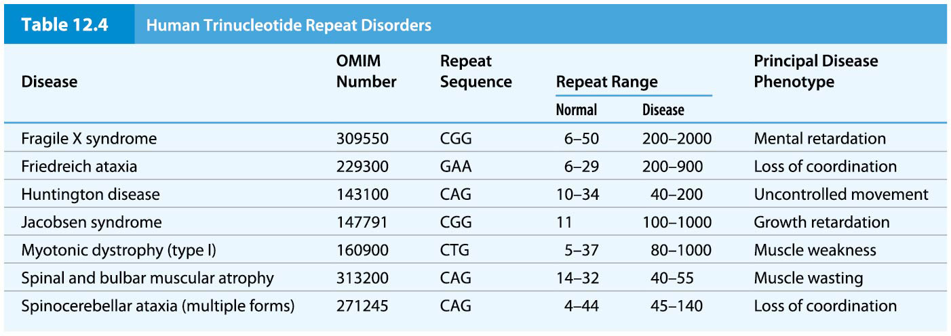
Table 12.4 Human Trinucleotide Repeat Disorders

Slide 32
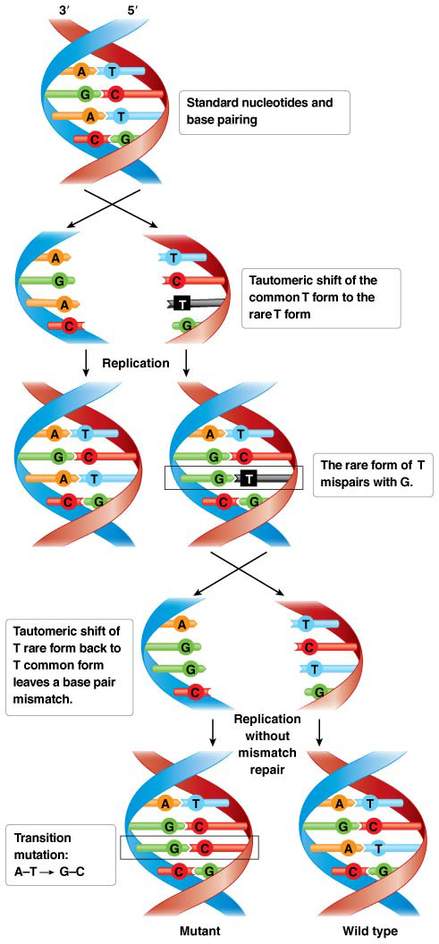
Spontaneous Nucleotide Base Changes
DNA nucleotide bases can occasionally convert to alternative structures called tautomers, with slight differences in bonding and placement of hydrogens
Tautomeric shifts can lead to base-pair mismatches and incorporation of incorrect bases during replication
This is the most common form of replication error
32

Slide 33
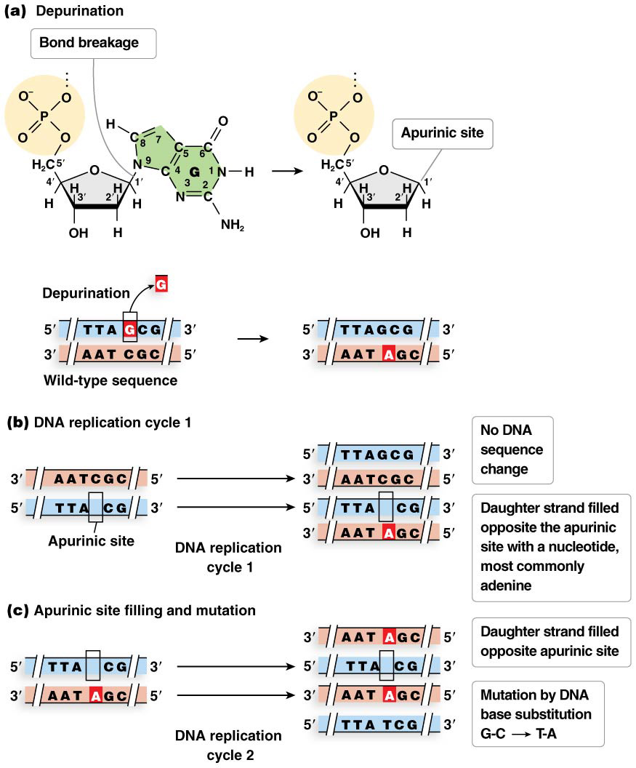
DNA Nucleotide Lesions
Depurination: the loss of a purine (A, G) from a nucleotide by breaking the covalent bond linking the nucleotide base to the sugar
An unrepaired lesion of this type is called an apurinic site
DNA polymerase will usually compensate by putting an adenine into the site during replication
33

Slide 34
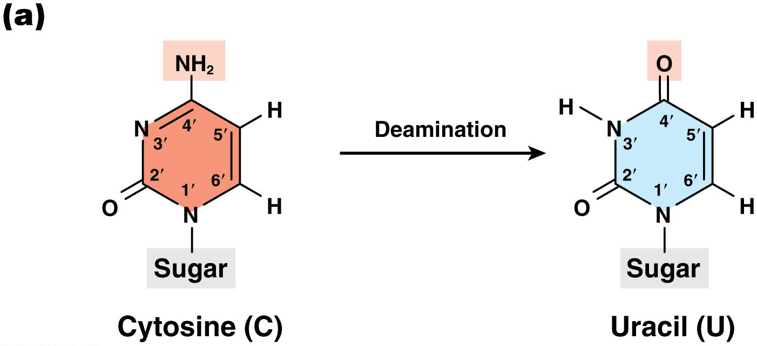
Deamination
Deamination: the loss of an amino group (NH₂) from a nucleotide
For example, when cytosine is deaminated, an oxygen atom usually takes its place, converting the cytosine into uracil
DNA mismatch repair removes the uracil from the DNA and replaces it with cytosine, restoring the wild-type sequence
34

Slide 35
12.4 Mutations May Be Induced by Chemicals or Ionizing Radiation
Induced mutations are produced by interactions between DNA and physical, chemical, or biological agents that generate mutations
Agents that cause DNA damage leading to mutations are called mutagens
Mutagens interact with DNA in specific ways to cause particular types of sequence changes
35

Slide 36
Chemical Mutagens
Chemical mutagens can be classified by their modes of action on DNA as follows:
Nucleotide base analogs
Deaminating agents
Alkylating agents
Oxidizing agents
Hydoxylating agents
Intercalating agents
36

Slide 37
Nucleotide Base Analogs
A base analog is a chemical compound with a structure similar to a DNA nucleotide base
These can pair with normal nucleotides—DNA polymerases cannot distinguish the analogs from normal nucleotides
37

Slide 38
Deaminating Agents
A deaminating agent removes amino groups from nucleotide bases
Deamination of adenine produces hypoxanthine, which can mispair and lead to A-T to G-C base-pair substitutions
38

Slide 39
Alkylating Agents
Alkylating agents added bulky side groups such as methyl (CH₃) and ethyl (CH₃-CH₂) groups to bases
These added groups are called bulky adducts
Bulky adducts interfere with DNA base pairing and may distort the DNA double helix
39

Slide 40
Hydroxylating Agents
Hydroxylating agents add hydroxyl groups to a recipient compound. Hydroxylamine adds a hydroxyl group to cytosine
This can mispair with adenine, creating a C-G to T-A transition mutation
40

Slide 41
Oxidative Reactions
Oxidation is a chemical process of electron transfer by addition of an oxygen atom or removal of a hydrogen atom
Oxidizing agents, like bleach and hydrogen peroxide, cause oxidative reactions that can lead to mutations
For example, oxidized guanine can mispair with adenine, leading to a tranversion mutation (G-C to T-A)
41

Slide 42
DNA Intercalating Agents
Some molecules are able to fit between DNA base pairs
These intercalating agents distort the DNA duplex; some can also form bulky adducts that contribute to DNA distortion
The distortion leads to DNA nicking that is not efficiently repaired, resulting in frameshift mutations due to added or lost nucleotides
42

Slide 43
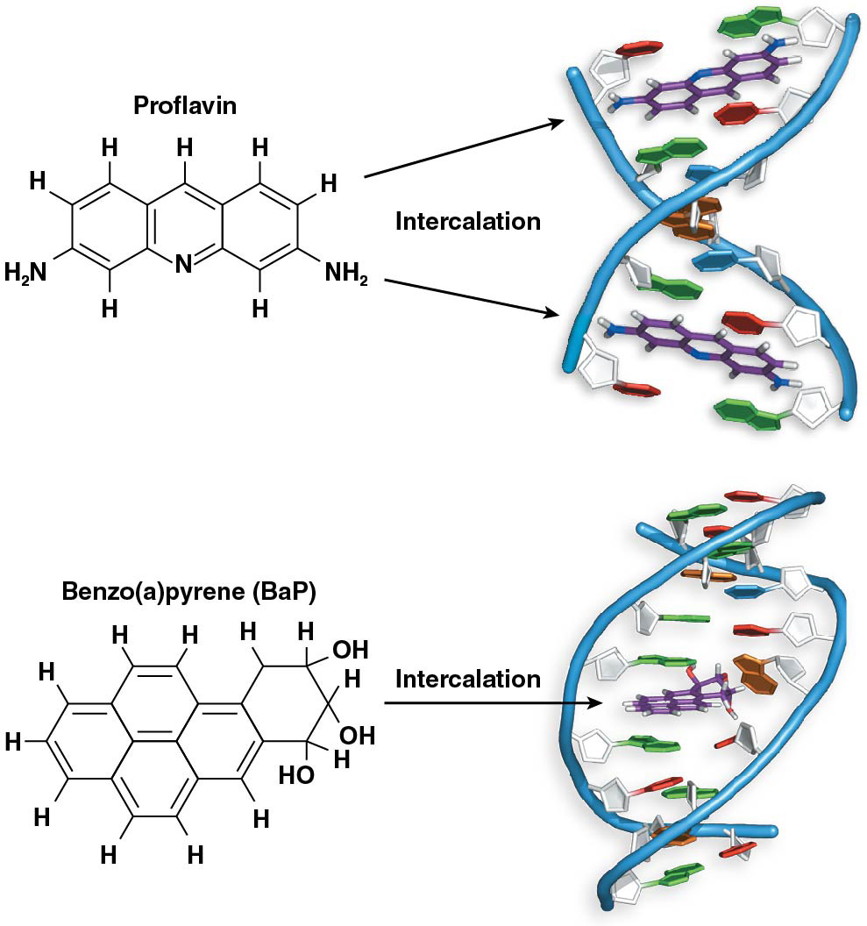
Figure 12.13 DNA intercalating agents.

Slide 44
Radiation-Induced DNA Damage
Photoproducts are aberrant structures with additional bonds involving nucleotides; caused by UV irradiation
Pyrimidine dimers are produced by the formation of one or two additional covalent bonds between adjacent pyrimidine nucleotides
DNA repair systems of most organisms can identify and correct most pyrimidine dimers
Those that are not repaired cause disruption of replication because the complementary adenines of the new DNA strand cannot form hydrogen bonds with the dimerized thymines
Replication stalls at this point leaving a gap
44

Slide 45
Other Types of Radiation
Irradiation that has higher energy than UV light includes X-rays and radioactive materials
These cause damage in multiple ways; the most serious are single-stranded or double-stranded breaks in DNA
These breaks can block DNA replication and are dealt with by specialized repair systems
45

Slide 46
12.5 Repair Systems Correct Some DNA Damage
The integrity of DNA is under continuous assault from spontaneous change and from mutagens
Organisms preserve the fidelity of DNA using multiple repair systems
These either directly repair DNA damage or allow the organism to circumvent the problems caused by unrepaired damage
46

Slide 47
Direct Repair of DNA Damage
The most direct way to repair DNA lesions is to identify and then reverse the DNA damage
One direct mechanism is the proofreading activity of DNA polymerase
Several other repair systems also carry out direct repair of DNA damage
47

Slide 48
Mismatch Repair
Mismatched nucleotides that escape DNA polymerase proofreading or are tautomeric may be detected and repaired by mismatch repair
Repair enzymes distinguish between the original, correct nucleotide and the new, mismatched nucleotide using the presence of methylation on the original strand
In E. coli, methylation is common on the adenine of 5′-GATC-3′ sequences
48

Slide 49
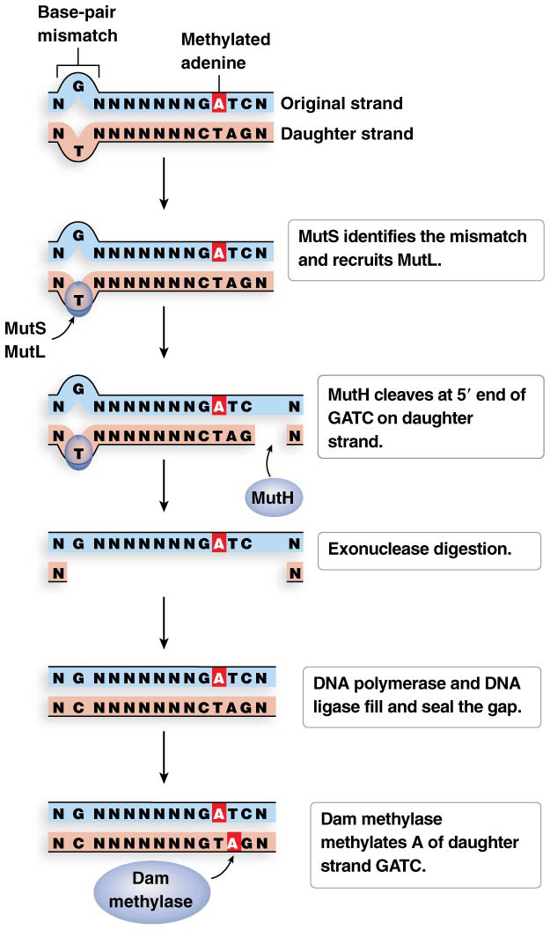
Mismatch Repair in E. coli
The E. coli protein MutS recognizes and binds to the DNA mismatch. MutS then recruits the MutL protein to the site
The MutH protein is then recruited to the site; it breaks a phosphodiester bond on the 5′ side of the guanine of a GATC sequence on the unmethylated daughter strand
An exonuclease digests nucleotides from the “nick” through the mismatched nucleotide
DNA polymerase fills the gap in the daughter strand
DNA ligase completes the repair
Dam methylase methylates the adenine of the GATC sequence on the daughter strand
49

Slide 50
Nucleotide Base Excision Repair
Nucleotide base excision repair is a multistep process
Nucleotide excision repair recognizes and removes bulky adducts, such as UV light damage, that distort DNA
Enzymes recognize and bind to the damaged region
A segment of nucleotides is removed from the damaged strand
DNA polymerase fills in the gap and DNA ligase seals the sugar-phosphate backbone
50

Slide 51
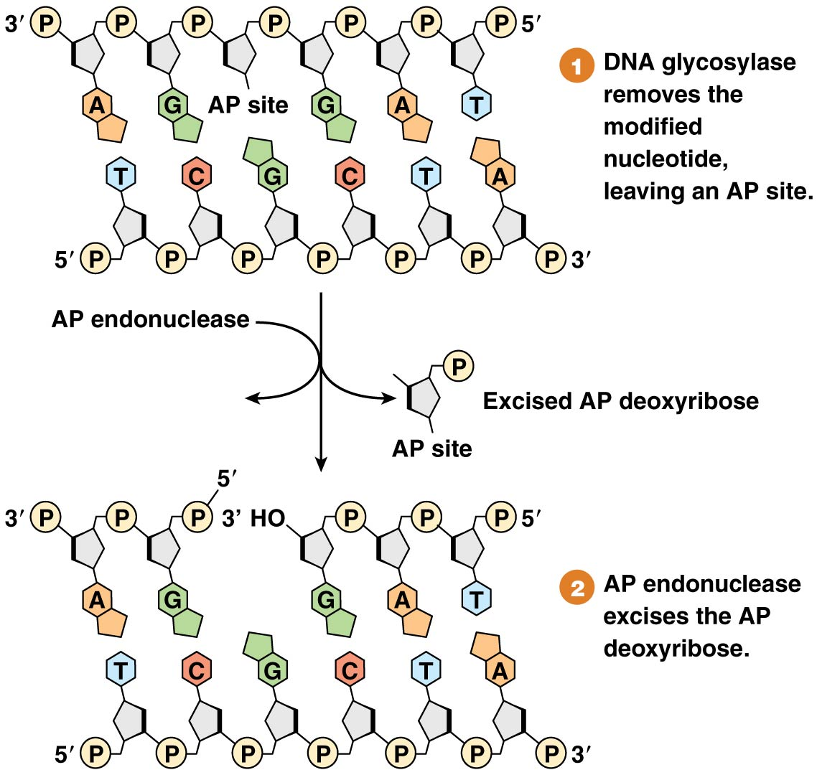
Figure 12.18 Nucleotide base excision repair.

Slide 52
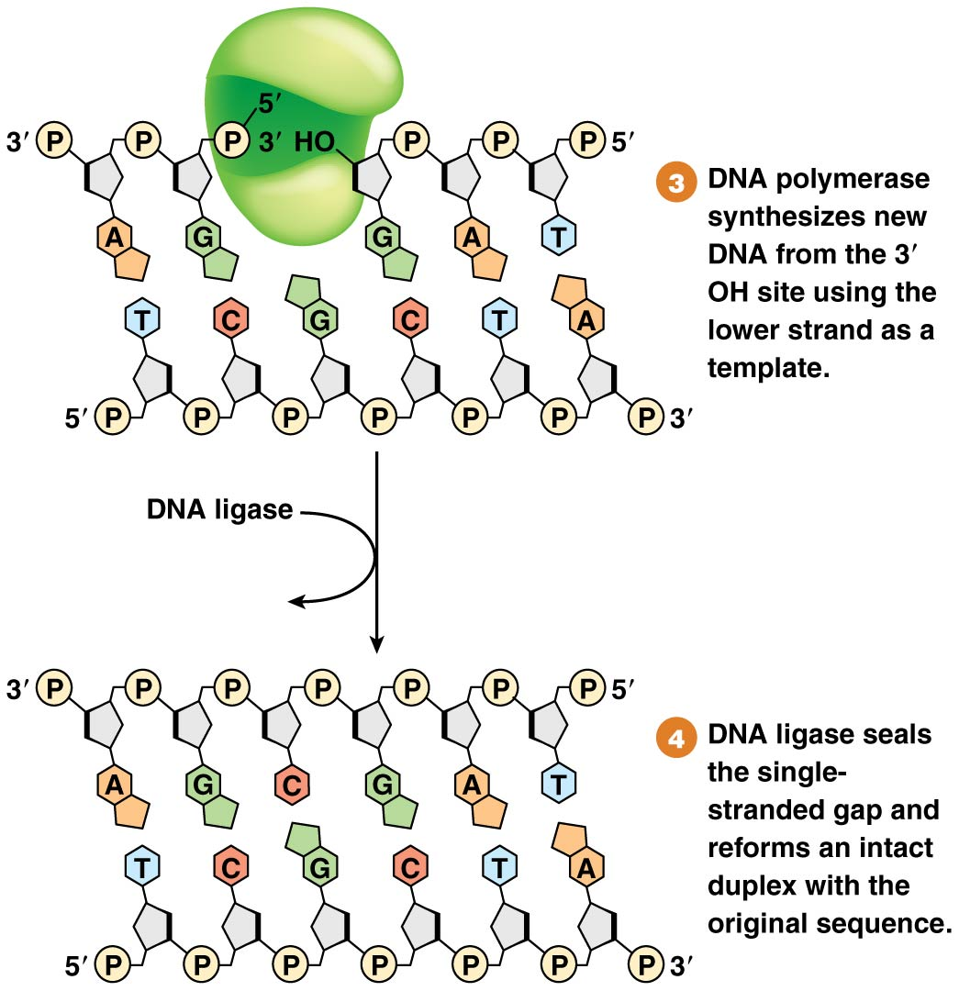
Figure 12.18 Nucleotide base excision repair.

Slide 53
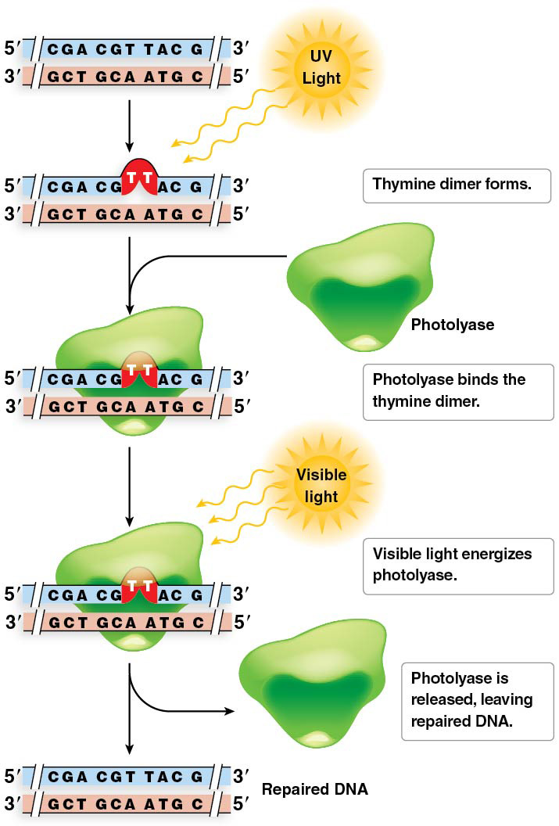
Direct Repair of UV-Induced Photoproducts
UV radiation is the most common mutagen of most organisms
It can be addressed by photoreactive repair or UV repair
53

Slide 54
DNA Damage Signaling Systems
Biochemical mechanisms to recognize the presence of DNA damage and initiate a repair response consist of a tightly regulated genetic process. In humans and other animals, a multiprotein complex acts as a genomic sentry to identify damage
BRCA1 is the first gene implicated in inherited forms of breast and ovarian cancer susceptibility
ATM plays a pivotal role in communicating DNA damage through signal transduction to activate transcription of the p53 gene. ATM activates the “p53 repair pathway”.
54
Notes:
54

Slide 55
Role of the p53 Repair Pathway
The p53 repair pathway controls cell responses to mutation by deciding to:
Pause the cell cycle at the G₁-to-S transition to allow time for repair; or
Direct the cell to undergo programmed cell death
55
Notes:
55

Slide 56
12.6 Proteins Control Translesion DNA Synthesis and the Repair of Double-Strand Breaks
DNA damage that escapes repair before replication may block replication
Some mechanisms allow replication to progress despite the presence of DNA damage
Not all damage repair systems are error free—few are a significant source of DNA changes leading to mutation
Error-prone repair mechanisms are activated only under conditions of widespread DNA damage that would otherwise prevent completion of DNA replication and/or cause cell death
56
Notes:
56

Slide 57
Translesion DNA Synthesis
The SOS repair system is a last-ditch effort of a heavily damaged bacterial system to replicate its DNA and divide
It is accomplished by activation of translesion DNA polymerases, or bypass polymerases
These error-prone polymerases have no proofreading ability, and can replicate across lesions that would stall DNA polymerase III
57
Notes:
57

Slide 58
Overcoming the Problems Caused by Photoproducts
The gaps left by stalled DNA synthesis are filled by translesion DNA synthesis, which is carried out by specialized DNA polymerases that can replicate across gaps
These DNA polymerases lack proofreading activity so they are error-prone
58

Slide 59
Double-Strand Break Repair
If both strands of DNA are broken, neither strand can act as a template for repair
This type of damage can occur from exposure to X-rays and certain types of oxygen radicals
These lesions are called double-strand breaks
Two mechanisms have evolved to carry out double-strand break repair
59
Notes:
59

Slide 60
Nonhomologous End Joining
A double-strand break that occurs during G₁ prevents completion of DNA replication
Nonhomologous end joining (NHEJ) allows cells to regain the ability to complete DNA replication, though the process inevitably leads to mutation
It is a four-step process
60
Notes:
60

Slide 61
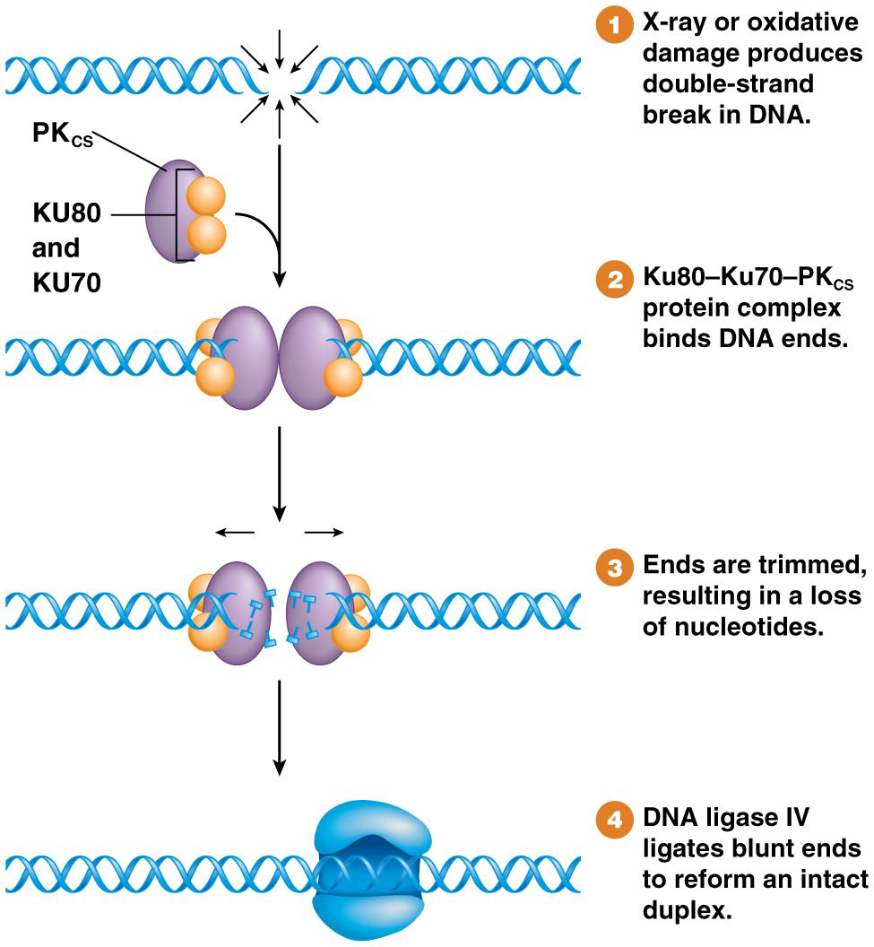
Figure 12.22 Nonhomologous end joining.

Slide 62
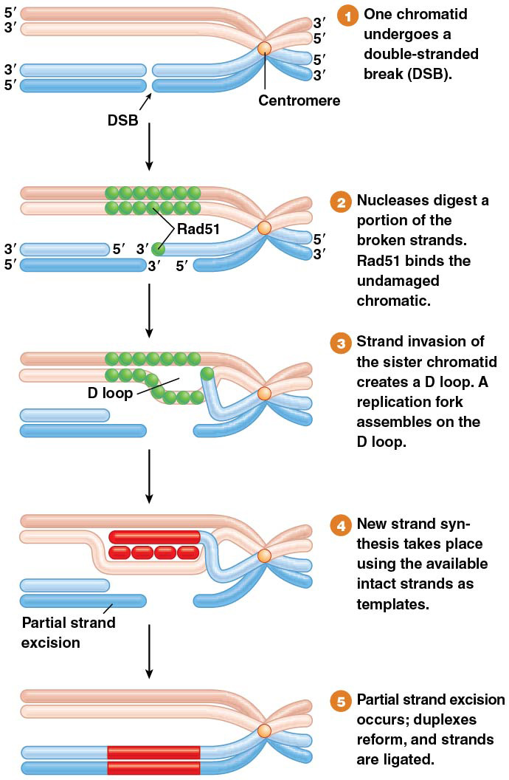
Synthesis-Dependent Strand Annealing
Double-strand breaks that occur after replication can be repaired by an error-free process called synthesis-dependent strand annealing (SDSA)
62
Notes:
62

