Slide 1
13

Slide 2
13.2 Changes in Euploidy Result in Various Kinds of Polyploidy
Polyploidy is the presence of three or more sets of chromosomes in the nucleus of an organism
It can result from duplication of chromosome sets within a species (autopolyploidy)
It can also occur from combining the chromosome sets of different species (allopolyploidy)
Many types of polyploidy are possible
2

Slide 3
Autopolyploidy
Three mechanisms lead to autopolyploidy:
Multiple fertilizations of one egg by multiple pollen grains
Meiotic nondisjunction leading to a diploid rather than haploid gamete
Mitotic nondisjunction in sex stem cells
3

Slide 4
Allopolyploidy
Allopolyploids carry multiple sets of chromosomes that originate in different species, and result in a hybrid offspring that is infertile because the chromosome sets are not homologous
Chromosome nondisjunction in these hybrids leads to cells with double the number of chromosomes so that now each chromosome has a homolog for pairing, and the hybrid is fertile
4

Slide 5
Reduced Recessive Homozygosity
Polyploids have more than two alleles of each gene
Recessive phenotypes are produced only in individuals who are homozygous for that allele
This occurs much less frequently in polyploids than in normal diploids
5

Slide 6
13.3 Chromosome Breakage Causes Mutation by Loss, Gain, and Rearrangement of Chromosomes
Mutations that result in loss or gain of chromosome segments can produce severe abnormalities due to gene dosage imbalances
Changes may be large enough to detect microscopically
Others may be too small for microscopy but may be detectable with molecular methods
6

Slide 7
Partial Chromosome Deletion
When a chromosome breaks, both DNA strands are severed at a location called a chromosome break point
The broken chromosome ends can adhere to other broken ends or the termini of intact chromosomes
Or, if the broken chromosome is acentric (lacks a centromere), it may be lost during cell division
7

Slide 8
Breakage Can Result in Partial Chromosome Deletion
Partial chromosome deletion: loss of a portion of a chromosome
Depending on the size it can affect more genes
Detachment of one chromosome arm leads to a terminal deletion; the broken fragment lacks a centromere and is lost during cell division
Organisms with one normal and one terminally deleted chromosome are called partial deletion heterozygotes
8

Slide 9
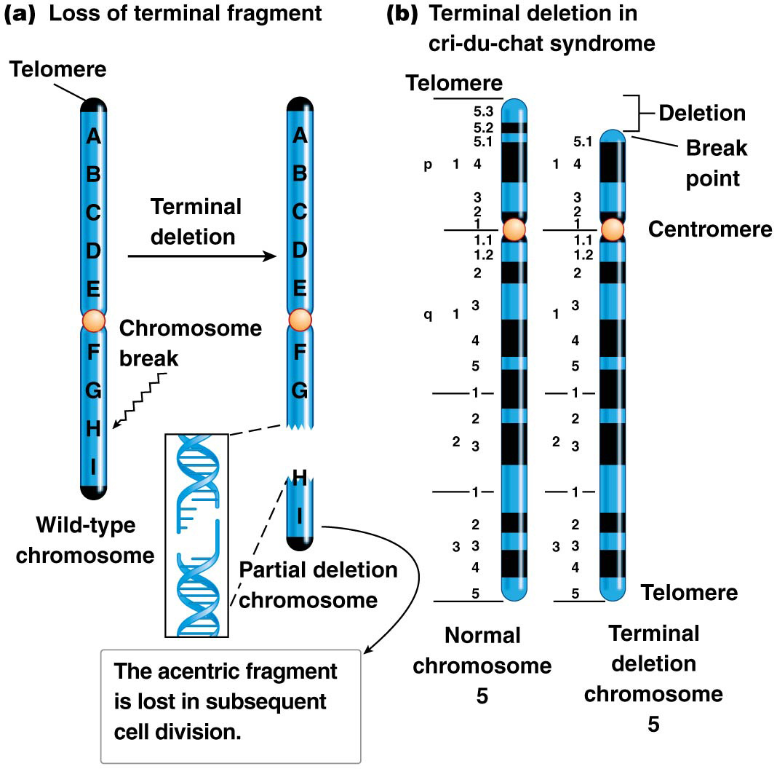
Figure 13.10 Chromosome terminal deletion.

Slide 10
Larger Chromosome Deletions
An interstitial deletion is the loss of an internal portion of a chromosome, and results from two chromosome breaks
These are observed in many organisms, including humans
For example, WAGR syndrome is a series of conditions caused by deletion of multiple genes on chromosome 11; patients may have all or just some symptoms depending on exactly which genes are deleted
10

Slide 11
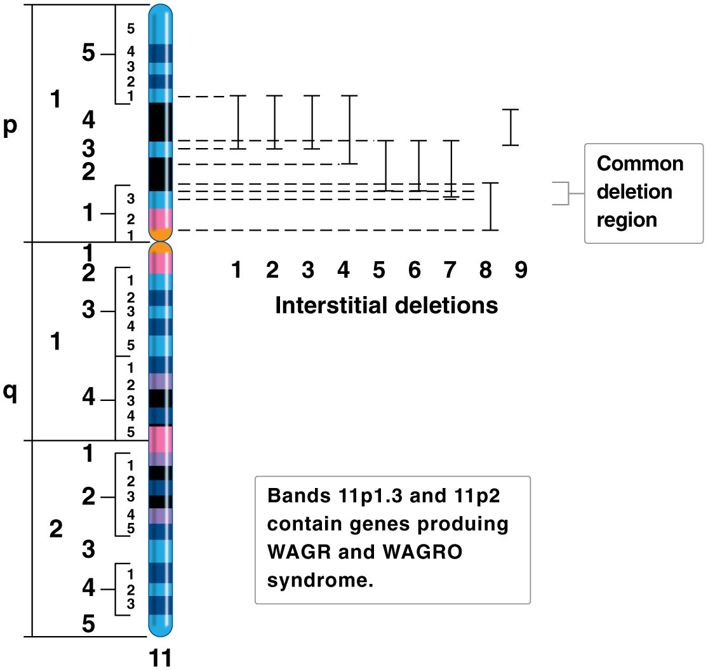
Figure 13.11 Interstitial deletions of chromosome 11 in WAGR and WAGRO syndromes.

Slide 12
Detecting Duplication and Deletion
Large deletions or duplications can be detected by microscopy that reveals altered chromosome banding patterns
Microdeletions and microduplications are much smaller and not easily detected with banding analysis
Instead, molecular techniques such as FISH (fluorescent in situ hybridization) can be used to detect absence or duplication of DNA sequence
12

Slide 13
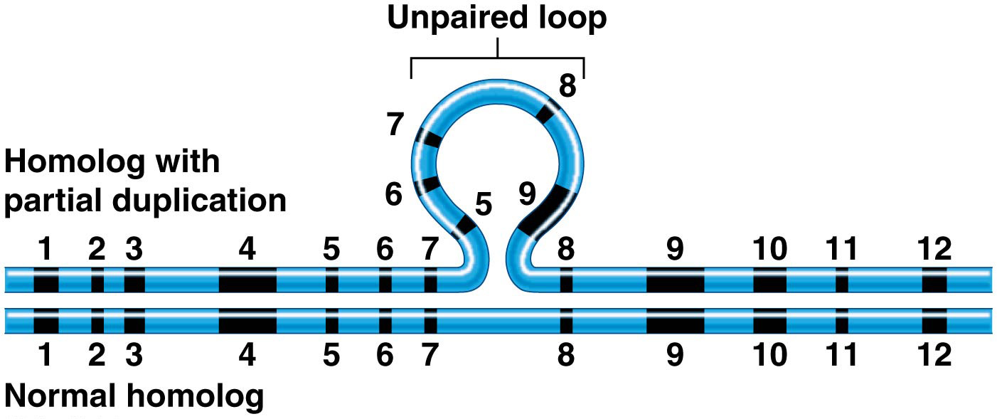
Another Microscopic Approach
Microscopic observation during prophase I when homologs synapse can show regions of chromosome duplication or deletion
A large deletion or duplication creates an area of mismatch between the altered chromosome and its normal homolog
This creates an unpaired loop, which is normal genetic material if one chromosome carries a deletion or it is duplicated genetic material if one homolog has a duplication

Slide 14
Deletion Mapping
Pseudodominance occurs when a recessive allele is “unmasked” by a deletion that removes the dominant allele on the homolog
It is used to map the position of genes on a chromosome via deletion mapping
Heterozygous individuals carrying a mutant allele on one homolog and a deletion on the other are tested for the mutant phenotype.
Deletion mapping allows researchers to pinpoint the location of a gene, to the smallest deletion interval that displays pseudodominance
14

Slide 15
13.4 Chromosome Breakage Leads to Inversion and Translocation of Chromosomes
Sometimes chromosome breakage leads to reattachment of the wrong broken ends
Reattachment in the wrong orientation leads to chromosome inversion; reattachment to a nonhomologous chromosome leads to chromosome translocation
If no critical genes are mutated, and dose-sensitive genes remain in balance, there may be no phenotypic consequences
15

Slide 16
Chromosome Inversion
Two types of chromosome inversion can occur, depending on the relative position of the centromere
In a paracentric inversion, the centromere is outside of the inverted region
In a pericentric inversion, the centromere is within the inverted region
Inversion heterozygotes have one normal and one inverted homolog
16

Slide 17
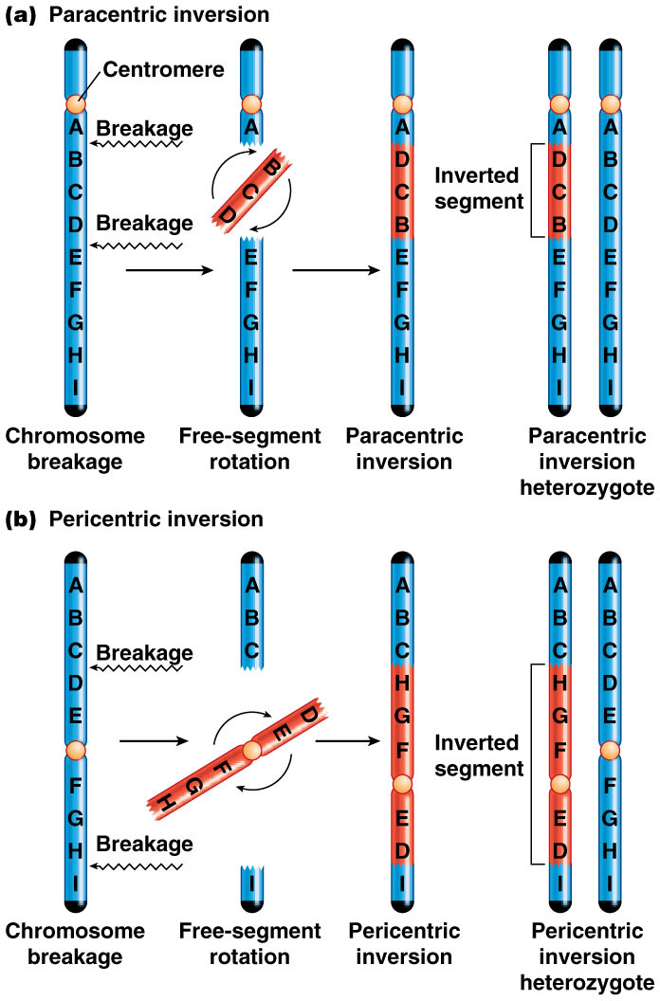
Figure 13.16 Paracentric and pericentric chromosome inversion.

Slide 18
Chromosome Pairing and Recombination
Alignment of a normal chromosome with its inverted homologs results in the formation of an inversion loop at synapsis
Crossing over that occurs outside the inverted region takes place as normal
Crossing over within the inverted region results in duplications and deletions in the recombinant chromosomes
18

Slide 19
Genetic Implications of Recombination in Inversion Heterozygotes
The probability of crossover within the inversion loop is proportional to the size of the loop
Inversion suppresses the production of recombinant chromosomes, identified as crossover suppression
Fertility may be altered if an inversion heterozygote carries a very large inversion
19

Slide 20
Chromosome Translocation
Translocations occur when broken ends of nonhomologous chromosomes are reattached
Translocation heterozygotes, with one normal copy and one translocated copy of each chromosome, may be normal in phenotype if no genes are disrupted by the breakage and reattachment events
20

Slide 21
Three Types of Translocations
Unbalanced translocations arise when a piece of one chromosome is translocated to a nonhomolog and there is no reciprocal event
Reciprocal balanced translocations occur when pieces of two nonhomologs switch places
Robertsonian translocations, also called chromosome fusions, involve fusion of two nonhomologous chromosomes
21

Slide 22
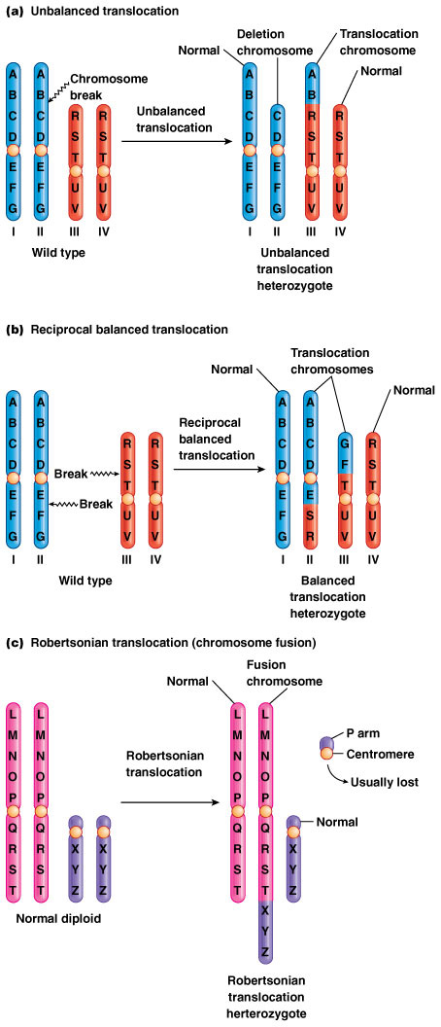
Figure 13.19 Unbalanced, reciprocal balanced, and Robertsonian chromosome translocations.

Slide 23
13.5 Transposable Genetic Elements Move throughout the Genome
Transposable genetic elements are DNA sequences that can move within the genome by an enzyme-driven process, transposition
They vary in length, sequence composition, and copy number
A transposable element can cause a mutation if it inserts into a wild-type allele and disrupts its function; this is called insertional inactivation
23

Slide 24
Discovery of Transposition
Barbara McClintock discovered transposition using crosses involving three linked genes, C, Sh, and Wx, in maize
C = purple kernels, c₁ = colorless; Sh = plump kernels, sh = shrunken; Wx = shiny kernels, wx = waxy
In experiments with trihybrid C Sh Wx/c₁ sh wx, she observed some kernels that were mostly purple but had sectors that lacked color in various patterns; the colorless sectors were all shrunken and waxy
24

Slide 25
The Characteristics and Classification of Transposable Elements
Complexity of transposable elements varies and there are several different transposition mechanisms
However, all transposable elements have two sequence features in common
The transposable element is flanked by terminal inverted repeats
The inserted transposable element is bracketed by flanking direct repeats
25

Slide 26
Characteristics of Transposition Events
Staggered cuts are made in both strands of DNA at the new target site for transposable element insertion, leaving short single-stranded overhangs on each end of the cut
The double-stranded transposable element is inserted into its new site
DNA is replicated at the new site of insertion to fill the single-stranded gaps, producing flanking direct repeats
26

Slide 27
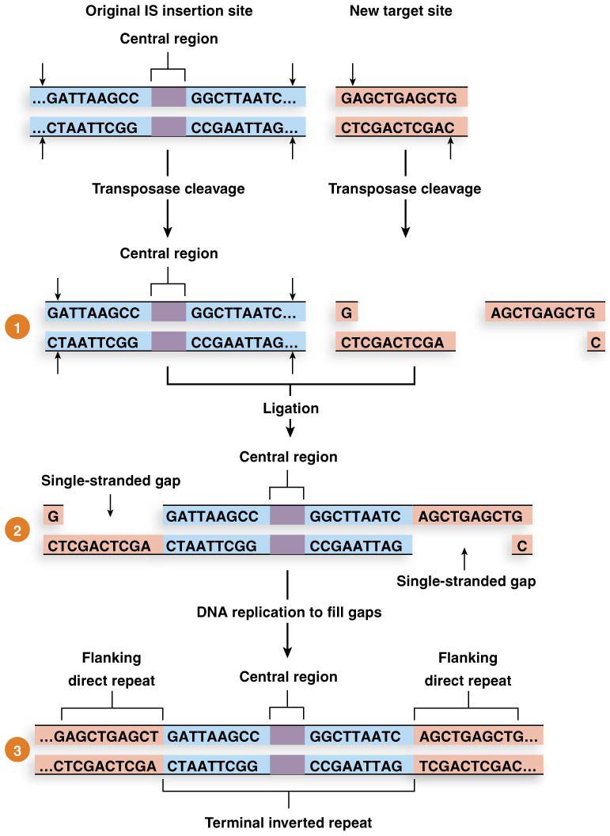
Figure 13.24 Transposition of an IS element.

Slide 28
Types of Transposition
There are two types of transposition
Replicative transposition is a “copy-and-paste” of the transposon
Nonreplicative transposition is a “cut-and-paste” of the transposon
28

Slide 29
Categories of Transposable Elements
DNA transposons (Class II transposable elements) transpose as DNA sequences, are found in all types of organisms, and may be replicative or nonreplicative
All DNA transposons carry the gene for transposase, which moves the transposon
Simple transposons only contain the transposase gene
Composite transposons also contain one or more additional genes
29

Slide 30
Categories of Transposable Elements
Retrotransposons (Class I transposable elements) are composed of DNA, are found in eukaryotes and are replicative
They transpose through an RNA intermediate
The RNA is copied back into DNA by reverse transcriptase
The DNA is then inserted into a new location where flanking direct repeats are formed
30

Slide 31
13.6 Transposition Modifies Bacterial Genomes
Bacterial genomes contain two categories of transposable elements
IS (insertion sequence) elements are simple transposable elements containing terminal inverted repeats surrounding a gene (sometimes two genes) encoding transposase
Composite transposons carry transposase plus one or more additional genes
31

Slide 32
13.7 Transposition Modifies Eukaryotic Genomes
Eukaryotic transposable elements are plentiful and highly varied
Transposition may be replicative or nonreplicative
Transposon types include Ac/Ds elements, P elements, and retrotransposons
32

Slide 33
Drosophila P Elements
The Drosophila melanogaster genome carries several dozen copies of a transposable element called a P element
These have been recently introduced into wild strains (since the 1960s) by cross-species transfer
Today, all wild-caught D. melanogaster contain P elements
33

Slide 34
Retrotransposons
Retroviruses infect eukaryotic cells, and have genomes composed of single-stranded RNA
On infection the RNA is transcribed into double-stranded DNA by reverse transcriptase, allowing the DNA to integrate into the host’s genome
The viral genes gag and env, encoded by the integrated virus, are needed to produce new retroviral particles; pol encodes reverse transcriptase
34

Slide 35
Retrotransposons Are Related to Retroviruses
Retrotransposons are related to retroviruses; all carry pol and some contain gag
None encode env, thus they can be reverse transcribed and inserted into host DNA, but are unable to produce viral particles
The gene(s) carried on retrotransposons are flanked by long terminal repeats (LTRs)
35

Slide 36
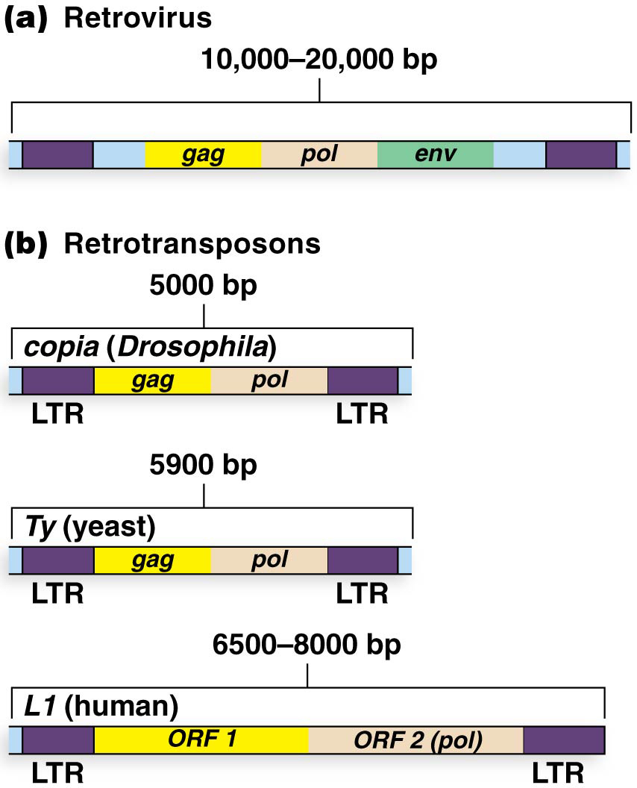
Figure 13.27 Retrovirus structure and selected eukaryotic retrotransposons.

Slide 37
LINE and SINE Elements of Humans
More than 45% of the human genome is composed of transposable DNA
Long interspersed nuclear elements (LINEs) and short interspersed nuclear elements (SINEs) are relatively abundant, and can cause mutations
37

Slide 38
L1 Elements
L1 elements are particularly common LINEs (about 600,000 per genome) that vary in length from 6.5 to 8.0 kb
Full-length L1 elements encode a protein with nuclease and reverse transcriptase function, and may also encode an RNA-binding protein
L1 elements are associated with spontaneous human mutations
38

Slide 39
Alu Elements
Alu elements are the most common of the SINEs and they actively generate mutations
They vary in length from 100 to 300 bp and are flanked by 7–20 bp direct repeats
The human genome contains about 1.2 million of these elements; these are relatively recent additions to the genome and are found in close primate relatives but no other mammals
39

