Slide 1
14

Slide 2
14.1 Transcriptional Control of Gene Expression Requires DNA–Protein Interaction
Certain bacterial genes needed to continuously perform routine tasks undergo constitutive (i.e., continuous) transcription
Some genes, needed for responses to changing environmental conditions require regulated transcription
Regulation of transcription includes control of both initiation and amount of transcription
2

Slide 3
Gene Regulation in Bacteria
Most regulation of gene expression in bacteria is transcriptional regulation
Control results from interactions between DNA-binding proteins and regulatory sequences of DNA
Post-transcriptional mechanisms are also important
3

Slide 4
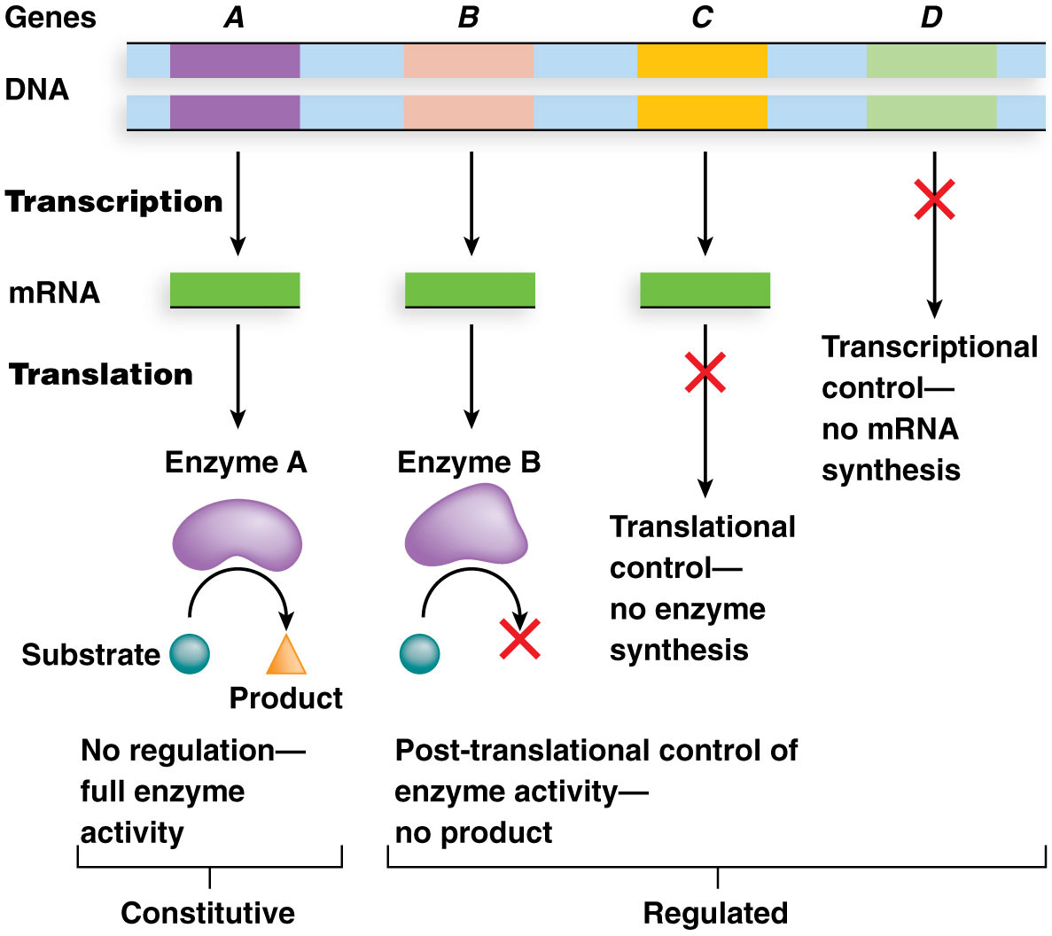
Figure 14.1 An overview of gene expression in bacteria.

Slide 5
Negative and Positive Control of Transcription
Negative control of transcription involves binding of a repressor protein to a regulatory DNA sequence and preventing transcription of a gene or gene cluster
Positive control of transcription involves binding of an activator protein to regulatory DNA and initiating gene transcription
5

Slide 6
Repressor Proteins
Repressor proteins are a broad category of regulatory proteins that exert negative control of transcription
Activated repressors bind to sequences such as those called operators:
Their binding blocks transcription initiation.
They can be activated or inactivated via interactions with other compounds
6

Slide 7
Repressor Proteins Have Two Active Sites
Repressor proteins usually have two active sites through which they perform their functions
The DNA-binding domain locates and binds operator DNA sequence or other target DNA sequences
The allosteric domain binds a molecule or protein, which causes a change in conformation of the DNA-binding domain; this property is called allostery
7

Slide 8
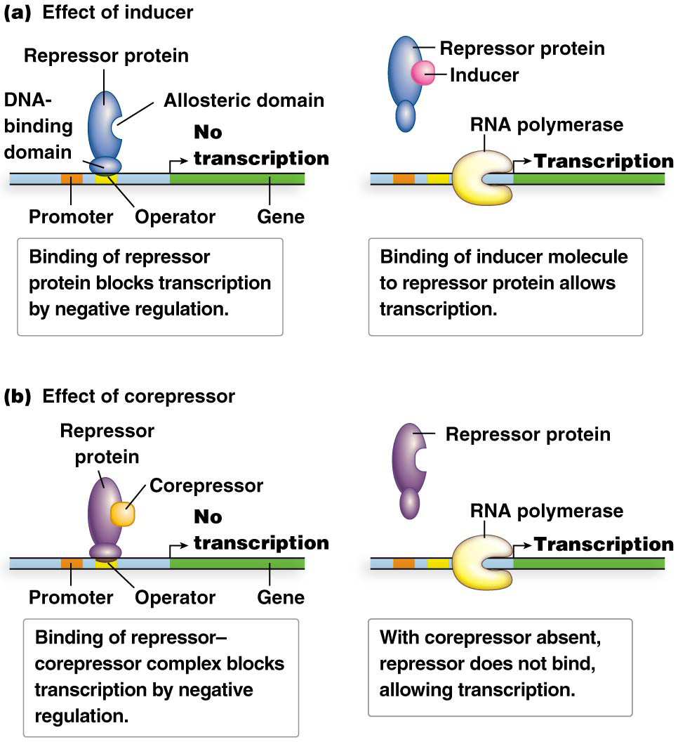
Allostery Alters Repressor Function
Allosteric domains operate in two modes
Some repressor proteins undergo inactivation of their DNA-binding domains as a result of allosteric changes brought about by binding an inducer at the allosteric site
Other repressors undergo activation of the DNA-binding domain upon allosteric binding to a corepressor
8

Slide 9
Positive Control
Positive control of transcription is accomplished by activator proteins that bind regulatory DNA sequences called activator binding sites
Activator protein binding facilitates RNA polymerase binding at promoters and helps initiate transcription
Activator proteins have a DNA-binding domain
9

Slide 10
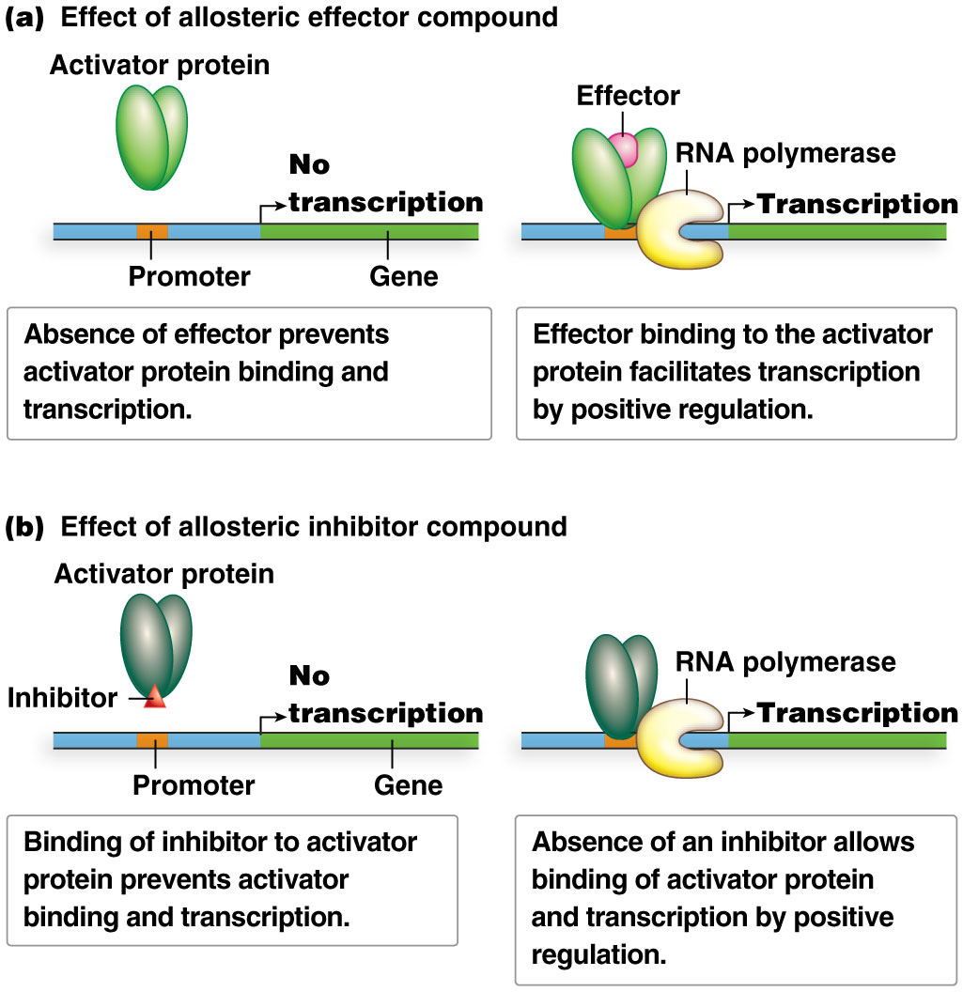
Two Modes of Action for Positive Control
In one mode of action, the DNA-binding domain is inactive until an allosteric effector compound binds the allosteric domain and induces a conformational change that activates the DNA-binding domain
In an alternative mode, certain activator proteins have a DNA-binding domain that is converted to inactive conformation by binding of an inhibitor to the allosteric domain
10

Slide 11
Regulatory DNA-Binding Proteins
DNA-binding proteins have amino acids with side chains that associate with nucleotides of particular DNA sequences
The protein simultaneously contacts multiple nucleotides; specificity is dictated by the unique patterns of hydrogen, nitrogen, and oxygen atoms that characterize the nucleotides
A common motif in DNA-binding regions of proteins is secondary structure, usually α helices
11

Slide 12
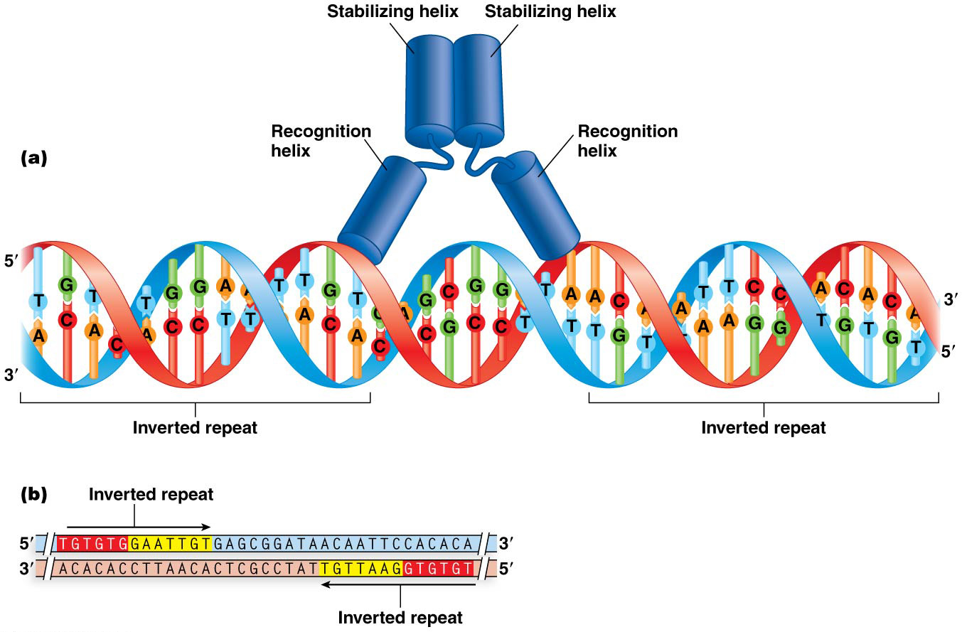
Structural Features of DNA-Binding Proteins and Target DNA Sequences
Bacterial regulatory DNA sequences frequently have inverted or direct repeats; each polypeptide of a regulatory homodimer interacts with one repeat
The most common structural feature of these proteins in bacteria is the helix-turn-helix (HTH) motif, in which two a-helical regions interact with the DNA sequences
A recognition and a stabilizing helix are separated by a “turn” in each polypeptide
12

Slide 13
14.2 The lac Operon Is an Inducible Operon System under Negative and Positive Control
Clusters of genes undergoing coordinated transcriptional regulation by a shared regulatory region are called operons
These are common in bacterial genomes; genes in a particular operon nearly always participate in the same metabolic or biosynthetic pathway
The lactose (lac) operon of E. coli is responsible for producing three polypeptides needed for use of lactose
13

Slide 14
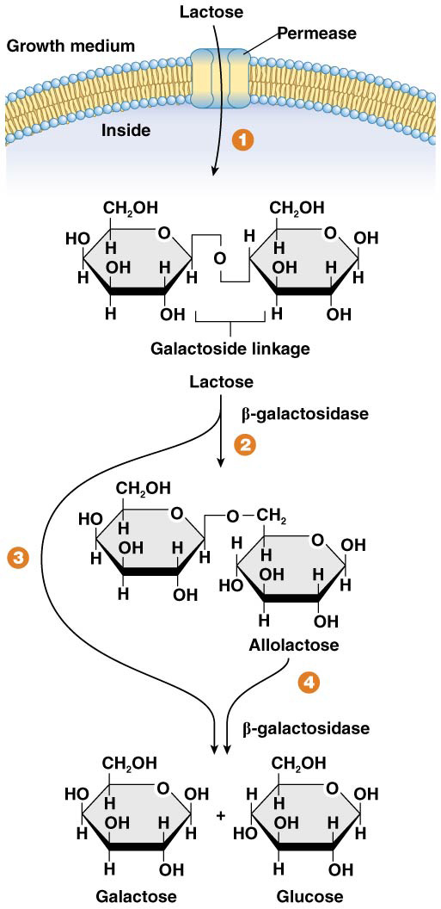
Lactose Metabolism
The monosaccharide, glucose, is the preferred energy source of E. coli. It is metabolized by the biochemical pathway glycolysis
Lactose is one of many sugars that can serve as an alternate carbon source; its utilization is controlled by the lac operon, which is an inducible operon system. Lactose is a disaccharide consisting of glucose and galactose, joined by a covalent β-galactoside linkage
Inducible systems are turned on only when an inducer compound is available
Bacteria with a lac⁺ phenotype can grow on media containing lactose as the only sugar. They do this by producing a gated channel formed by the enzyme permease at the cell membrane that allows lactose to enter the cell and the enzyme β-galactosidase to break the β-galactoside linkage
14

Slide 15
Lactose Utilization
Glucose produced by lactose breakdown enters glycolysis; the galactose is processed to produce glucose, which then enters glycolysis
The breakdown of lactose also produces a small amount of allolactose, which acts as an inducer compound
Bacteria with a lac⁻ phenotype are unable to utilize lactose
15

Slide 16
Lac Operon Structure
The lac operon consists of a multipart regulatory region and three structural genes
The regulatory region contains the promoter that binds RNA polymerase, the operator (lacO) that binds the lac repressor protein, and the CAP–cAMP region. These regions partially overlap and are immediately upstream of the start of transcription of the structural genes
The three structural genes are:
lacZ, which encodes β-galactosidase
lacY, which encodes the enzyme permease
lacA, which encodes transacetylase
They are transcribed as a single, polycistronic mRNA, which is translated to produce the three distinct polypeptides
16

Slide 17
LacI
The lacI gene is next to, but not part of, the lac operon
LacI encodes the lac repressor protein; it is constitutively expressed
The lac repressor protein have a DNA-binding domain that binds to the lacO sequence and an allosteric domain that binds the inducer, allolactose
17

Slide 18
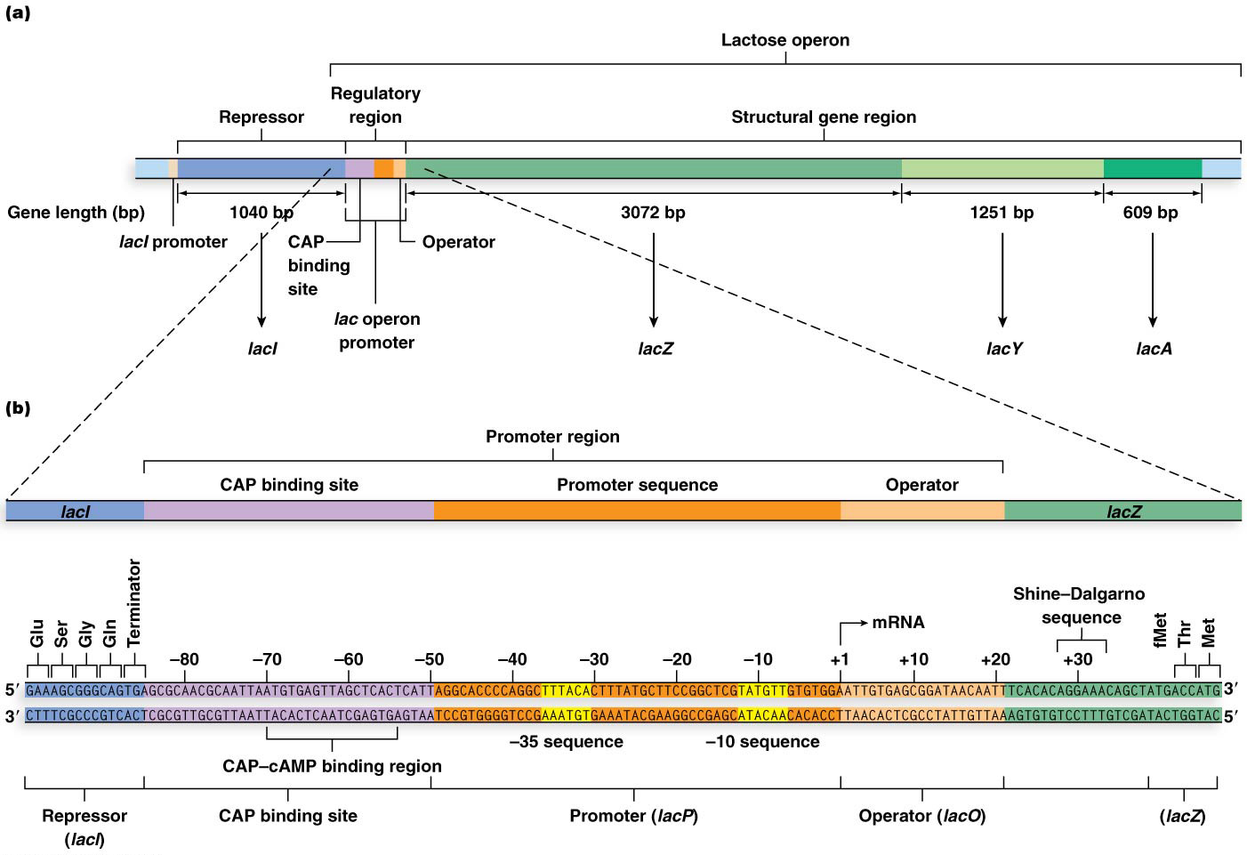
Figure 14.6 The lactose (lac) operon of E. coli.

Slide 19
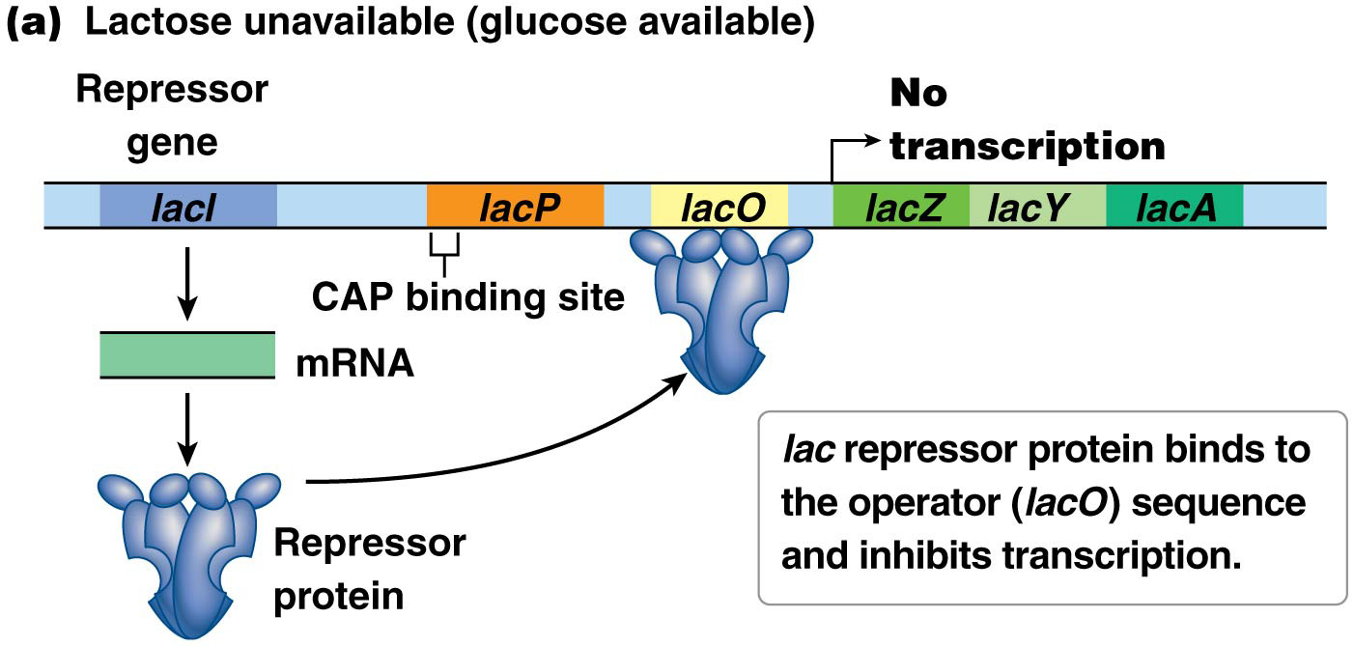
Lac Operon Function
The lac operon is transcriptionally silent when no lactose is available or when glucose is available
When no β-galactosidase is produced, there is no allolactose in the cell and the lac repressor protein binds to lacO, preventing transcription
This is an example of negative control
19

Slide 20
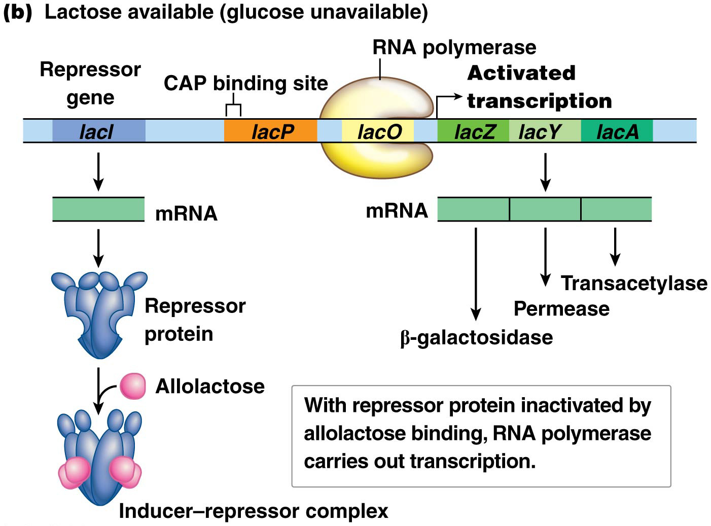
Lac Operon Function (continued)
When lactose is available to the cell and glucose is not, transcription of the lac operon is induced
With synthesis of β-galactosidase, allolactose is produced, and binds to the allosteric domain of the lac repressor
The formation of the inducer–repressor complex alters the DNA-binding domain of the repressor and prevents it from binding the operator
20

Slide 21
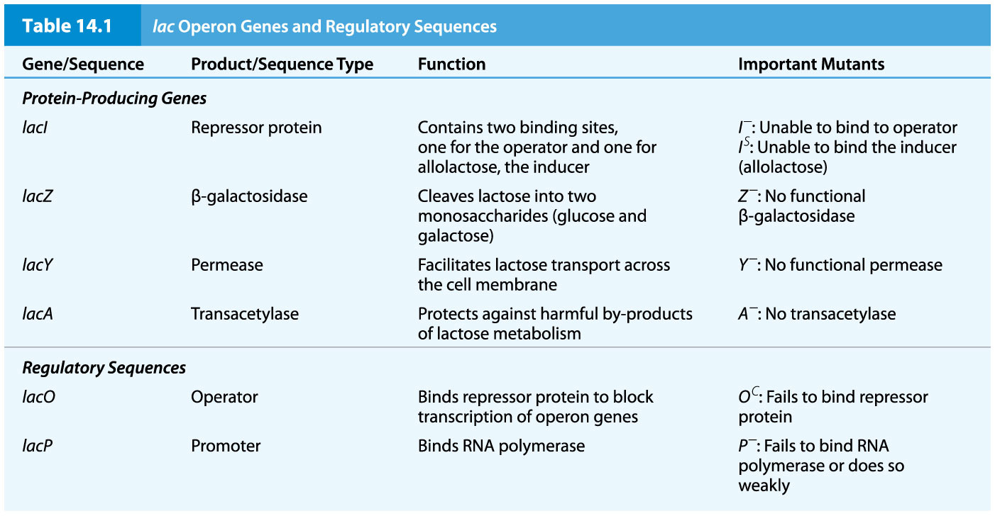
14.3 Mutational Analysis Deciphers Genetic Regulation of the lac Operon
Genetic analysis of lac operon mutants led to identification of each gene and regulatory region and a functional description of the operon
The work of Jacob, Monod, and Lwoff laid the foundation for description of transcriptional regulation at the DNA sequence level
21

Slide 22
Analysis of Structural Gene Mutations
Several dozen lac⁻ mutants were generated by treating E. coli with mutagens
Complementation analysis assigned mutations into two complementation groups; these correspond to the lacZ and lacY genes
Complementation analysis is carried out in partial diploids produced by conjugation between F′ (lac) and F⁻ bacteria
22

Slide 23
Example
The genotype of a partial diploid can be written as: F′ I⁺ P⁺ O⁺ Z⁺ Y⁻
I⁺ P⁺ O⁺ Z⁻ Y⁺
The F′ copy of the operon is unable to produce a functional permease (lacY⁻) and the other copy is unable to produce functional β-galactosidase (lacZ⁻)
However, in combination, the mutations carried by each copy of the operon complement because the wild-type allele of each gene is dominant to the mutant allele
23

Slide 24
Table 14.2 Synthesis of β-Galactosidase and Permease by Haploids and Partial Diploids with Structural Gene Mutations

Slide 25
Lac Operon Regulatory Mutations
Certain mutations of the lac operon lead to constitutive mutants, in which the genes are transcribed continuously whether or not lactose is available
Other regulatory mutants cause cells to be unresponsive to the presence of lactose, and therefore lac⁻
Genetic mapping of constitutive mutants localizes them to the lacO and lacI regions
25

Slide 26
Two Components to the lac Operon
The discovery of the two sites of constitutive mutations led Jacob and Monod to suggest that the operon functioned under a negative regulatory system
Constitutive mutations could affect the production of a regulatory protein (lacI) or its DNA-binding site (lacO)
26

Slide 27
Operator Mutations
Lac operator mutations are exclusively cis-acting, meaning they influence transcription of genes only on the same chromosome
Normally the lac repressor protein binds operator sequences unless allolactose is bound to its allosteric site
O^{c} mutants have altered operator sequences to which the repressor protein cannot bind and the structural genes are continuously expressed
27

Slide 28
Experiments with Partial Diploids
Partial diploids in which an O^{c} mutation was adjacent to Z⁺ and an O⁺ sequence was adjacent to Z⁻ led to constitutive expression of Z⁺
A second experiment in which the O^{c} mutation was adjacent to Z⁻ and the O⁺ sequence was adjacent to Z⁺ led to normal expression of Z⁺
Together these two experiments showed that operator is cis-dominant, influencing transcription only of downstream genes
28

Slide 29
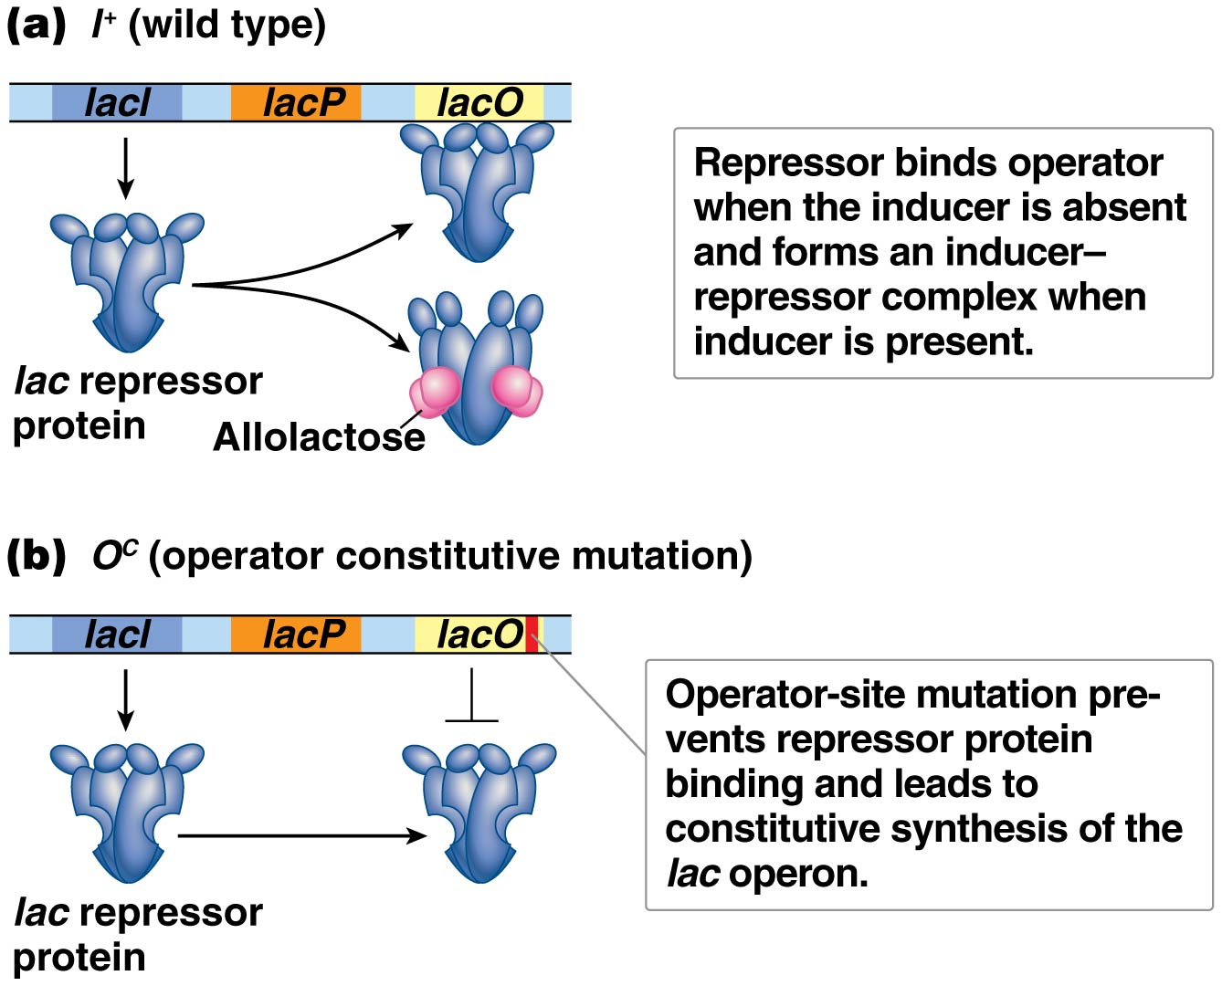
Figure 14.9 Regulatory mutations of lacI and lacO.

Slide 30
Table 14.3 Synthesis of β-Galactosidase and Permease by Haploids and Partial Diploids with Regulatory Mutations

Slide 31
Constitutive Repressor Protein Mutations
In a haploid cell with genotype lacI⁻ that is otherwise wild type, the Z and Y genes are constitutively expressed
A partial diploid with I⁺ on one chromosome, which also carries Z⁻ and Y⁺, and I⁻ on the other chromosome, which also carries Z⁺ and Y⁻, has normal expression of both the Z and Y genes
This indicates that lacI⁺ produces a regulatory protein that is trans-acting; that is, it is capable of diffusing and interacting with both operators in a partial diploid
31

Slide 32
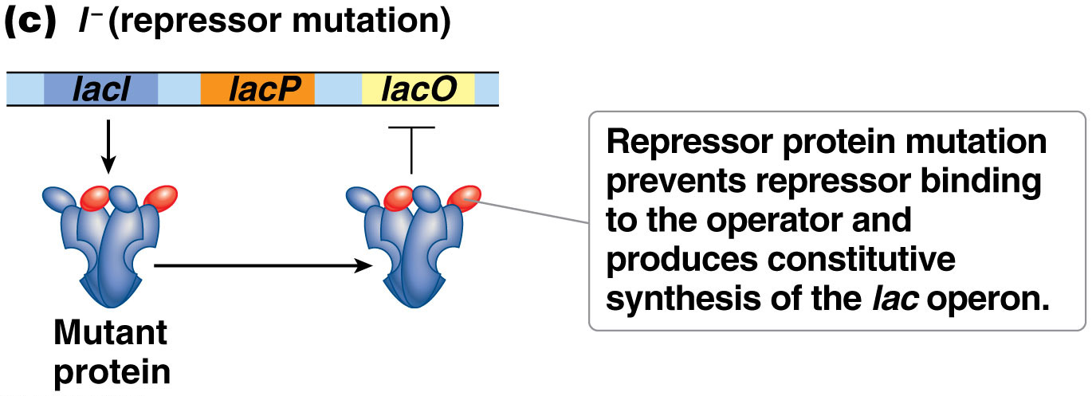
Nature of lacI⁻
The lacI⁻ gene produces a mutant form of repressor protein that is unable to bind the operator sequence
Since the repressor cannot bind the operator, transcription cannot be repressed, leading to constitutive transcription
However, in partial diploids, if lacI⁺ is also present, genes will be normally expressed
32

Slide 33
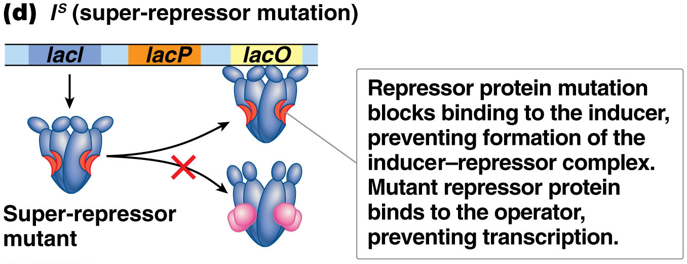
Super-Repressor Protein Mutations
A second set of lacI mutations leads to a noninducible operon; the Z and Y genes are not expressed, even in the presence of lactose
The mutation causes the allosteric domain to be altered so that allolactose cannot bind to it; the I^{s} (for super-repressor) mutation is dominant to the I⁺ allele
This leads to cells that are unresponsive to the presence of lactose
33

Slide 34
Promoter Mutations
Mutations of promoter consensus sequences significantly reduce transcription and may eliminate it entirely
Most mutations of lacP reduce or eliminate transcription of lacZ and lacY, which are located in cis
Active transcription of lac operon genes takes place only when glucose is depleted from the cell and lactose is available to it
34

Slide 35
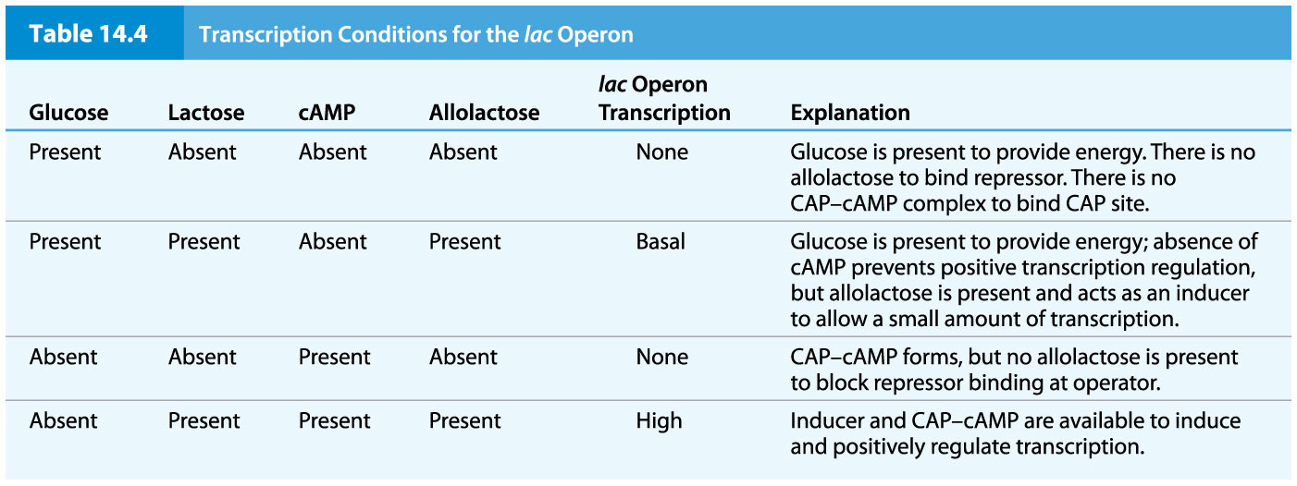
Table 14.4 Transcription Conditions for the lac Operon

Slide 36
Operon Transcription in Absence of Glucose, Presence of Lactose
cAMP levels rise due to availability of adenylcyclase
CAP-cAMP complex forms and binds the CAP site of the lac promoter
Allolactose forms in a side reaction of lactose metabolism
Repressor protein binds allolactose, changes conformation, and releases from the operator
36

Slide 37
Molecular Analysis of the lac Operon
Molecular analysis has identified the DNA sequences of the lac operon components
The repressor protein-binding region overlaps with the promoter-binding location for RNA polymerase, supporting the hypothesis that repressor protein blocks RNA polymerase binding
Three distinct segments of operator DNA sequence are identified: O₁, O₂, and O_{3.} Each of the three segments of the operator sequences interacts differently with the repressor protein
37

Slide 38
Operator and Repressor Interactions
The three segments of the operator share a conserved 21-bp inverted repeat around a central G-C base pair
The tetrameric repressor binds to O₁ and O₃ and induces DNA loop formation that brings O₁ and O₃ close together
The loop structure includes part of the promoter and blocks access by RNA polymerase
38

Slide 39
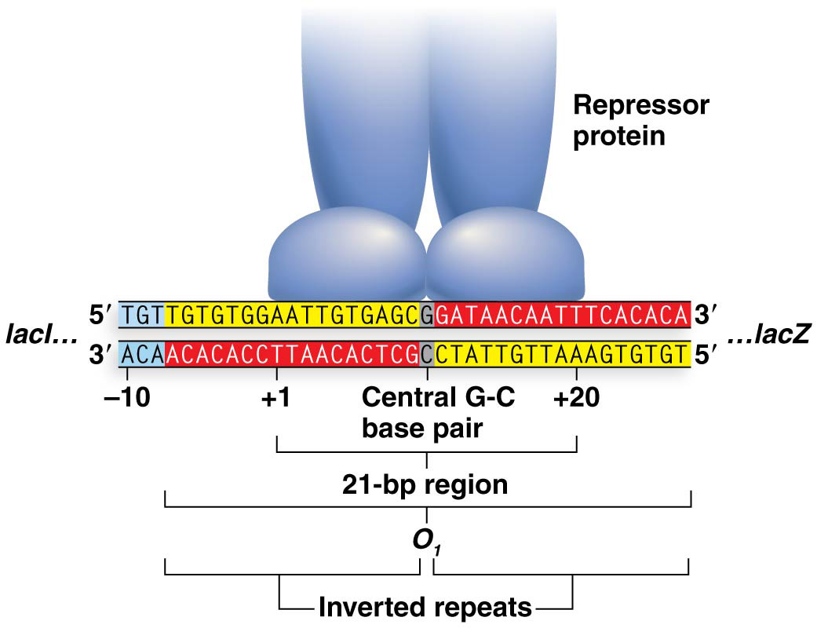
Figure 14.11 The lacO region O₁ contains an inverted repeat sequence.

Slide 40
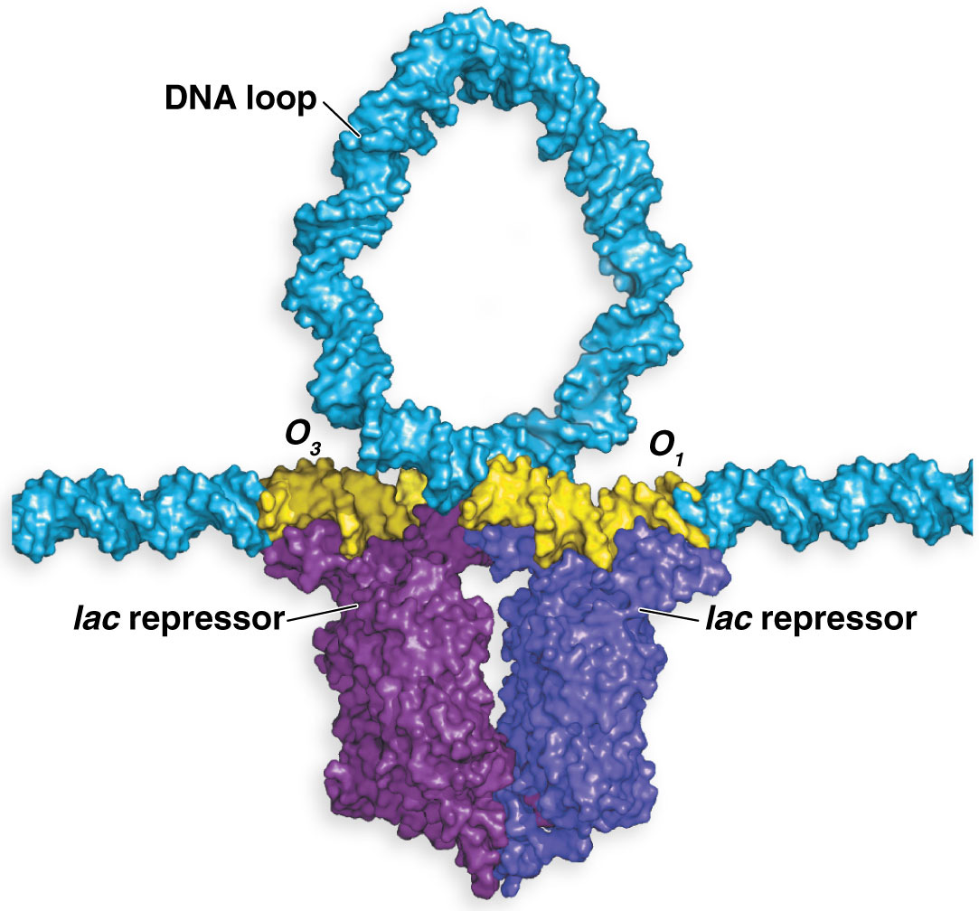
Figure 14.12 lac repressor protein binding.

Slide 41
14.4 Transcription from the Tryptophan Operon Is Repressible and Attenuated
Repressible operons: are operons involved in anabolic pathways operate through activity of the end product to block transcription of the operon
Certain repressible operons have a second regulatory capability called attenuation, which can fine-tune transcription to match the immediate needs of the cell
41

Slide 42
Feedback Inhibition of Tryptophan Synthesis
The trp operon contains five structural genes and a regulatory region with a promoter (trpP), operator (trpO), and leader region (trpL) that contains the attenuator region
The protein products of the structural genes (trpE, trpD, trpC, trpB, and trpA) are responsible for tryptophan synthesis
A sixth gene outside the operon encodes the trpR protein, a repressor protein that is activated when bound to tryptophan
42

Slide 43
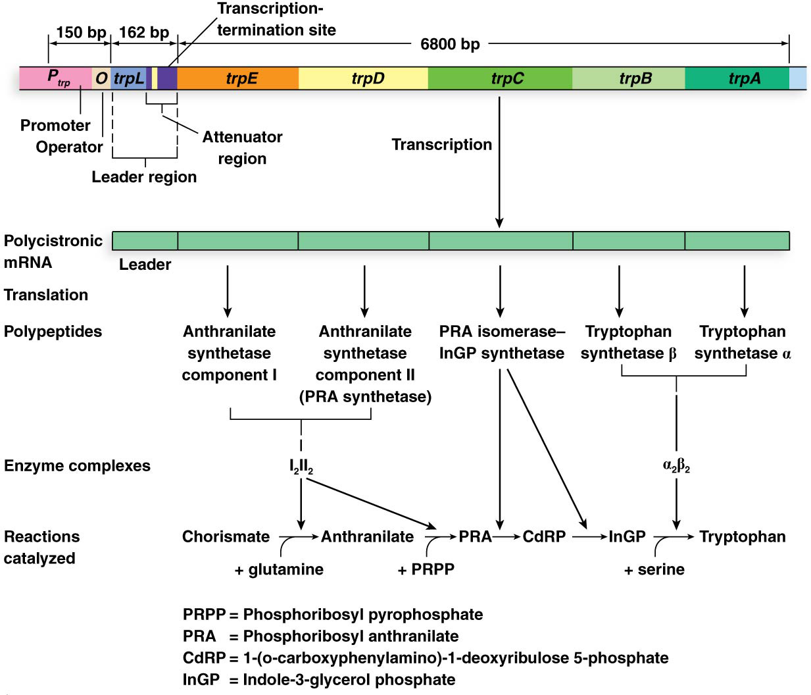
Figure 14.14 The tryptophan (trp) operon.

Slide 44
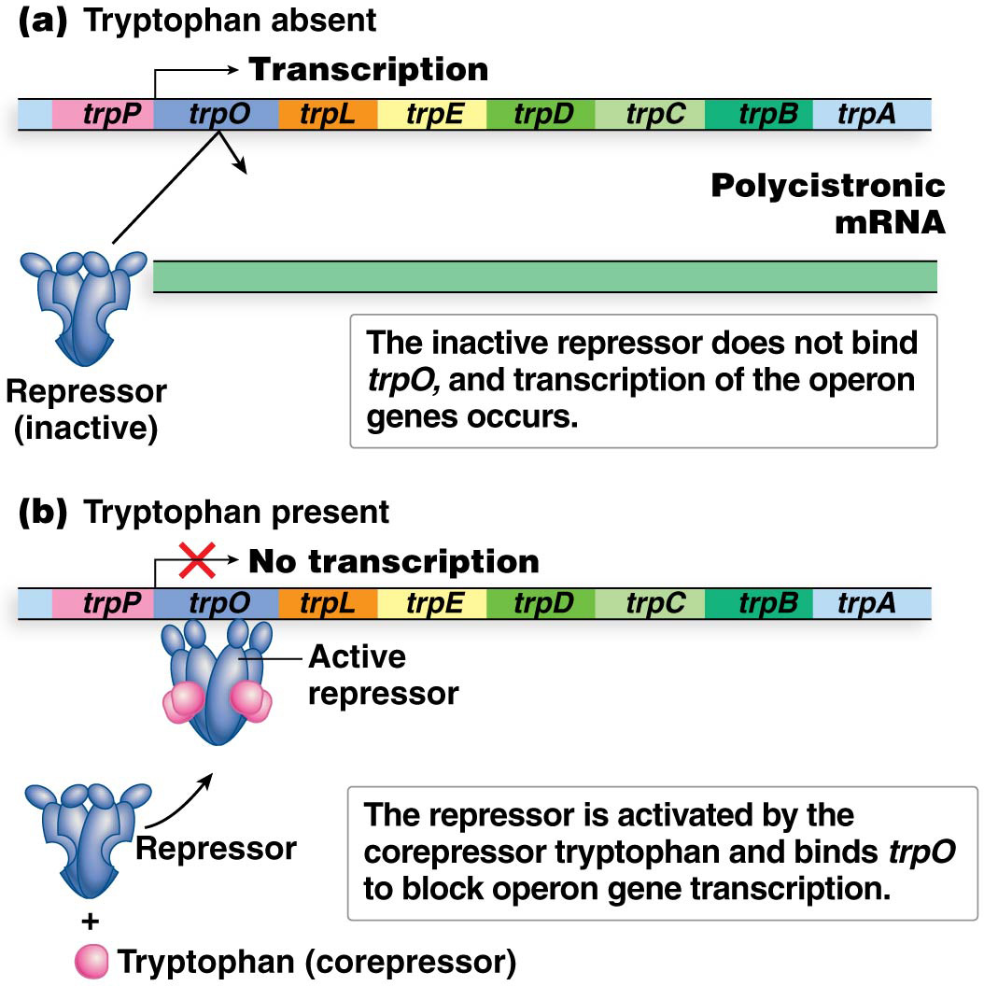
Feedback Inhibition of the trp Operon
Tryptophan acts as a corepressor by binding to the trp repressor and activating it
Activated repressor binds to trpO and prevents transcription of the operon
When tryptophan is absent from the cell, the repressor protein cannot bind the operator, allowing for transcription of the operon
44

Slide 45
Limitations of Feedback Inhibition of the trp Operon
Given the function of the trpR protein, it would be expected that trpR⁻ cells should produce tryptophan constitutively, as the repressor protein is not available to inhibit transcription
However, this is not the case; trpR⁻ strains have higher rates of operon transcription in the presence of tryptophan than trpR⁺ strains but not 100%
This suggests that a second mechanism regulates operon expression
45

Slide 46
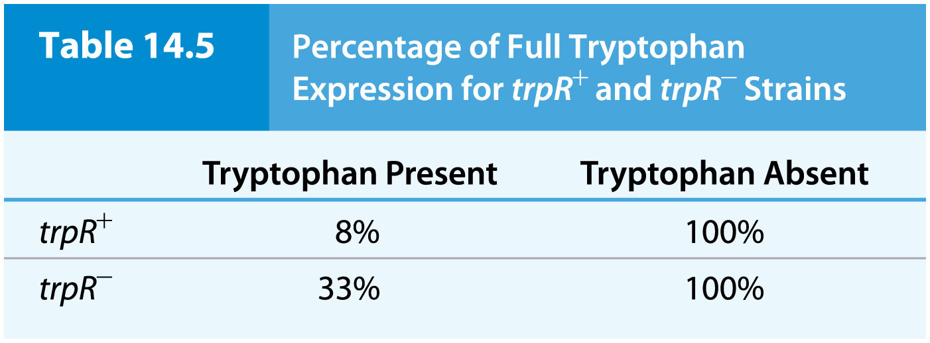
Table 14.5 Percentage of Full Tryptophan Expression for trpR⁺ and trpR⁻ Strains

Slide 47
Attenuation of the trp Operon
The second mechanism controlling trp operon expression is attenuation, controlled by the 162-bp trpL region
The trpL region contains four repeat DNA sequences and the mRNA produced contains complementary repeats as well as start and stop codons for a 14–amino acid polypeptide
47

Slide 48
Critical Features of the trpL Sequence
The four repeat sequences (1, 2, 3, and 4) can form different stem-loop structures
Among the codons for the short polypeptide are two back-to-back codons for tryptophan
These codons are “sensors” for the availability of tryptophan in the cell
48

Slide 49
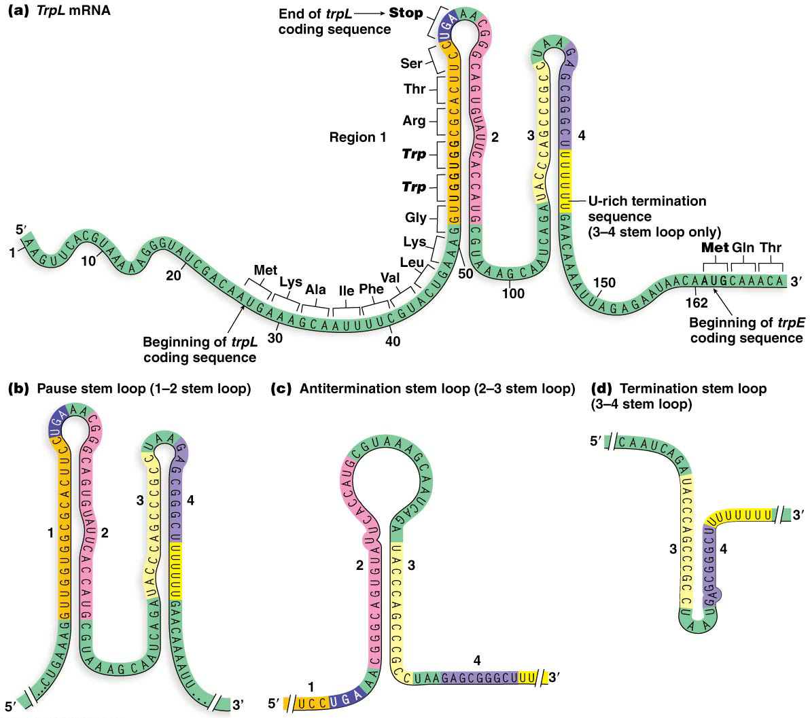
Figure 14.16 The trpL attenuator region and its mRNA transcript.

Slide 50
Stem-Loop Structures and Attenuation
Two stem-loop structures, the 3–4 stem loop and 2–3 stem loop, are central to attenuation; the 1–2 stem loop plays a relatively minor role
The 3–4 stem loop of mRNA is the termination stem loop, which halts RNA polymerase progress along the DNA within the leader region
Region 4 is followed by a poly-uracil sequence that functions similarly to intrinsic termination of transcription in bacteria
50

Slide 51
Stem-Loop Structures and Attenuation (continued)
The 3–4 stem loop may be accompanied by formation of a 1–2 stem loop, which can induce a pause in the attenuation
Alternatively, a 2–3 stem loop of mRNA, the antitermination stem loop, forms when region 1 is not available for pairing and thus prevents region 3 from interacting with region 4
This allows RNA polymerase to continue through the leader sequence and into the structural genes
51

Slide 52
Role of trp in Formation of Regulatory Stem-Loop Structures
Transcription across regions 1 and 2 allows for the 1–2 stem loop to form, and a slight pause in transcription is just long enough for a ribosome to bind to the start codon in trpL
Codons 10 and 11 of the trpL region are tryptophan codons; with an adequate supply of tryptophan, these are easily translated and the ribosome moves to the stop codon, partially obscuring regions 1 and 2
This allows only regions 3 and 4 to pair, causing termination of transcription by attenuation
52

Slide 53
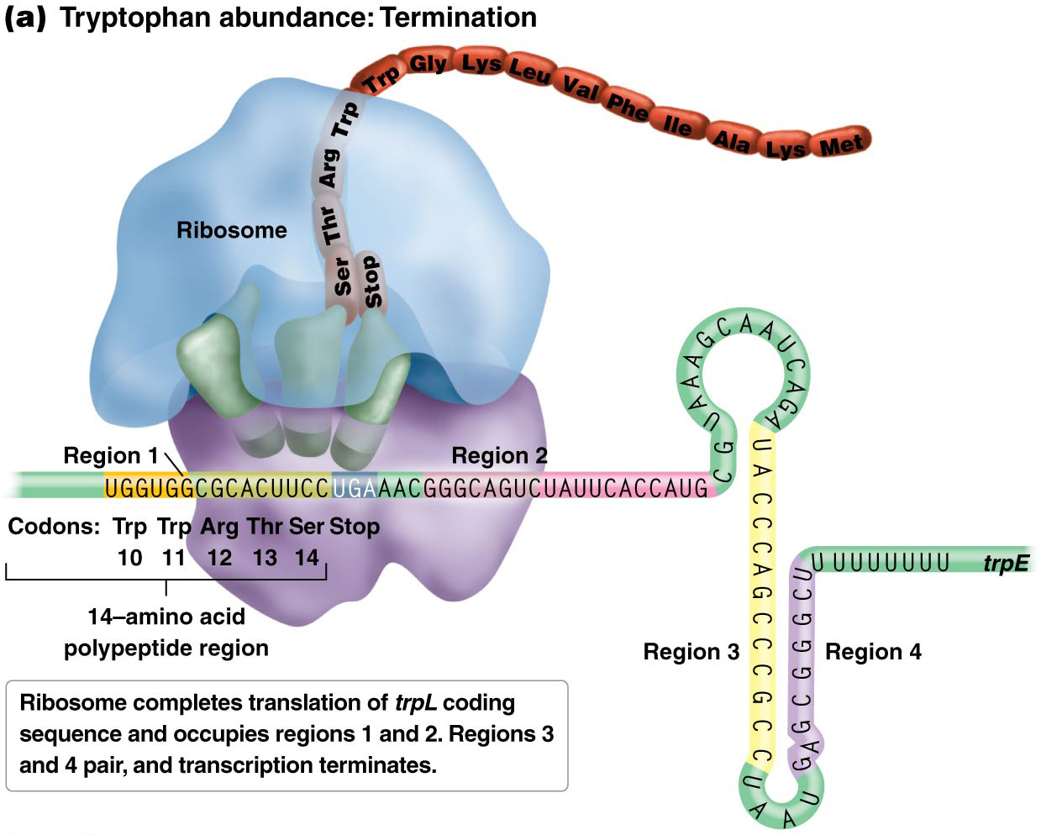
Figure 14.17a TrpL mRNA stem loop formation.

Slide 54
Role of trp in Formation of Regulatory Stem-Loop Structures (continued)
Without an adequate supply of tryptophan, translation stalls at codons 10 and 11
The ribosome obscures region 1, allowing regions 2 and 3 to pair
This creates that antitermination conformation, allowing for continued transcription of genes needed for production of tryptophan
54

Slide 55
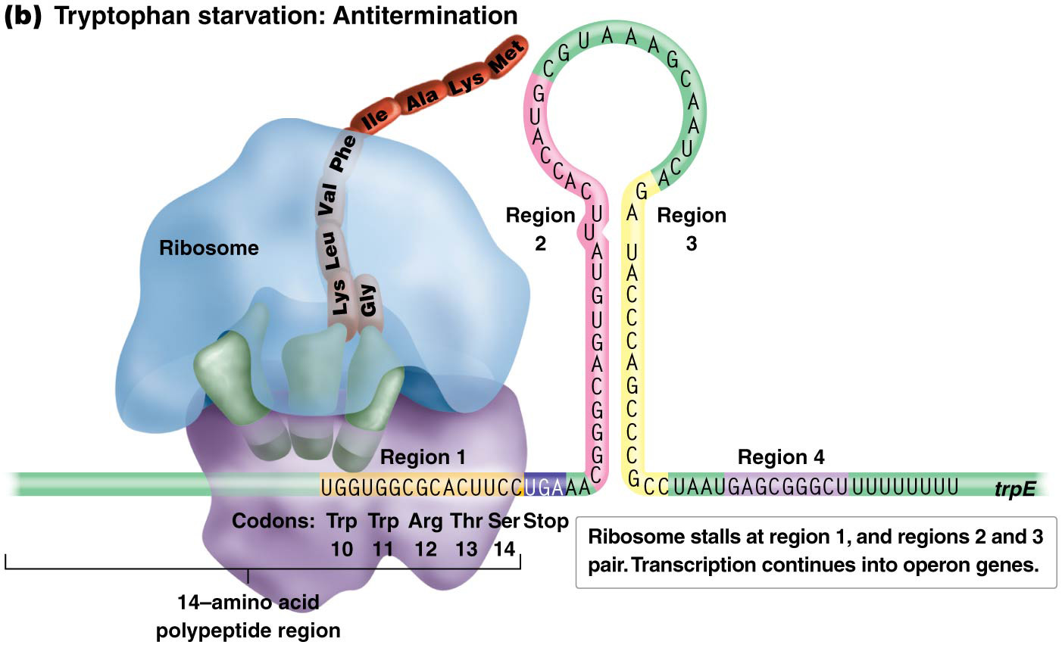
Figure 14.17b TrpL mRNA stem loop formation.

Slide 56
Attenuation Mutations
If the tryptophan codons are altered to specify different amino acids, tryptophan production is affected
Mutating one of the two codons alters attenuator responsiveness to tryptophan, and mutating both of them abolishes the attenuator’s ability to sense tryptophan
Mutation of regions 3 and 4, which prevents stable binding between them, also reduces the efficiency of the attenuation mechanism
56

Slide 57
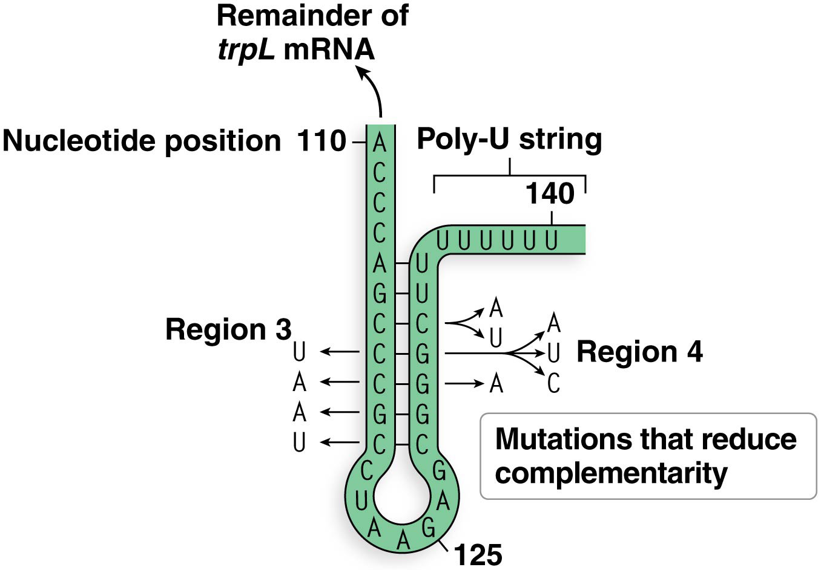
Figure 14.18 Mutations of trpL.

