Slide 1
15

Slide 2
15.1 Cis-Acting Regulatory Sequences Bind Trans-Acting Regulatory Proteins to Control Eukaryotic Transcription
DNA–protein interactions in eukaryotes follow a similar scheme to those in bacteria
Activator proteins bind regulatory sequences to stimulate transcription
Repressor proteins bind other sequences to hinder transcription
The regulatory proteins are found in large complexes in eukaryotes, unlike in bacteria
2

Slide 3
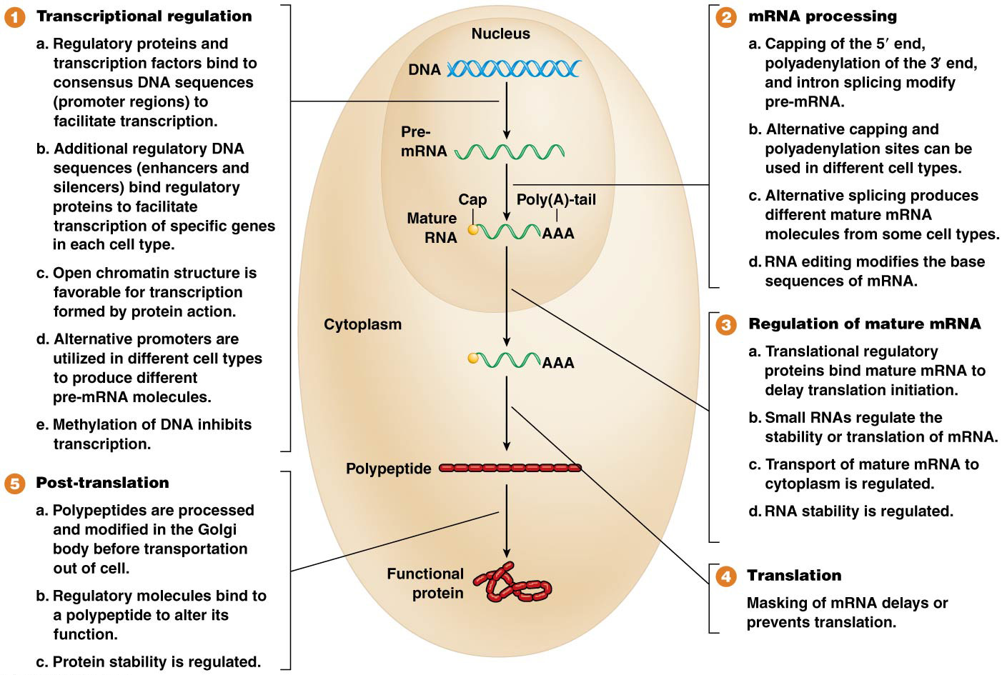
Figure 15.1 An overview of gene regulation mechanisms in eukaryotes.

Slide 4
Transcriptional Regulatory Interactions
Three sets of regulatory DNA sequences are commonly involved in eukaryotic gene regulation:
The core promoter region, containing the TATA box and other sequences, is immediately adjacent to the start of transcription; these bind RNA polymerase II and its associated transcription factors
Upstream of the core promoter region are various proximal elements that also regulate genes
At greater distances from the core promoter are the enhancer and silencer sequences (or enhancers and silencers). They may be close to or very far upstream or downstream from the genes they regulate; they may even be within the genes they regulate
4

Slide 5
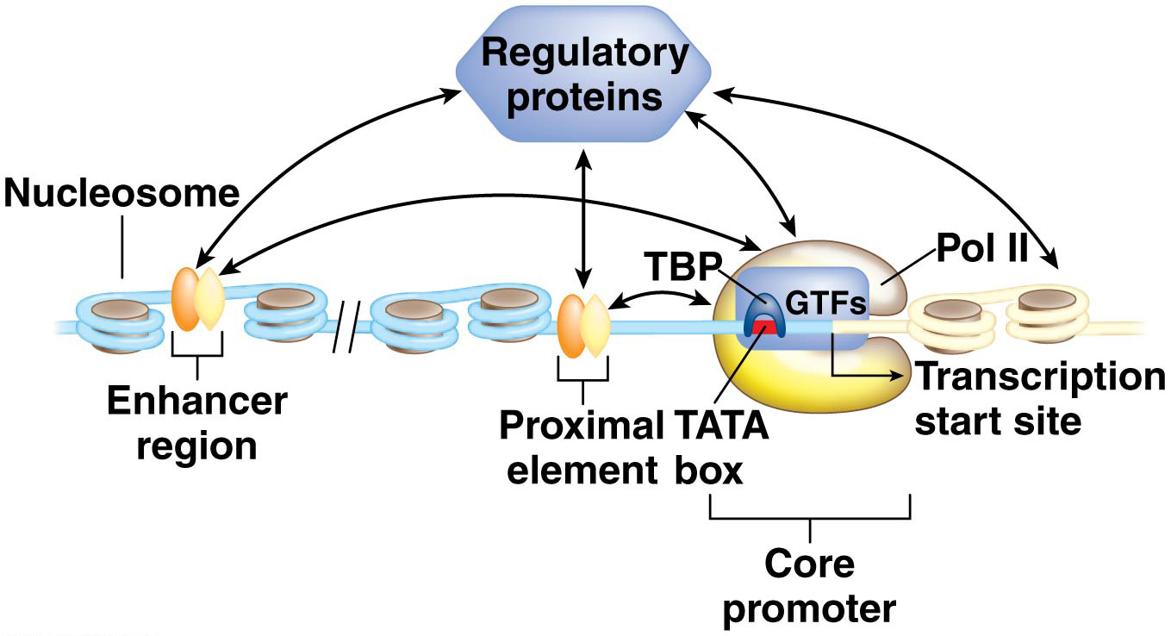
Figure 15.2 Regulatory interactions in eukaryotic transcription.

Slide 6
Cis-Acting Regulatory Sequences and Trans-Acting Proteins
All three regulatory regions (core promoter, proximal elements and enhancers or silencers) contain cis-acting regulatory sequences, which regulate transcription of genes on the same chromosome as the sequences
RNA polymerase II (Pol II) and various general transcription factors (GTFs) bind the core promoter; these are trans-acting regulatory proteins, which can bind to their target sequences on any chromosome
6

Slide 7
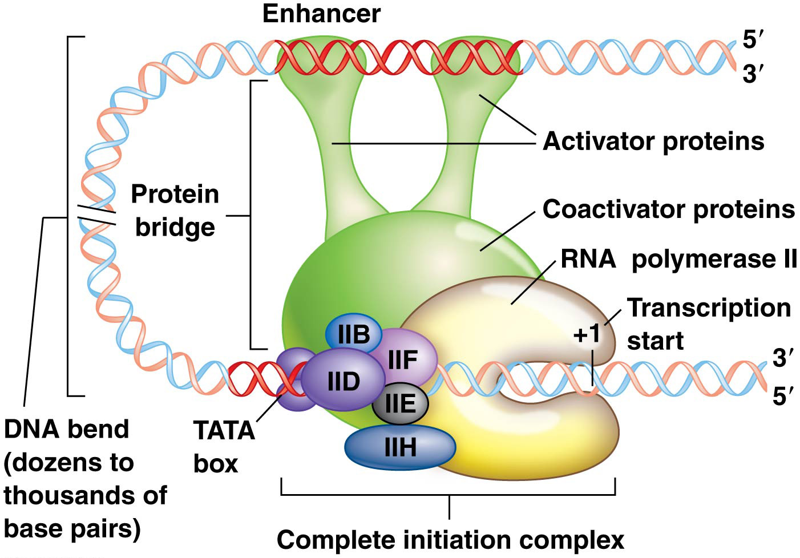
Enhanceosome Action
Aggregations of multiple proteins around the enhancers form large complexes called enhanceosomes
Enhanceosomes direct DNA bending into loops
The loops allow enhanceosome proteins to interact with RNA polymerase and transcription factors at the core promoter and proximal promoter elements
Loops may be small or large based on the distance between the enhancer sequence and the gene it regulates
7

Slide 8
Transcriptional Regulation by Enhancers and Silencers
Enhancers and silencers typically contain binding sites (modules) for a number of transcription factors
Occasionally the same sequence can act as an enhancer or a silencer, depending on which regulatory proteins are present and bind to the sequence
Sometimes the enhancer or silencer sequence is very distant from the gene it regulates
A model for understanding transcriptional regulation must include a mode of action of enhancers and silencers and take the variability of their locations and tissue-specific regulation patterns into account
8

Slide 9
A Model for Control of Eukaryotic Transcription
The Sonic hedgehog (SHH) gene in humans and other mammals directs limb formation under an enhancer 1 million bp away from the SHH gene
SHH is expressed in a tissue-specific fashion due to the action of two different enhancers
One combination of regulatory proteins binds the brain enhancer in brain tissue, but a different combination binds the limb enhancer in developing limbs
9

Slide 10
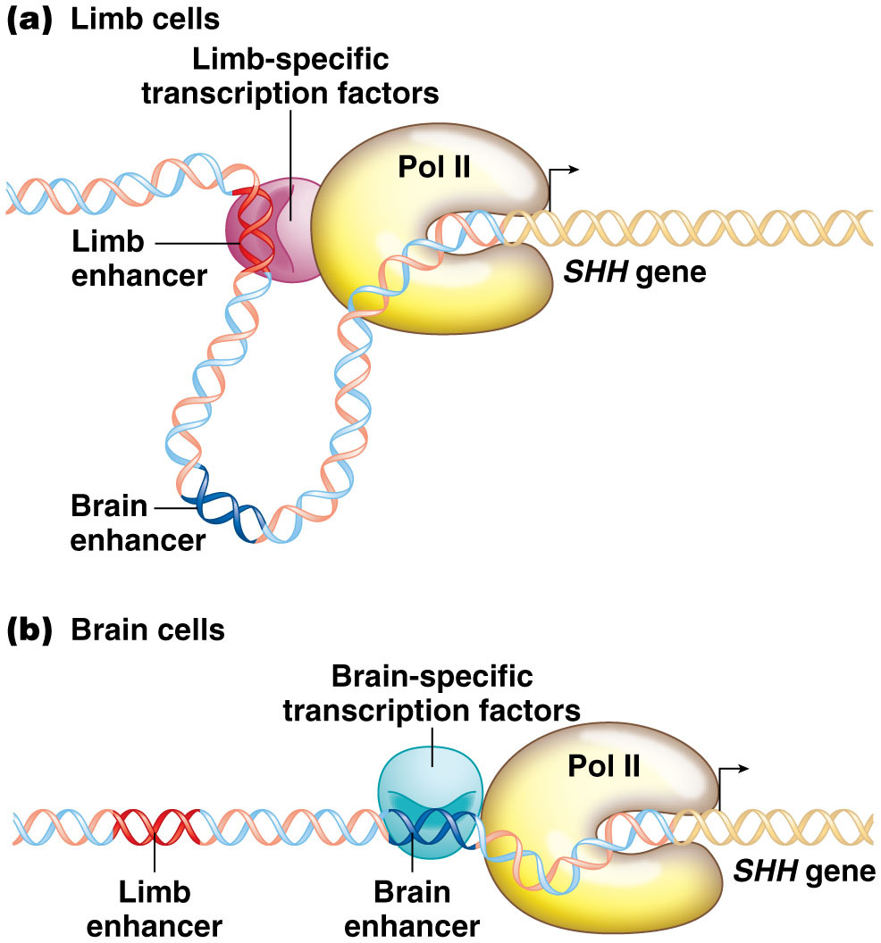
Figure 15.4 Tissue-specific enhancer action.

Slide 11
Enhancer-Sequence Conservation
Some enhancer sequences are conserved among different species
Enhancer sequence conservation indicates evolutionary constraint on enhancer diversification; enhancer elements that have been conserved throughout vertebrate evolution regulate genes controlling vertebrate body plan development
11

Slide 12
Yeast Enhancer and Silencer Sequences
In the yeast Saccharomyces cerevisiae, transcription of genes in the galactose utilization pathway is carefully regulated by enhancer-like sequences
When galactose is the only sugar available, wild-type yeast induce transcription of four enzyme-producing genes, GAL1, GAL2, GAL7, and GAL10
Together these import and then break down galactose
12

Slide 13
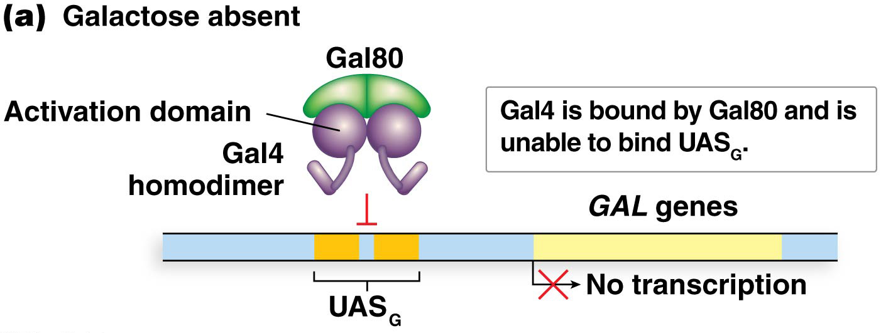
Upstream Activator Sequences
Each of the GAL genes has its own promoter and similar enhancer elements that are bound by a regulatory activator protein, Gal4, encoded by the GAL4 gene
The enhancer element is called the upstream activator sequence (UAS, or UAS_{G})
Gal4 is continuously present in cells and interacts with the Gal80 protein that binds Gal4 and keeps it inactive when galactose is absent. When Gal4 is bound to Gal80, the Gal4 DNA-binding domain is unable to bind UAS_{G}
13

Slide 14
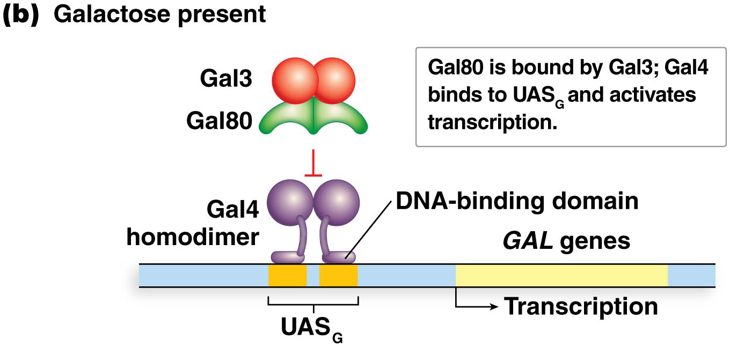
Gal4 Function in the Presence of Galactose
When galactose is present, galactose and Gal3, encoded by the GAL3 gene, bind to Gal80
Gal80 releases Gal4, freeing the DNA-binding domain of Gal4 to recognize and bind to the UAS_{G} sites
The transcriptional activation domain then activates transcription of the GAL genes
14

Slide 15
Gal4 Activation of Transcription
Gal4 binding of UAS_{G} leads to formation of a multiprotein complex called the Mediator
The Mediator is an enhanceosome that induces formation of a DNA loop, making contact with the general transcription apparatus at the GAL gene promoters
Transcription of GAL genes is dependent on transcription activation by Gal4/UAS_{G} binding and subsequent Mediator formation
15

Slide 16
Repressor Proteins and Silencer Sequences
Eukaryotic repressors inhibit transcription through different mechanisms than those seen in bacteria
One mechanism is the binding of repressor proteins to silencer sequences, cis-acting regulatory sequences that directly prevent enhancer-mediated transcription
The GAL genes utilize such a mechanism; the protein Mig1 is produced in the presence of glucose (no need to utilize galactose) and binds silencer sequences upstream of the GAL genes
16

Slide 17
Figure 15.10 Transcription repression of the yeast GAL1 gene.

Slide 18
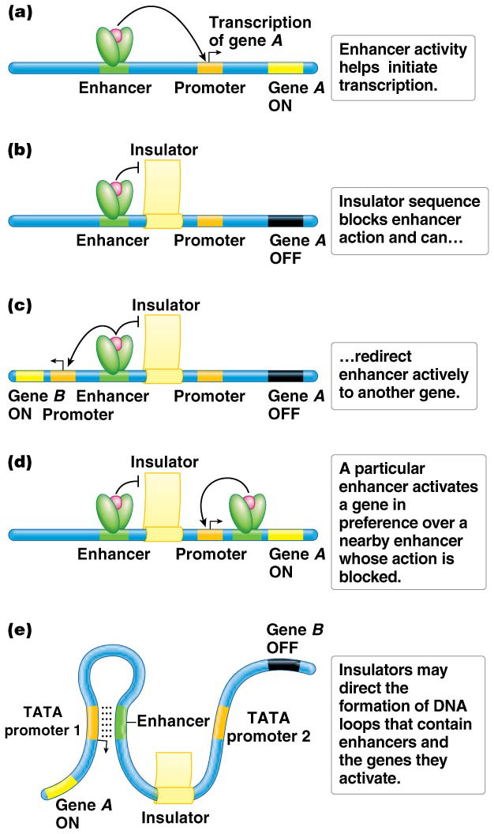
Insulator Sequences
Insulator sequences are cis-acting sequences located between enhancers and the promoters of genes that need to be protected from the action of the enhancers
Insulators ensure that only the target gene is regulated by the enhancer
Insulators may allow formation of DNA loops that contain the enhancers and their intended target promoters while excluding nontarget genes
18

Slide 19
15.2 Chromatin Remodeling and Modification Regulates Eukaryotic Transcription
Some regions of the genome are constitutive heterochromatin (tightly packed)
Other regions switch between euchromatin (lightly packed) and heterochromatin (tightly packed) often based on tissue type or cellular needs during certain times
Position effect variegation (PEV) occurs when the euchromatin is placed near heterochromatin, which spreads into the euchromatin, silencing genes. PEV is widespread in eukaryotic genomes; several genes and proteins are important in establishing and maintaining chromatin structures associated with control of gene expression
19

Slide 20
Heterochromatin and PEV and eye color in flies (see PPT lesson3)
The stopping point of heterochromatic spread determines whether or not the relocated eye color gene will be expressed
If the eye color gene remains euchromatic, it is expressed; if the gene is compacted into heterochromatin, it is not expressed
In flies with the wild-type (red eye color) allele, some eye cells will have an active eye color gene; others an inactive one (resulting in no color), giving a speckled appearance
20

Slide 21
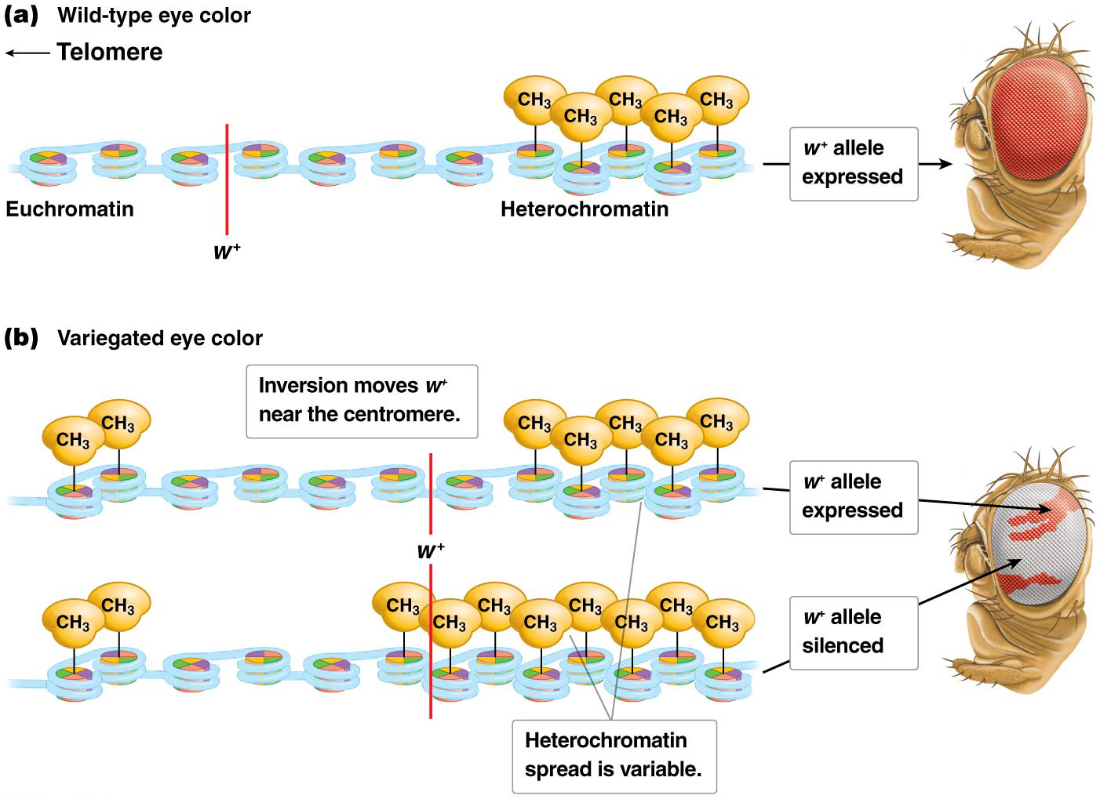
Position effect variegation of eye color in Drosophila.
65

Slide 22
Chromatin modification
Certain genes produce proteins that make epigenetic “marks” on histone proteins; these involve attachment and detachment of methyl, acetyl, and phosphoryl groups to histones
Chromatin remodeling control gene expression
Epigenetic modification patterns of histones may be passed through generations of cells
22

Slide 23
Epigenetic Heritability
Mechanisms controlling differential chromatin states produce patterns of gene expression in different cells (needed for growth and development of the organism)
All cells in the body contain the same genetic information; differences in morphology and function result from differential gene expression
Differences between somatic cells are epigenetic, resulting from different chromatin states, affecting gene transcription
23

Slide 24
Epigenetic Heritability (continued)
Epigenetic patterns are often heritable through mitosis from one generation of cells to the next, so that daughter cells have the same patterns of gene expression as the parent cells
Epigenetic differences may also be heritable from one generation of organism to the next through meiosis—there is some evidence of this
24

Slide 25
Five Important Features of Epigenetic Modification
Epigenetic modification patterns alter chromatin structure
They are transmissible during cell division or between generations
They are reversible
They are directly associated with gene transcription
They do not alter DNA sequence
25

Slide 26
Chemical Modifications of Chromatin
Chromatin modifier proteins chemically alter histone proteins in the nucleosomes by adding or removing chemical groups
The modifications alter the strength of the nucleosome-DNA associations, and can cause chromatin structure to relax, forming open promoters, or to condense, leading to closed promoter structures
Principal chemical modifications are addition and removal of acetyl and methyl groups
26

Slide 27
Histone Acetylation
Histone acetyltransferases (HATs) are recruited by activators and add acetyl (COCH₃) groups; these act as writers. The acetylation relaxe the histone/DNA interaction.
Acetyl groups are removed by histone deacetylases (HDACs), which are recruited by repressors; these act as erasers
27

Slide 28
Histone Methylation
Methyl (CH₃) groups are added to N-terminal histone tails by histone methyltransferases (HMTs); these act as writers. Methylation plays a role in converting open chromatin to closed chromatin.
Demethylation is carried out by histone demethylases (HDMTs); these act as erasers
28

Slide 29
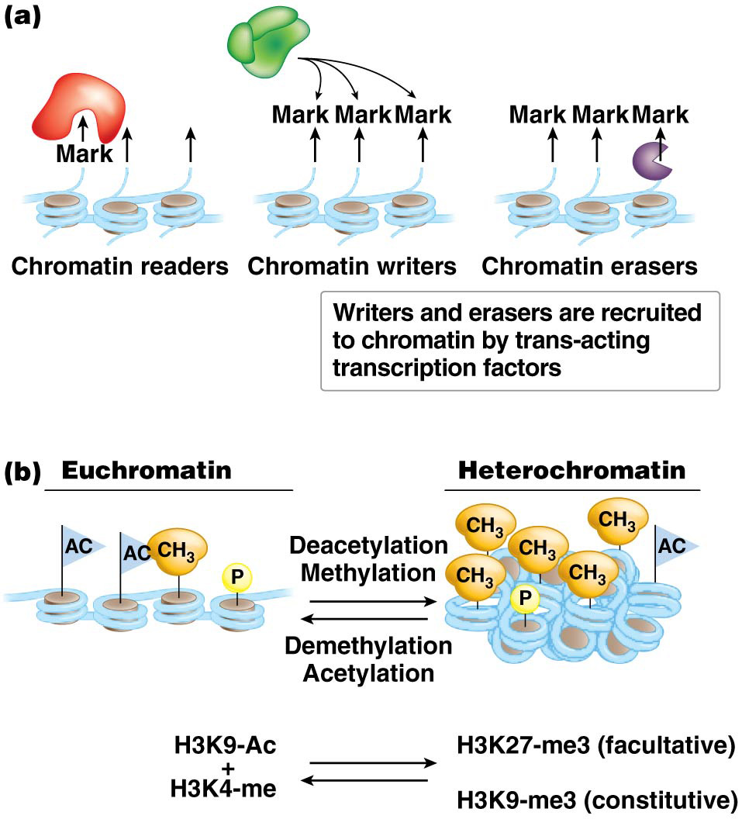
Writers, Erasers and Readers
“Writer” enzymes add chemical groups to chromatin;
“eraser” enzymes remove groups from chromatin
“readers” proteins recognize modified histones are
Writers and erasers are recruited to specific chromatin locations with DNA binding proteins attached to modify histone tails
29

Slide 30
Mechanisms by Which Proteins Access Target DNA Sequences
There are three basic mechanisms by which trans-acting proteins access target DNA sequences:
some regulatory sequences are not tightly bound by histones, so that regulatory proteins can easily access the DNA sequences
proteins called chromatin remodelers change the distribution or composition of histones
proteins called chromatin modifiers can enzymatically modify histones by adding or removing acetyl or methyl groups to particular lysine residues
Open promoters and covered promoters are two states at opposite ends of a continuum of nucleosome interaction with regulatory DNA sequences
30

Slide 31
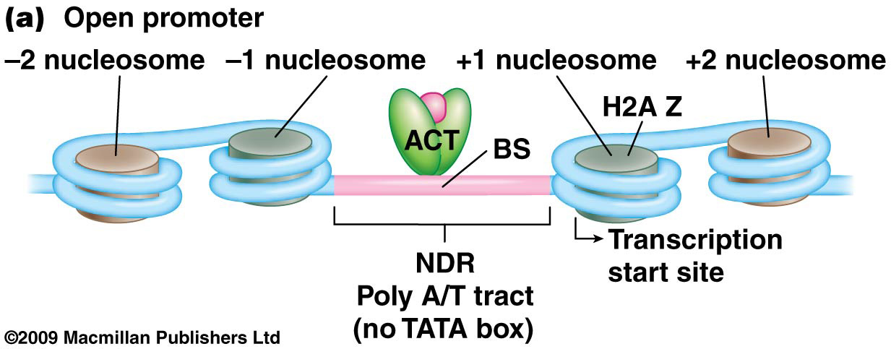
Open Promoters
Open promoters cause genes to be constitutively expressed; they have a nucleosome-depleted region (NDR) of 100–150 bp immediately upstream of the transcription start site
These promoters usually do not have a TATA box, but instead have a poly A/T tract that contains binding sequences (BS) that attract transcriptional activators (ACT). The binding region is flanked by sequences that help position one nucleosome upstream and one downstream (called the +1 nucleosome) of the NDR
31

Slide 32
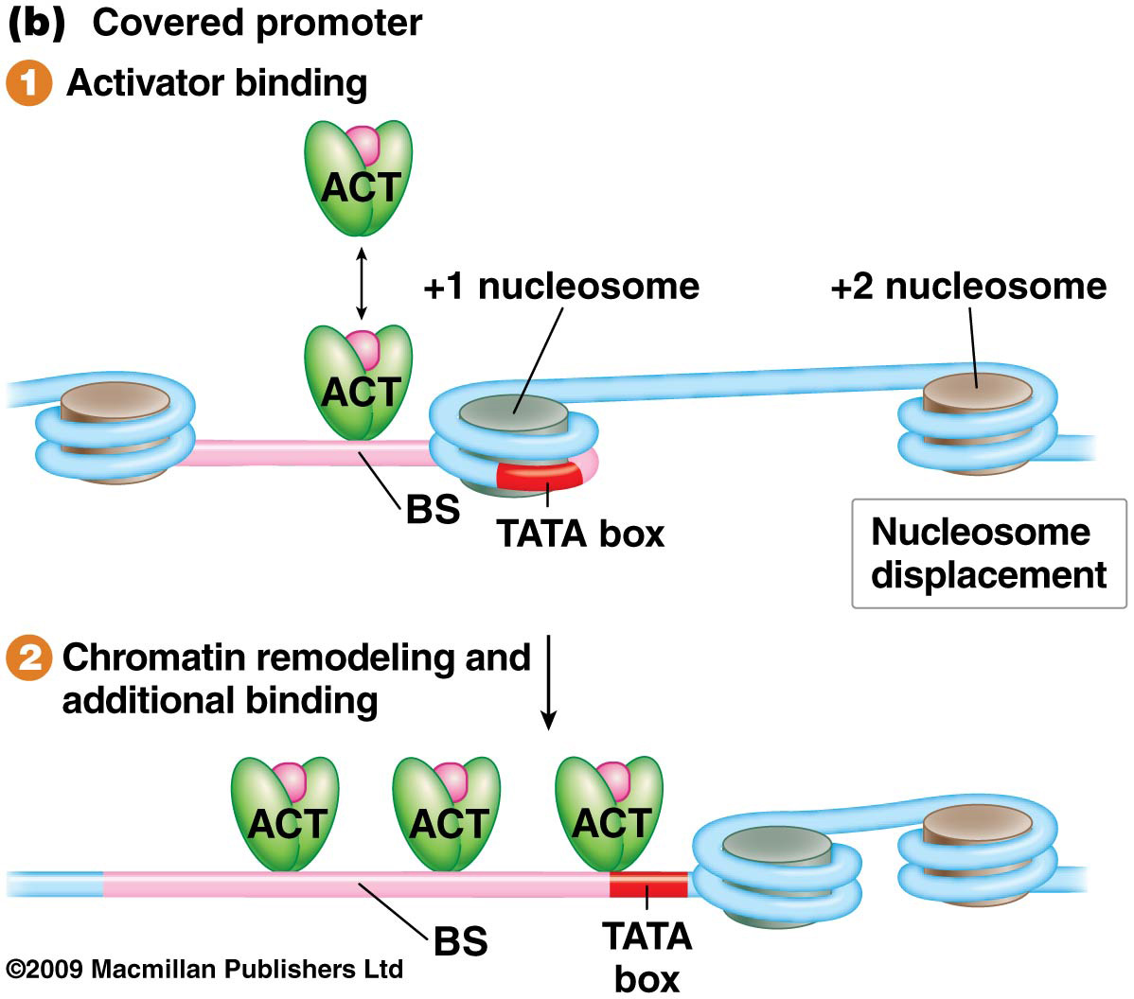
Covered Promoters
Covered promoters characterize genes whose transcription is regulated; transcription is blocked until nucleosomes are displaced or removed from the promoter
These promoters generally contain TATA boxes and other transcription-factor binding sequences
There is active competition between nucleosomes and transcription factors for binding
32

Slide 33
Mechanisms of Chromatin Remodeling
Chromatin remodeling refers to modifications that reposition nucleosomes so as to open or close promoters and other regulatory sequences. These depends on the condensation of chromatin.
Open chromatin has a relaxed association between DNA and nucleosomes, and allows for access by regulatory proteins
Closed chromatin is produced by modifications that cause regulatory sites to be covered by nucleosomes, restricting access by regulatory proteins
Two example on how to change chromatin condensation are: 1) presence of DNase I hypersensitive sites, 2) use of Chromatin remodelers

Slide 34
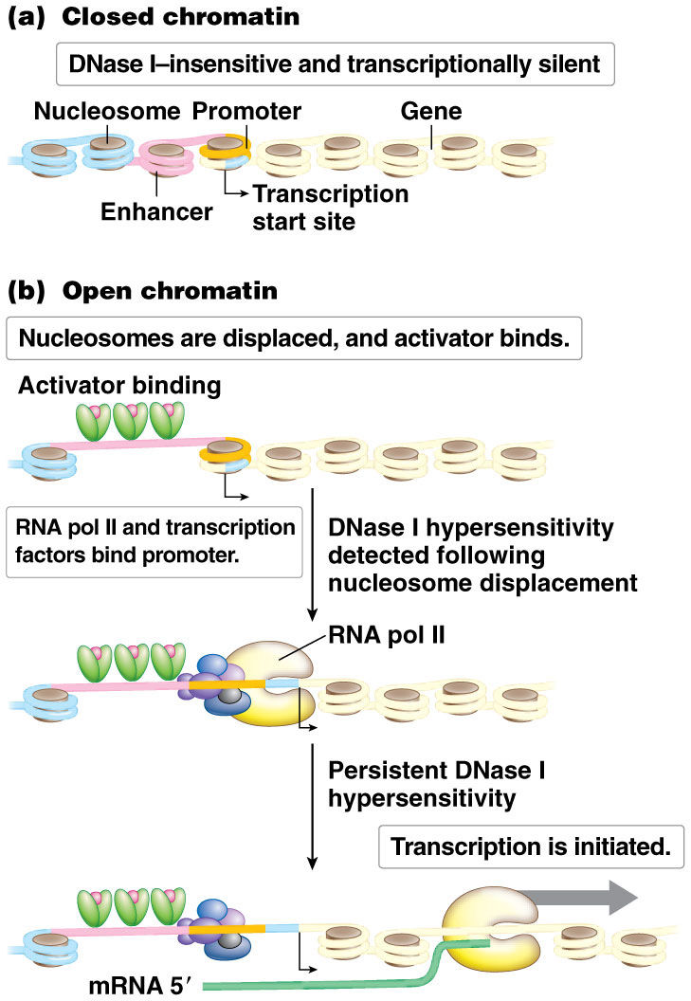
DNase I Hypersensitivity
Regions of chromatin that are sensitive to DNase I digestion are called DNase I hypersensitive sites
Hypersensitivity occurs in the immediate vicinity of transcribed genes and surround promoters, enhancers, and other transcription-regulating sequences
34

Slide 35
Chromatin Remodelers
Chromatin remodelers are protein complexes that move nucleosomes in three principal ways:
By causing nucleosomes to slide along DNA or remove them from DNA to uncover enhancers or promoters
By inducing nucleosome movement, usually repressing transcription
By changing the composition of histone octamers, activating genes
Chromatin remodelers include the SWI/SNF complex, ISWI complex, and SWR1 complex
35

Slide 36
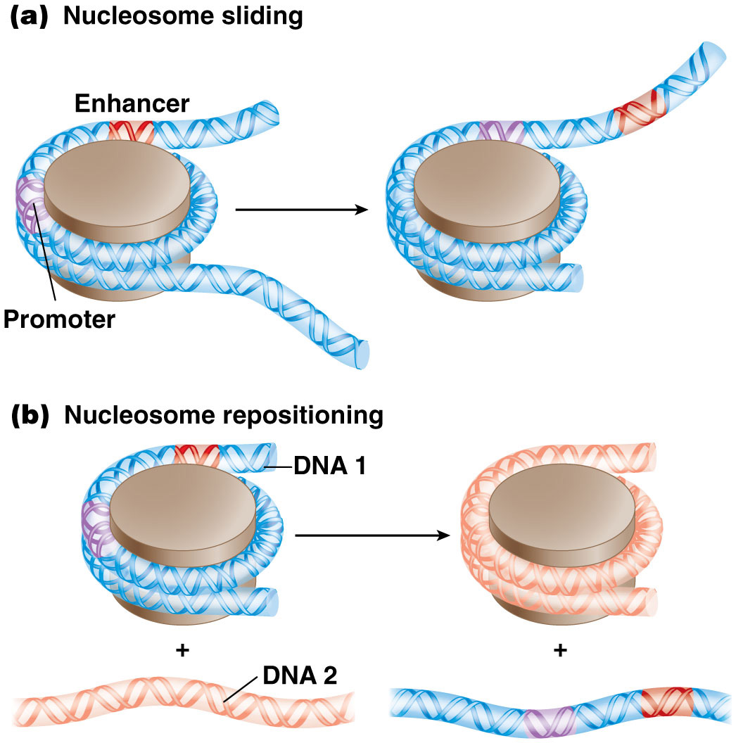
Figure 15.16 Nucleosome displacement to expose regulatory sequences.

Slide 37
The SWI/SNF Complex
The SWI/SNF complex functions to open chromatin structure by displacing or ejecting nucleosomes
The ISWI complex contains remodelers that mainly control placement of nucleosomes into a position that silences transcription
37

Slide 38
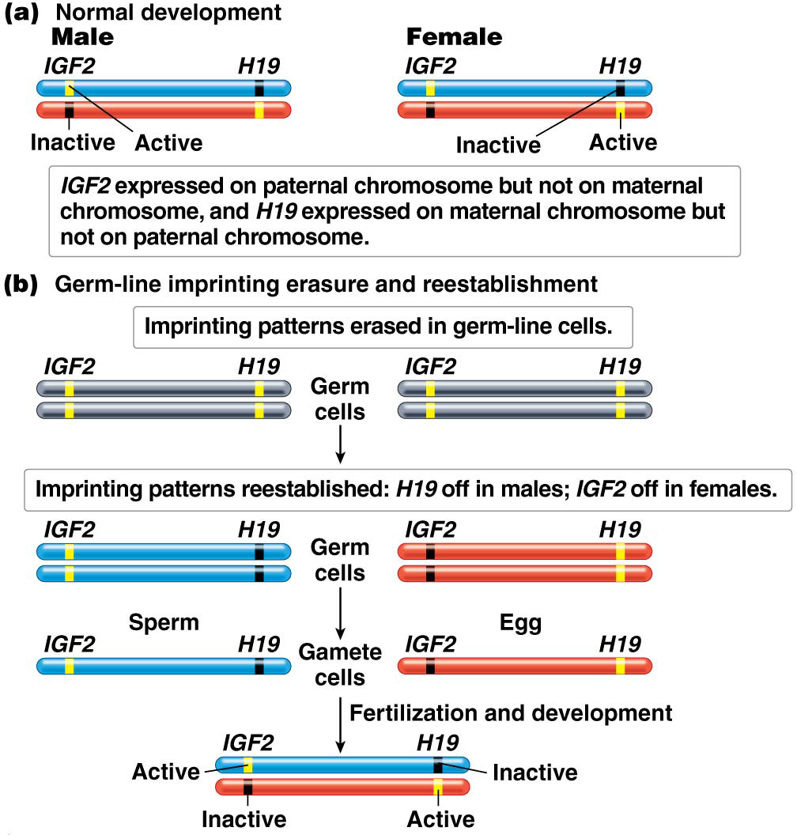
Genomic Imprinting
Genomic imprinting is a specialized example of resetting epigenetic patterns during meiosis
Any pattern of expression of imprinted genes that differs from the normal pattern has profound consequences
38

Slide 39
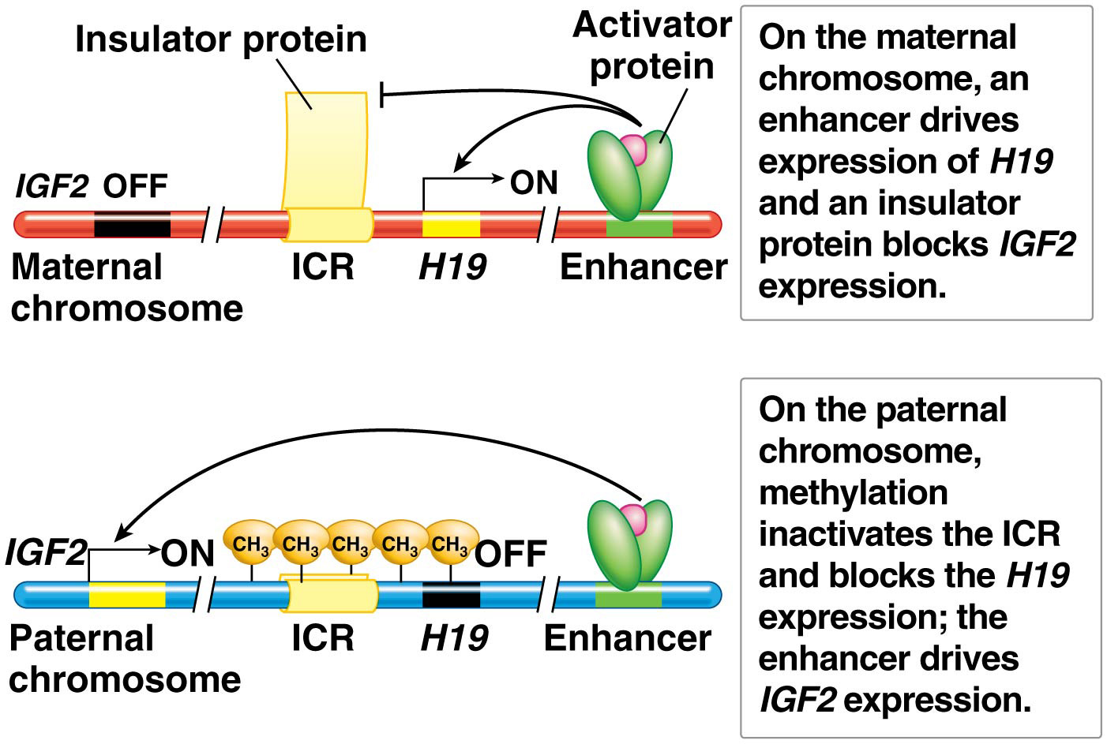
Genomic Imprinting
Genomic imprinting, which affects a small number of mammalian genes, involves the expression of only one of the inherited alleles of a gene, depending on the parent from which it is inherited. The expressed gene copy is always maternal in some imprinted genes and always paternal in others
39

Slide 40
15.3 RNA-Mediated Mechanisms Control Gene Expression
RNA is a key component in the regulatory control of eukaryotic gene expression. Some examples are long coding RNAs, micro RNAs, and small interfering RNAs
Long noncoding RNAs (lncRNAs) play critical roles in gene regulation in eukaryotic cells
They are long RNAs that lack substantial open reading frames
Many may act as scaffolds linking regulatory proteins to affect gene expression
An example of an lncRNA is Xist, which is involved in X-chromosome inactivation in eutherian mammals
40

Slide 41
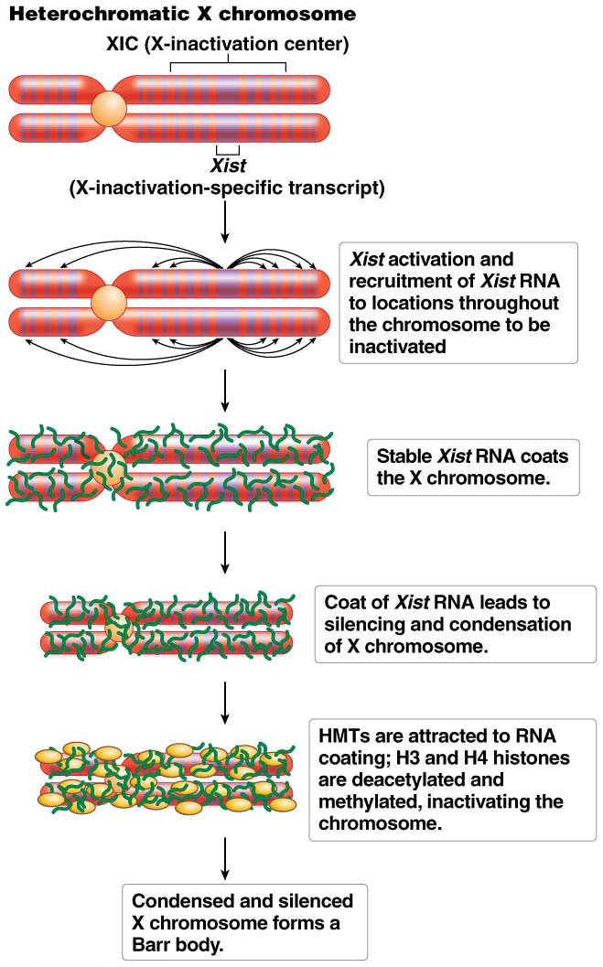
A Role for IncRNAs in Gene Regulation
Eutherian mammalian females have two X chromosomes compared to the single X of males
To balance gene dosage, one female X chromosome is inactivated; this is a random process
The X-inactivation specific transcript (Xist) gene is in the X-inactivation center (XIC) on the X chromosome; it is active on the heterochromatic X and inactive on the euchromatic X
41

Slide 42
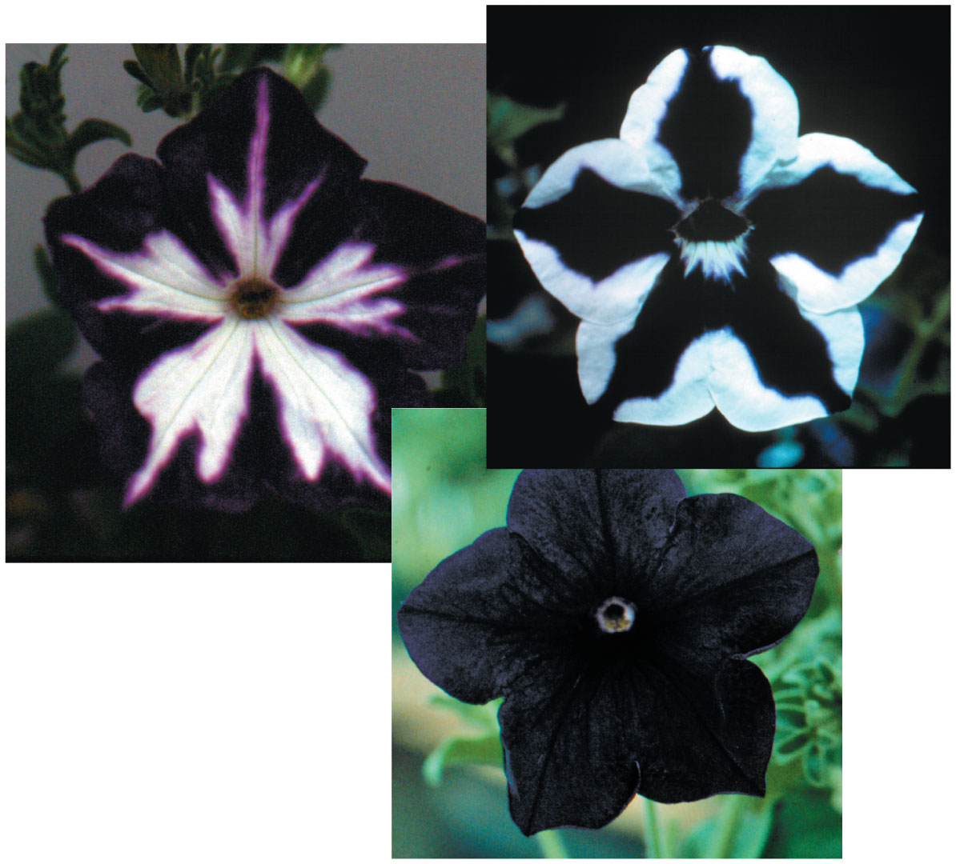
RNAi interference
In the early 1990s, Jorgensen and colleagues introduced an additional gene for pigment production into petunias, with the aim of deepening the flower color
Many of the resulting flowers were variegated, with some having stripes of deep pigment and stripes lacking pigment; others were almost entirely white. The phenomenon was called cosuppression, because the introduced gene and the plant’s normal pigment-producing gene were both suppressed. Similar phenomena were observed in other organisms
In 1998 a team led by Fire and Mello found that double-stranded RNA (dsRNA) was taking part in a regulatory mechanism now called RNA interference (RNAi)
42

Slide 43
Gene Silencing by Double-Stranded RNA
RNAi silences gene expression transcriptionally, or posttranscriptionally
Small regulatory RNAs can bind to mRNA targets by complementary base pairing. This can lead to destruction of the target mRNA or can block its translation (posttranscriptionally)
Some regulatory RNAs enter the nucleus and bind DNA to block transcription of the target gene (transcriptionally)
43

Slide 44
MicroRNAs
dsRNA can be produced from endogenous genes or other sequences or can come from exogenous sources. RNA polymerase II and produce transcripts that fold back upon themselves to produce dsRNA
In many eukaryotes, genes encode precursors of dsRNA that are cleaved into microRNAs (miRNAs) of 21–24 nucleotides
44

Slide 45
Other Sources of dsRNAs
Small interfering RNAs (siRNAs) are usually complementary RNAs that come from exogenous sources or other endogenous transcription. Some eukaryotes have RNA-dependent RNA polymerases that can produce dsRNA using a single-stranded RNA template
Some exogenous sources of dsRNA, such as those produced by RNA viruses, can also trigger gene silencing
45

Slide 46
Cleaving dsRNA
Dicer activity cleaves dsRNA molecules to 21–25-bp fragments
The size of these fragments are species-specific
46

Slide 47
Creation of miRNA
Precursor transcripts are synthesized in the nucleus and processed into miRNAs by Dicer activity
The initial transcript is called primary microRNA (pri-miRNA); it forms a double-stranded stem of about 65–70 nucleotides, with free ends on one side and a single-stranded loop on the other
In animals, the Drosha enzyme complex cuts the pri-miRNA near the middle of the stem and produces two segments. One of these is precursor microRNA (pre-miRNA), which is transported to the cytoplasm, where Dicer removes the terminal loop
RISC then binds to the remaining 21–25 bp and separates the strands to create miRNAs
47

Slide 48
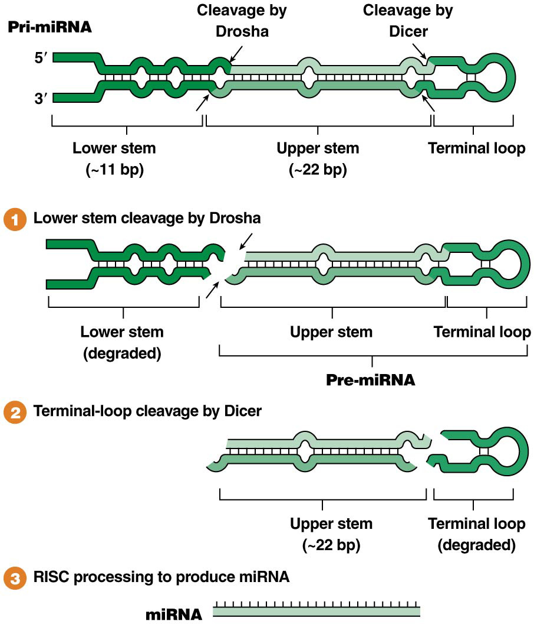
Figure 15.26 Stepwise processing of pri-miRNA to produce miRNA.

Slide 49
The Evolution and Applications of RNAi
RNAi is widespread in eukaryotes
It is thought that it evolved by helping organisms protect their genomes against mutational effects of transposable genetic elements
Most transposons in eukaryotes are located in heterochromatin and are silent
Mutations in the RNAi system can reactivate transposons by reversing transcriptional silencing
49

Slide 50
The Evolution and Applications of RNAi (continued)
RNAi also plays a protective role in response to viral infection
In plants, infection of a single leaf by a virus can generate an RNAi response that blocks viral replication and protects the rest of the plant from the infection
RNAi can be used to selectively “knock down” expression of selected genes to determine the effect on the phenotype
50

