Slide 1
0
21

Slide 2
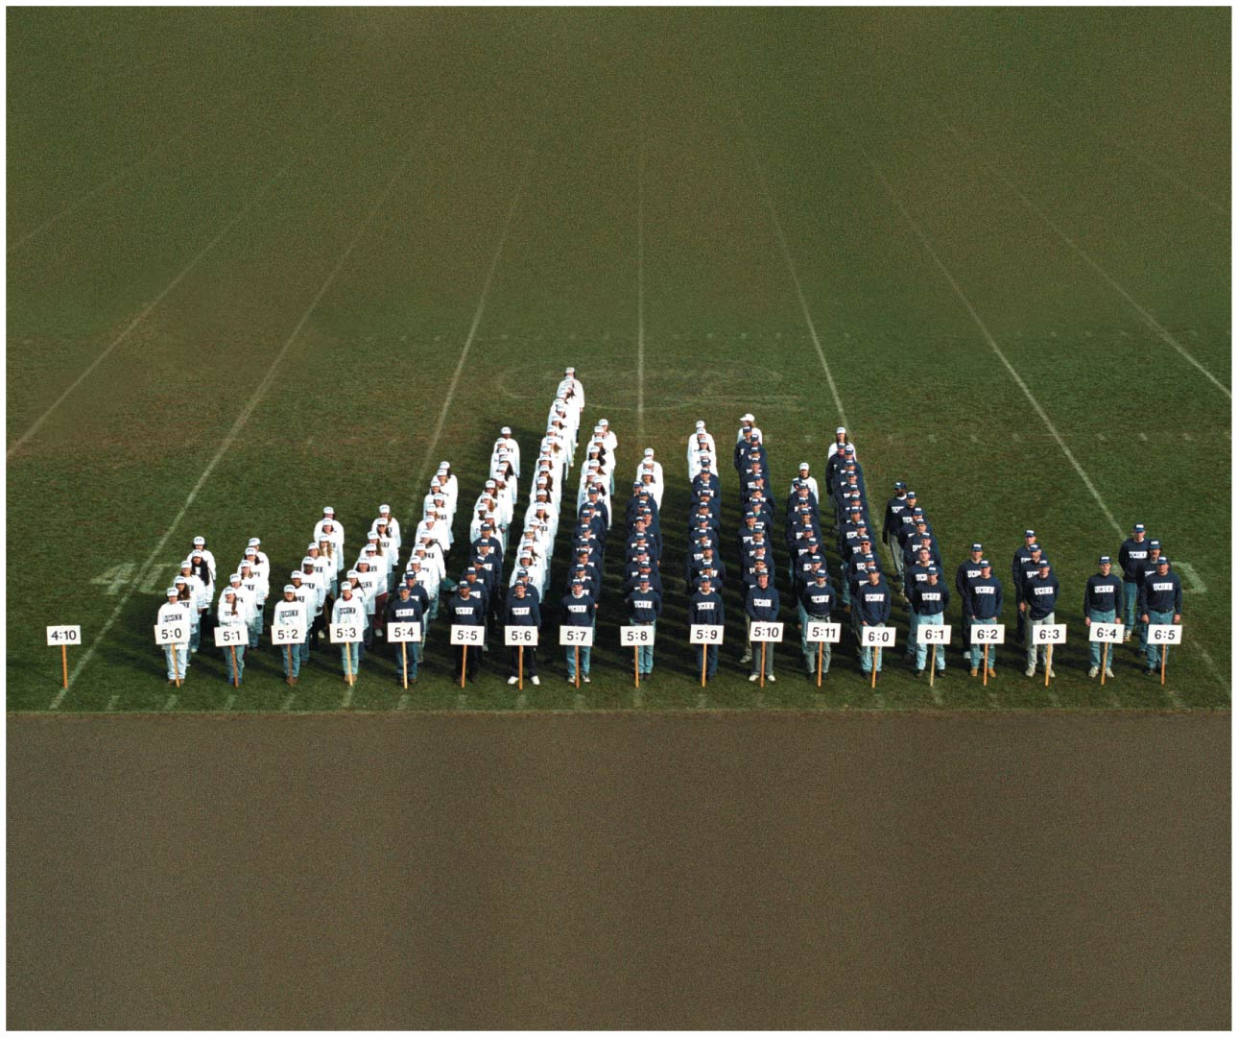
Chapter 21 Opener
2

Slide 3
21.1 Quantitative Traits Display Continuous Phenotypic Variation
The phenotypes of single-gene traits commonly display discontinuous variation; organisms can be assigned to discrete, sharply distinguishable categories. Discontinuous patterns of variation lead to genetic ratios like the 3:1 ratio of F₂ offspring of self-fertilized F₁
Polygenic and multifactorial traits usually show continuous variation, with a range of values in an uninterrupted continuum
3

Slide 4
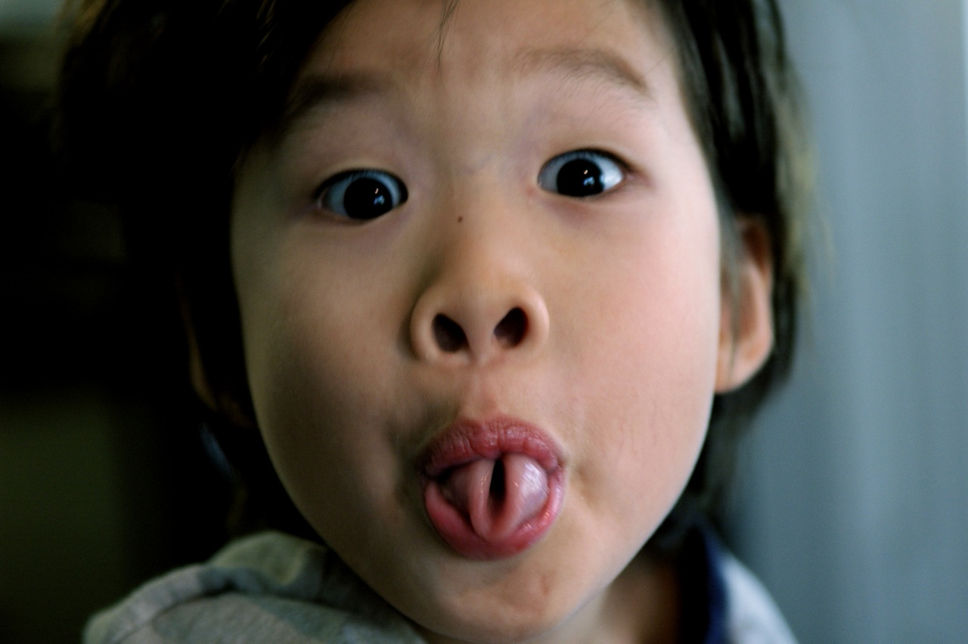
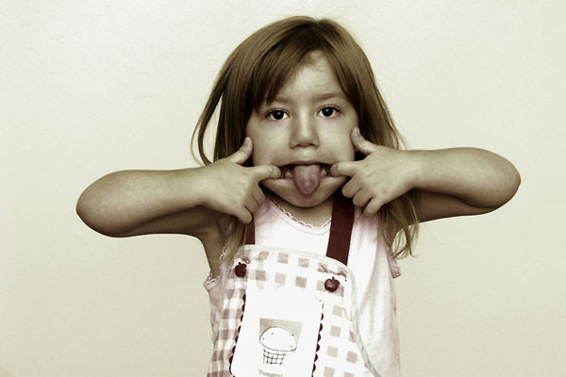
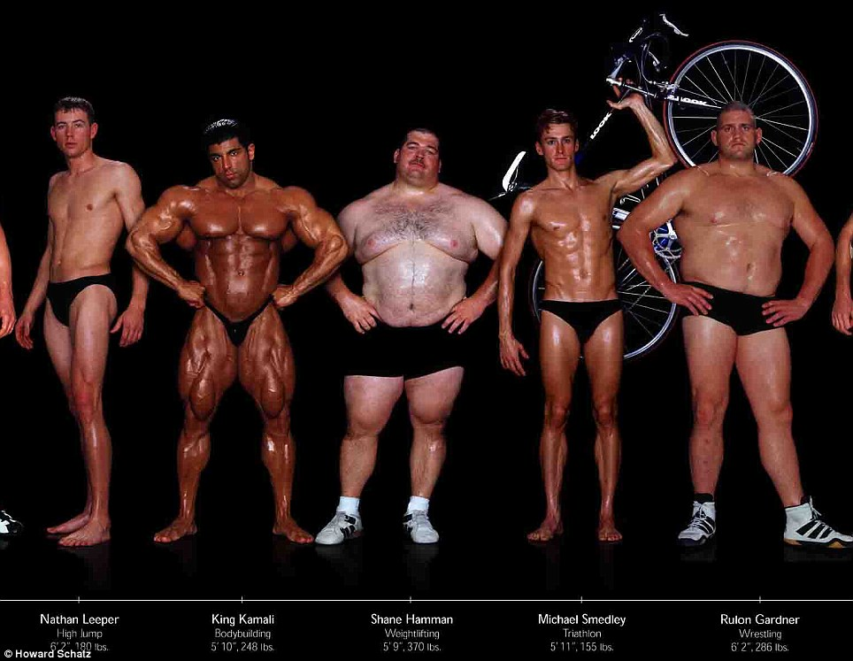
Discontinuous variation
Continuous variation

Slide 5
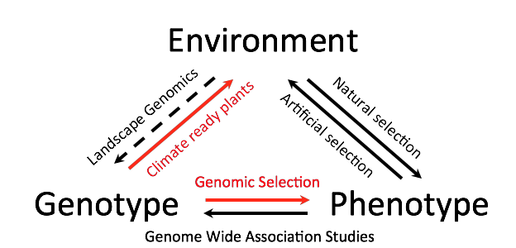

Slide 6
Genetic Potential
Human height is an example of a multifactorial trait with continuous variation
Adult height is influenced by multiple genes
Phenotypes are also influenced by environmental factors, such as nutrition
Parents transmit a “genetic potential” to offspring that may or may not be met, depending on environment
6

Slide 7
Major Genes and Additive Gene Effects
Continuous variation of polygenic traits results from effects of multiple genes that may exert different amounts of influence
For example, the human OCA2 gene has several alleles that strongly influence eye color, and is called a major gene. Eye color is influenced by other genes to a lesser degree, and these are called modifier genes
7

Slide 8
Additive Effects
In some polygenic traits, the continuous distribution of phenotype results from incremental contributions by multiple genes
These are called additive genes, and each can be assigned a value that indicates its contribution to the polygenic trait, called an additive trait
8

Slide 9
Multiple-Gene Hypothesis
In the early 1900s, geneticists began to investigate the idea that segregation of alleles of multiple genes played a role in phenotypic variation of certain traits
This was called the multiple-gene hypothesis
It was used by Nilsson-Ehle to describe genetic control of kernel color in wheat
Kernel color ranges from deep red to white and is influenced by alleles of two genes, A and B
9

Slide 10
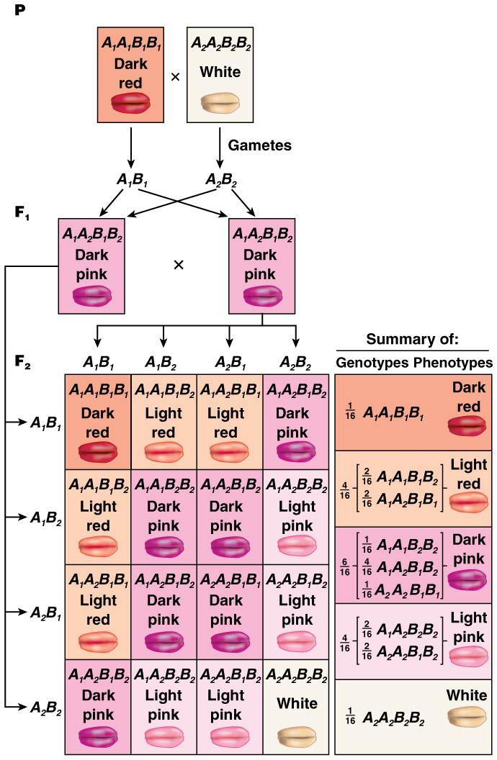
Multiple-Gene Hypothesis to Explain Kernel Color in Wheat
Kernel color ranges from deep red to white and is influenced by alleles of two genes, A and B
Alleles A₁ and B₁ of the two genes responsible for kernel color are equivalent and each add one unit of color to the phenotype. Alleles A₂ and B₂ are also equivalent, and neither adds any color
The greater the number of “1” alleles, the more intense the resulting color, with A₁A₁ B₁B₁ plants having the darkest color and A₂A₂ B₂B₂ having the lightest
10

Slide 11
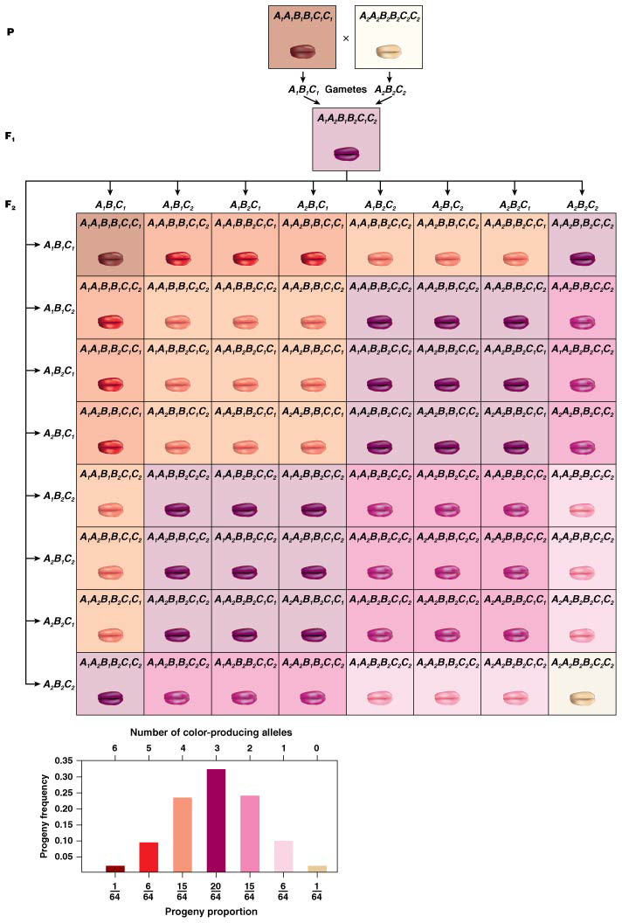
Additive Genes and Continuous Variation
As the number of additive genes contributing to a trait increases, the number of possible phenotypic categories increases also
The wheat kernel color, with two genes contributing, had five phenotypic classes
Where three genes contribute to a phenotype, seven classes are possible
11

Slide 12
Continuous Phenotypic Variation from Multiple Additive Genes
The more phenotypes that occur along a scale of measurement, the less obvious the demarcation between categories
The number of phenotypic categories is calculated as 2n + 1, where n = the number of genes
For example, for three additive genes contributing to a polygenic trait, there would be 2(3) + 1 = 7 phenotypic categories; this assumes just two alleles for each contributing gene
12

Slide 13
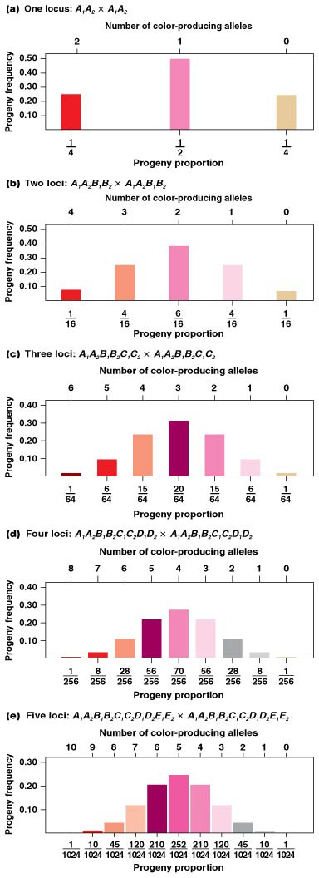
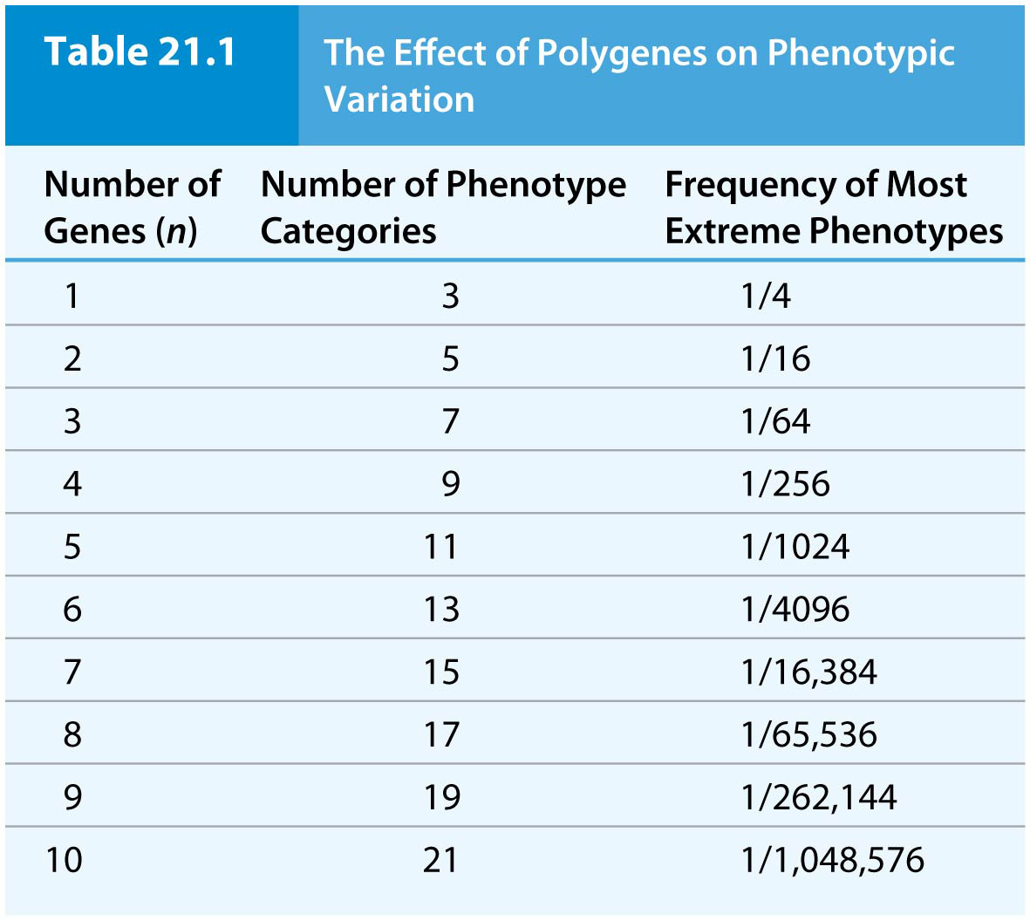
14

Slide 14
Effects of Environmental Factors on Phenotypic Variation
It is important (though difficult) to sort out genetic and nongenetic factors that determine phenotypic variation
Where no gene–environment interaction takes place, genotype corresponds to a distinct phenotype
The more gene–environment interaction that occurs, the wider the potential range of phenotypic values that may occur
14

Slide 15
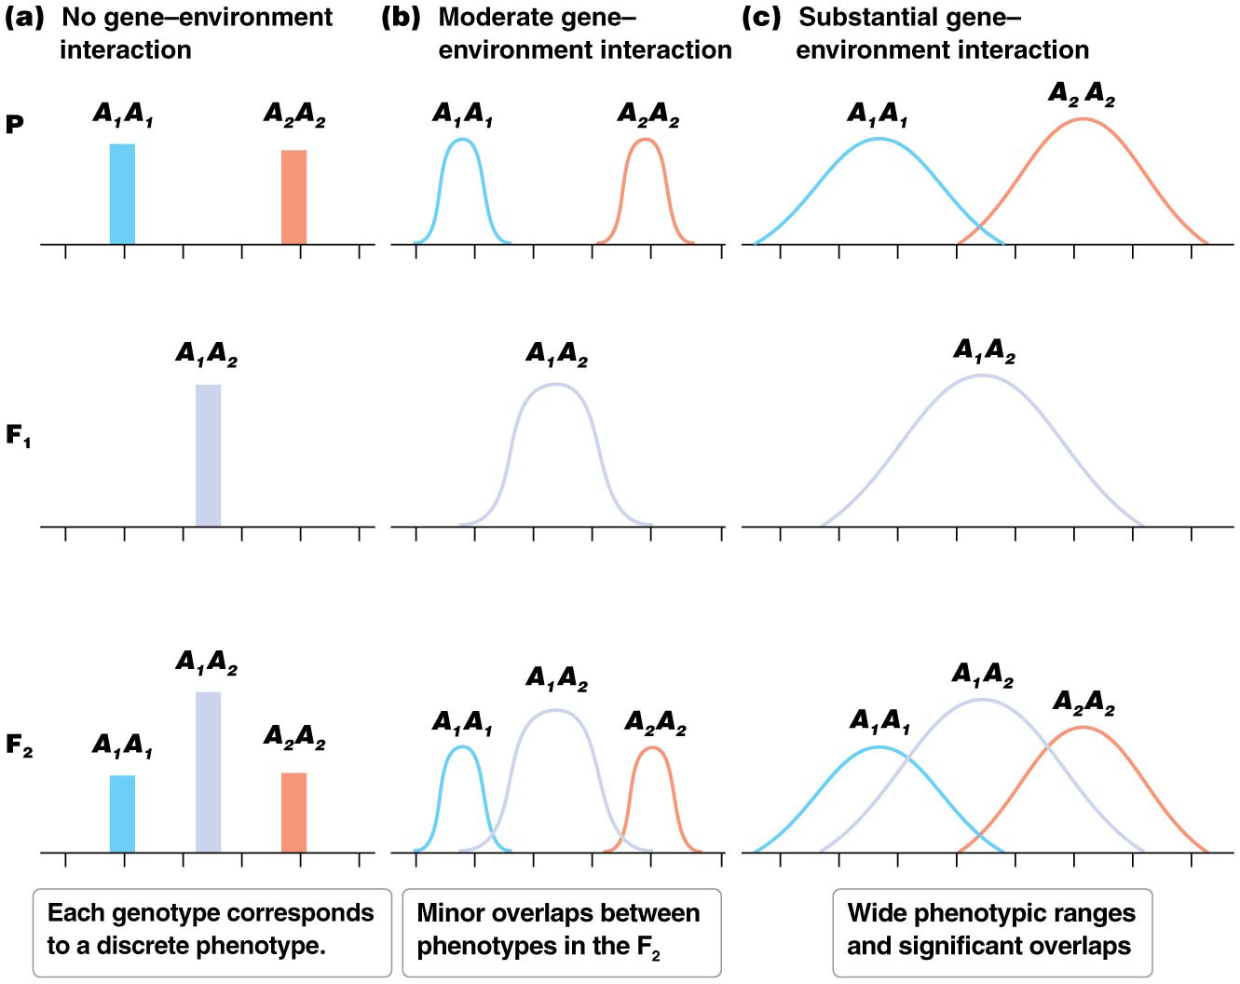
Figure 21.5 The effect of gene–environment interaction.
20

Slide 16
Threshold Traits
Some traits may have continuous variation of phenotype, but the phenotypes can still be divided into distinct categories.
These traits are called threshold traits, and are often encountered in medical situations, where individuals can be either “affected” (having the condition) or “unaffected” (normal). A small proportion of the population will be over a threshold and will have an affected phenotype
Threshold traits are proposed to be polygenic or multifactorial traits, with a continuous distribution of genetic liability. Genetic liability is a term for the organism’s risk of having the affected phenotype
The majority of a population will lie below the threshold of genetic liability, the point beyond which an individual will show the affected phenotype
16

Slide 17
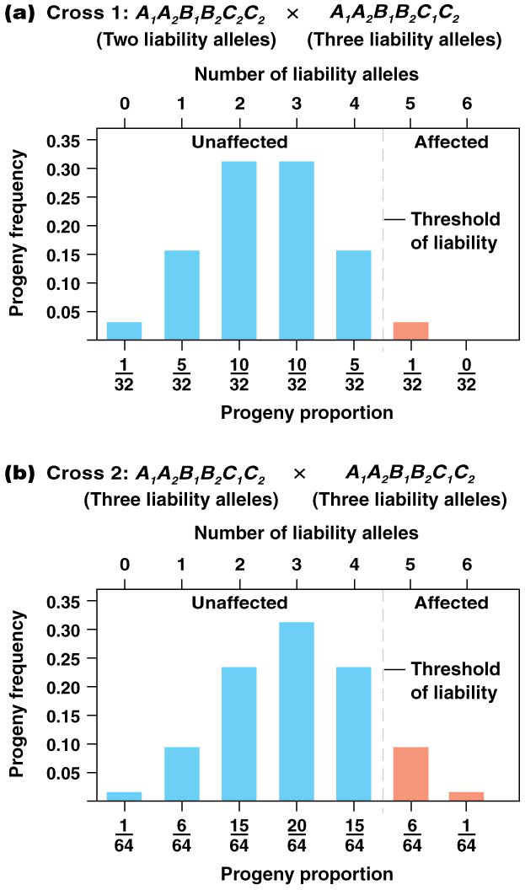
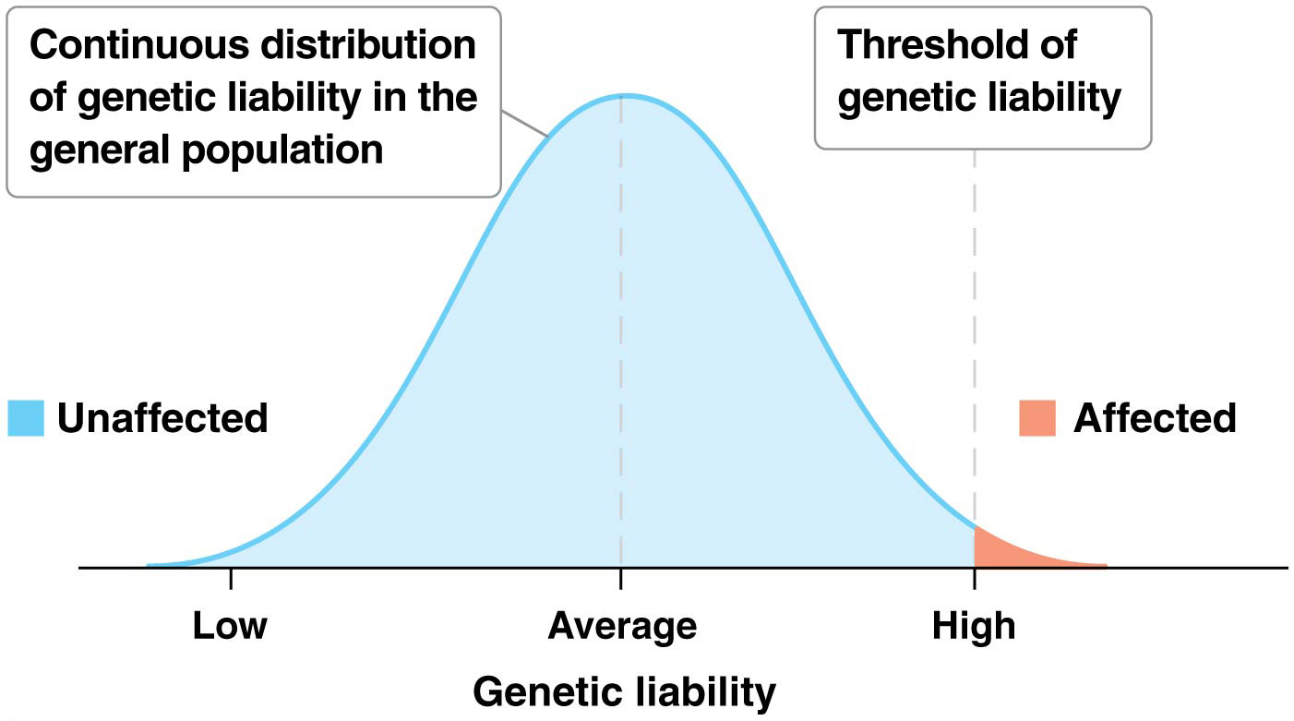
Figure 21.6 Threshold traits.
22

Slide 18
Nongenetic Factors
The influence of environmental and developmental factors on threshold traits is important
They likely play a role in determining whether individuals with a genetic liability near the threshold end up having the trait
18

Slide 19
21.2 Quantitative Trait Analysis Is Statistical
In 1918, Fisher used statistical analysis to show that quantitative traits result from segregation of alleles of multiple genes with an additive effect
The tools and approaches pioneered by Fisher allow scientists to identify genetic influences on phenotypes in terms of quantitative measurement
The first step in quantifying phenotypic variation is to construct a frequency distribution of values for that trait. The distribution shows the proportion of individuals that fall into each category described for the trait
Individuals should be a random sample, not selected for any attribute related to the trait being studied
19

Slide 20
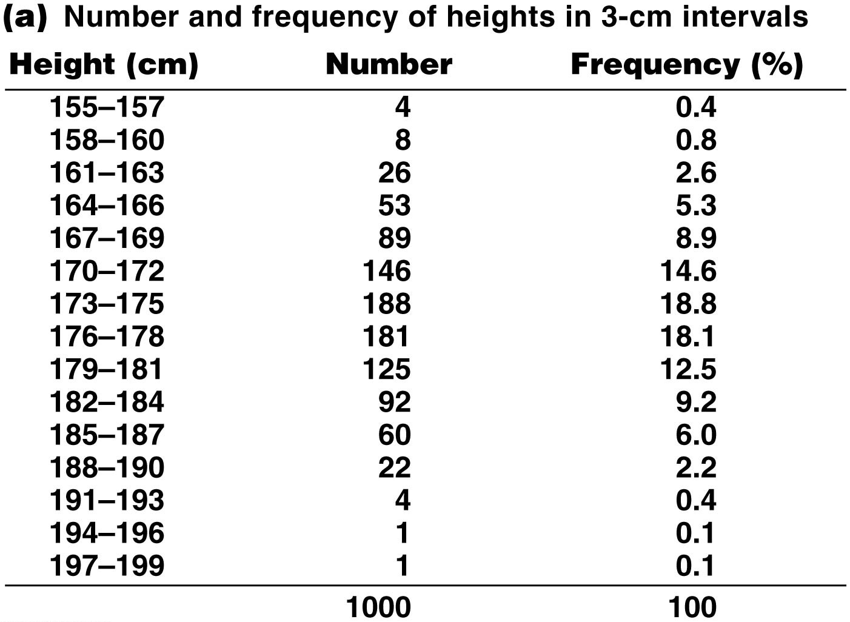
Figure 21.8a Adult height.
28

Slide 21
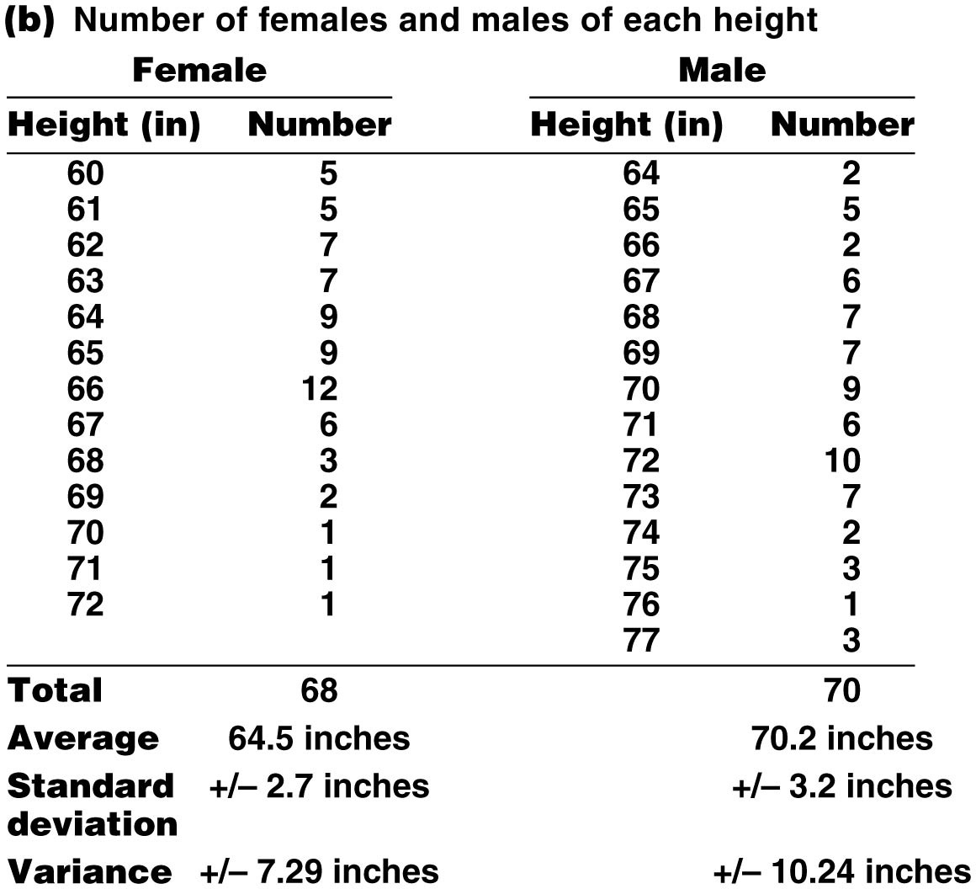
Figure 21.8b Adult height.
29

Slide 22
Next Steps
After the frequency distribution is constructed, the average or mean value (x) is calculated. This is calculated by adding all the values and dividing by the total number of individuals (n)
The mode, or modal value, is the most common value in the distribution
The median or median value is the middle value
22
Notes:
22

Slide 23
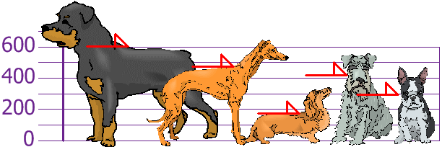
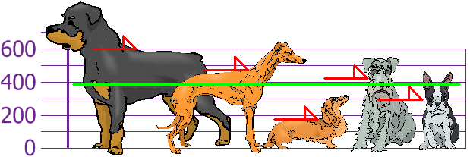
Mean
The mean is the average of the numbers.
Mean = (600 + 470 + 170 + 430 + 300)/ = 1970/5 = 394

Slide 24
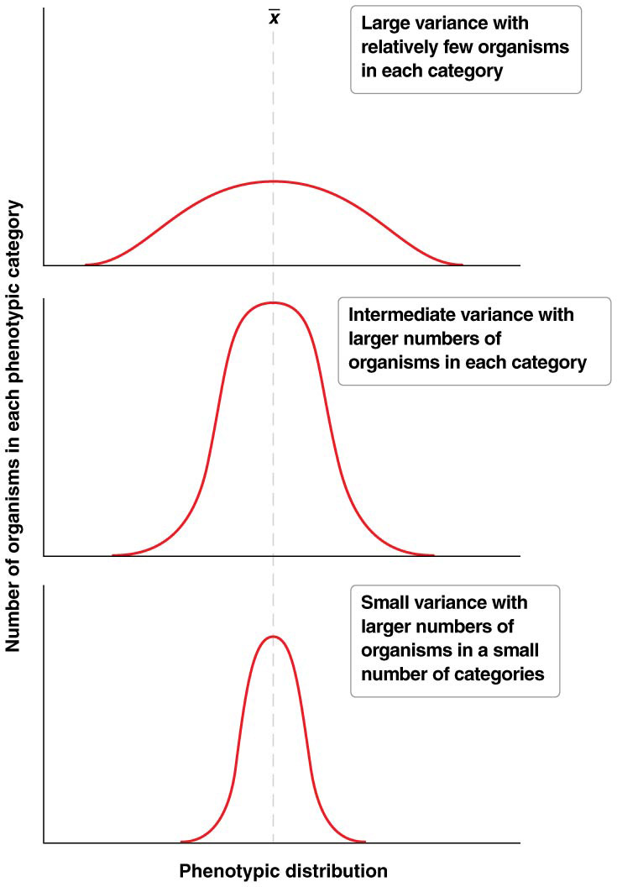
Variance
The variance (s²) is a measure of the spread of distribution around the mean; it interprets how much variation exists within the sample
It is the sum of the square of the difference between each individual value and the mean, divided by the degrees of freedom (df), that is, the number of independent variables
24
Notes:
24

Slide 25
Variance
variance measures how far a set of numbers is spread out.

Slide 26
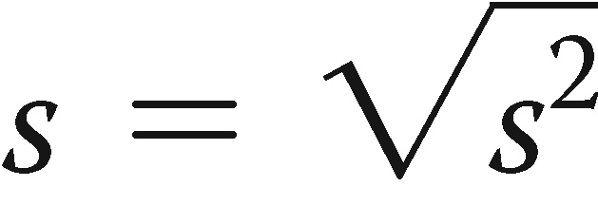
Standard Deviation
The standard deviation (s) expresses deviation from the mean in the same units as the scale of measurement for the sample
It is usually expressed as:
26
Notes:
26

Slide 27
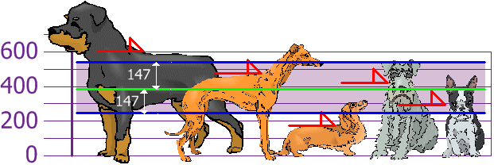
Standard deviation
Standard deviation or s for the sample standard deviation is a measure that is used to quantify the amount of variation or dispersion of a set of data values.
The Standard Deviation is just the square root of Variance, so:
Standard Deviation: σ = √21,704 = 147.32... = 147

Slide 28
Partitioning Phenotypic Variance
A key part of analyzing quantitative trait variation is to analyze the factors thought to contribute to phenotypic variance (V_{P})
Phenotypic variance (V_{P}) can be divided into genetic variance (V_{G}) and environmental variance (V_{E})
Genetic variance is the proportion of phenotypic variance due to genotype differences
Environmental variance is the portion of the phenotypic variance due to variability in environment inhabited by individuals in a population
28
Notes:
28

Slide 29
Partitioning Phenotypic Variance (continued)
In highly inbred populations (i.e., in the lab, no environmental effect) where all individuals are homozygous for alleles controlling a trait, V_{G} = 0
Carefully controlled lab experiments can sometimes control all environmental variables so that V_{E} = 0; however, in nature, neither V_{E} nor V_{G} is zero
29
Notes:
29

Slide 30
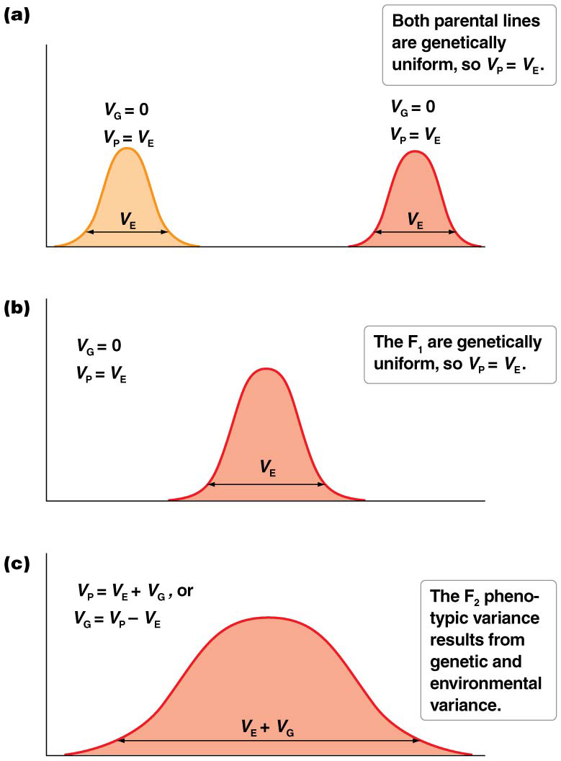
Genetic and Environmental Variability, Illustrated
If two different pure-breeding parental lines are genetically uniform, V_{P} = V_{E} in those lines
They can be crossed to produce genetically uniform F₁, where V_{P} = V_{E}
If the F₁ are crossed, now there will be both genetic and environmental variability among the F₂, so, V_{P} = V_{E} + V_{G}
30
Notes:
30

Slide 31
Partitioning Genetic Variance
Genetic variance can be partitioned into three different kinds of allelic effects:
Additive variance (V_{A}) derives from the added effects of all alleles contributing to the trait
Dominance variance (V_{D}) results from dominance relationships in which heterozygous individuals are not intermediate between the two homozygous states
Interactive variance (V_{I}) derives from epistatic interactions (effect of one gene being dependent on the presence of others) between alleles of genes contributing to a quantitative trait
31
Notes:
31

Slide 32
21.3 Heritability Measures the Genetic Component of Phenotypic Variation
The concept of heritability was developed to help measure the proportion of phenotypic variation that is due to genetic variation
Heritability differs from trait to trait; the phenotypic variation of a trait with high heritability is largely the result of genetic variation, whereas only a small proportion of phenotypic variation of a trait with low heritability can be attributed to genetic variation
Heritability is an important measure of the potential responsiveness of a trait to selection
32
Notes:
32

Slide 33
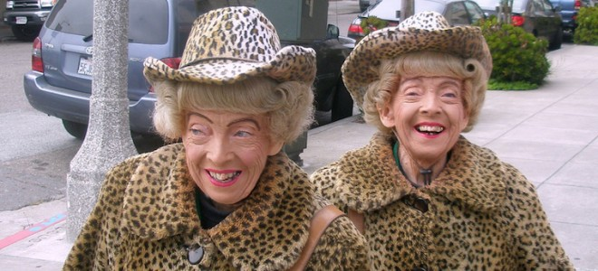
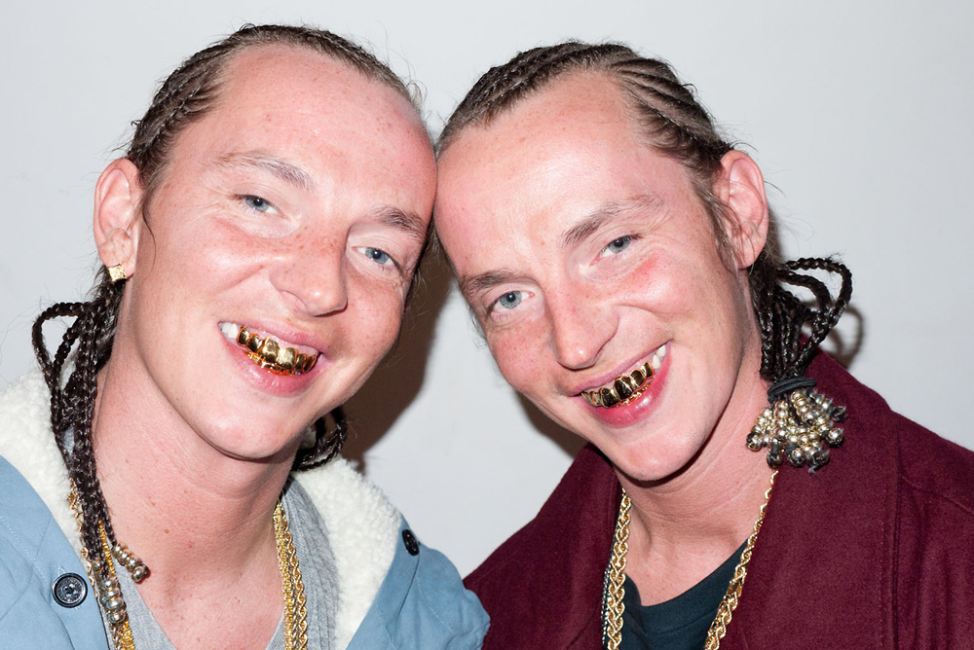
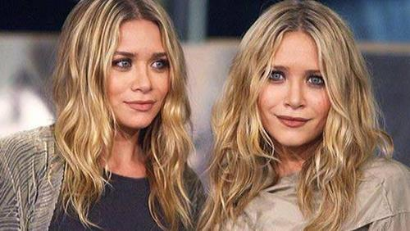
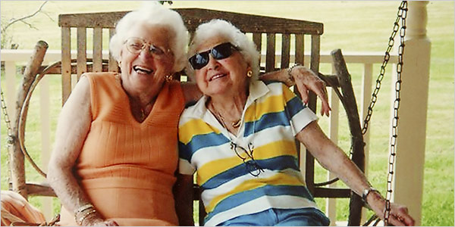
Heritability
Heritability is a statistic used in breeding and genetics works that estimates how much of the genetic diversity of a phenotypic trait in a population is due to genetic differences in that population and not environmental effect. Other causes of measured variation in a trait are characterized as environmental factors, including measurement error.

Slide 34
Two Measures of Heritability
Broad sense heritability (H²) estimates the proportion of phenotypic variation that is due to total genetic variation (H² = V_{G} /V_{P})
Narrow sense heritability (h²) estimates the proportion of phenotypic variation that is due to additive genetic variation (h² = V_{A} /V_{P})
Both are expressed as proportions ranging in magnitude from 0.0 to 1.0
34
Notes:
34

Slide 35
Heritability Is Easily Misunderstood
Four attributes of heritability are central to its meaning:
It is a measure of the degree to which genetic differences contribute to phenotypic variation of a trait
Heritability values are accurate only for the environment and population in which they are measured
Heritability for a given trait in a population can change
High heritability does not preclude environmental factors
35
Notes:
35

Slide 36
Twin Studies
Heritability is very difficult to measure accurately in human populations; however, phenotypic variation in twins can provide some insights
Identical twins, or monozygotic (MZ) twins, share all of their alleles, so for MZ twins V_{P} = V_{E}
Fraternal, or dizygotic (DZ), twins are no more closely related than any pair of siblings born at different times, with an average of 50% of their alleles in common, so in this case V_{P} = V_{E} + ½V_{G}
36
Notes:
36

Slide 37
Concordance and Discordance
The study of identical twins (MZ) reared together versus those reared apart is an alternative approach to estimating the influence of genes on phenotypic variation
Concordance is the percentage of twin pairs in which both have the same phenotype for a trait
Discordance is the percentage of twins pairs in which the twins have a dissimilar phenotype
If phenotype is 100% genetically determined, concordance would be 100%
37
Notes:
37

Slide 38
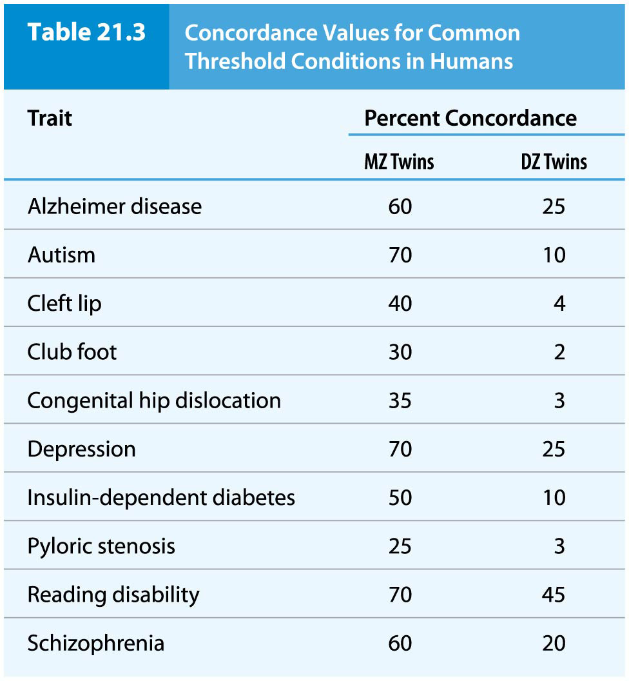
Table 21.3 Concordance Values for Common Threshold Conditions in Humans
48

Slide 39
Narrow Sense Heritability and Artificial Selection
Estimates of phenotypic variation that is due to the effects of alleles of additive genes are particularly useful in agriculture. You can select particular strains.
High narrow sense heritability values (= largely due to genetic variation) correlate with a greater degree of response to selection
Estimating the potential response to selection for a trait begins with calculation of a selection differential (S), the difference between the means of the whole population and the breeding population
The response to selection (R) depends on the extent to which the difference between the population mean and the mean of the mating individuals can be passed on to progeny: R = S(h²)
39
Notes:
39

Slide 40
Modes of Selection
Selection response is expected to be greatest when h² = 1.0. Selection operating over many generations has three possible modes that each affect mean and variance in the populations
Directional selection is when the mean is shifted in one direction because one extreme of the phenotype distribution is favored; the phenotypic range is narrowed and variance is reduced
Stabilizing selection favors an intermediate phenotype over extremes, and phenotypic variance is reduced
Disruptive selection occurs when the extreme phenotypes are favored over the intermediate phenotypes. In disruptive selection, the phenotypic variance is increased and a phenotypic split may occur within the population
40
Notes:
40

Slide 41
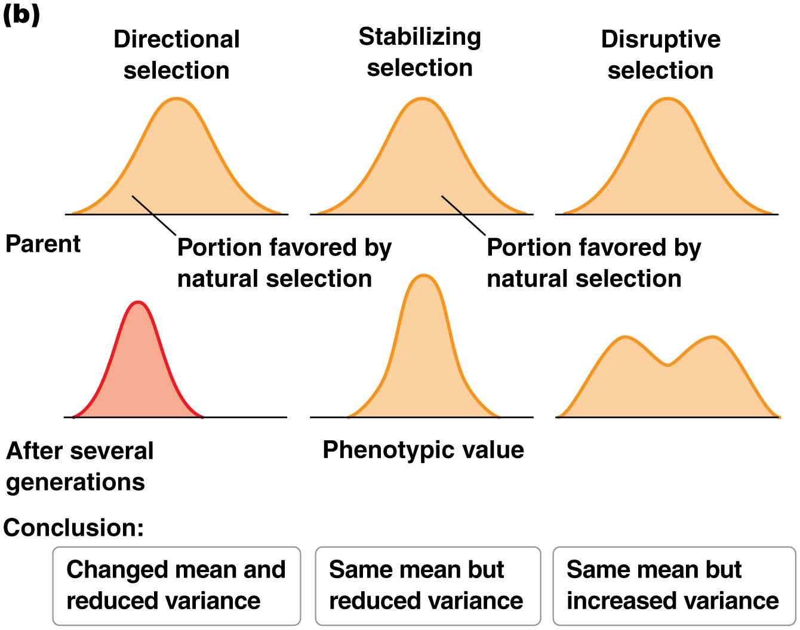
Figure 21.11b Response to artificial and natural selection.
55

Slide 42
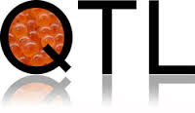
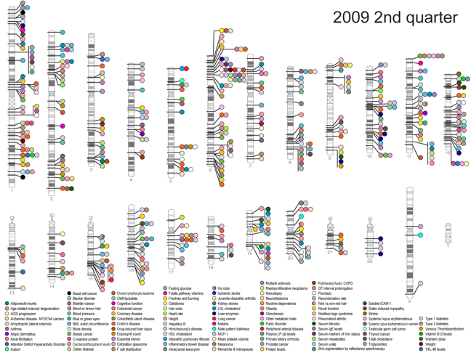
Quantitative Trait Loci

Slide 43
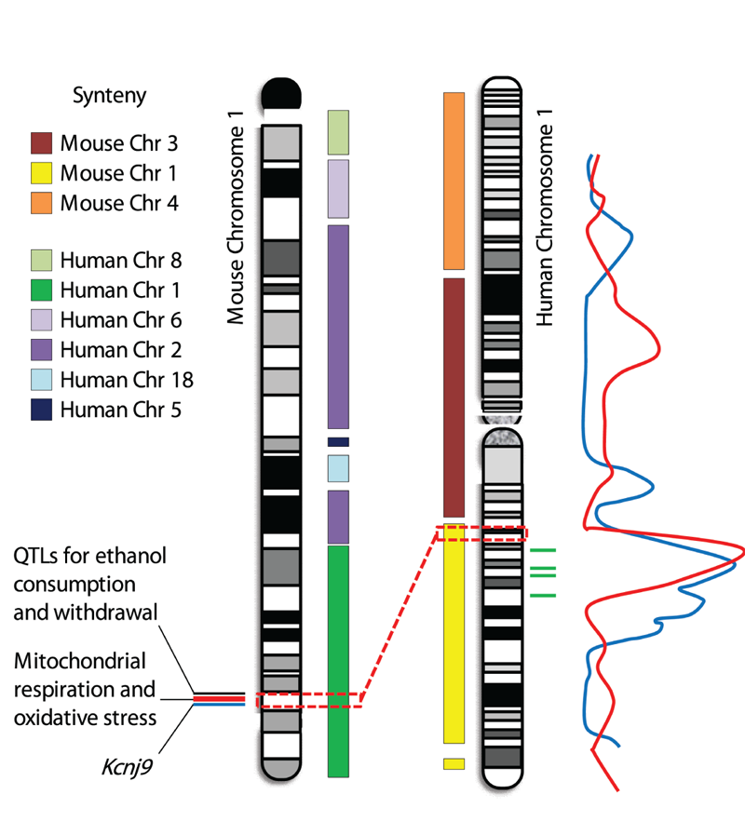
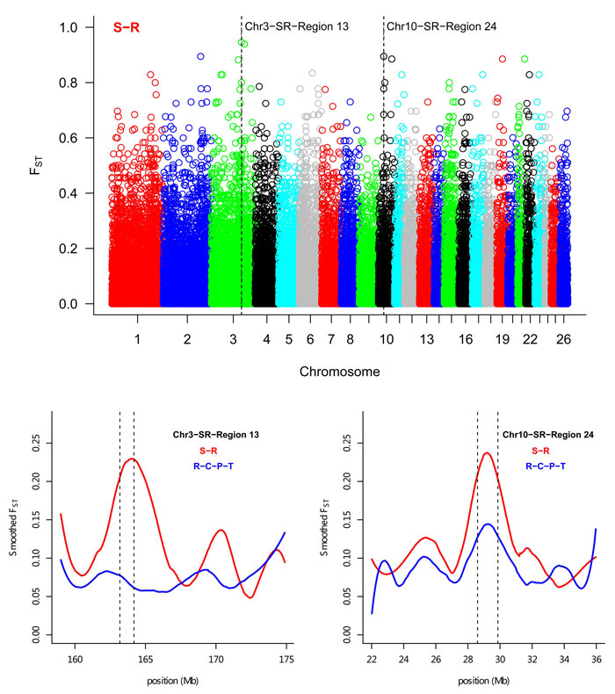

Slide 44
21.4 Quantitative Trait Loci Are the Genes That Contribute to Quantitative Traits
Quantitative trait loci (QTLs) are genes that contribute to phenotypic variation in quantitative traits
Individually, one such gene is called a quantitative trait locus
Special statistical methods must be used to identify them
44
Notes:
44

Slide 45
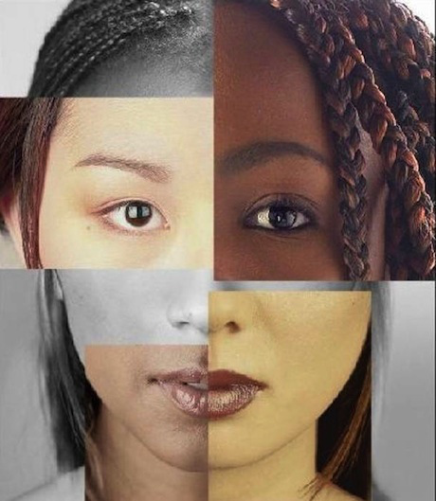
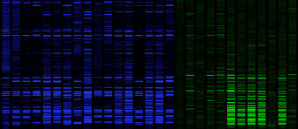
QTL
Quantitative trait locus (QTL) analysis is a statistical method that links two types of information: phenotypic data (trait measurements) and genotypic data (usually molecular markers)—in an attempt to explain the genetic basis of variation in complex traits.
The goal of this process is to identify the action, interaction, number, and precise location of these regions.
The founder of QTL analysis is Ronald Fisher, which show that genes display an additive effect and that are also influenced by the environment.

Slide 46
QTL Mapping
The specialized statistical methods used to detect and map QTLs is called QTL mapping
It involves identifying regions of chromosomes that are likely to contain QTLs
The chromosome regions are identified by frequent co-occurrence of a genetic marker, such as a SNP, in organisms with a particular phenotype
QTL analysis can lead to identification of the potential chromosome location of a QTL, but does not identify the molecular basis of action of the QTL; other genetic methods are used for this
46
Notes:
46

Slide 47
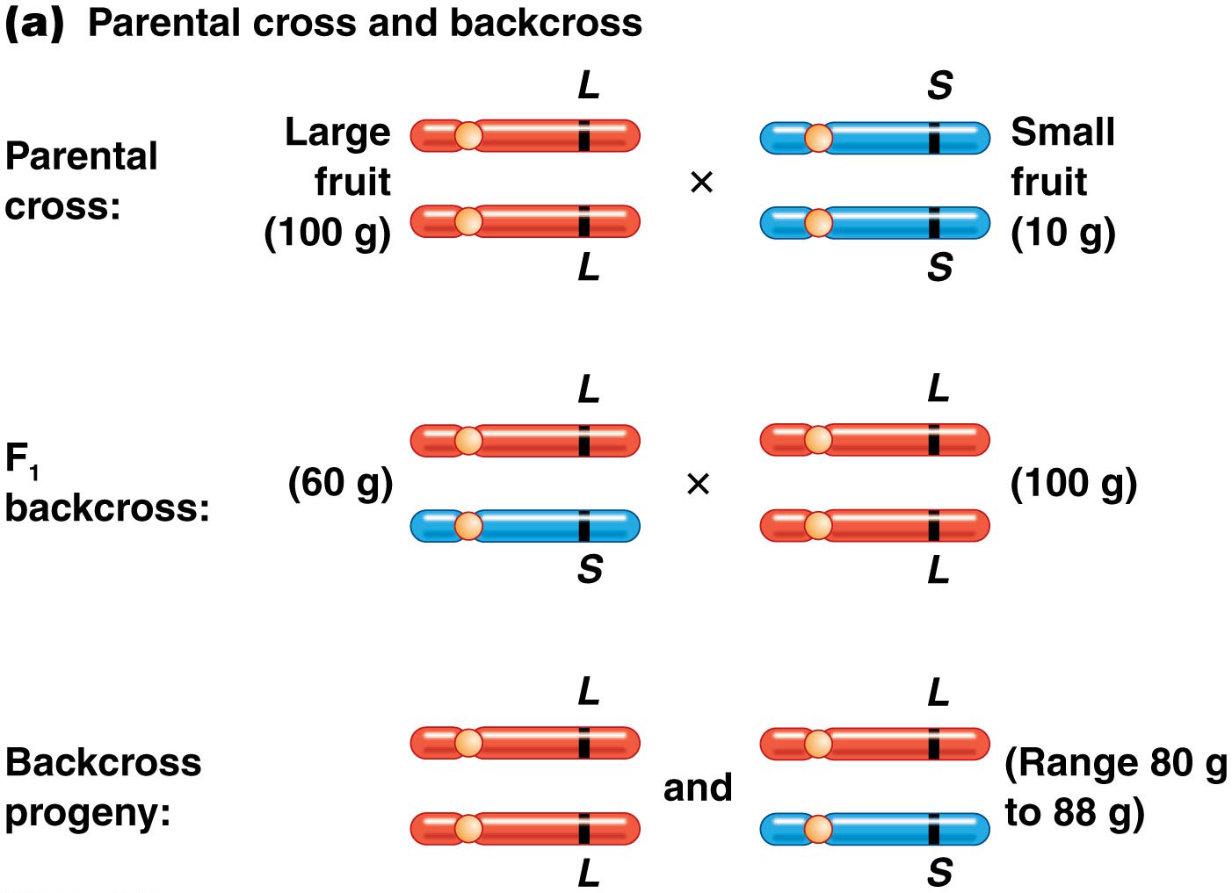
Figure 21.12a Quantitative trait locus (QTL) detection and mapping.
60

Slide 48
Example: Tomato Fruit Size
Suppose large-fruited (LL; 100 g) and small-fruited (SS; 10 g) tomatoes are crossed (LL × SS)
The F₁ are heterozygous for each marker and intermediate in size (LS; 60 g)
When backcrossed to the LL parent, the F₁ produce F₂ that varied in weight from 80 to 88 g; average tomato weight is compared for LL plants versus LS plants for each marker
48
Notes:
48

Slide 49
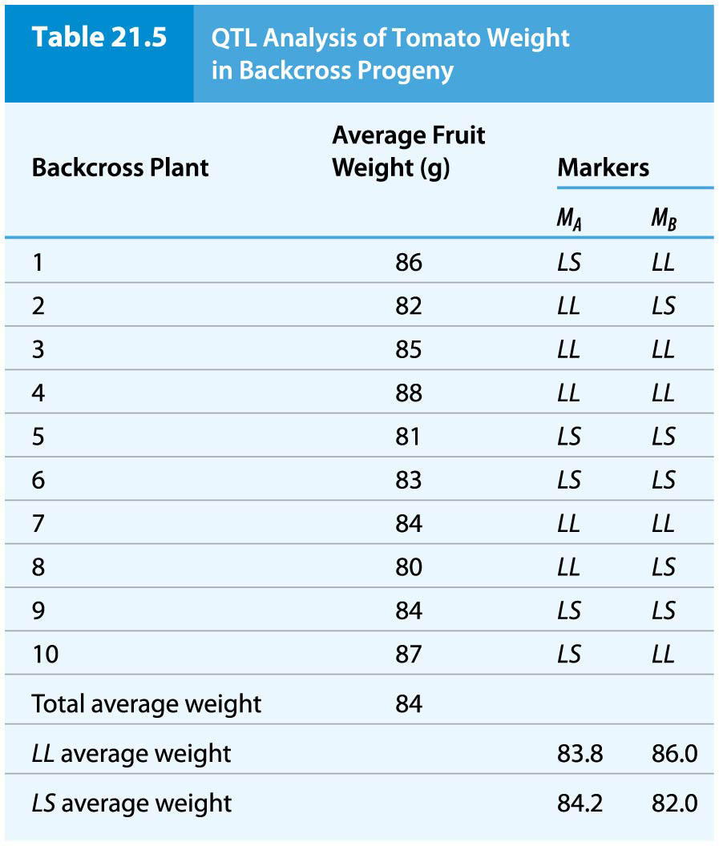
Table 21.5 QTL Analysis of Tomato Weight in Backcross Progeny
62

Slide 50
Example: Tomato Fruit Size (continued)
There is almost no difference in average weight for marker M_{A}
However, there is a greater difference between the average weights of tomatoes from plants carrying the M_{B} marker
This may suggest that a QTL residing near M_{B} contributes to fruit weight
To test this statistically, a lod score is calculated
50
Notes:
50

Slide 51
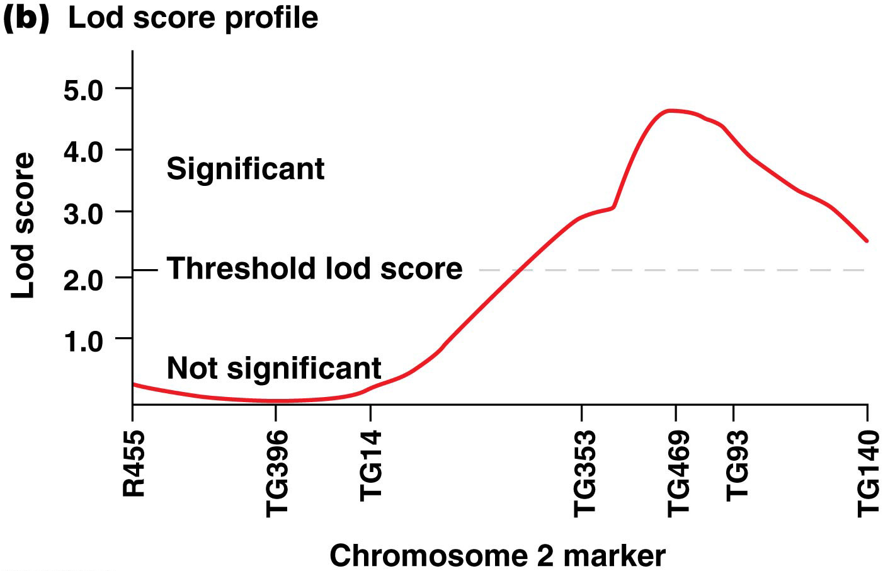
Figure 21.12b Quantitative trait locus (QTL) detection and mapping.
65

Slide 52
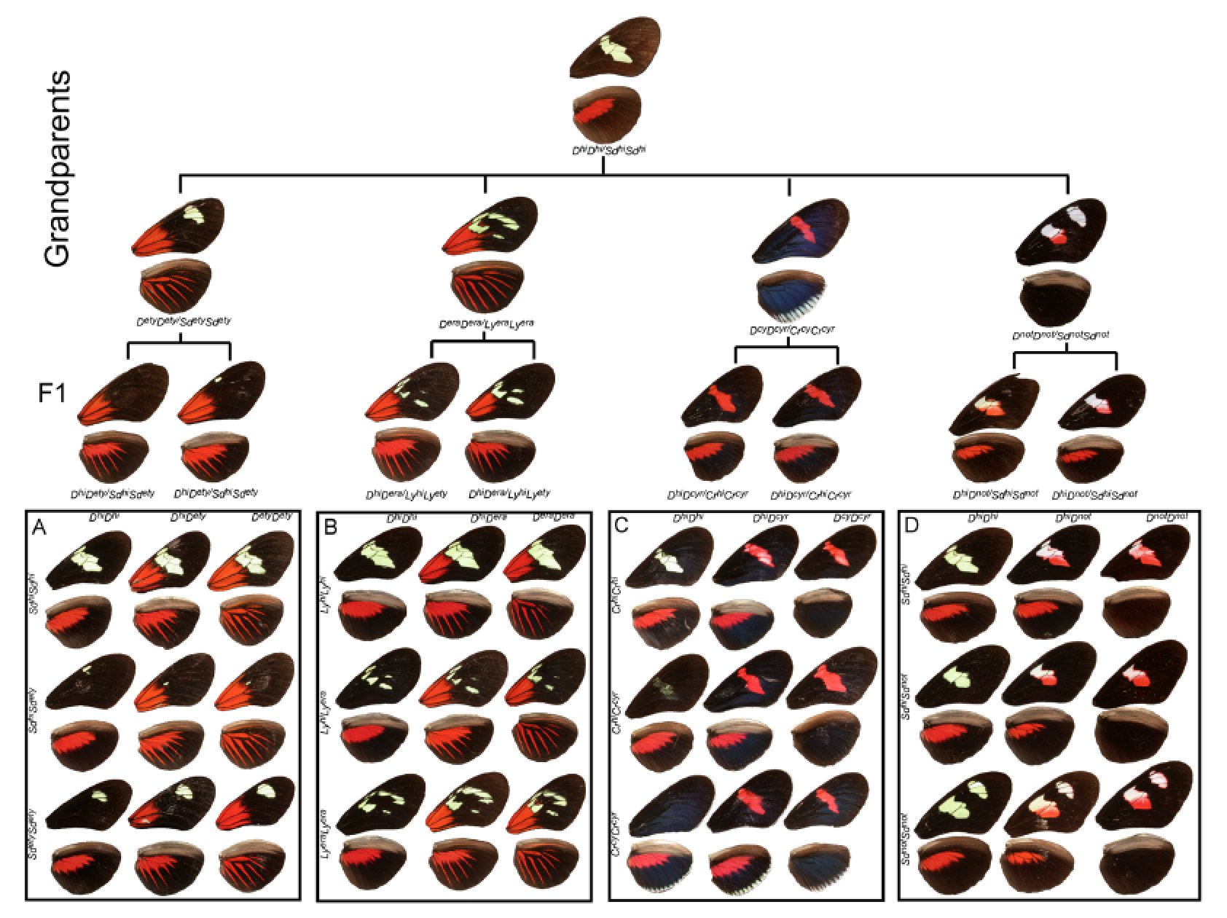
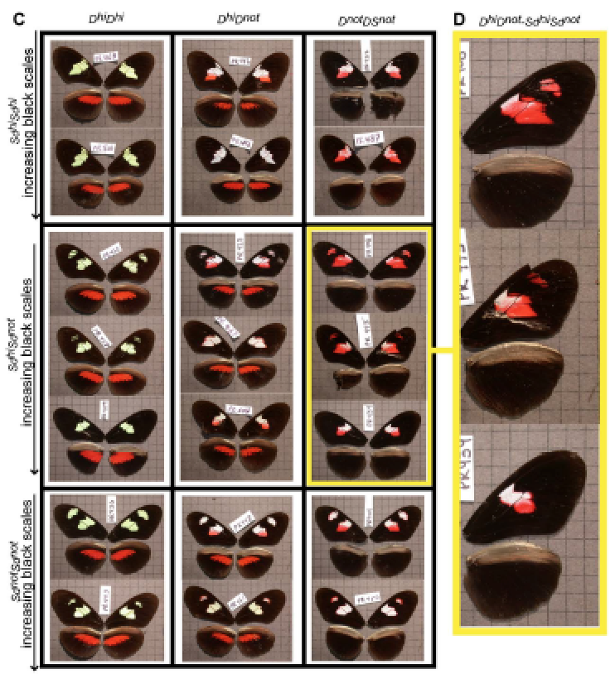
Example: butterfly wing color pattern

Slide 53
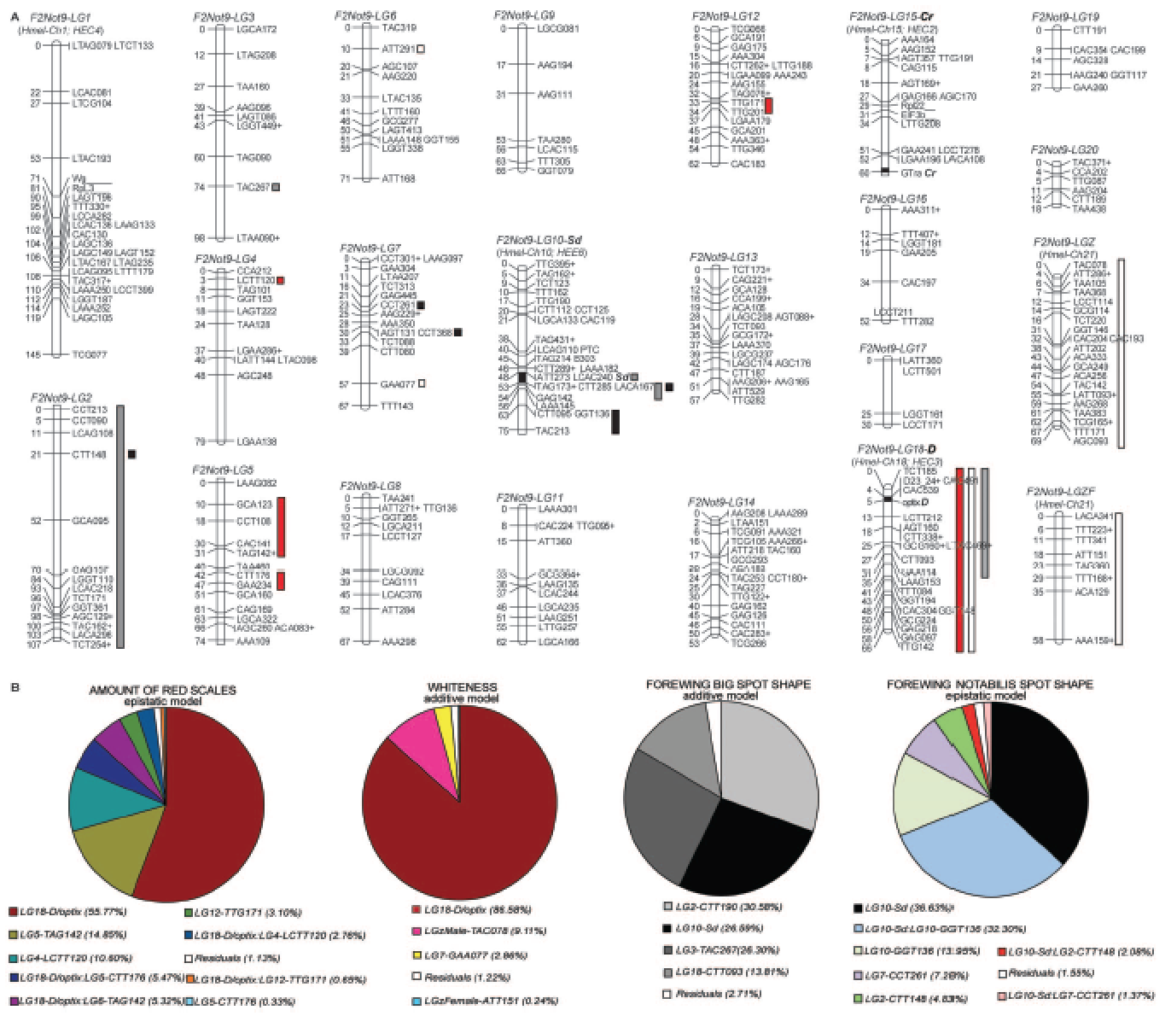
Example: butterfly wing color pattern

Slide 54
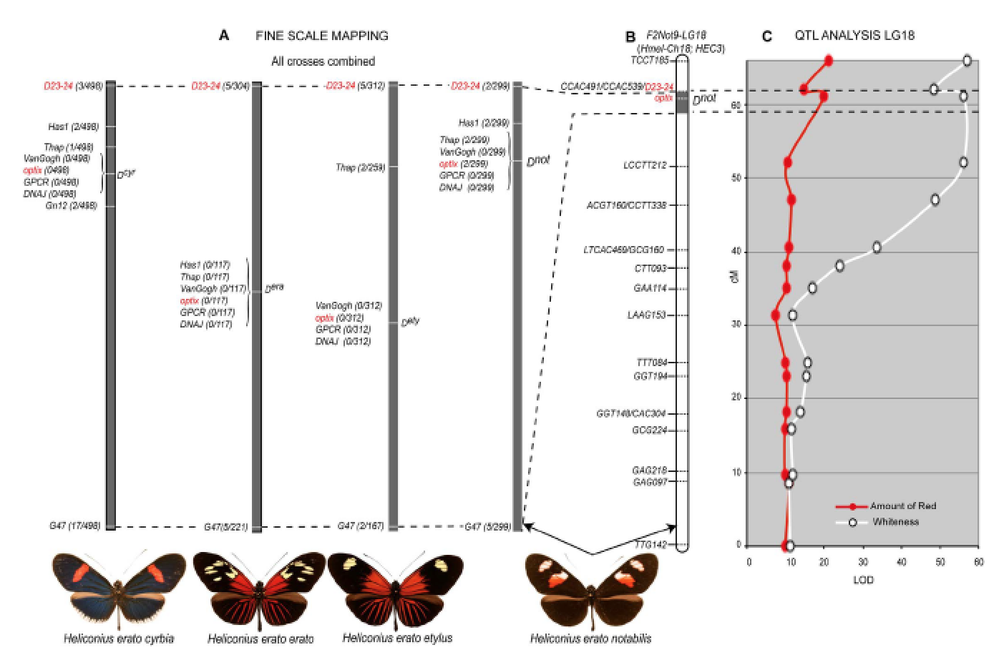
Example: butterfly wing color pattern

Slide 55
Genome-Wide Association Studies
Genome-wide association studies (GWAS) seek to tie the presence of a particular sequence variant with a QTL influencing a specific phenotype
GWAS allows scanning of an entire genome by statistically testing for marker variants associated with phenotypic variation
Chromosome regions can be identified and inspected more closely for candidate genes
55
Notes:
55

Slide 56
Genome-Wide Association Studies (continued)
GWAS can use DNA from organisms in random mating, so that extensive controlled crosses are not needed
It takes advantage of the tendency of alleles of closely linked genetic markers to display linkage disequilibrium
If a group of closely linked SNPs forms a haplotype, it can be correlated with the presence or absence of a certain phenotype; the statistical test for association between a trait and a SNP is similar to the chi-square test
56
Notes:
56

Slide 57
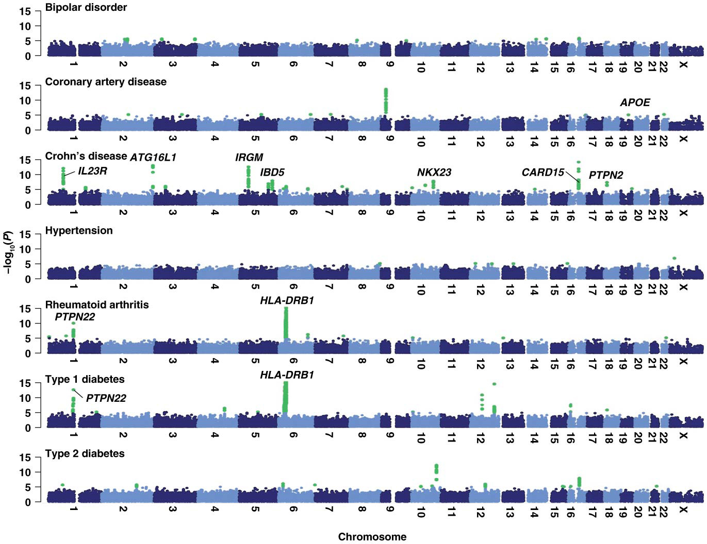
Figure 21.15 Manhattan plots of the results of a genome-wide association study of seven common diseases.
75

Slide 58
Impact of GWAS Analyses
Hundreds of new genes contributing to disease risk have been identified; new therapies are being developed to target these genes
To date, only a small percentage of the inherited variation thought to exist has been detected, possibly because each individual susceptibility allele is rare
58
Notes:
58

Slide 59
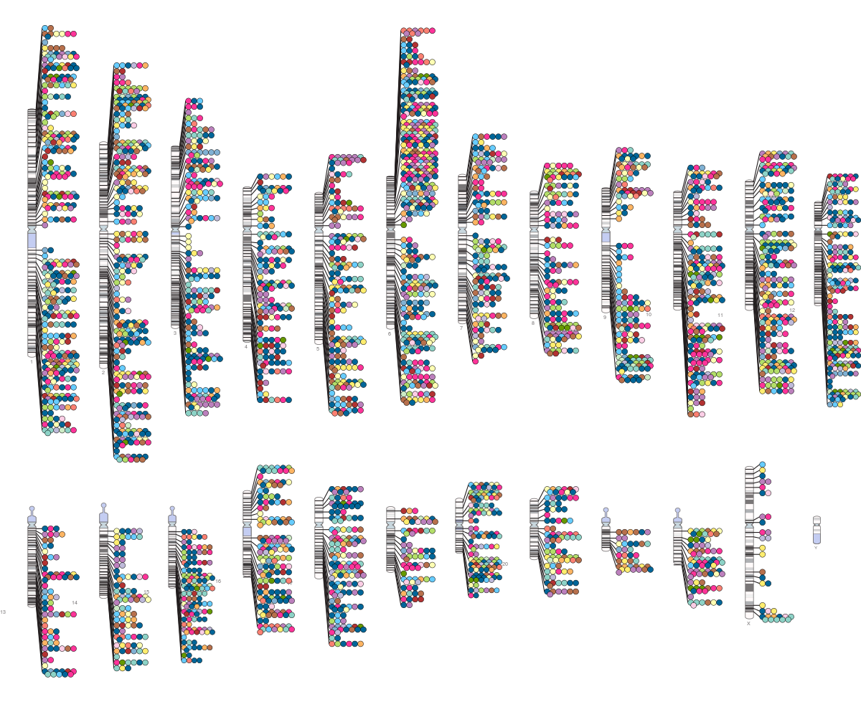
The Human disease map from QTLs studies

Slide 60
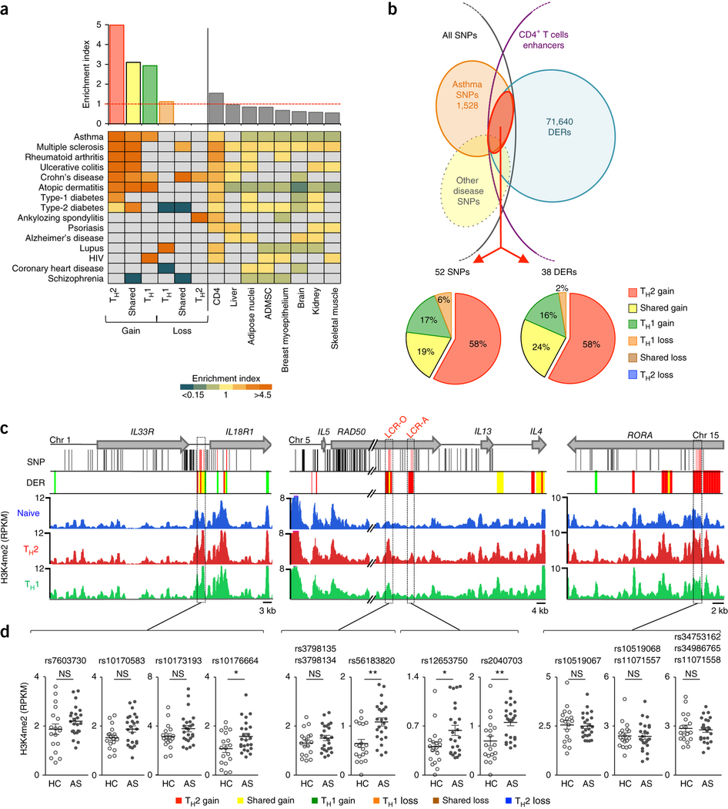
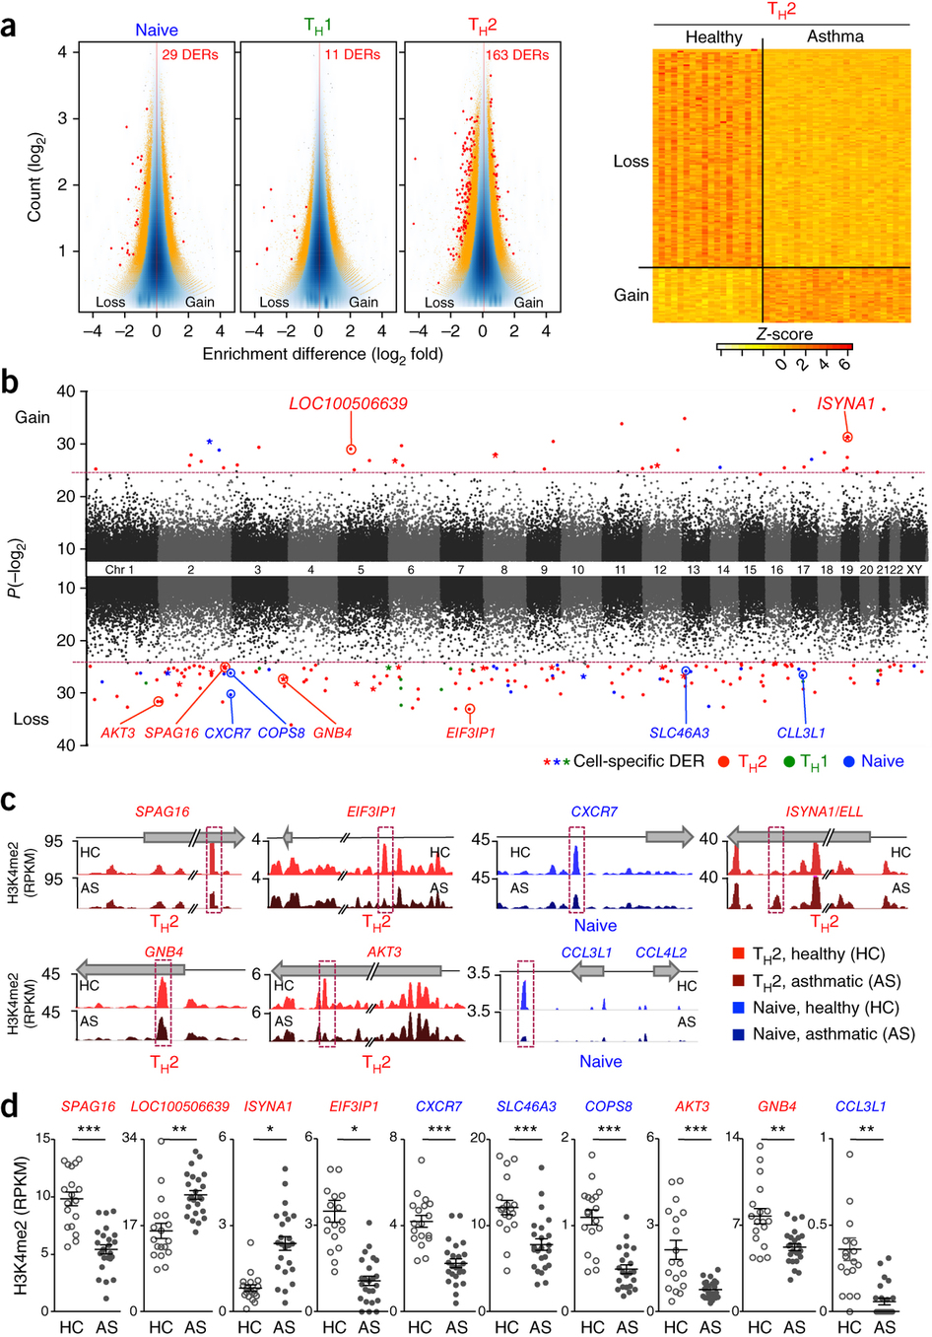
Asthma

