Slide 1
0
22

Slide 2
Populations and Gene Pools
A population is a group of interbreeding organisms.
A gene pool is the collection of genes and alleles found in the members of a population
Each member of a population carries a portion of the gene pool in its genome
The pattern of mating between individuals and the effect of evolutionary processes on alleles determine how alleles are dispersed into genotypes, and their frequencies in successive generations
2

Slide 3
Genetic Variation, Population and Evolution
Population genetics is the study of the distribution and changes in frequency of alleles within populations.
The main processes of evolution (natural selection, genetic drift, gene flow, mutation and genetic recombination) form an integral part of the theory that underpins population genetics.
Population genetics examine phenomena as adaptation, speciation, population subdivision, and population structure.

Slide 4
The Genetic Variation in a Population Is Caused by Multiple Factors
Mating
Random forces- Genetic drift and population bottleneck
Distribution
Migration

Slide 5
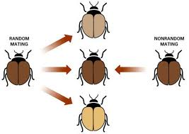
Mating and inbreeding
Individuals do not always chose their partner via random mating. Nonrandom mating can sometimes occur because one organism chooses to mate with another based on certain traits. Specific behavioral choices during mating shape the genetic combinations that appear in successive generations. Mating patterns of that population are no longer random.
Nonrandom mating can generate:
-inbreeding, individuals with similar genotypes are more likely to mate with each other rather than with individuals with different genotypes. The genetic consequences of inbreeding for populations are an increase in the frequency of homozygous genotypes and a decrease in frequency of heterozygous genotypes
Inbreeding depression is the reduction in fitness of inbred organisms due to the reduced level of heterozygosity

Slide 6
Genetic Drift
Variation in the relative frequency of different genotypes in a small population, owing to the chance disappearance of particular genes as individuals die or do not reproduce. Changes in relative allele frequency, called genetic drift, can either increase or decrease by chance over time. An allele is either lost by a population or is the only allele present at a particular gene locus within a population. Both possibilities decrease the genetic diversity of a population. Typically, genetic drift occurs in small populations, where infrequently occurring alleles face a greater chance of being lost.

Slide 7
Genetic Drift
Genetic drift refers to chance fluctuations of allele frequencies that result due to “sampling error”
Genetic drift occurs in all populations but is especially prominent in small populations
Genetic drift can raise or lower the frequency of an allele in a small population every generation
Once allele frequencies are changed, the next generation begins with the new frequencies
7

Slide 8
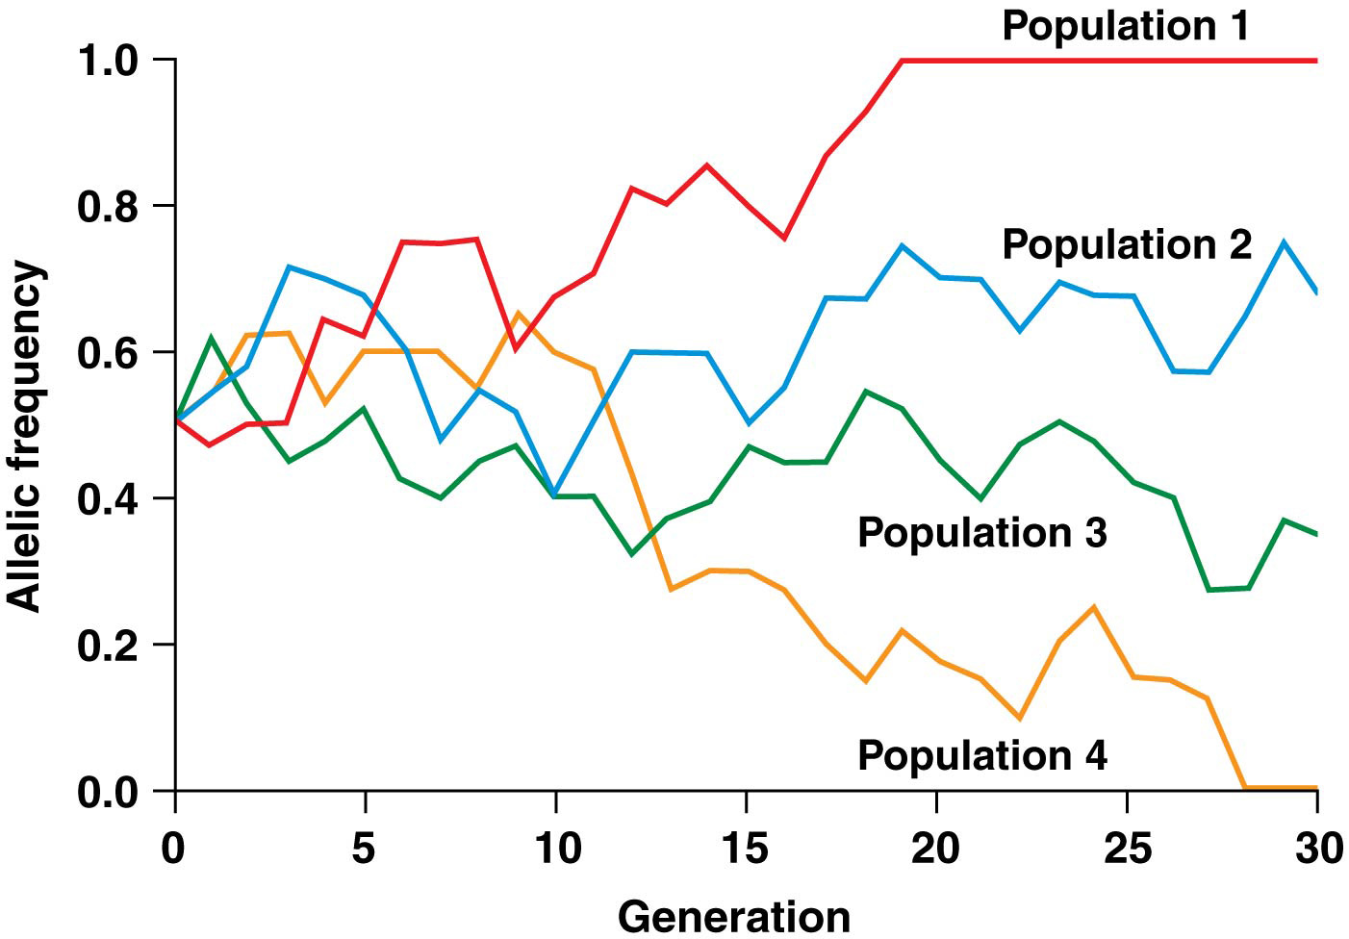
59

Slide 9
Genetic drift and the Founder Effect
Small population size provides the conditions under which sampling errors can produce significant genetic drift of allele frequency
Establishment of a new population by a small number of founding organisms can produce a difference in allele frequencies, and is called the founder effect
9

Slide 10
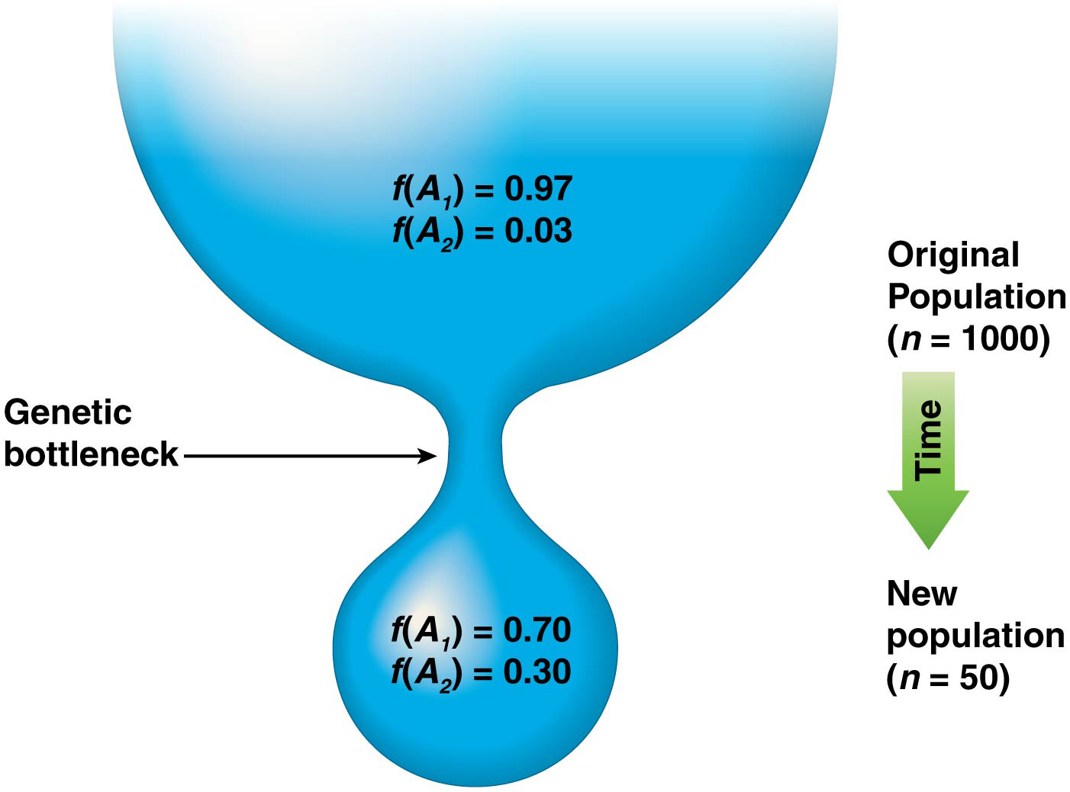
Genetic Bottlenecks
In genetic bottlenecks, a relatively large population is reduced to a small number by a catastrophic event unrelated to natural selection
Survivors of the bottleneck likely have a low level of genetic diversity and usually carry alleles in very different frequency than the original population
Genetic drift is common after a population experiences a population bottleneck.
10

Slide 11
Distribution
How does the physical distribution of individuals affect a population? A species with a broad distribution rarely has the same genetic makeup over its entire range. For example, individuals in a population living at one end of the range may live at a higher altitude and encounter different climatic conditions than others living at the opposite end at a lower altitude.
The relative allele frequency may differ dramatically from those at the opposite boundary. Distribution is one way that genetic variation can be preserved in large populations over wide physical ranges, as different forces will shift relative allele frequencies in different ways at either end.

Slide 12
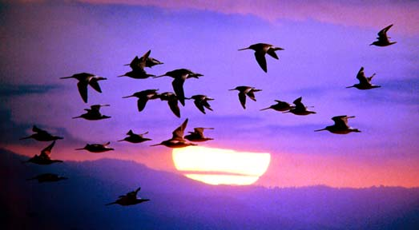
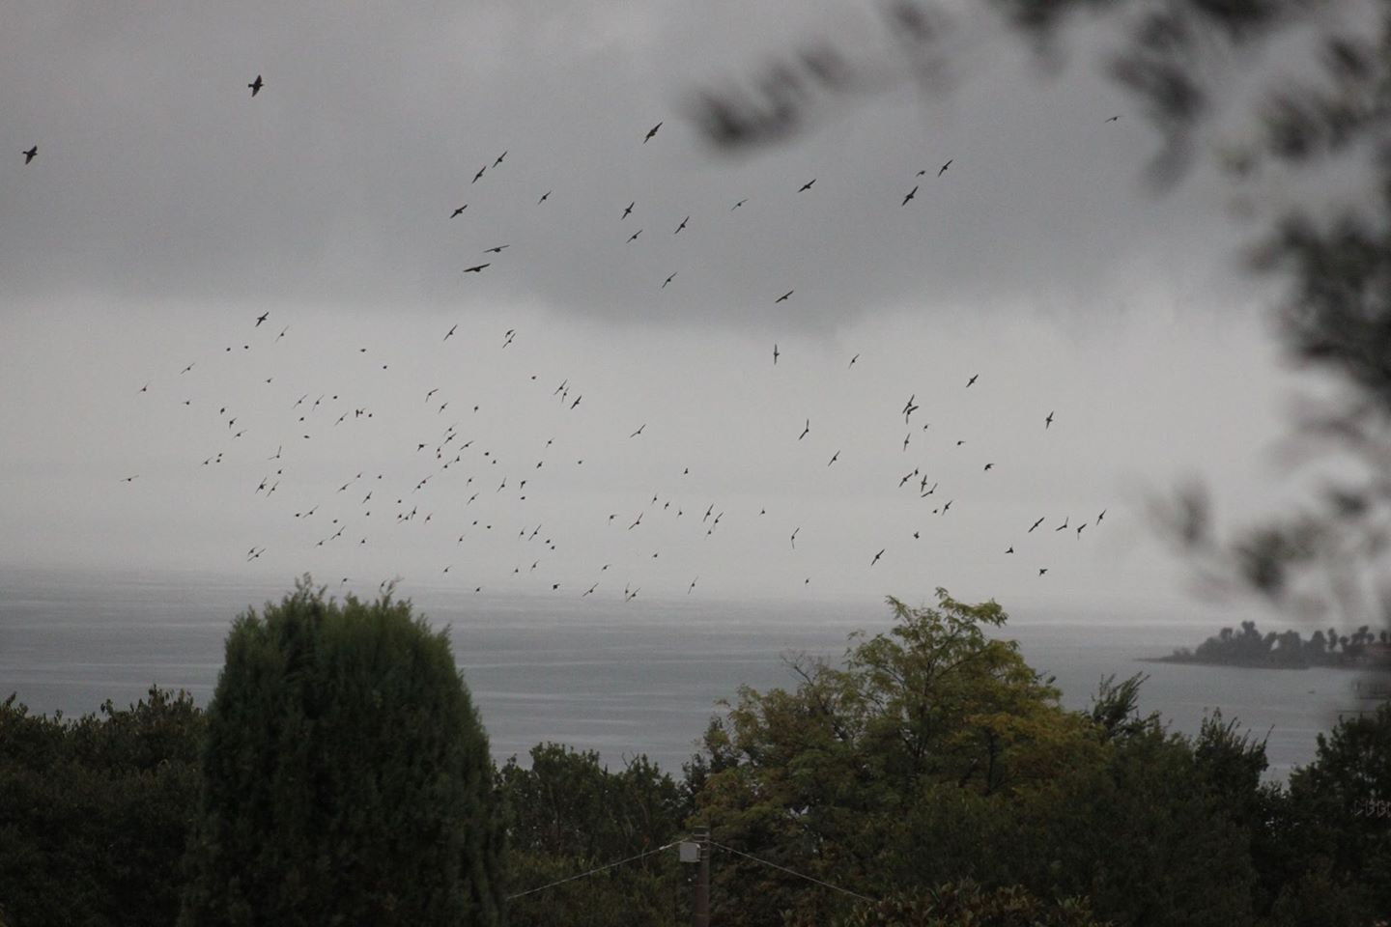
Migration Is Movement of Organisms and Genes between Populations
Migration is the movement of organisms from one location to another. Although it can occur in cyclical patterns (as it does in birds), migration when used in a population genetics context often refers to the movement of organisms between populations and the reproduction of migrant organisms in their new populations.
Migration is also known as gene flow and the new population is called an admixed population
12

Slide 13
Migration and the effects of Gene Flow
Gene flow has two principal effects on population
In the short run, gene flow can change allele frequencies in the admixed population
In the long run, gene flow acts to equalize frequencies of alleles between populations that remain in genetic contact
13

Slide 14
Island Model of Migration
A one-way gene flow from population 1 into population 2 is described by the island model of migration
It depicts gene flow from a mainland population to an island population
The admixed population has an immediate evolutionary change in allele frequencies, but will not be in H-W equilibrium at first; this requires one generation of random mating
14

Slide 15
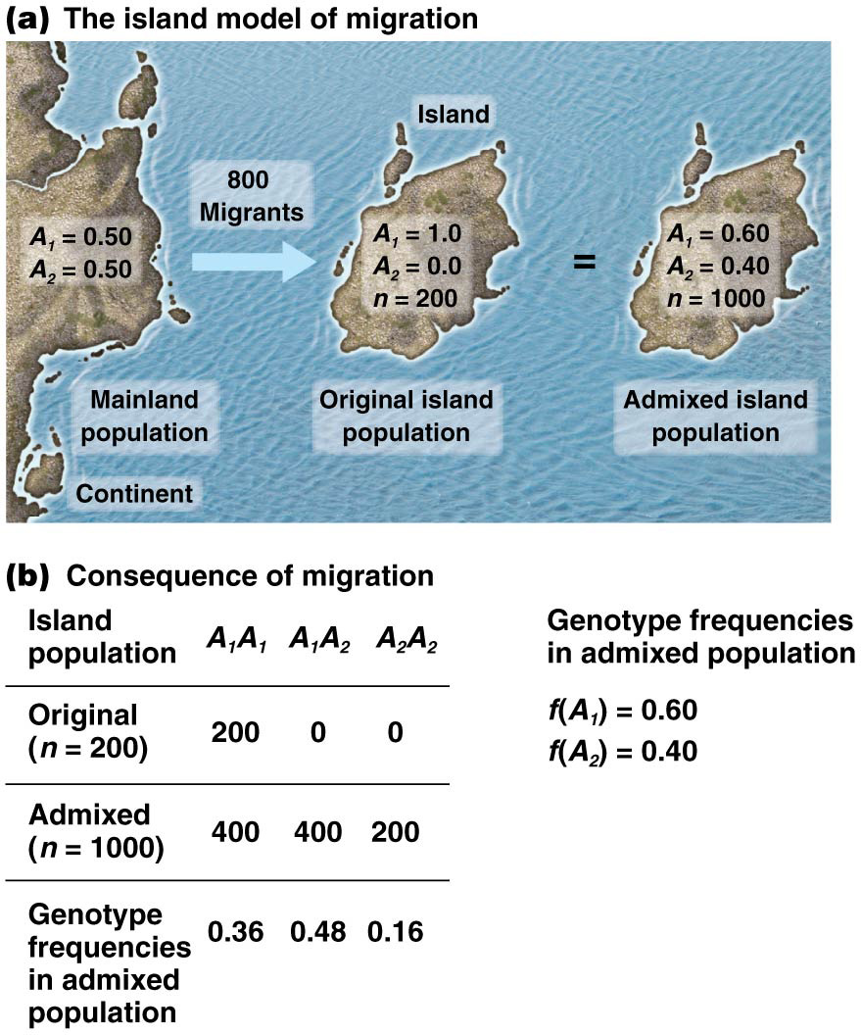
54

Slide 16
Fundamentals of Population Genetics
Hardy-Weinberg principle
Natural Selection and Adaptation
Genetic drift
Mutation
Gene flow and transfer

Slide 17
22.1 The Hardy-Weinberg Equilibrium Describes the Relationship of Allele and Genotype Frequencies in Populations
In the early 1900s, several researchers debated the fate of genes in populations
With random mating and the absence of evolutionary change, allele frequencies result in a stable equilibrium frequency
Hardy-Weinberg (H-W) equilibrium, predict the frequencies of alleles and genotypes
17

Slide 18
Assumptions of Hardy-Weinberg Equilibrium
H-W equilibrium serves as a model to calculate the frequencies of alleles and genotypes in a theoretical population that is: a) infinitely large, b) practices random mating, and c) does not experience evolutionary change
Under these conditions, allele and genotype frequencies should remain constant
However, in nature, no population meets all the criteria for H-W equilibrium
18

Slide 19
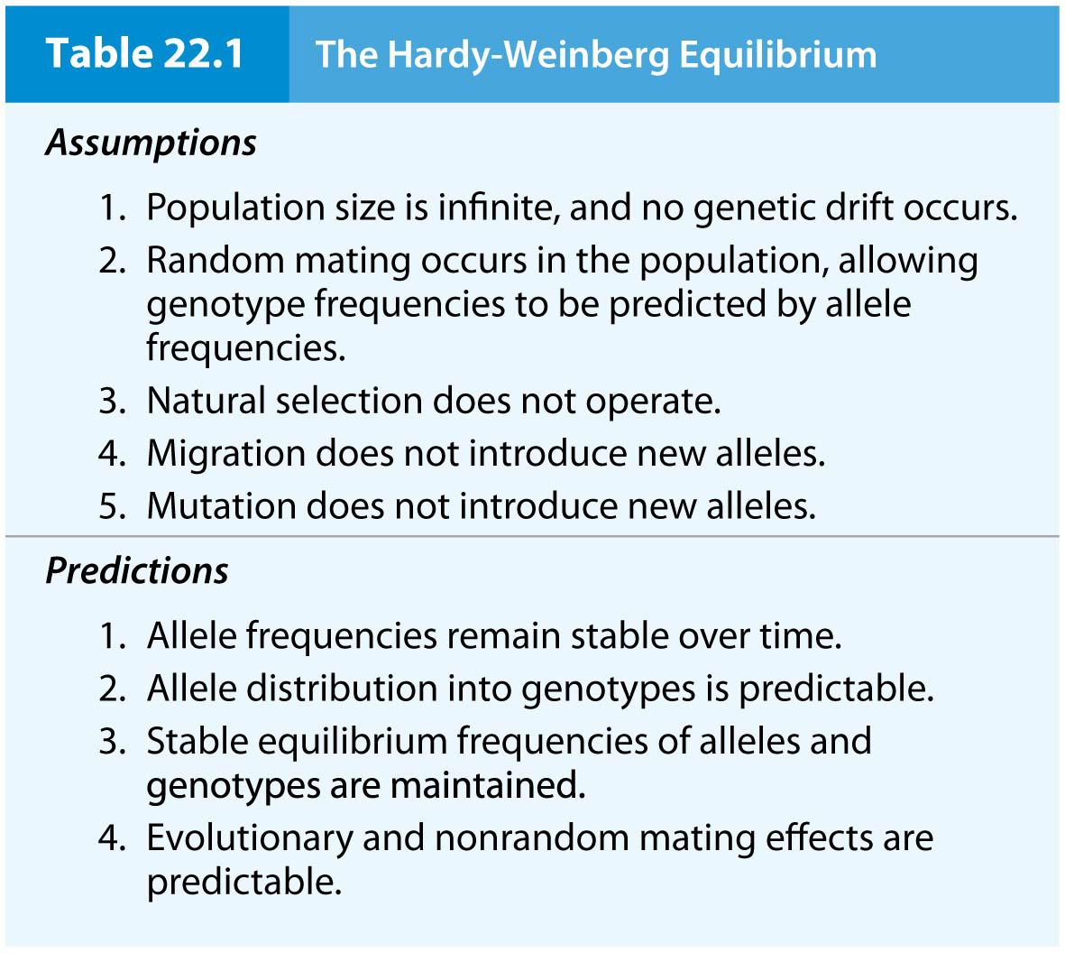
Table 22.1 The Hardy-Weinberg Equilibrium
6

Slide 20
The Hardy-Weinberg Equilibrium
The simplest predictions of H-W equilibrium involve two alleles of an autosomal gene, A₁ and A_{2.} The frequencies for these are given as f(A₁) = p and f(A₂) = q
Since there are only two alleles of the gene, p + q = 1.0
Three possible genotypes: A₁A₁, A₁A₂, and A₂A₂
The genotype frequencies can be computed using the binomial expansion (p + q)²
The summation of the genotype frequencies is p² + 2pq + q² = 1.0, where p² = frequency of A₁A₁, 2pq = frequency of A₁A₂, and q² = frequency of A₂A₂
20

Slide 21
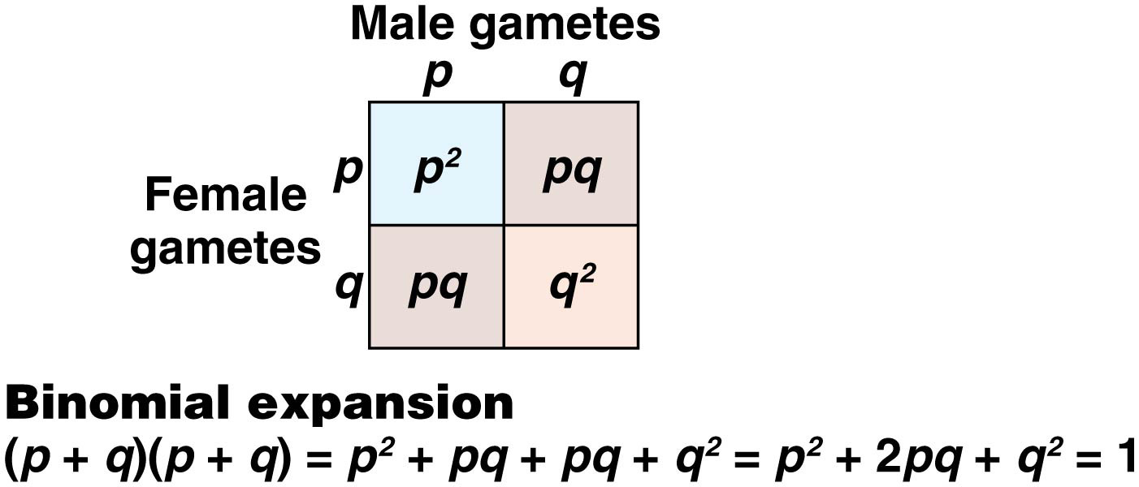
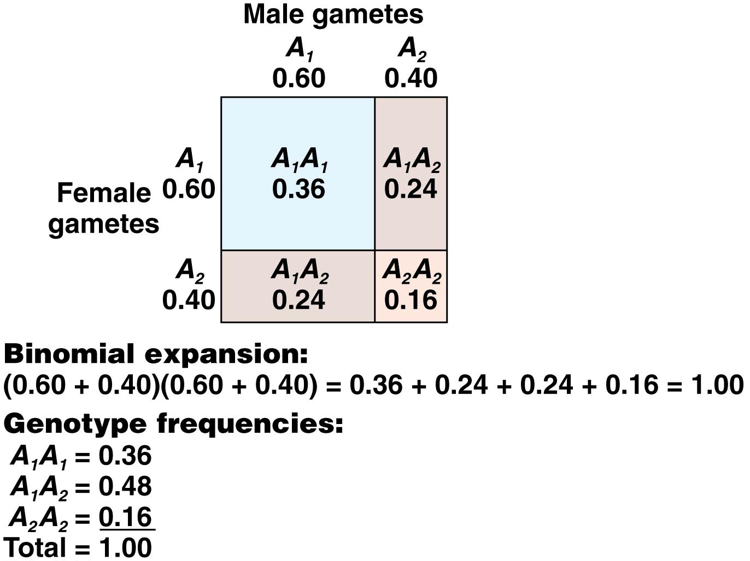
10

Slide 22
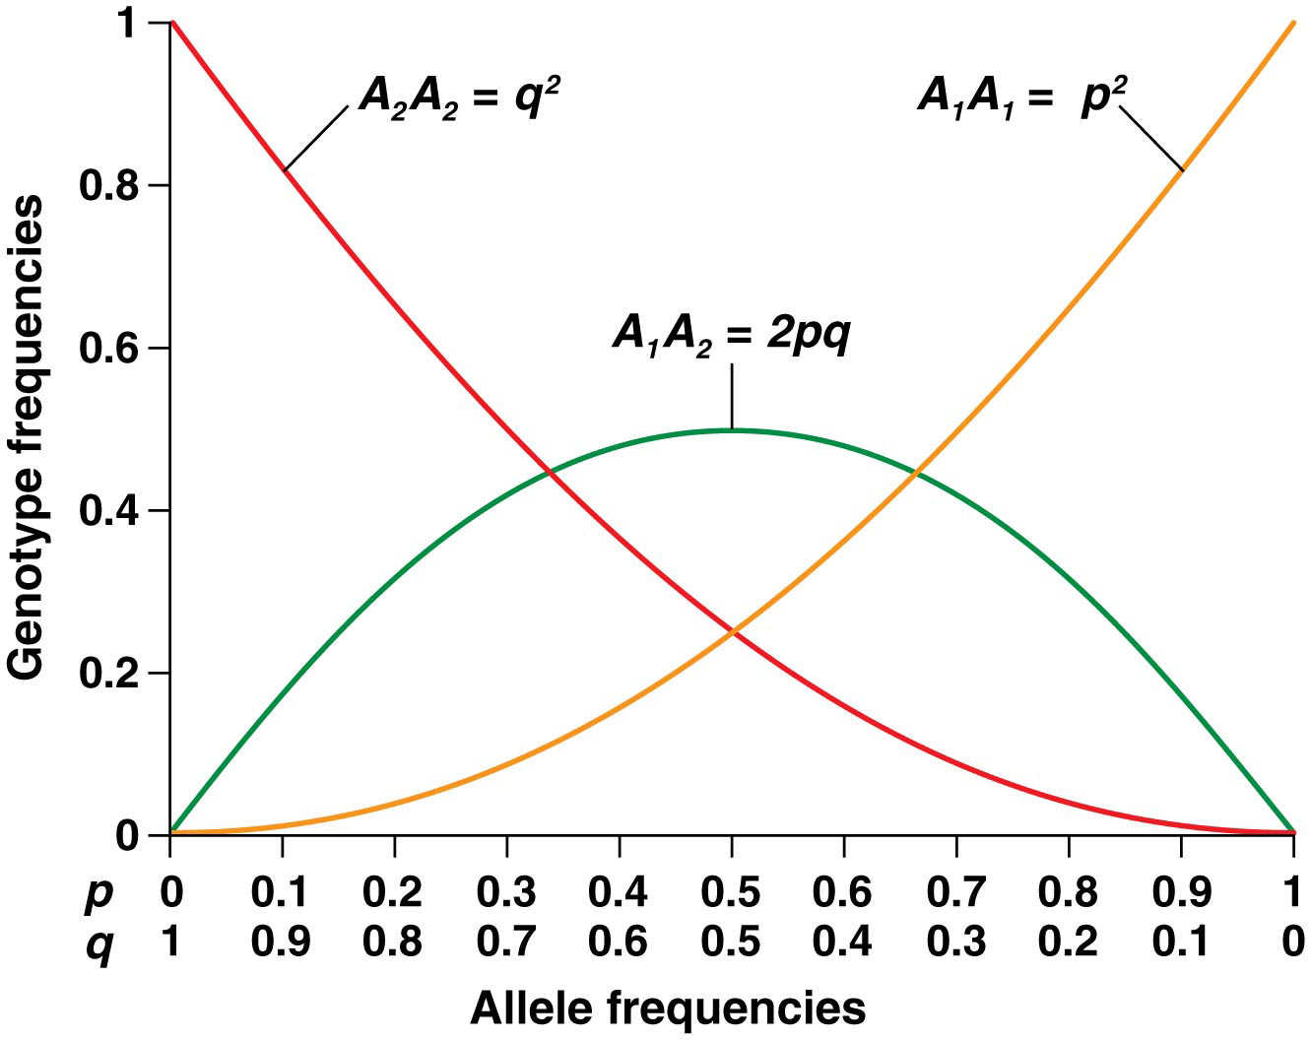
Random Mating Leads to Predictable Genotype Frequencies
Random mating for one generation produces genotype frequencies that can be predicted from allele frequencies
With random mating and no evolutionary change, these frequencies will remain constant from one generation to the next
For any frequency of p and q, an expected equilibrium distribution of genotypes can be derived

Slide 23
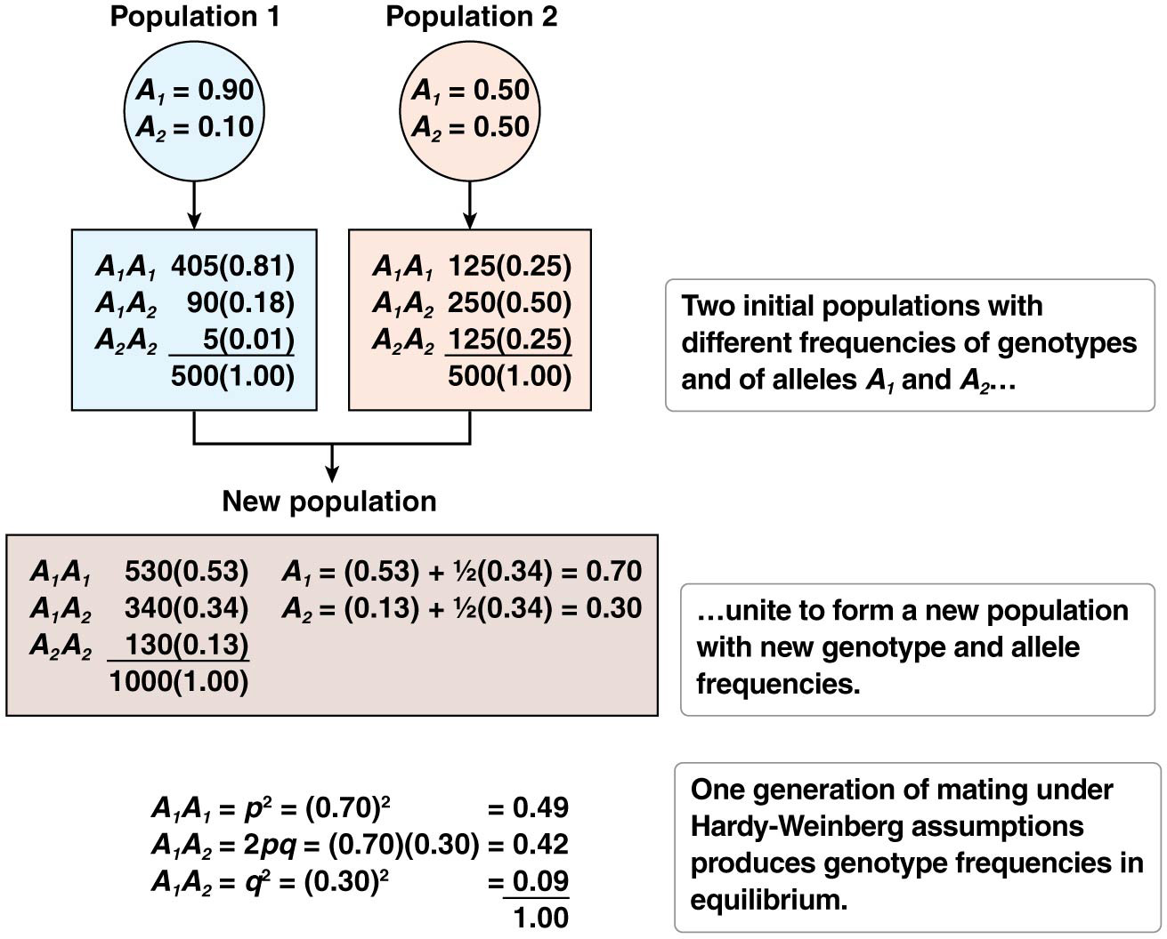
Figure 22.4 One generation of random mating produces Hardy-Weinberg equilibrium frequencies for genotypes of autosomal genes.
15

Slide 24
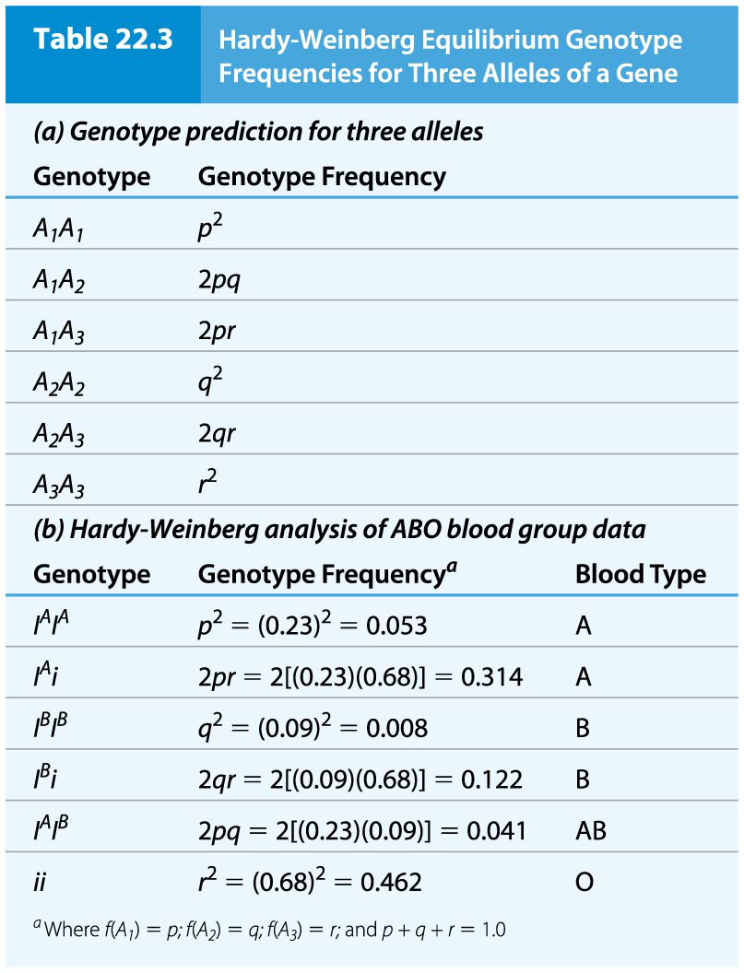
The Hardy-Weinberg Equilibrium for More Than Two Alleles
H-W equilibrium values can be determined for more than two alleles, for example, in the case of three alleles, such as the ABO blood type alleles
The allele frequencies are p, q, and r
In this case, p + q + r = 1.0 and the allele frequencies are calculated by
the trinomial expansion: (p + q + r)²
The six possible genotypes are
p² + 2pq + q² + 2pr + r² + 2qr = 1.0
24

Slide 25
Determining Autosomal Allele Frequencies in Populations
Comparisons of allele frequencies among populations can identify relationships and diversification of populations. Documentation of allele frequency changes over time is a hallmark of population evolution
Several methods can be utilized to calculate allele frequencies.
The square root is the only method can be used if a population is in H-W equilibrium. It does not require the exact genotype of every individual to be known; for example, it does not require that homozygous dominant and heterozygous individuals be distinguished. The q term is calculated as the square root of the frequency of the homozygous recessive class, and then p is simply calculated as 1.0 − q
25

Slide 26
The Chi-Square Test of Hardy-Weinberg Predictions
The assumptions of H-W equilibrium are unattainable in real populations
The chi-square test can be used to determine whether observed genotype frequencies in populations are significantly different from those predicted by H-W equilibrium
If chi-square analysis shows significant deviation from H-W equilibrium expectations, the cause can be investigated
26

Slide 27
22.2 Natural Selection Operates through Differential Reproductive Fitness within a Population
H-W equilibrium is maintained when there is no evolutionary change in a population
However, allele frequencies do change when evolution occurs
The evolutionary impact can be calculated as long as the effect on allele frequency can be estimated
27

Slide 28
Differential Reproduction and Relative Fitness
Natural selection favors the reproductive success of some members of a population over others
The consequence of natural selection that leads to increased reproductive success of individuals with certain phenotypes is called differential reproduction
A common way to quantify natural selection intensity is to compare the reproductive success of other genotypes relative to the most favored genotype. This is called relative fitness (w), and organisms with the highest reproductive success are assigned a value of w = 1.0
28

Slide 29
Modes of Selection
Three possible modes that affect mean and variance in populations
Directional selection is when the mean is shifted in one direction because one extreme of the phenotype distribution is favored; the phenotypic range is narrowed and variance is reduced
Stabilizing selection favors an intermediate phenotype over extremes, and phenotypic variance is reduced
Disruptive selection occurs when the extreme phenotypes are favored over the intermediate phenotypes. In disruptive selection, the phenotypic variance is increased and a phenotypic split may occur within the population
Notes:
29

Slide 30
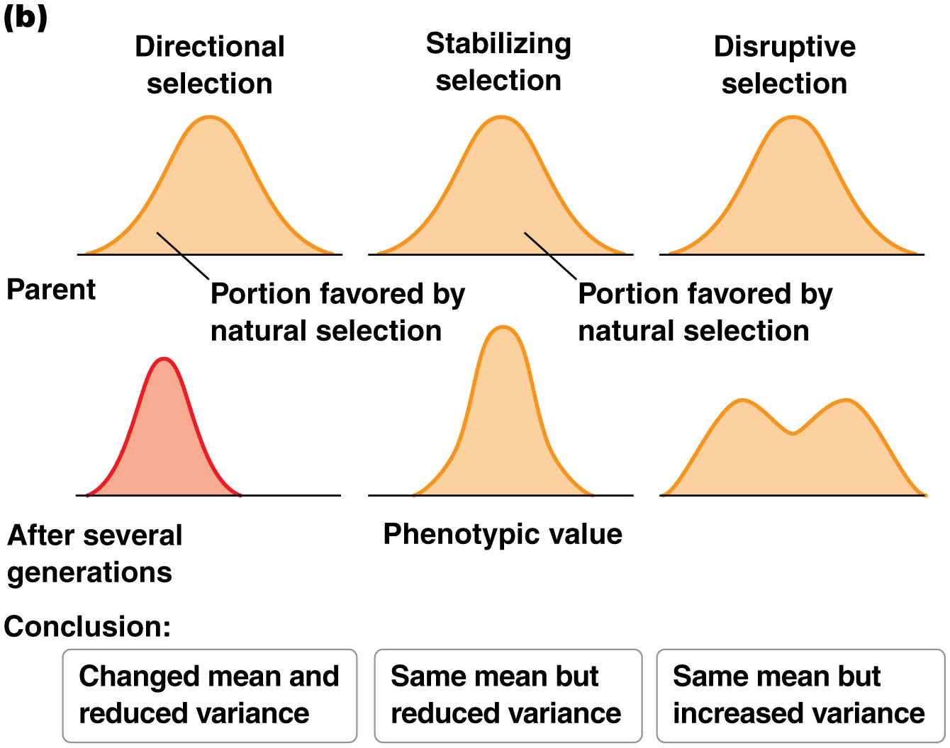
Modes of Selection
55

Slide 31
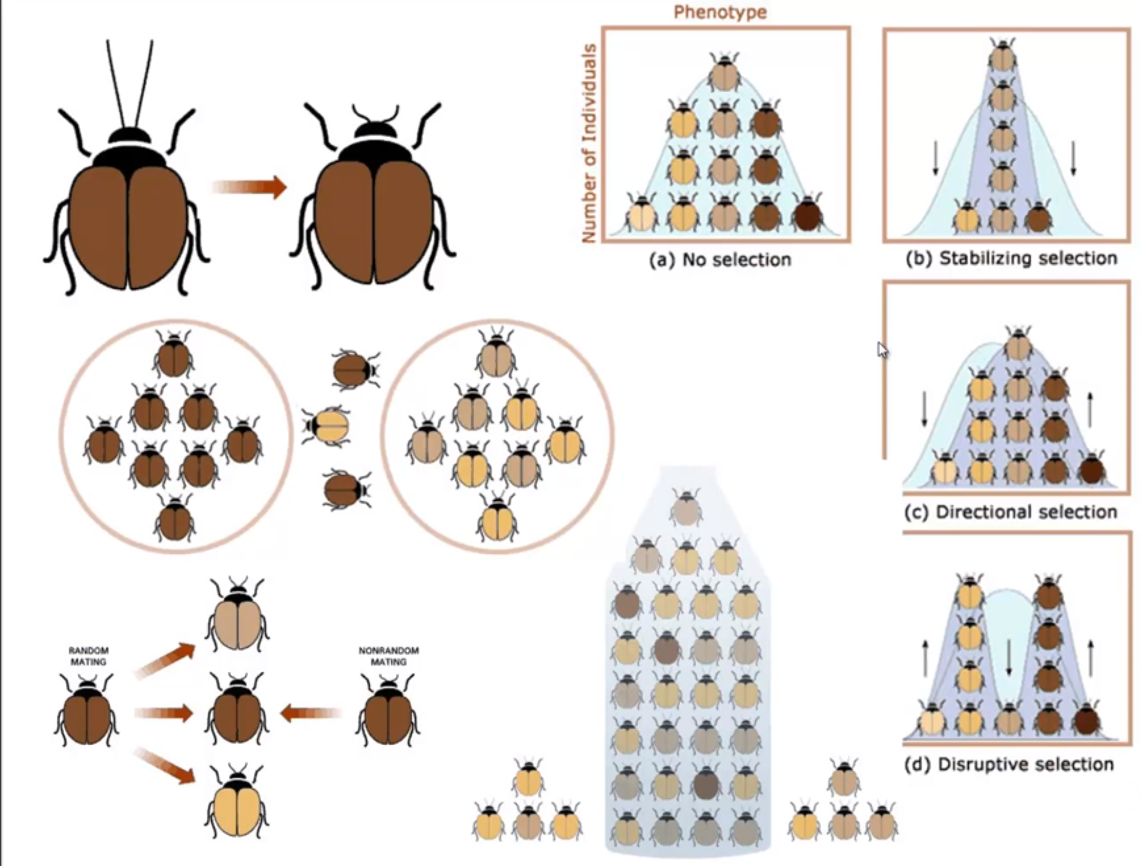
Modes of Selection
55

Slide 32
Directional Natural Selection
In directional natural selection, one phenotype with a homozygous genotype has a higher relative fitness than other phenotypes
Directional selection acts to increase the frequency of the favored allele over the others
For example, a case of codominant alleles of a gene, B₁ (p = 0.60) and B₂ (q = 0.40), with B₁B₁ having the highest relative fitness and B₂B₂ having the lowest
32

Slide 33
Survivors of each genotype:
B₁B₁ = (1.0)(360) = 360
B₁B₂ = (0.80)(480) = 384
B₂B₂ = (0.40)(160) = 64
Allele frequencies next generation:
f(B₁) = [(2)(360) + (384)]/1616 = 0.683
f(B₂) = [(2)(64) + (384)]/1616 = 0.317
33

Slide 34
Directional Natural Selection, Progression to Fixation
Directional natural selection will increase the frequency of certain alleles with variable intensity, depending on the strength of selection
If natural selection progresses for enough generations, the frequency of the favored allele will eventually become fixed at 1.0 and the unfavored allele will be eliminated. These fixed allele frequencies can be changed by mutation and migration, but not natural selection
Directional natural selection against organisms with the recessive phenotype will cause the frequency of the dominant allele to increase and the recessive to decrease or eventually to be completely eliminated. However, this can be a slow process, as heterozygous individuals will still carry the recessive allele

Slide 35
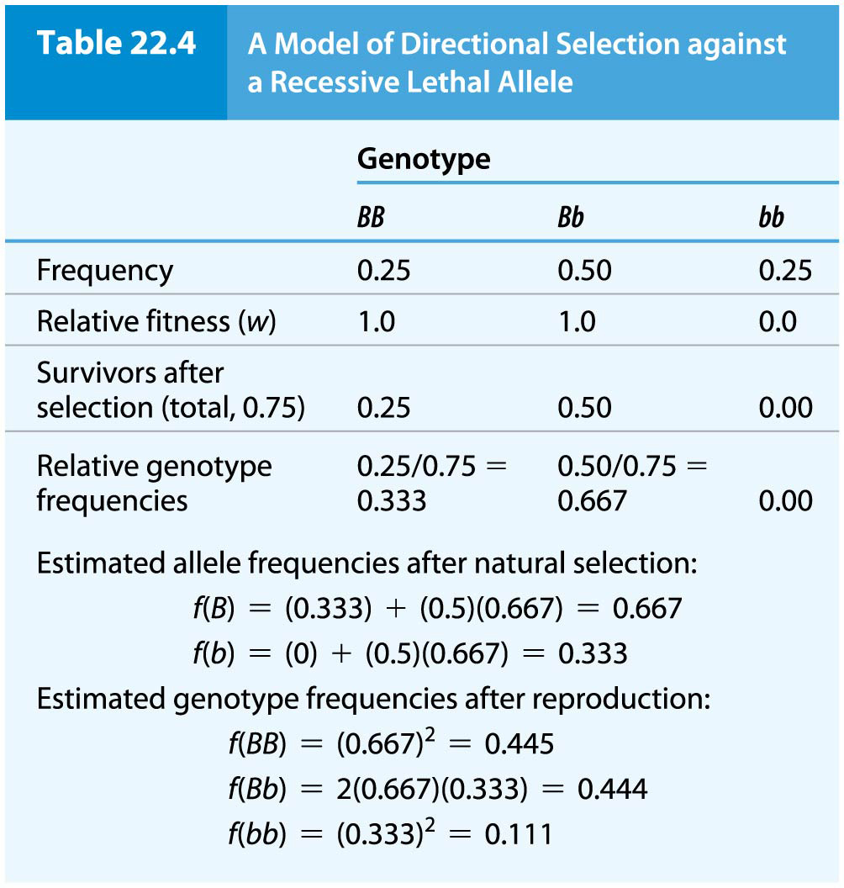
Table 22.4 A Model of Directional Selection against a Recessive Lethal Allele
356

Slide 36
Natural Selection Favoring Heterozygotes
Natural selection can produce and maintain genetic diversity within a population when the heterozygous genotype is favored
This can result in a balanced polymorphism, in which allele frequencies are maintained by selection favoring the heterozygote
For example, individuals who are heterozygous for the sickle cell anemia allele, β^{A}β^{S}, are resistant to malaria, such that heterozygotes in regions where malaria is prevalent are favored over either homozygote
36

Slide 37
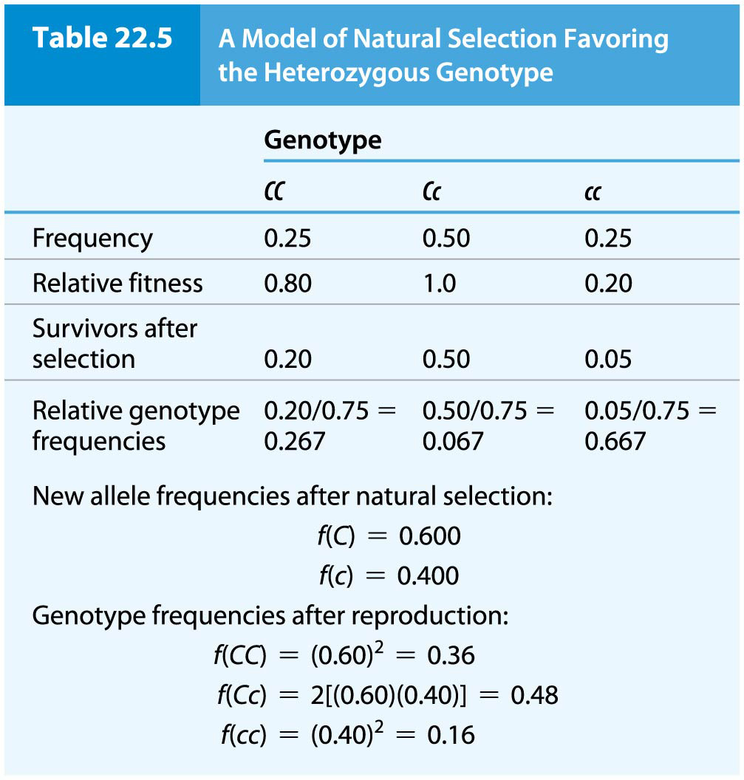
Table 22.5 A Model of Natural Selection Favoring the Heterozygous Genotype
42

Slide 38
22.3 Mutation Diversifies Gene Pools
Mutation is the ultimate source of all new genetic variation in populations. Mutations in the real world are commonly subject to natural selection
Gene mutation is a slow process, with small and gradual effects on allele frequencies in populations
The forward mutation rate (μ) pertains to A₁ to A₂ mutations, that is, the creation of new mutations
The reverse mutation rate (v), or reversion rate, pertains to mutation in the opposite direction, A₂ to A₁
In the absence of other evolutionary effects, the consequences of forward and reverse mutation on allele frequencies can be quantified

Slide 39
Mutation
Selection operates against new dominant mutations that reduce fitness; when a dominant mutation is lethal or nearly so, mutant organisms will have an effective fitness value of zero
If recessive deleterious mutation is masked by the wild-type allele in heterozygotes, recessive mutations are subject to selection only in homozygotes
39

Slide 40
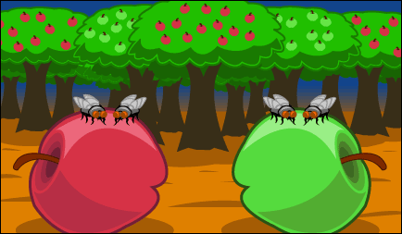
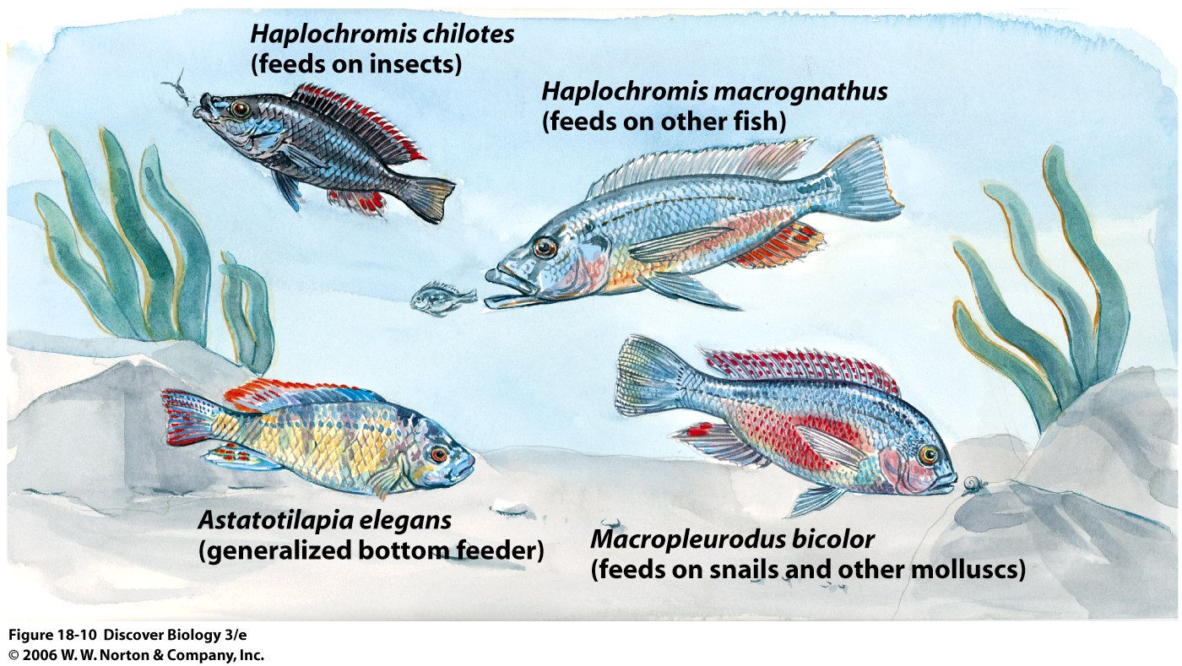
22.7 Species and Higher Taxonomic Groups Evolve by the Interplay of Four Evolutionary Processes
Evolutionary change at the species level and above is driven by reproductive isolation that can result from any conditions that prevent one population from mating with others
Isolated populations adapt to their particular circumstances and divergence is a likely consequence
40

Slide 41
Processes of Speciation
Charles Darwin laid out two guiding principles of speciation in 1859
He proposed that hereditary variation exists in all species and controls phenotypic variability
He also suggested that natural selection allows for increased survival and reproduction in individuals with favored phenotypic attributes
41

Slide 42
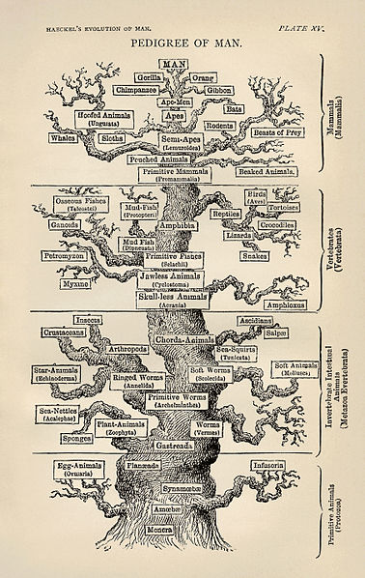
Processes of Speciation (continued)
Evolutionary history resembles a multibranched bush
For example, a lineage of horses and their relatives, zebras and donkeys, can be traced from the early Eocene (54 million years ago) to present, but there are numerous branches of the lineage that did not produce modern-day organisms
42

Slide 43
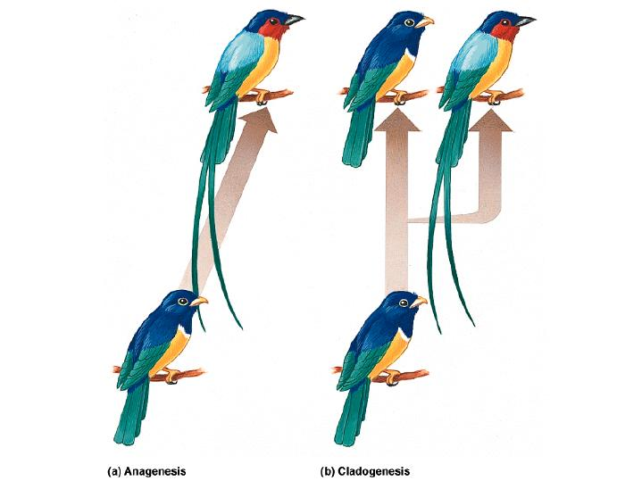
Patterns of Speciation
The evolutionary tree illustrate two patterns of speciation
Anagenesis is the process by which an original species is transformed into a different species over many generations
Cladogenesis is a pattern of branching in which an ancestral species gives rise to two or more new species

Slide 44
Reproductive Barriers
Reproductive barriers that prevent exchange of genes between populations may be prezygotic or postzygotic
Prezygotic mechanisms of reproductive isolation prevent mating among members of different species or the formation of a zygote following interspecies mating
Postzygotic mechanisms result in failure of a fertilized zygote to survive, or survival of but sterility of the individual produced
44

Slide 45
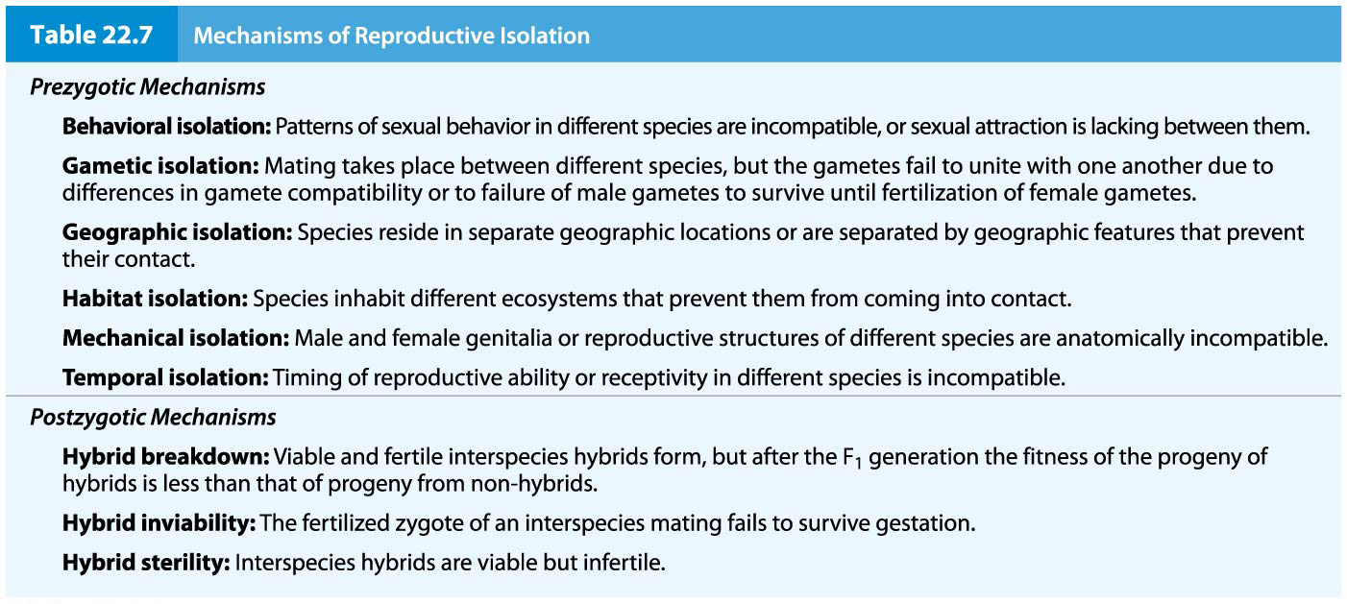
Table 22.7 Mechanisms of Reproductive Isolation
80

Slide 46
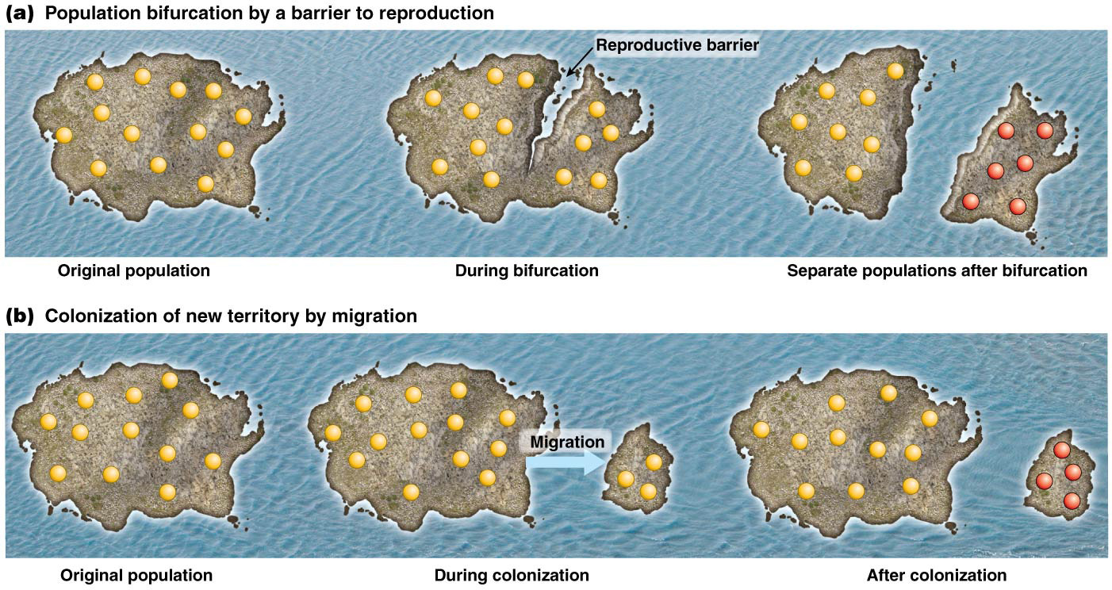
Allopatric Speciation
Allopatric speciation occurs when populations are separated by a physical barrier and thus new species develop in separate geographic locations
Separation can occur by the presence of a physical barrier between two segments of a population, for example, a glacier, mountain range, or canyon. It can also result from colonization of a new territory by some members of a population
46

Slide 47
Diversification of Drosophila Species on Hawaiian Islands
Bonacum and his colleagues examined Drosophila that inhabit the Hawaiian Islands, which were formed volcanically
The most closely related species are found on adjacent islands, and the phylogenetic pattern of species origin corresponds to the emergence of islands
These results support a model of allopatric speciation by colonization
47

Slide 48
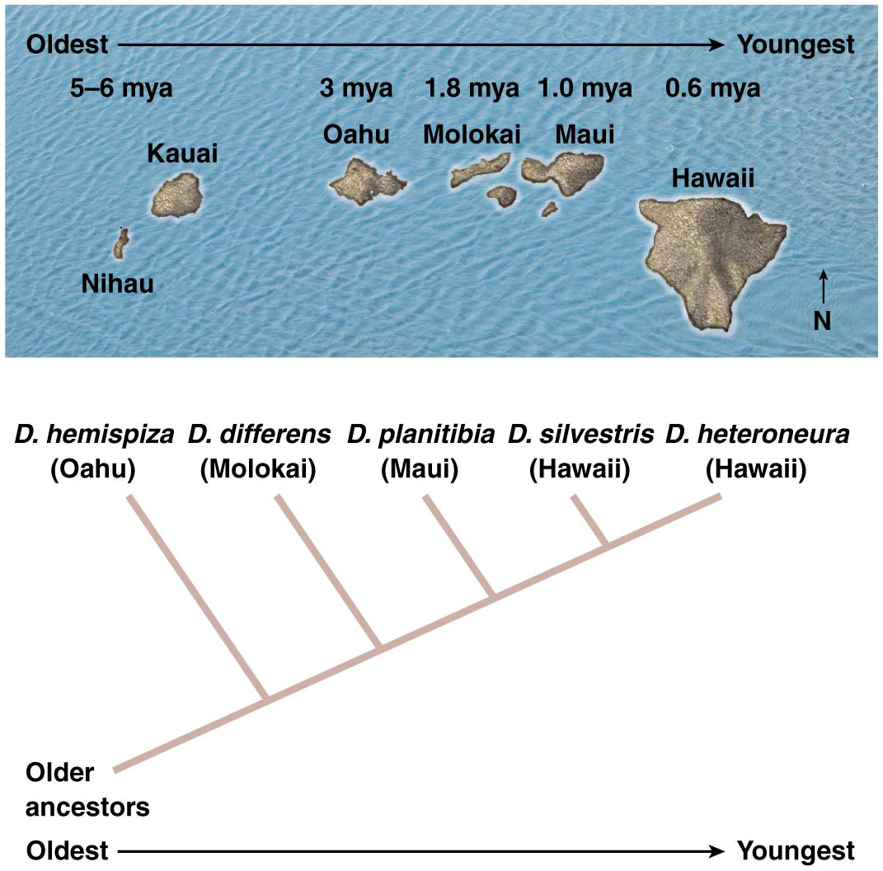
Figure 22.13 Phylogenetic relationships among Hawaiian Drosophila species.
84

Slide 49
Sympatric Speciation
In sympatric speciation, populations share a single habitat but are isolated by genetic, behavioral, seasonal or ecosystem-based mechanisms that prevent gene flow
Sympatric species are those that diverge while occupying the same geographic area
For example, animals that develop nocturnal or diurnal patterns of activity are most likely to mate with others with the same pattern
49

Slide 50
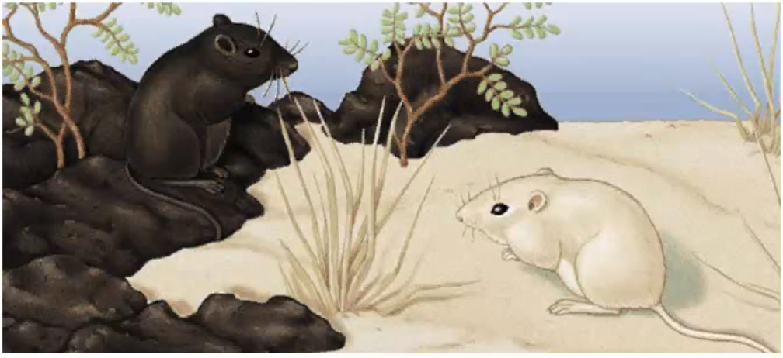
Adaptation
Adaptation is a process during which chracteristics with highest fitness are selected in the population. Individuals with better characteristics survive and transmit their genes.
Adaptation is one of the two main processes that explain the diverse species we see in biology, such as the different species of Darwin’s finches.

Slide 51
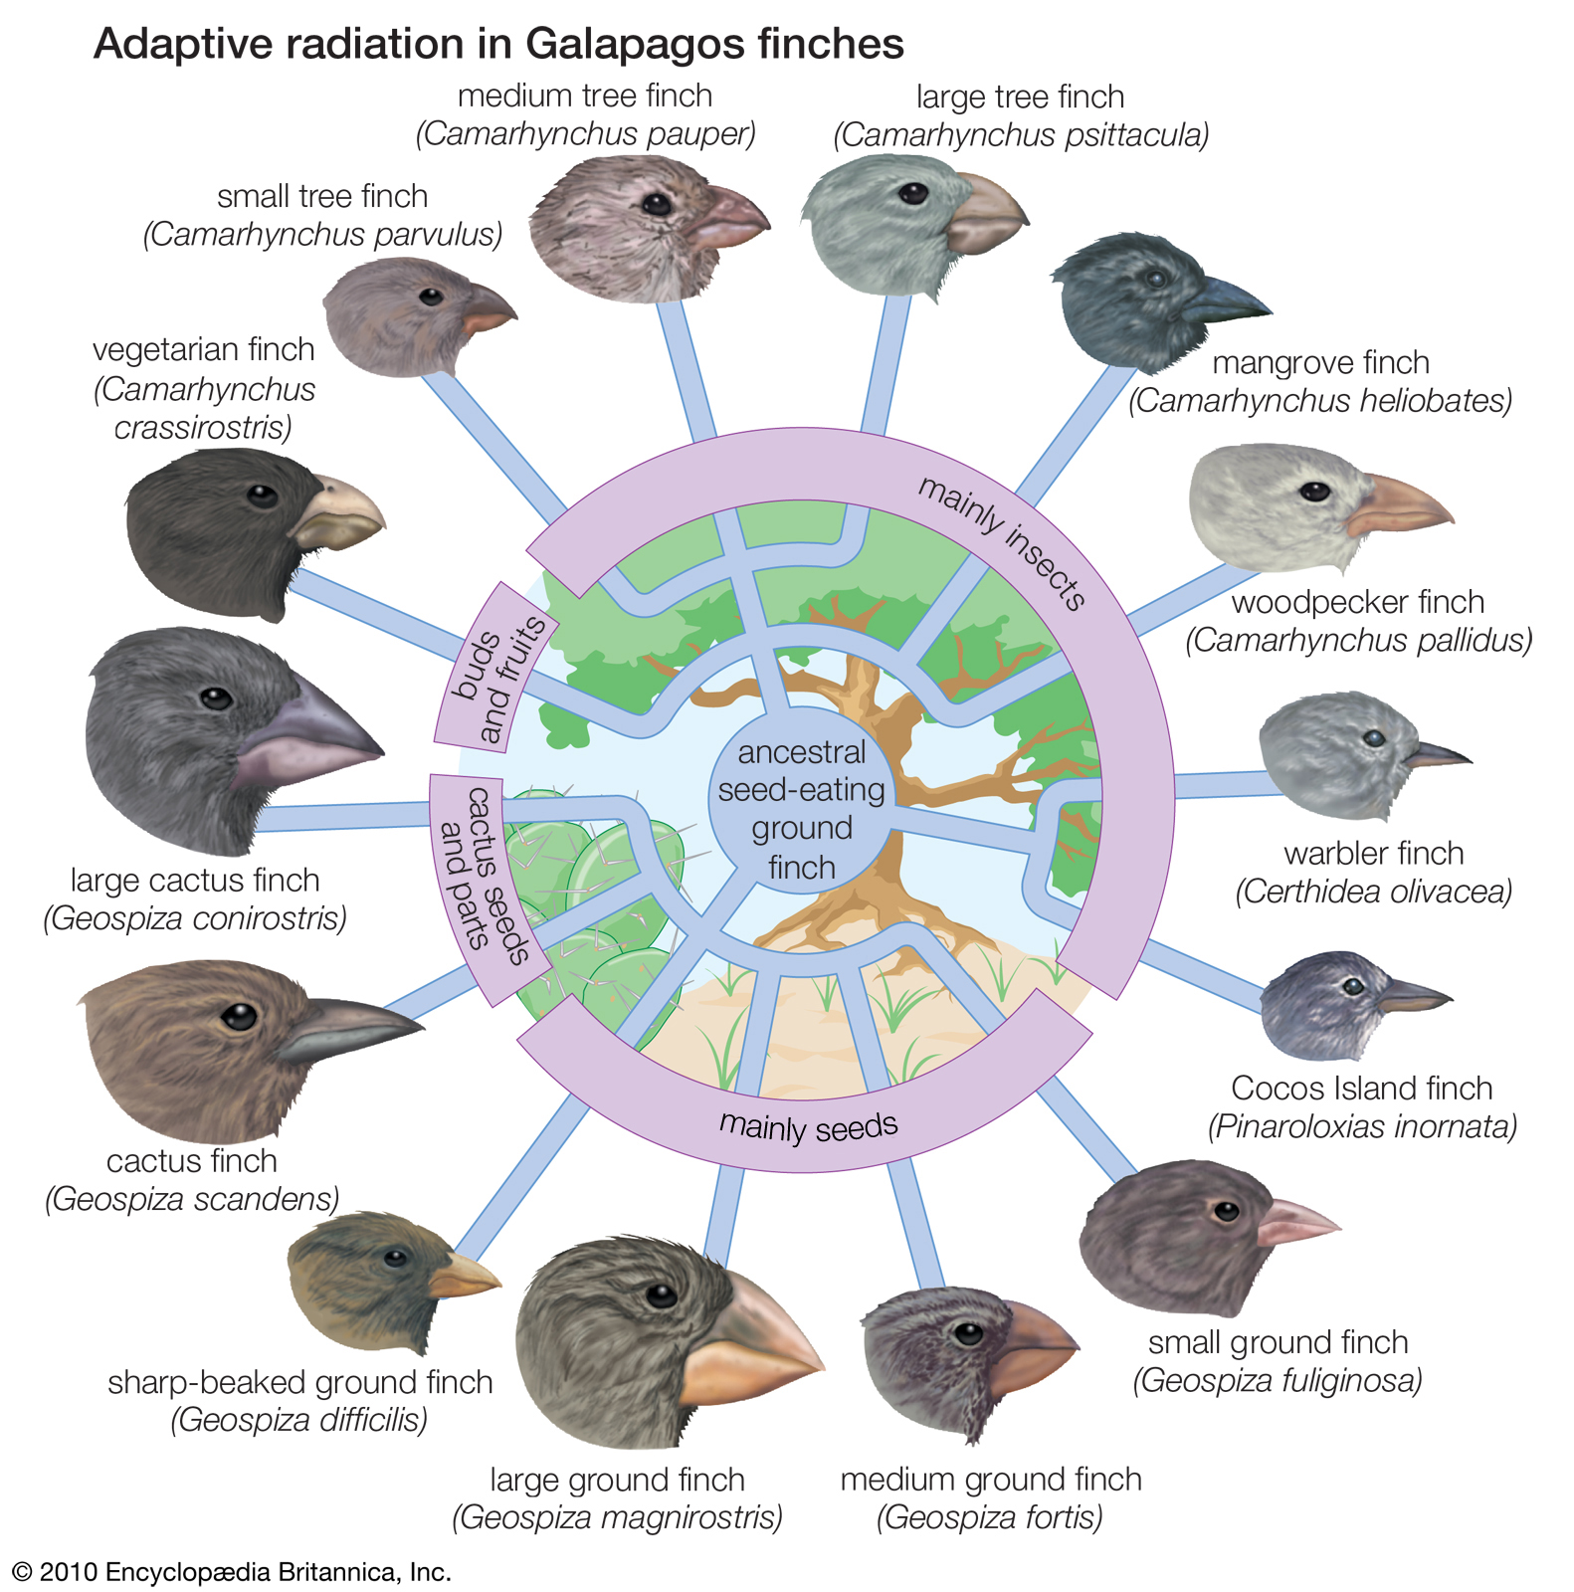
Adaptive Radiation

Slide 52
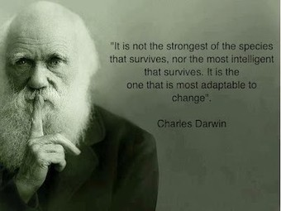

Slide 53
Molecular Evolution Changes Genes and Genomes through Time
Heritable variation that provides the raw material of evolution begins at the molecular level, with changes in DNA sequence and proteins
Molecular evolutionary analysis may be performed in different ways.
Several different molecular markers have been developed in order to quantify genetic differences and changes in populations and species.

Slide 54
Quantify genetic diversity
Genetic data can allow to:
-Determine the amount of genetic diversity and its partition
Measure population differentiation
Estimate inbreeding
Determine the structure of populations
Estimate the effective population size
Reconstruct historical events
Determine relationship among populations and species
Identify target of selection and adaptation

Slide 55
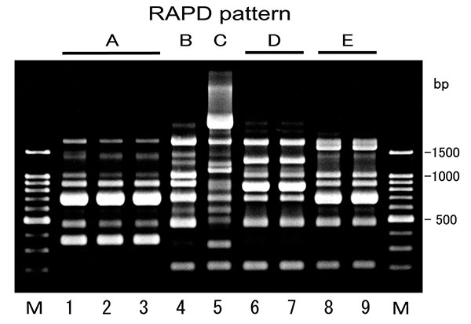
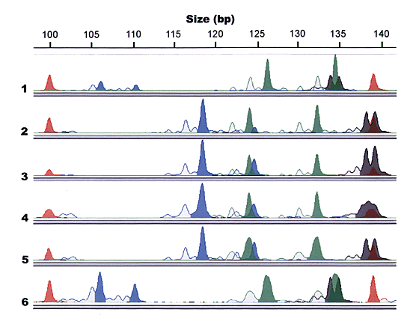
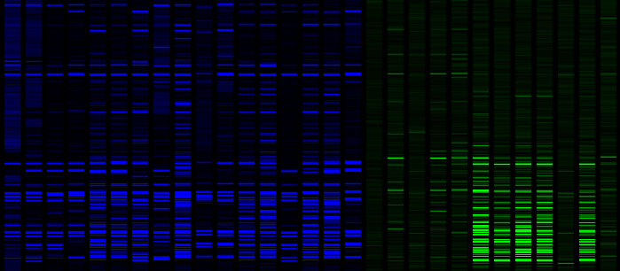
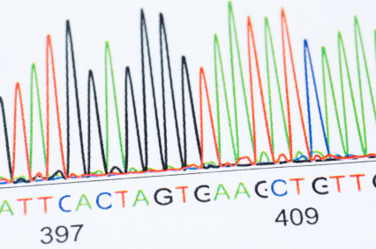
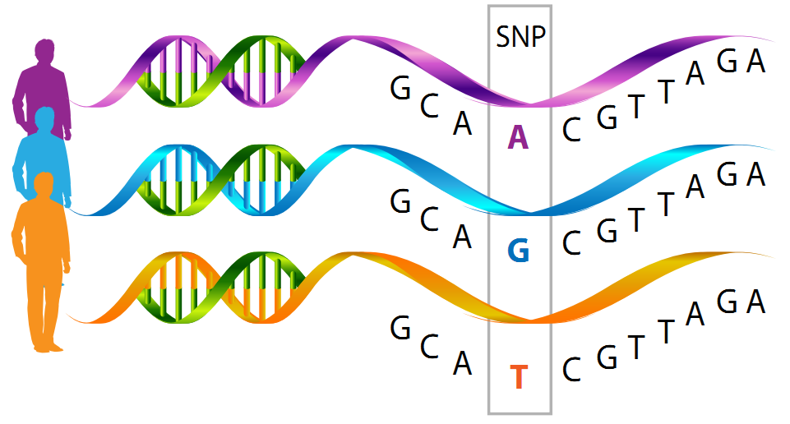
Genetic markers: from band pattern variation to DNA sequences and SNPs and whole genome
AFLP
Microsatellite
DNA sequence and SNPs

Slide 56
Genomic revolution

Slide 57
Novel gene Functions
Novel gene function can be obtained in different ways:
Functional changes in the protein coding sequence
Changes in the regulatory region controlling the expression of the gene
Duplication and divergence

Slide 58
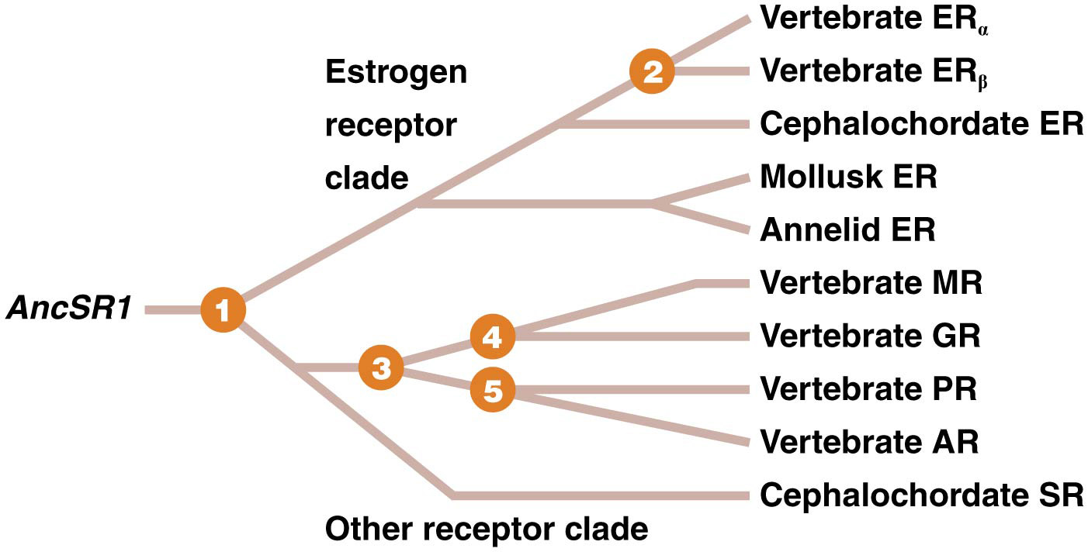
Vertebrate Steroid Receptor Evolution
New molecular functions arise due to natural selection of favorable mutations
For vertebrate steroid receptors (SRs), an ancestral receptor with a single original function duplicated and diversified (mutated) to produce new genes and proteins

Slide 59
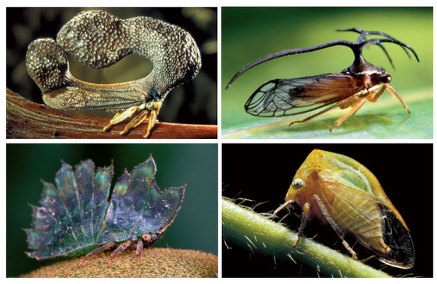
The Evolution of Novelty

Slide 60
The Evolution of Novelty
As animals have adapted to diverse habitats they have evolved
many new and different kinds of body parts. One of the
major outstanding questions in evolutionary biology is: What
kinds of mechanisms underlie the origin of morphological novelties?
Changes in gene expression during animal development are largely responsible for the evolution of morphological diversity.
Very different forms are generated by similar sets of developmental
genes, and a large body of empirical, comparative studies have led
to the general consensus that divergence in the expression and
regulation of toolkit genes and the genes they control largely
underlies morphological diversity

Slide 61
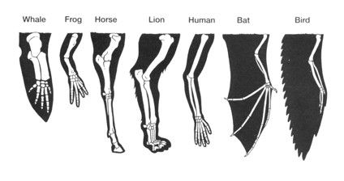
The Evolution of Novelty
Different novel structure have usually a common origin and similar developmental genes. The difference is the regulation of such genes = gene regulatory evolution.

Slide 62
Coevolution
When changes in at least two species' genetic compositions reciprocally affect each other’s evolution, coevolution has occurred.
There is evidence for coevolution at the level of populations and species.
Coevolution can occur at many biological levels: it can be as microscopic as correlated mutations between amino acids in a protein or as macroscopic as covarying traits between different species in an environment.

Slide 63
Convergent Evolution
Natural selection favors the most fit organism in a given environment
Convergent evolution results from identical or nearly identical mutant alleles that evolve independently and are similarly favored in separate populations (e.g., wings in birds and wings in bats)

Slide 64
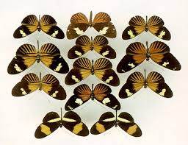
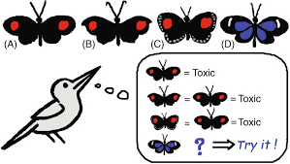
A classic example of morphological coevolution

Slide 65
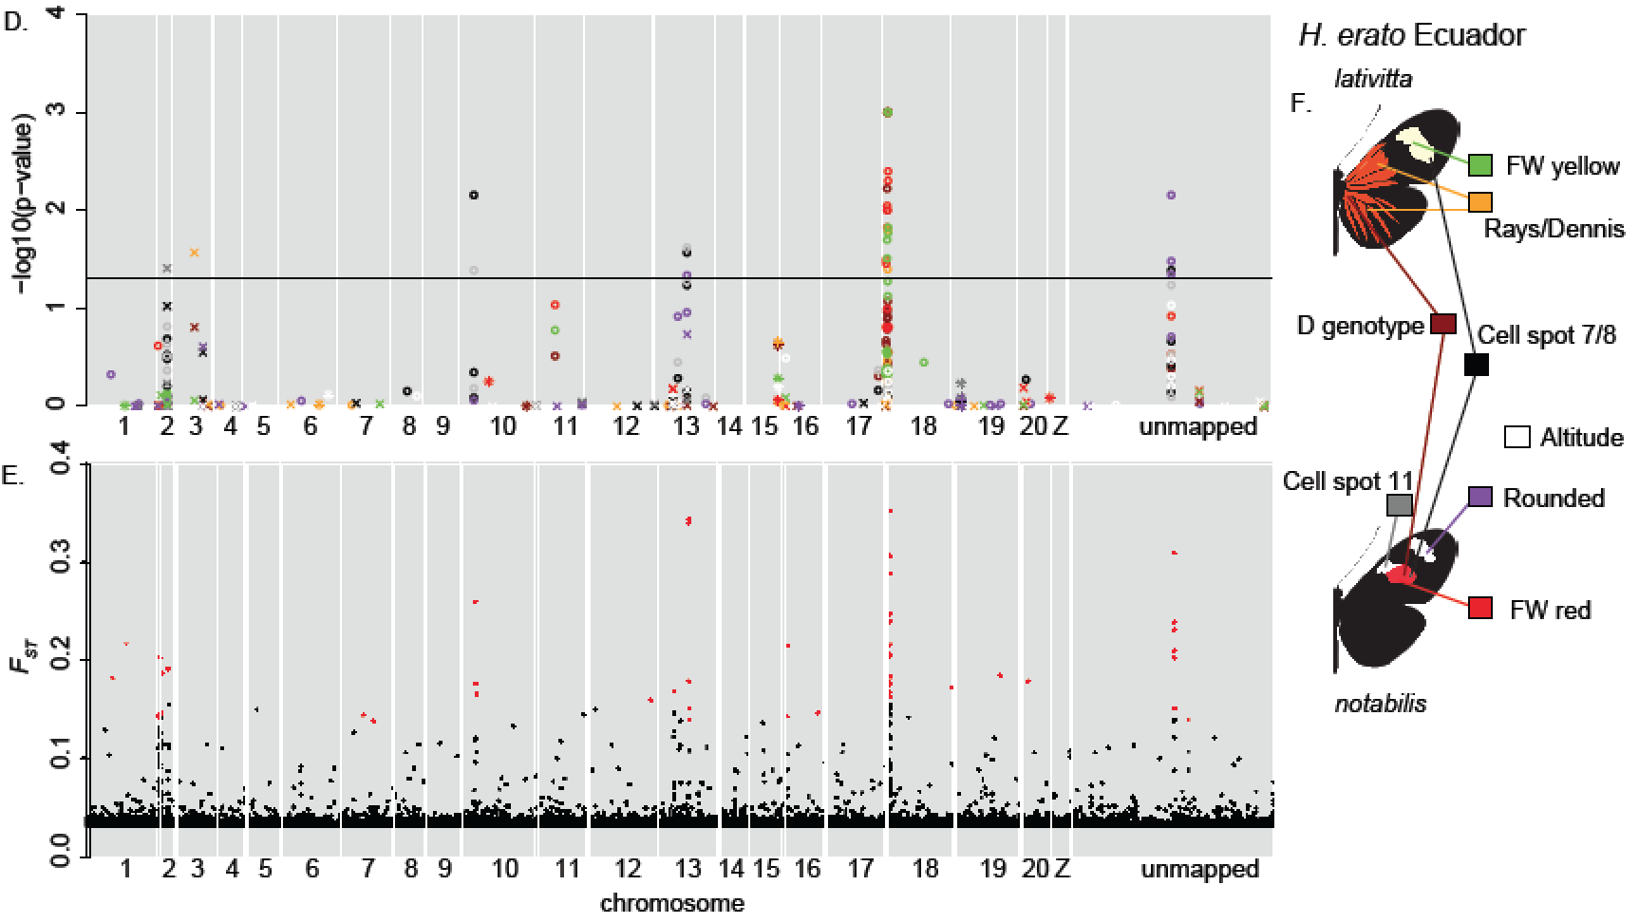
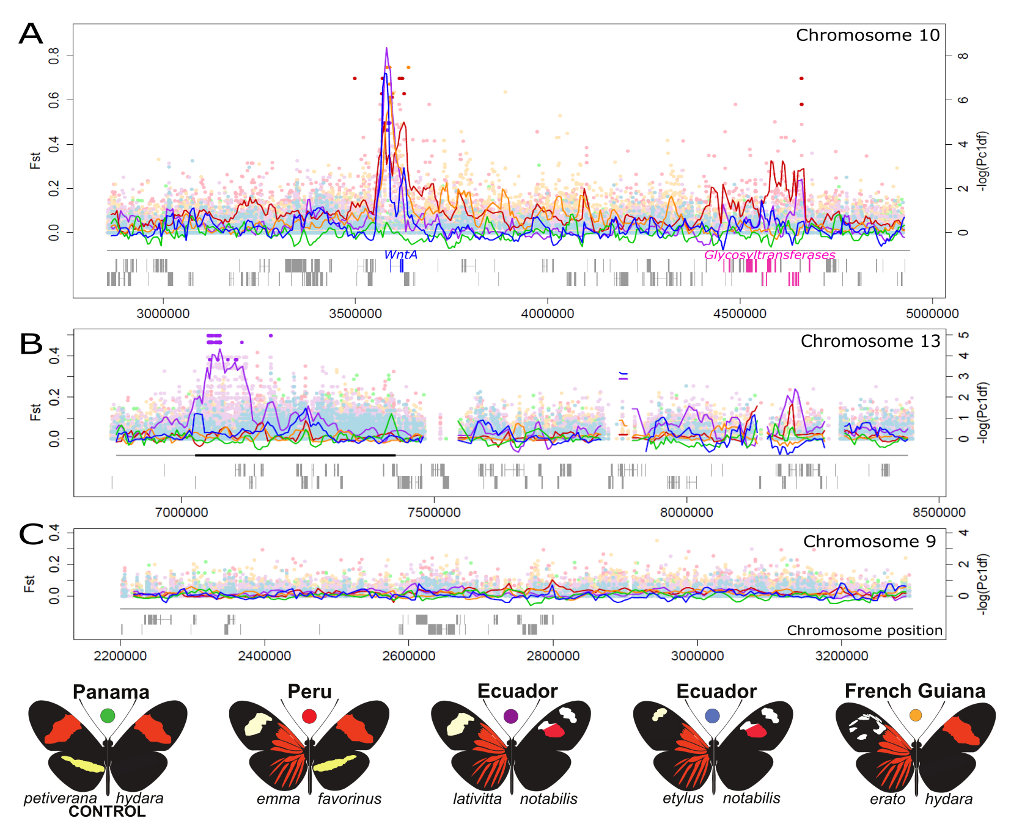
An example of a modern population genetics (genomics) study

Slide 66
An example of a modern population genetics (genomics) study

Slide 67
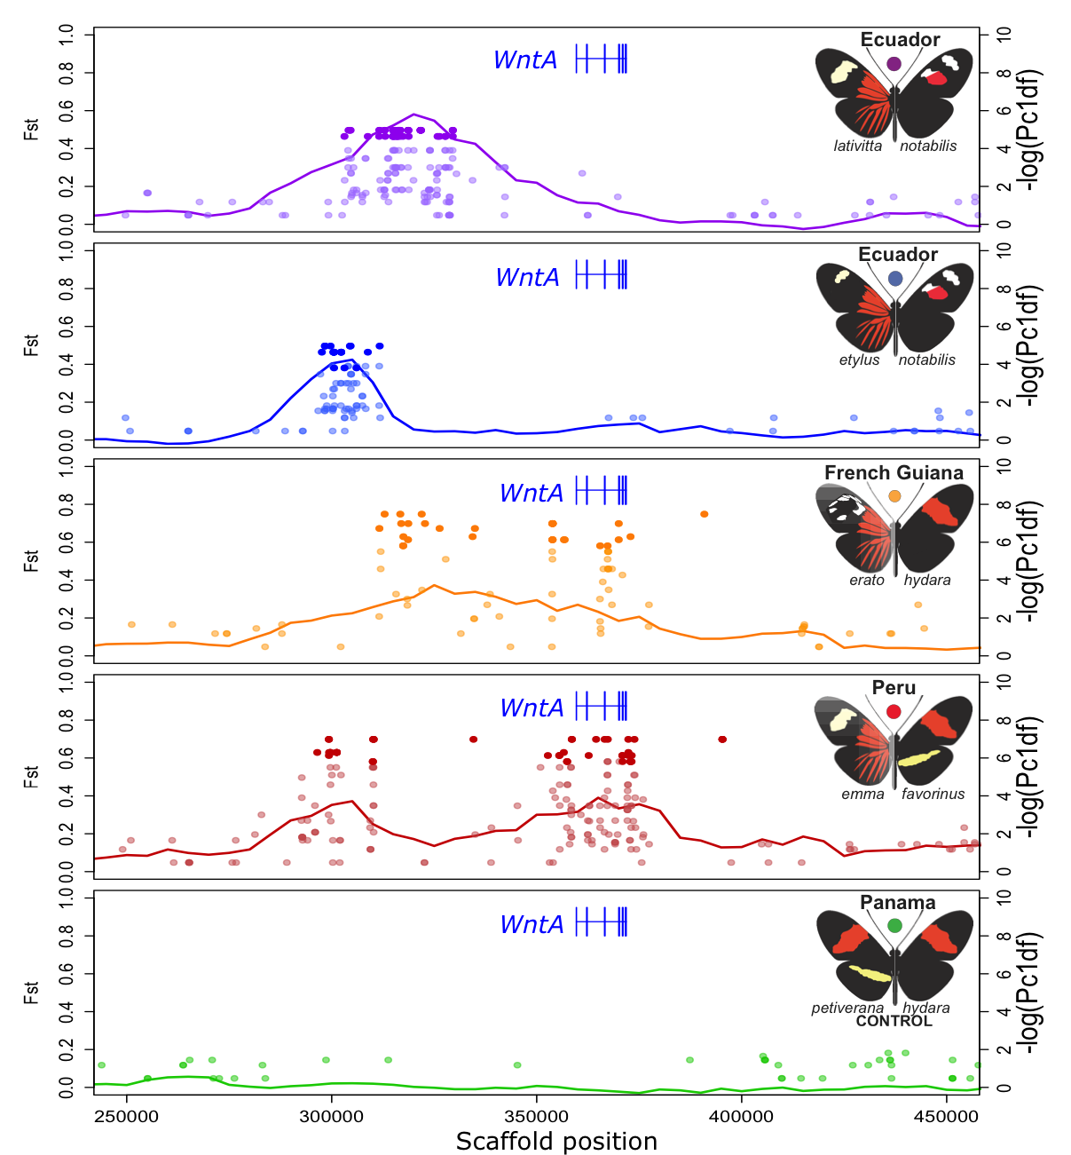
An example of a modern population genetics (genomics) study

Slide 68
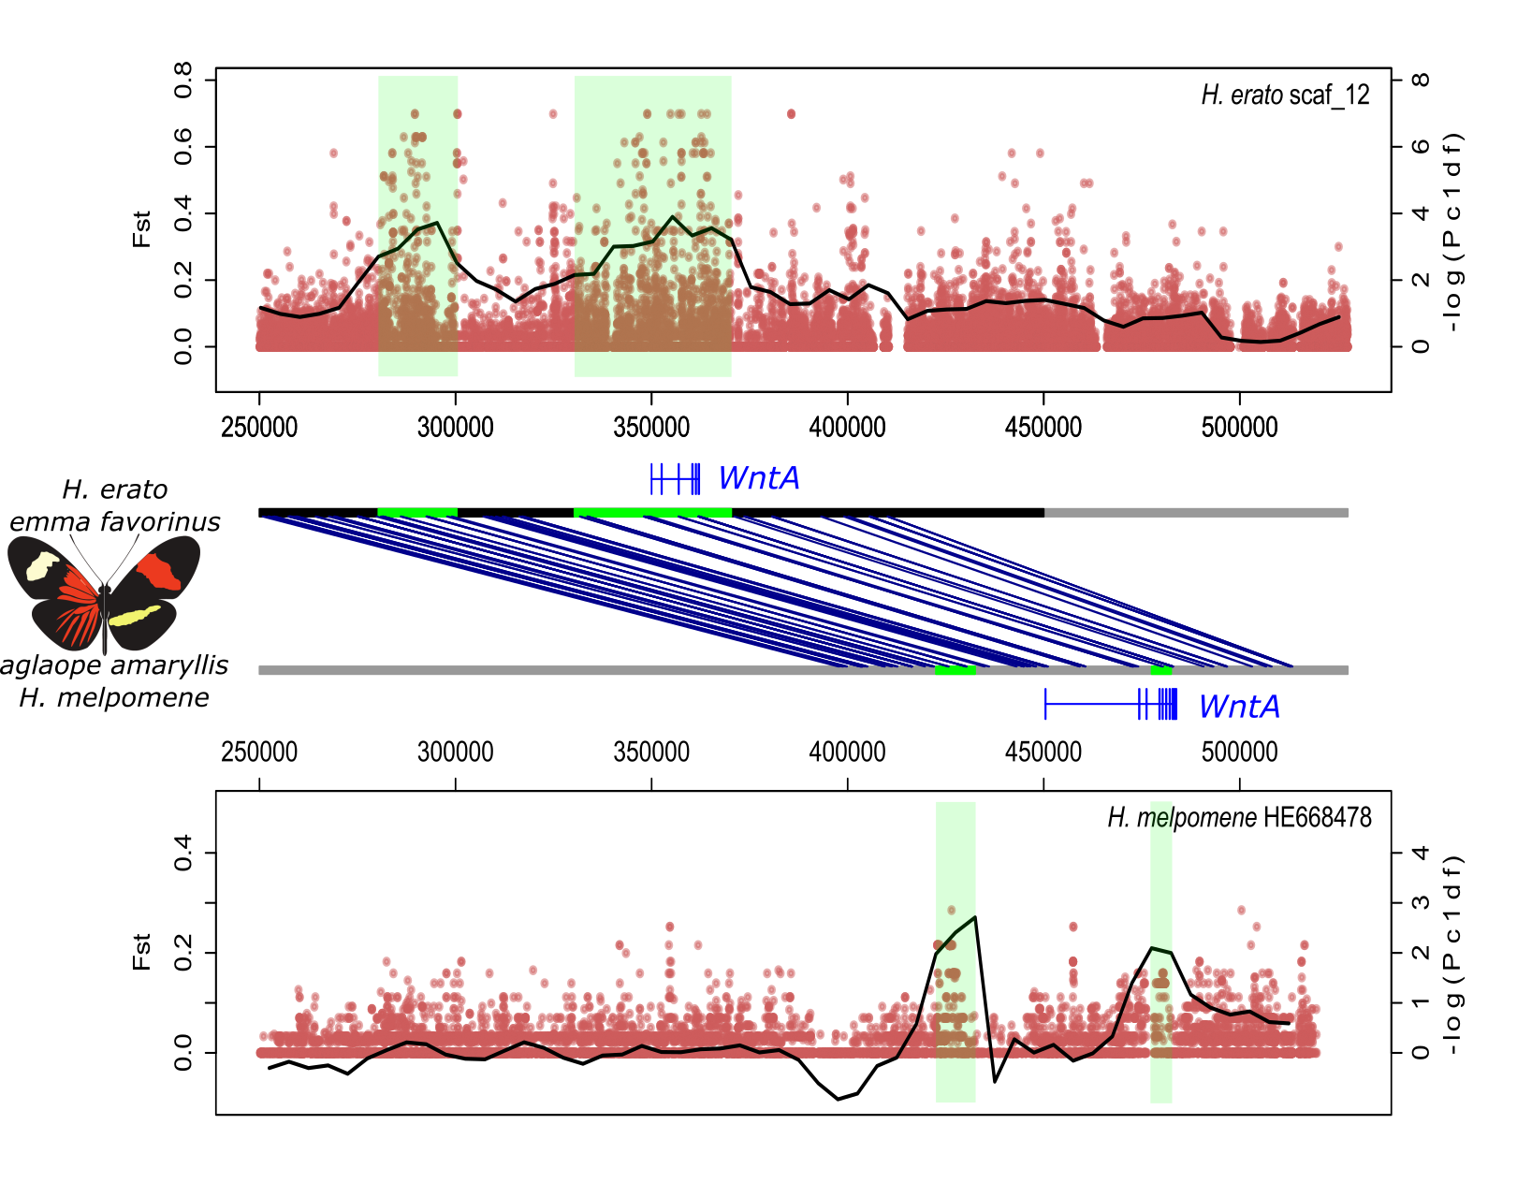
An example of a modern population genetics (genomics) study

